Slide 1
The evangelistic ideas that worked in secular, hedonistic Lyon
Toronto, Margins2016
Workshop

Slide 2
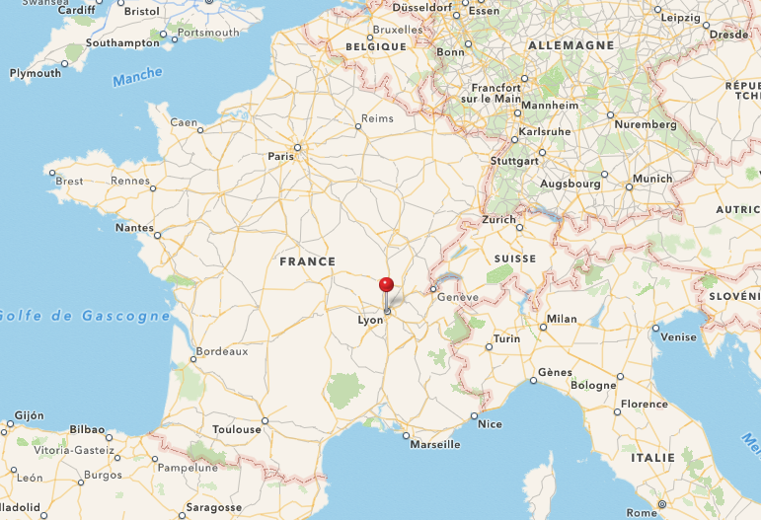

Slide 3
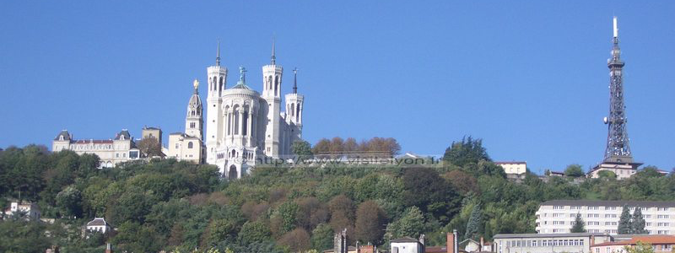
2 historical influences

Slide 4


2 contemporary influences

Slide 5
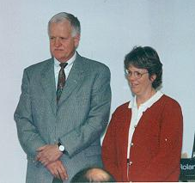
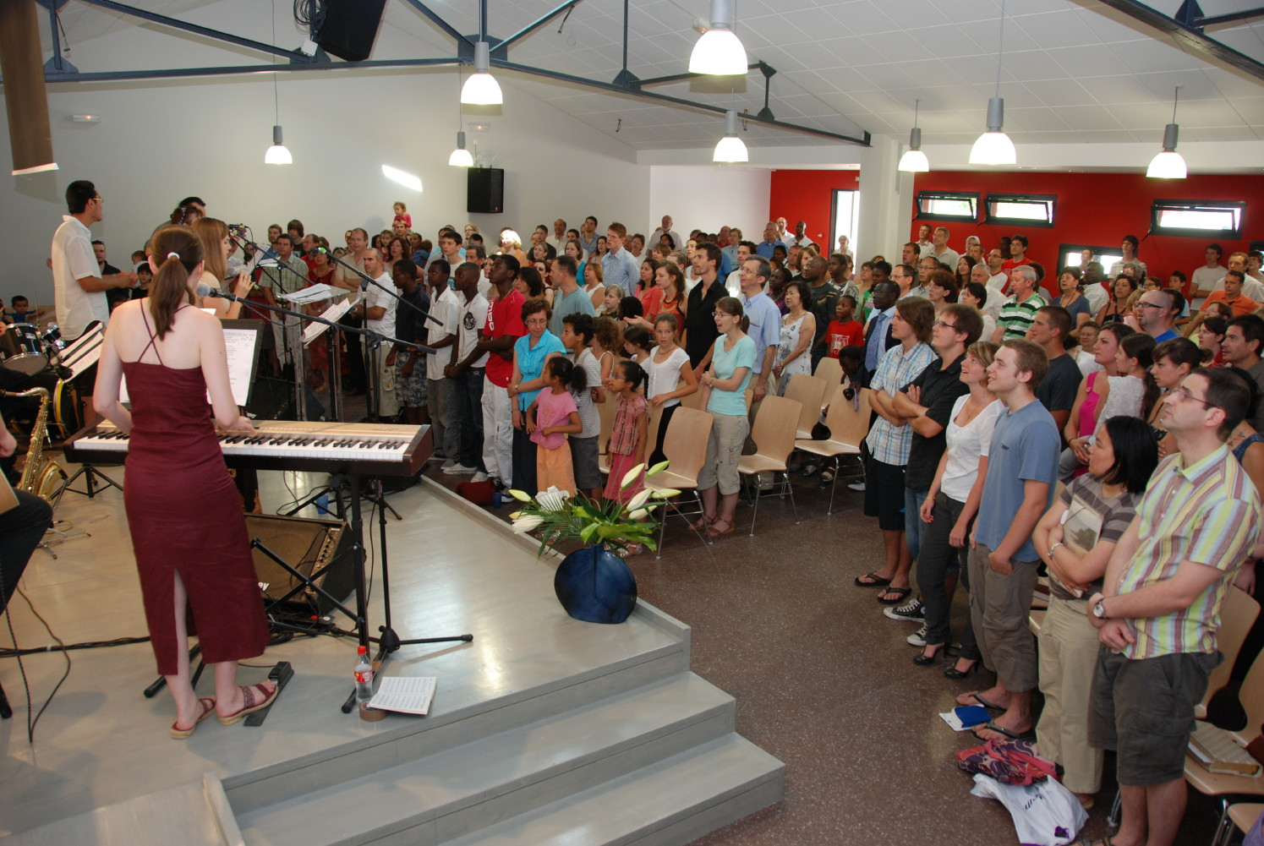

Slide 6
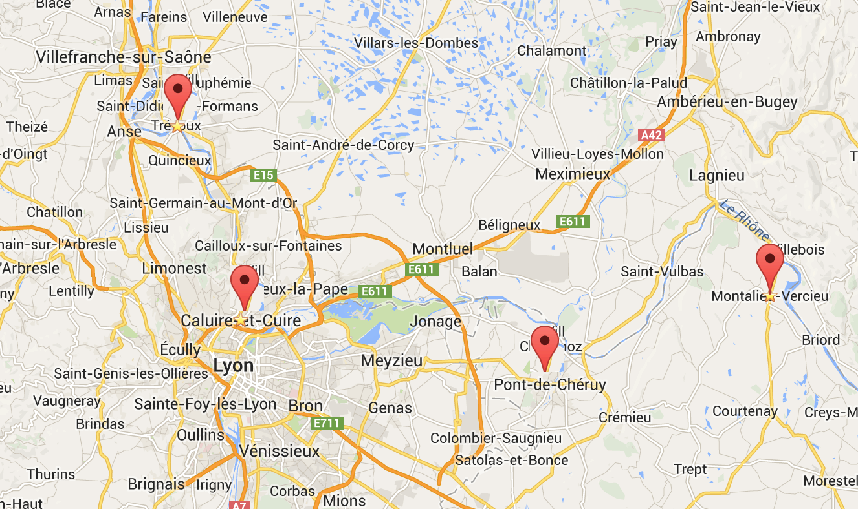
2 2015
3 2017 ?
4 2017 ?
1 2013
Notes:
Les projets d’implantation d’églises (1 pour 10 000) en partenariat avec une église sœur
Pont
Trévoux
Montalieu
Caluire
à partir des églises de maison

Slide 7
People to God’s people
People to God’s ideas
People to God’s Savior

Slide 8
Ideas to connect people to God’s people

Slide 9
Christmas cookies to the neighborhood
Clothing for the needy
Open air “kermesse”, party time for the young
Board games evening advertised on Internet
Family / kids’ club (neighborhood, not church)
…

Slide 10
Ideas to connect people to God’s Idea

Slide 11
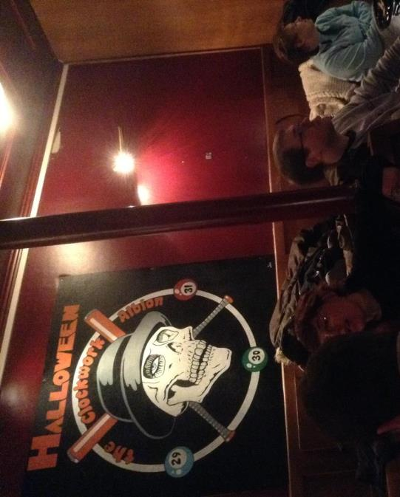
10 min speech in a restaurant or café (before dessert!)
Burger, Beer and Bible ☺
Multi-author conference
“Shoot the pastor” event

Slide 12
Possible themes
After death?
Catholics and Protestants – what diff?
Is God against religions?
God is good and I hurt?
Jesus did not resurrect
What is happiness?
Church and politics
2012 and the Mayas
Gun control and the Bible ☺

Slide 13
Ideas to connect people to God’S Savior

Slide 14
7 signs (difficult, actually ☹)
Gospel of John: (1) who is Jesus? (2) what does he want?
Meta-narrative of the Bible

Slide 15
Best tool: the meta-narrative
A perfect world: Genesis 1 & 2
A broken relationship: Genesis 3 & 4
A chosen man : Genesis 12, 17, 22
A behavior code: Exodus 19 & Ecclesiastes 2
A promised messiah : Isaiah 53 & Jeremiah 31

Slide 16
The birth of Jesus: Luke 1 & 2
The requirements of Jesus: John 3
The generosity of Jesus: John 4
The mission of Jesus: Luke 15
The death of Jesus : Luke 23
The resurrection of Jesus: Luke 24
The offer of grace: Acts 3 & Ephesians 2

