Slide 1
Serving on a Church Board

Slide 2
Three Types of Churches
Episcopal (overseer)
Presbyterian (elder)
Congregational (?)

Slide 3
Episcopal
The episcopal form of government has been the polity of the Church catholic as early as Ignatius of Antioch, all the way down to the time of
the Reformation. Advocates for an episcopal form of church government argue that the sheer fact that it went virtually uncontested until the time of the Reformation testifies to its claims ofapostolicity, although not all contemporary episcopalian apologists argue from history rather than Scripture. (http://www.theopedia.com/church‐government) Overseer = episkopē

Slide 4
Presbyterian
Common in Presbyterian and Reformed churches, this form of church government is commonly described as "Elder‐run" or "Presbyter‐run". (greek for elder
= presbyteros) Typically, original authority‐‐that is the authority that the church believes Christ gave to it‐‐is said to reside at the local elder level in this model of polity.
Thus the "highest" authority in a presbyterian or reformed church (after Christ) is said to be the Elders of the church. Those elders are typically elected by the congregation on a periodic basis (usually a term lasts about 3 years). Sometimes elders are elected by the drawing of lots.

Slide 5
Congregational
"The Oxford Dictionary of the Christian Church defines "congregationalism" as "that form of Church polity which rests on the independence and autonomy of each local church." According to this
source, the principles of democracy in church government rest on the belief that Christ is the sole head of his church, the members are all priests unto God, and these units are regarded each as an outcrop and representative of the church universal."

Slide 6
What kind of church do you serve?
Most of the churches in our tribe are definitely not Episcopal. We would fall into the
Presbytery (elder run) class with congregational elements.

Slide 7
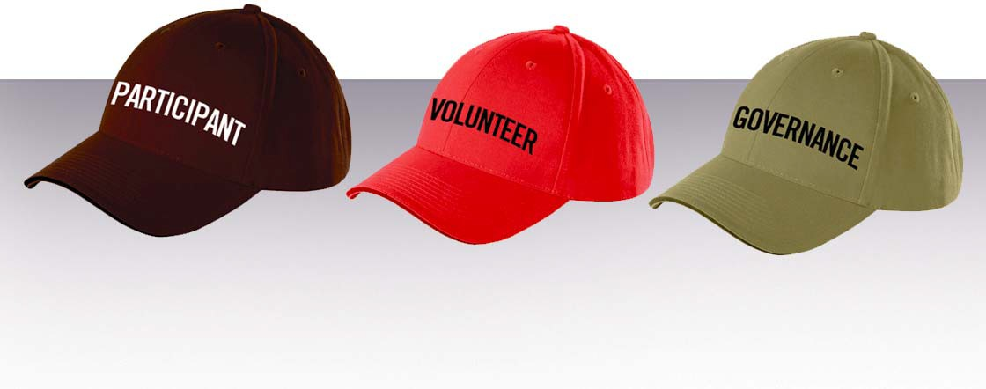
The Three Hats (Carver)

Slide 8
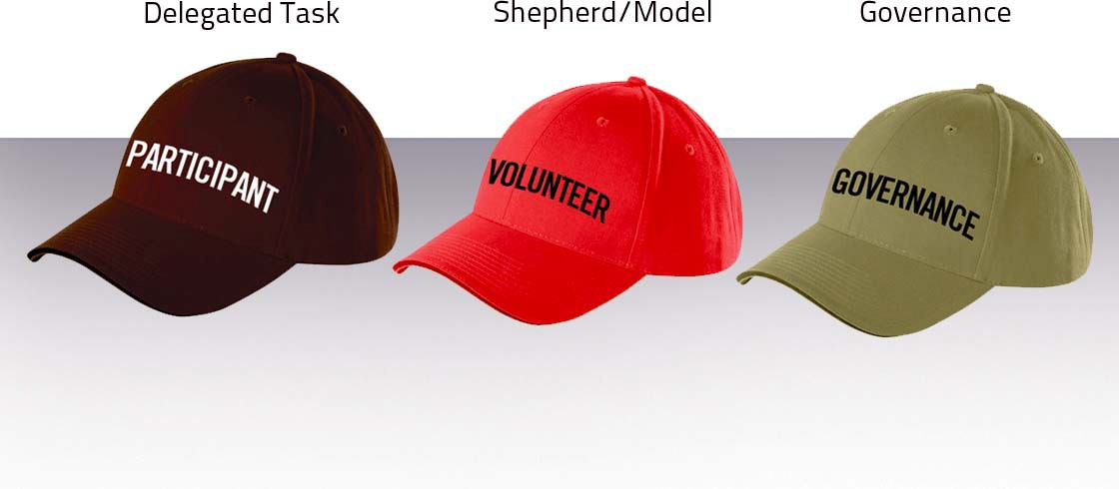
The Three Hats (Church)

Slide 9
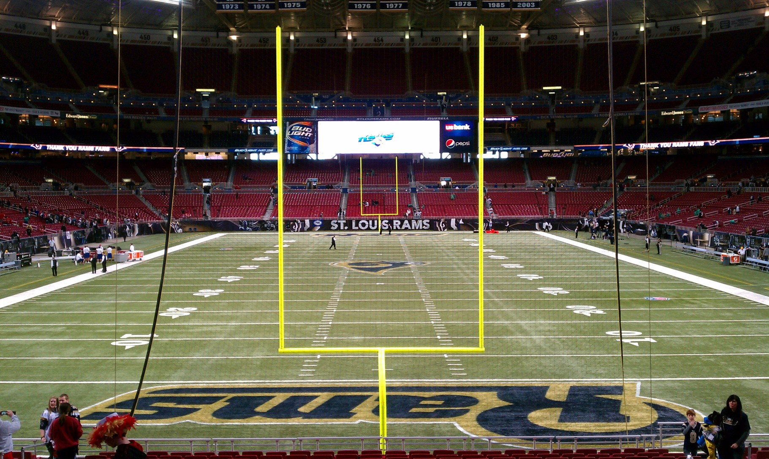
Governance

Slide 10
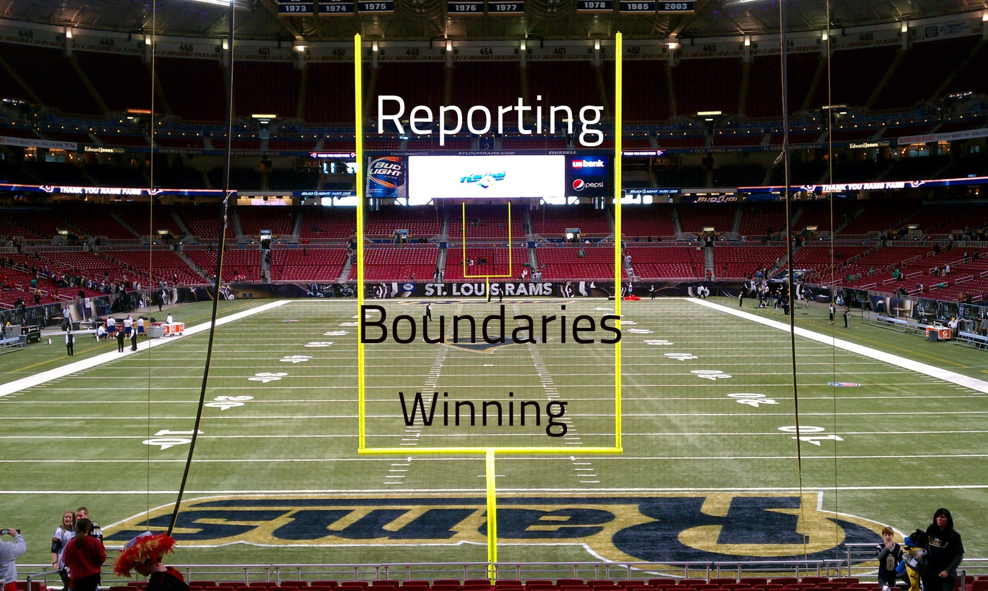
Governance

Slide 11
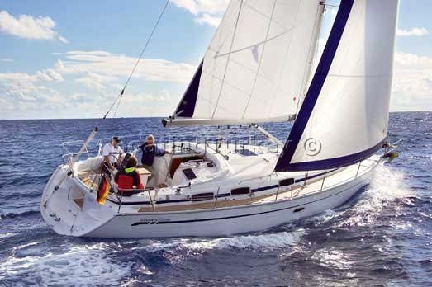
Governance
Vital elements for the sailor... wind
sail rudder heading
?

Slide 12
Governance
Vital elements for the sailor... wind
sail rudder heading keel

Slide 13
Five Steps in Program development
Ideas
Recommendation
Approval
Implementation
Evaluation
the 1‐3‐5 board principle

Slide 14
Governance – Legal Realities
D&O insurance
Fiscal Responsibility
HR Responsibility

Slide 15
The Shepherd/Model
Ezekiel 34 ‐ "I am against the shepherds..."
1 Peter 5:1‐3 "Be shepherd of God's flock!"
John 21 ‐ "Feed my sheep!"

Slide 16
The Care and Keeping of your pastor…
Retirement
Mentor/Mentee
Sabbatical
Vacation
Parsonage
Pay
Health Insurance
Task Management
Preaching schedule
"How are you doing?"
Conflict
Staff issues

Slide 17
Model
Qualifications of an Elder – 1 Timothy 3
Not exceptional
“I am writing these instructions so that you will know how people ought to conduct themselves.
First Follower
Integrity
“In order to lead volunteers you either need a gun or integrity.”

Slide 18
Delegated Task
Don’t confuse the three hats!
Governance (group) Shepherd/Model (not extrinsically authoritative)
Delegated Task (limited authority)

