Slide 1
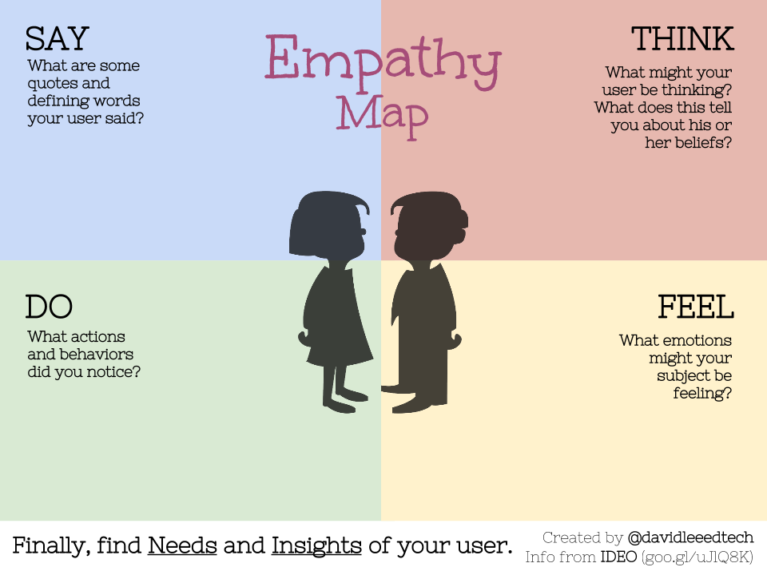
Empathy
Map
For
Tutees and Tutors

Slide 2

SAY
Empathy
Map
For
Tutee
THINK
I don’t know where to start with this topic.
I want my child to get the same educational opportunities.
I’m not great with technology, I hope its easy to use.
I need someone who can go slower and explain thing better.
Will it be affordable for me?
How can I ensure my child feels comfortable during session? And will he be understanding despite the my child condition?
Will I be able to catch up with the younger students?
I hope the tutor will be patient with me.
DO
FEEL
Looks for tutor based on specific subjects.
C0mmunicates any special needs with tutors.
Books lesson during non-working hours.
Ask question repeatedly during sessions.
Stresses about school works.
Worried about the quality of the tutoring experience.
A bit insecure about returning to study after a break.
Frustrated with their pace of learning.

Slide 3
SAY
Empathy
Map
For
Tutors
THINK
I’ve taken this subject and I know how to explain it simply.
This will help me build a teaching experience.
I want to share real-world application too.
I tailor my method to each student’s style.
Will they take me seriously as a tutor?
Am I making a real impact in student learning?
How can I make the session more interactive?
How can I build trust quickly with new learners?
DO
FEEL
Shares notes and tips that work for me during my time.
Offers structure sessions.
Focuses on mastery over memorization.
Adjust session for each learner’s pace.
Empathetic towards struggling students.
Proud about improving their teaching skills.
Rewarded by student growth.
Driven by both result and relationships.

Slide 4
EMPATHY MAP
SAY
THINK
"I want an easy-to-use platform where I can find help quickly."
"Will the tutor understand my learning style and pace?"
"Is this platform reliable and secure for my personal information?"
"I hope I can access tutoring sessions on-demand."
I need help understanding difficult subjects.
I wish I could get personalized support.
My schedule is already packed with school and extracurriculars.
It’s hard to find affordable tutoring options.
DO
FEEL
Searches for online resources (e.g., YouTube, forums).
Asks peers for help with complex topics.
Schedules study sessions around their busy timetable.
Tries to balance academic needs with personal life.
Frustrated when unable to grasp concepts.
Overwhelmed by school workload.
Relieved when they receive effective, timely support.
Anxious about exams and academic performance.

