Slide 1
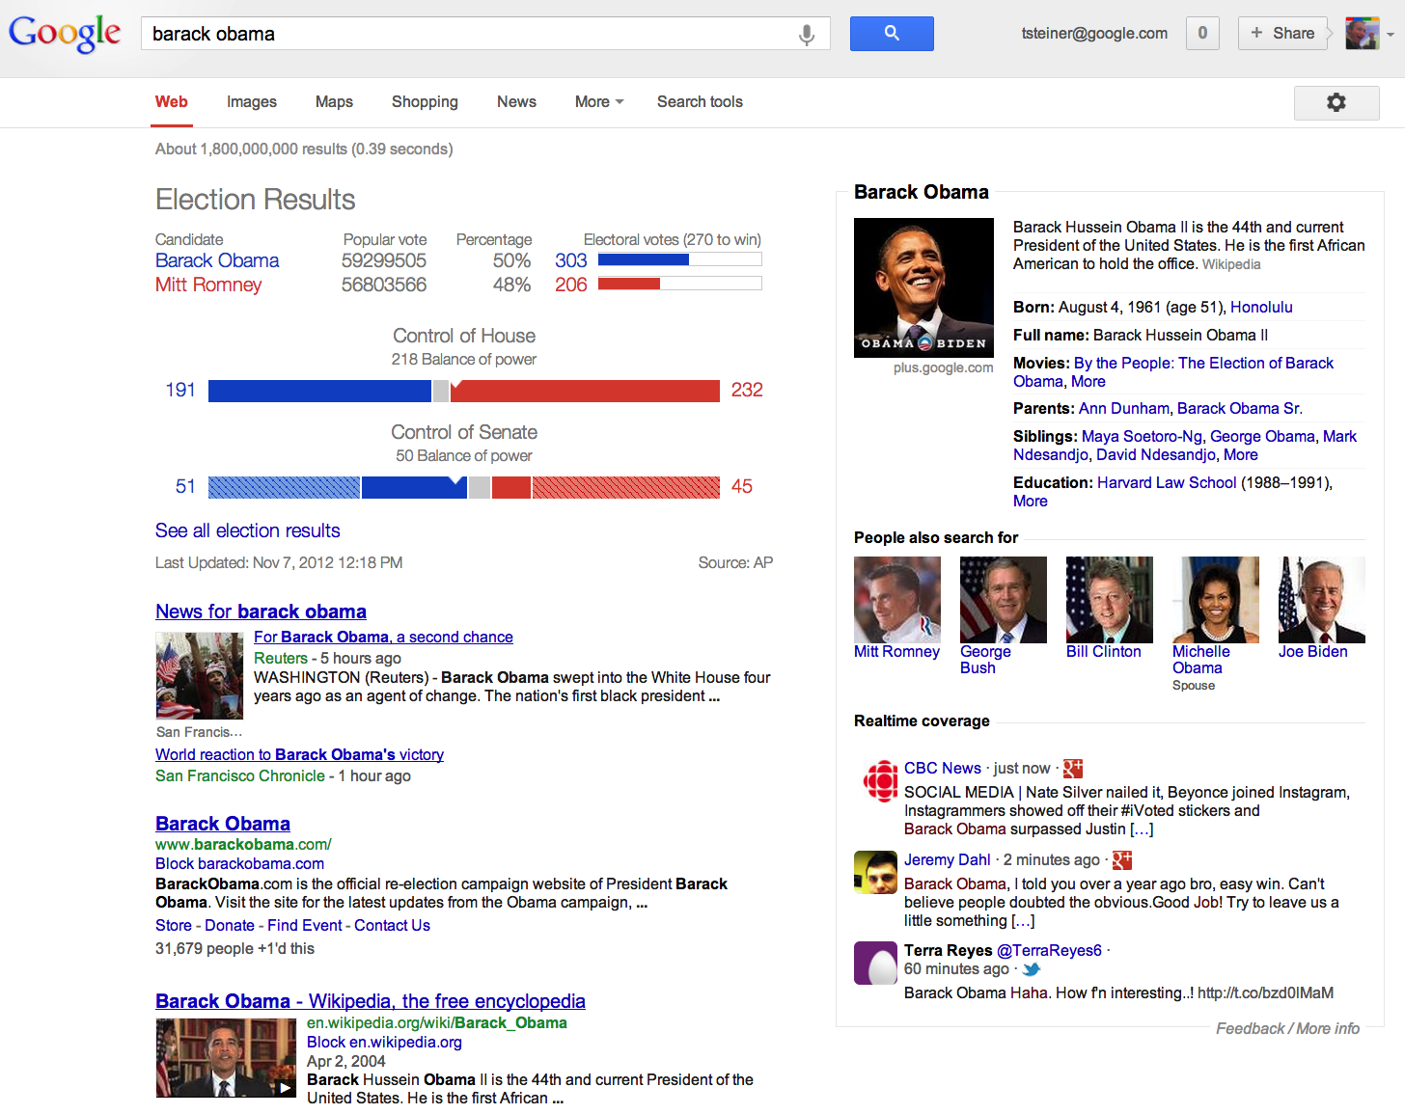
Adding Realtime Coverage to
the Google Knowledge Graph
Thomas Steiner, Ruben Verborgh, Raphaël Troncy,
Joaquim Gabarro, Rik Van de Walle
Chrome extension that adds realtime coverage to Google SERPs.
Interlinks the social Web with the Knowledge Graph.
Adds dynamic value to the otherwise
static Knowledge Graph facts.
Come see our demo. Please.

