Slide 1
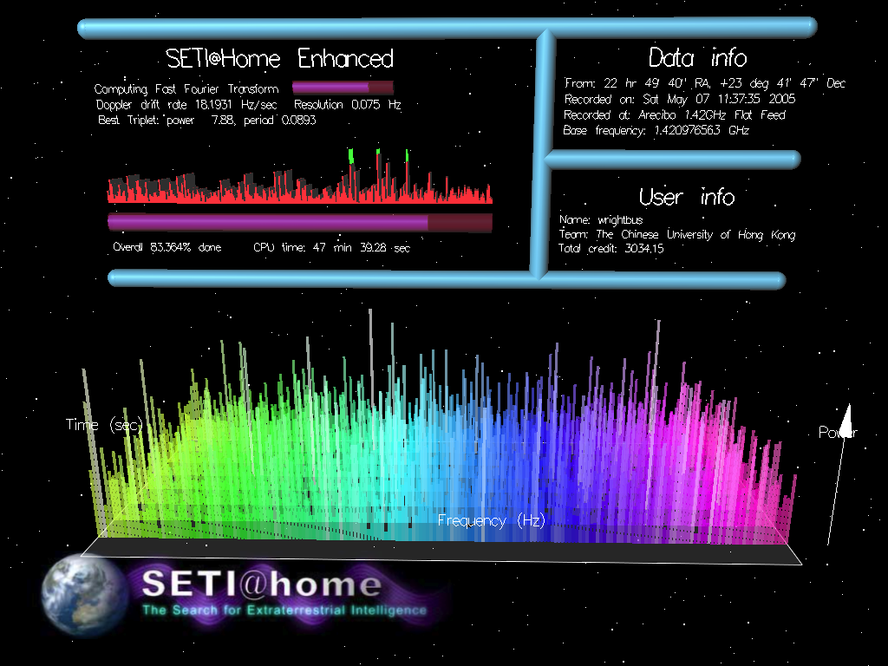
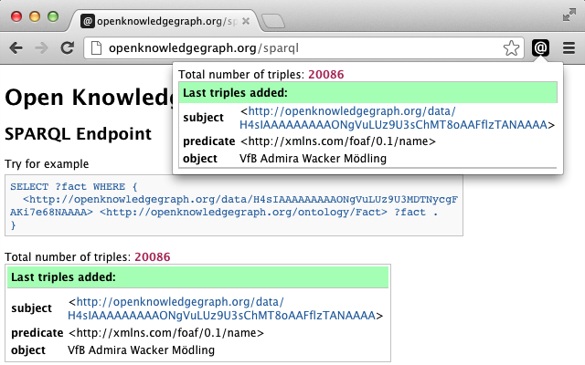
“How we stood on the shoulders of SETI@home…
…and made it SEKI@home…”
Search for Embedded Knowledge Items
Thomas Steiner (Universitat Politècnica de Catalunya, @tomayac)
Stefan Mirea (Jacobs University Bremen, @stmirea)

