Slide 1
Power BI Desktop
Gen-i Akademija

Slide 2
Workshop goal
Get familiar with Power BI Desktop
Get the tool that has excel capabilities, yet is excel, but also an analytical tool
Give us your feedback -> Sharing is caring!
How do you fancy the PowerBIDesktop? Find it usefull?
Do you see yourself using this fancy tool?
Advantages? (Easy applicable, visualization, R,..?)
Disadvantages? (Speed, non-intuitive, poor selection of visualizations,...)
Would you recommend this tool to the collegues in your team?
Can Power BI desktop any of your current selected tools?

Slide 3
materials:
https://github.com/tomazgeni/Seinfeld

Slide 4
Agenda and topics „covered“
Power BI Desktop – Get Data
Power BI Desktop – Manage Relationships
Power BI Desktop – Create Report
Power BI Desktop - Options
Power BI Desktop – Custom Visuals
Power BI Desktop - DAX
Power BI Desktop – R
Power BI service – Import / Publish / Share Report

Slide 5
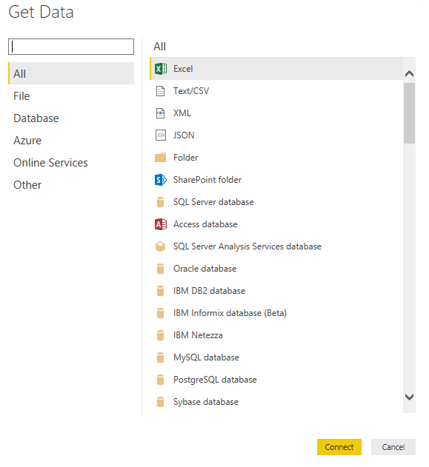
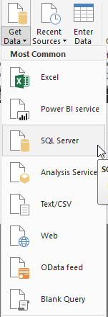
Get Data

Slide 6
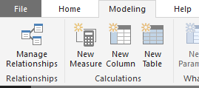
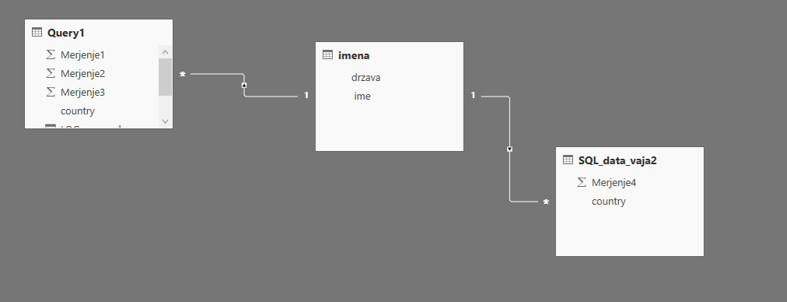
Manage Relationships

Slide 7

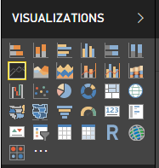

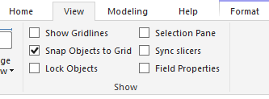
Create report

Slide 8
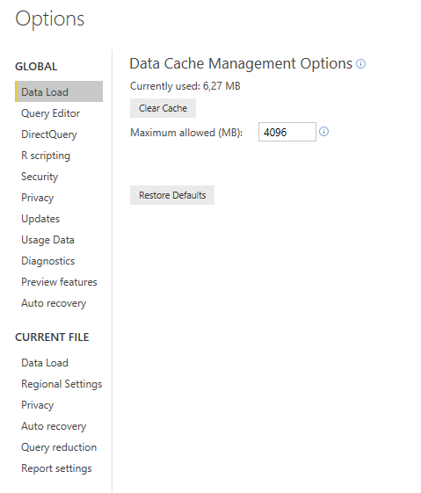
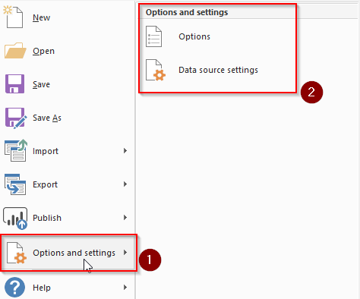
Power BI Desktop - Options

Slide 9
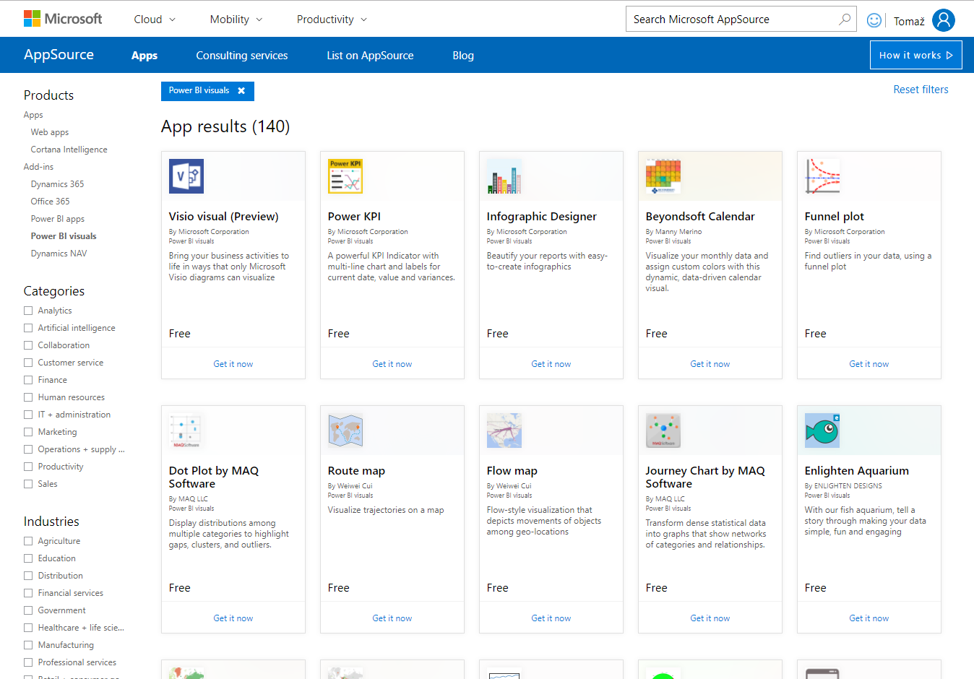
Power BI Desktop – Custom Visuals
Download from:
https://docs.microsoft.com/en-us/power-bi/power-bi-custom-visuals
In details:
https://appsource.microsoft.com/en-us/marketplace/apps?product=power-bi-visuals

Slide 10

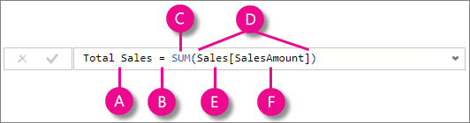
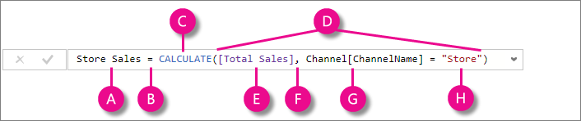
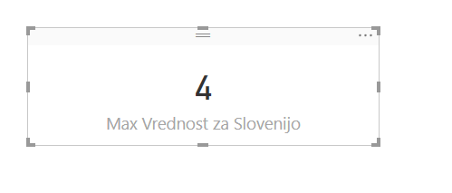
Power BI Desktop – DAX
Info: https://msdn.microsoft.com/en-us/library/gg413422.aspx

Slide 11
Power BI Desktop – DAX
Funkcije:
Date and time functions
Filter functions
Information functions
Logical functions
Math and Trig functions
Time intelligence functions
Text functions
Statistical functions
Parent / Child functions
Other functions
Vir: https://msdn.microsoft.com/en-us/library/ee634396.aspx

Slide 12
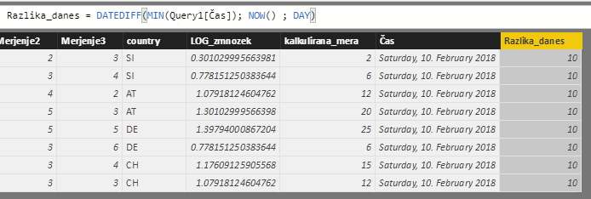
Power BI Desktop – DAX
Funkcije:
Date and time functions
Vir: https://msdn.microsoft.com/en-us/library/ee634396.aspx

Slide 13
Power BI Desktop – DAX
Funkcije:
Filter functions
Vir: https://msdn.microsoft.com/en-us/library/ee634396.aspx

Slide 14
Power BI Desktop – M
Hard core language

Slide 15
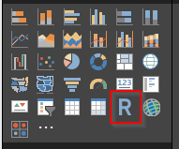
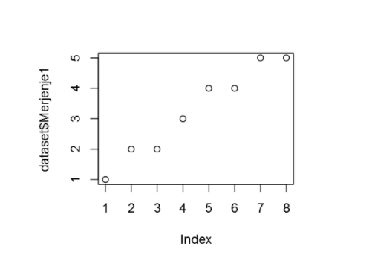
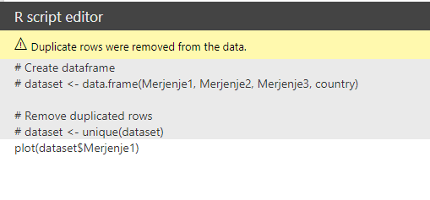
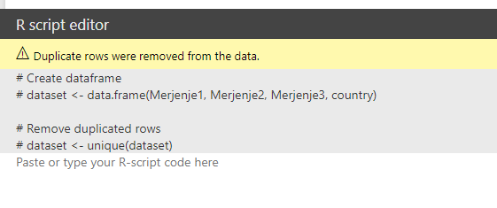
Power BI Desktop – R

Slide 16
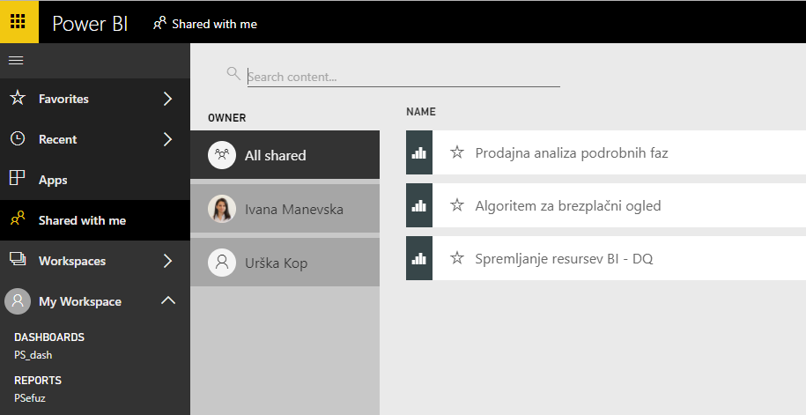
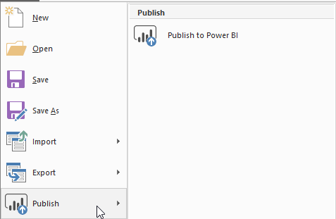
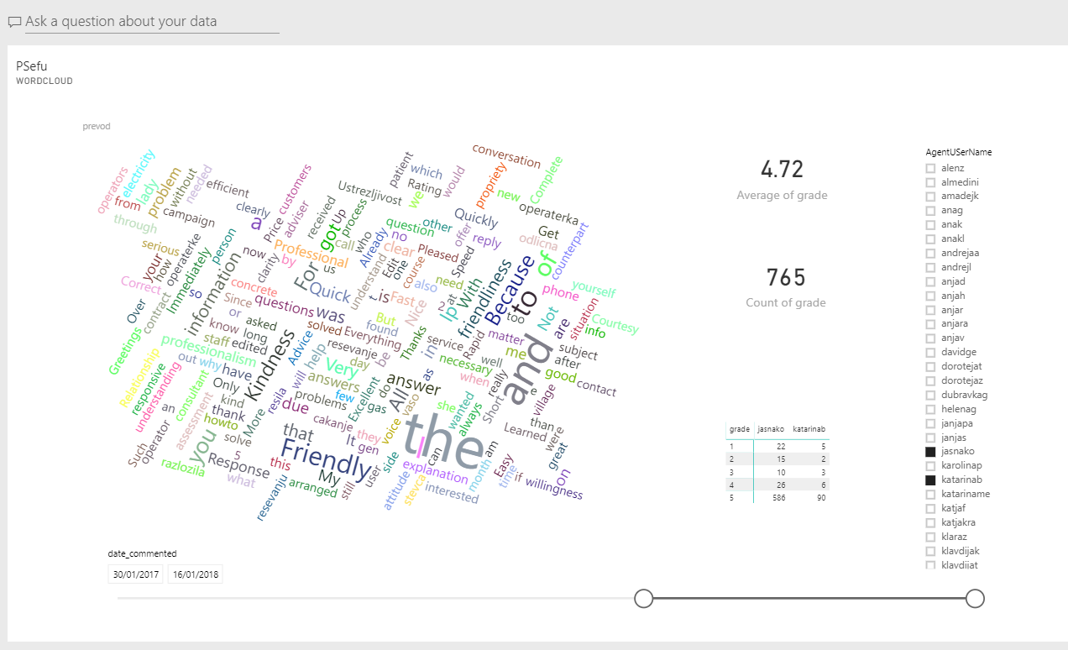
Power BI service – Import / Publish / Share Report

Slide 17
Paradigms: - Learn by doing - Learn by watching - Learn by being inspired

Slide 18
Data Stories gallery
Tell your story and get inspired:
http://community.powerbi.com/t5/Data-Stories-Gallery/bd-p/DataStoriesGallery
http://community.powerbi.com/t5/Data-Stories-Gallery/The-Power-BI-Whisky-Experience/m-p/328399
http://community.powerbi.com/t5/Data-Stories-Gallery/Business-Driver-Chart/m-p/20128
http://community.powerbi.com/t5/Data-Stories-Gallery/Vehicle-Showroom-Dynamics-Based-on-IoT-Device/m-p/20108

Slide 19
Power Query M
Cheat-list:
http://community.powerbi.com/t5/Data-Stories-Gallery/Bemint-Power-Query-M-Functions-dashboard/m-p/316417

Slide 20
Community and additional reading
Community: http://community.powerbi.com/
Additional reads:
R visuals; http://community.powerbi.com/t5/R-Script-Showcase/bd-p/RVisuals
Video Gallery: http://community.powerbi.com/t5/Webinars-and-Video-Gallery/bd-p/VideoTipsTricks
Microsoft Docs: https://docs.microsoft.com/en-us/power-bi/
Amazon:
https://www.amazon.com/Analyzing-Power-Pivot-Business-Skills/dp/150930276X/ref=sr_1_4?ie=UTF8&qid=1519157827&sr=8-4&keywords=power+bi
https://www.amazon.com/Definitive-Guide-DAX-intelligence-Microsoft/dp/073569835X/ref=sr_1_7?ie=UTF8&qid=1519157827&sr=8-7&keywords=power+bi
Craft your dashboard: http://community.powerbi.com/t5/Webinars-and-Video-Gallery/5-3-17-Webinar-How-to-Design-Visually-Stunning-Power-BI-Reports/m-p/168204

Slide 21
Data samples
Data1: https://raw.githubusercontent.com/vincentarelbundock/Rdatasets/master/csv/mosaicData/Alcohol.csv
Data2:
https://commondatastorage.googleapis.com/ckannet-storage/2012-07-26T090250/Countries-Continents-csv.csv

