Slide 1

Galway Meetup @ IBM
13/10/2015

Slide 2
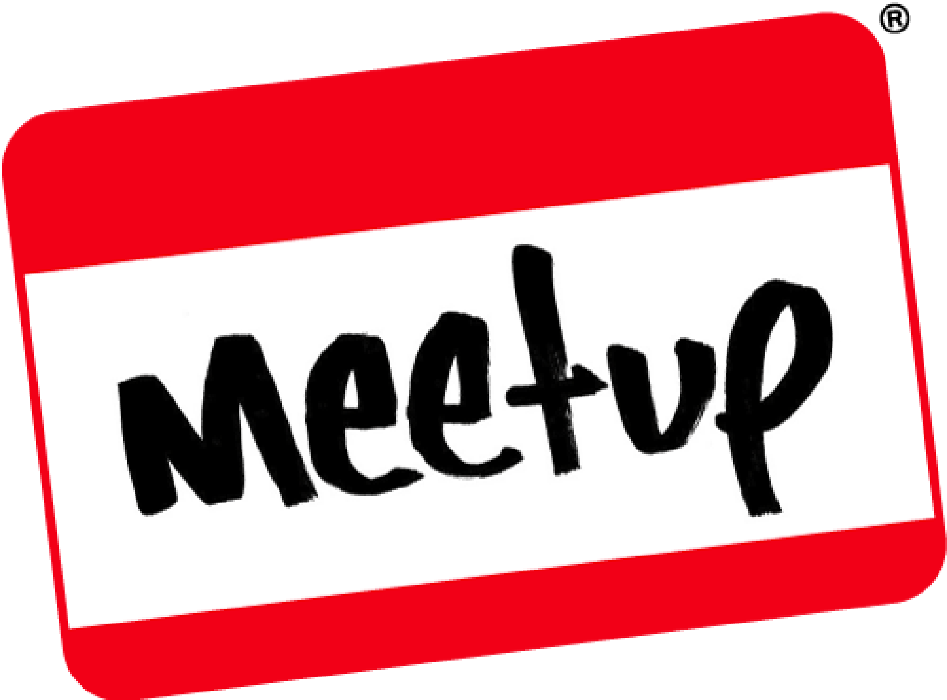
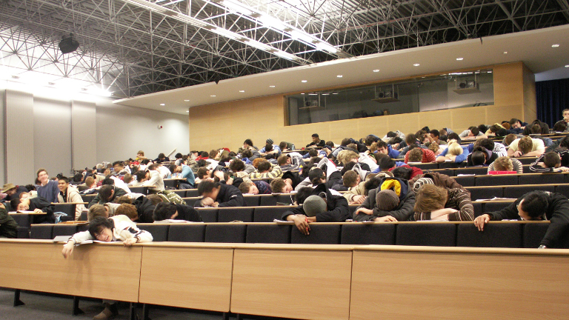
This is a
Not a

Slide 3
There are meetup rules...
Ask lots of questions
Keep slides to a minimum
Demo and then demo some more
Talk to people that you do not know
Don't judge! Everyone is welcome..

Slide 4

Photo Tweets ==
@docker
#DockerGalway

Slide 5

Thank you to...
Pat Hourigan
&

