Slide 1

Galway Meetup @ HPE
24/11/2015

Slide 2
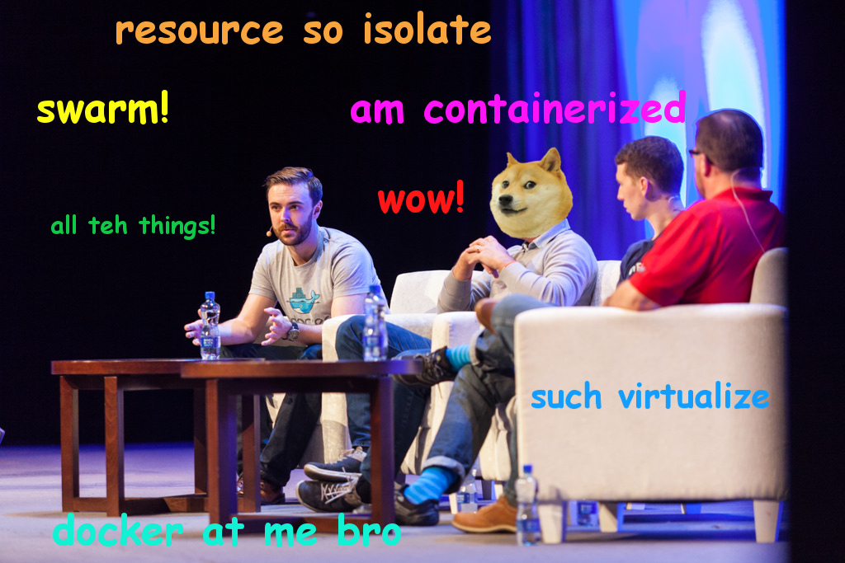
Who am I?
Tom Barlow (@tomwbarlow) - Software Engineer at Docker
Image courtesy of Sean Ryan, HPE

Slide 3
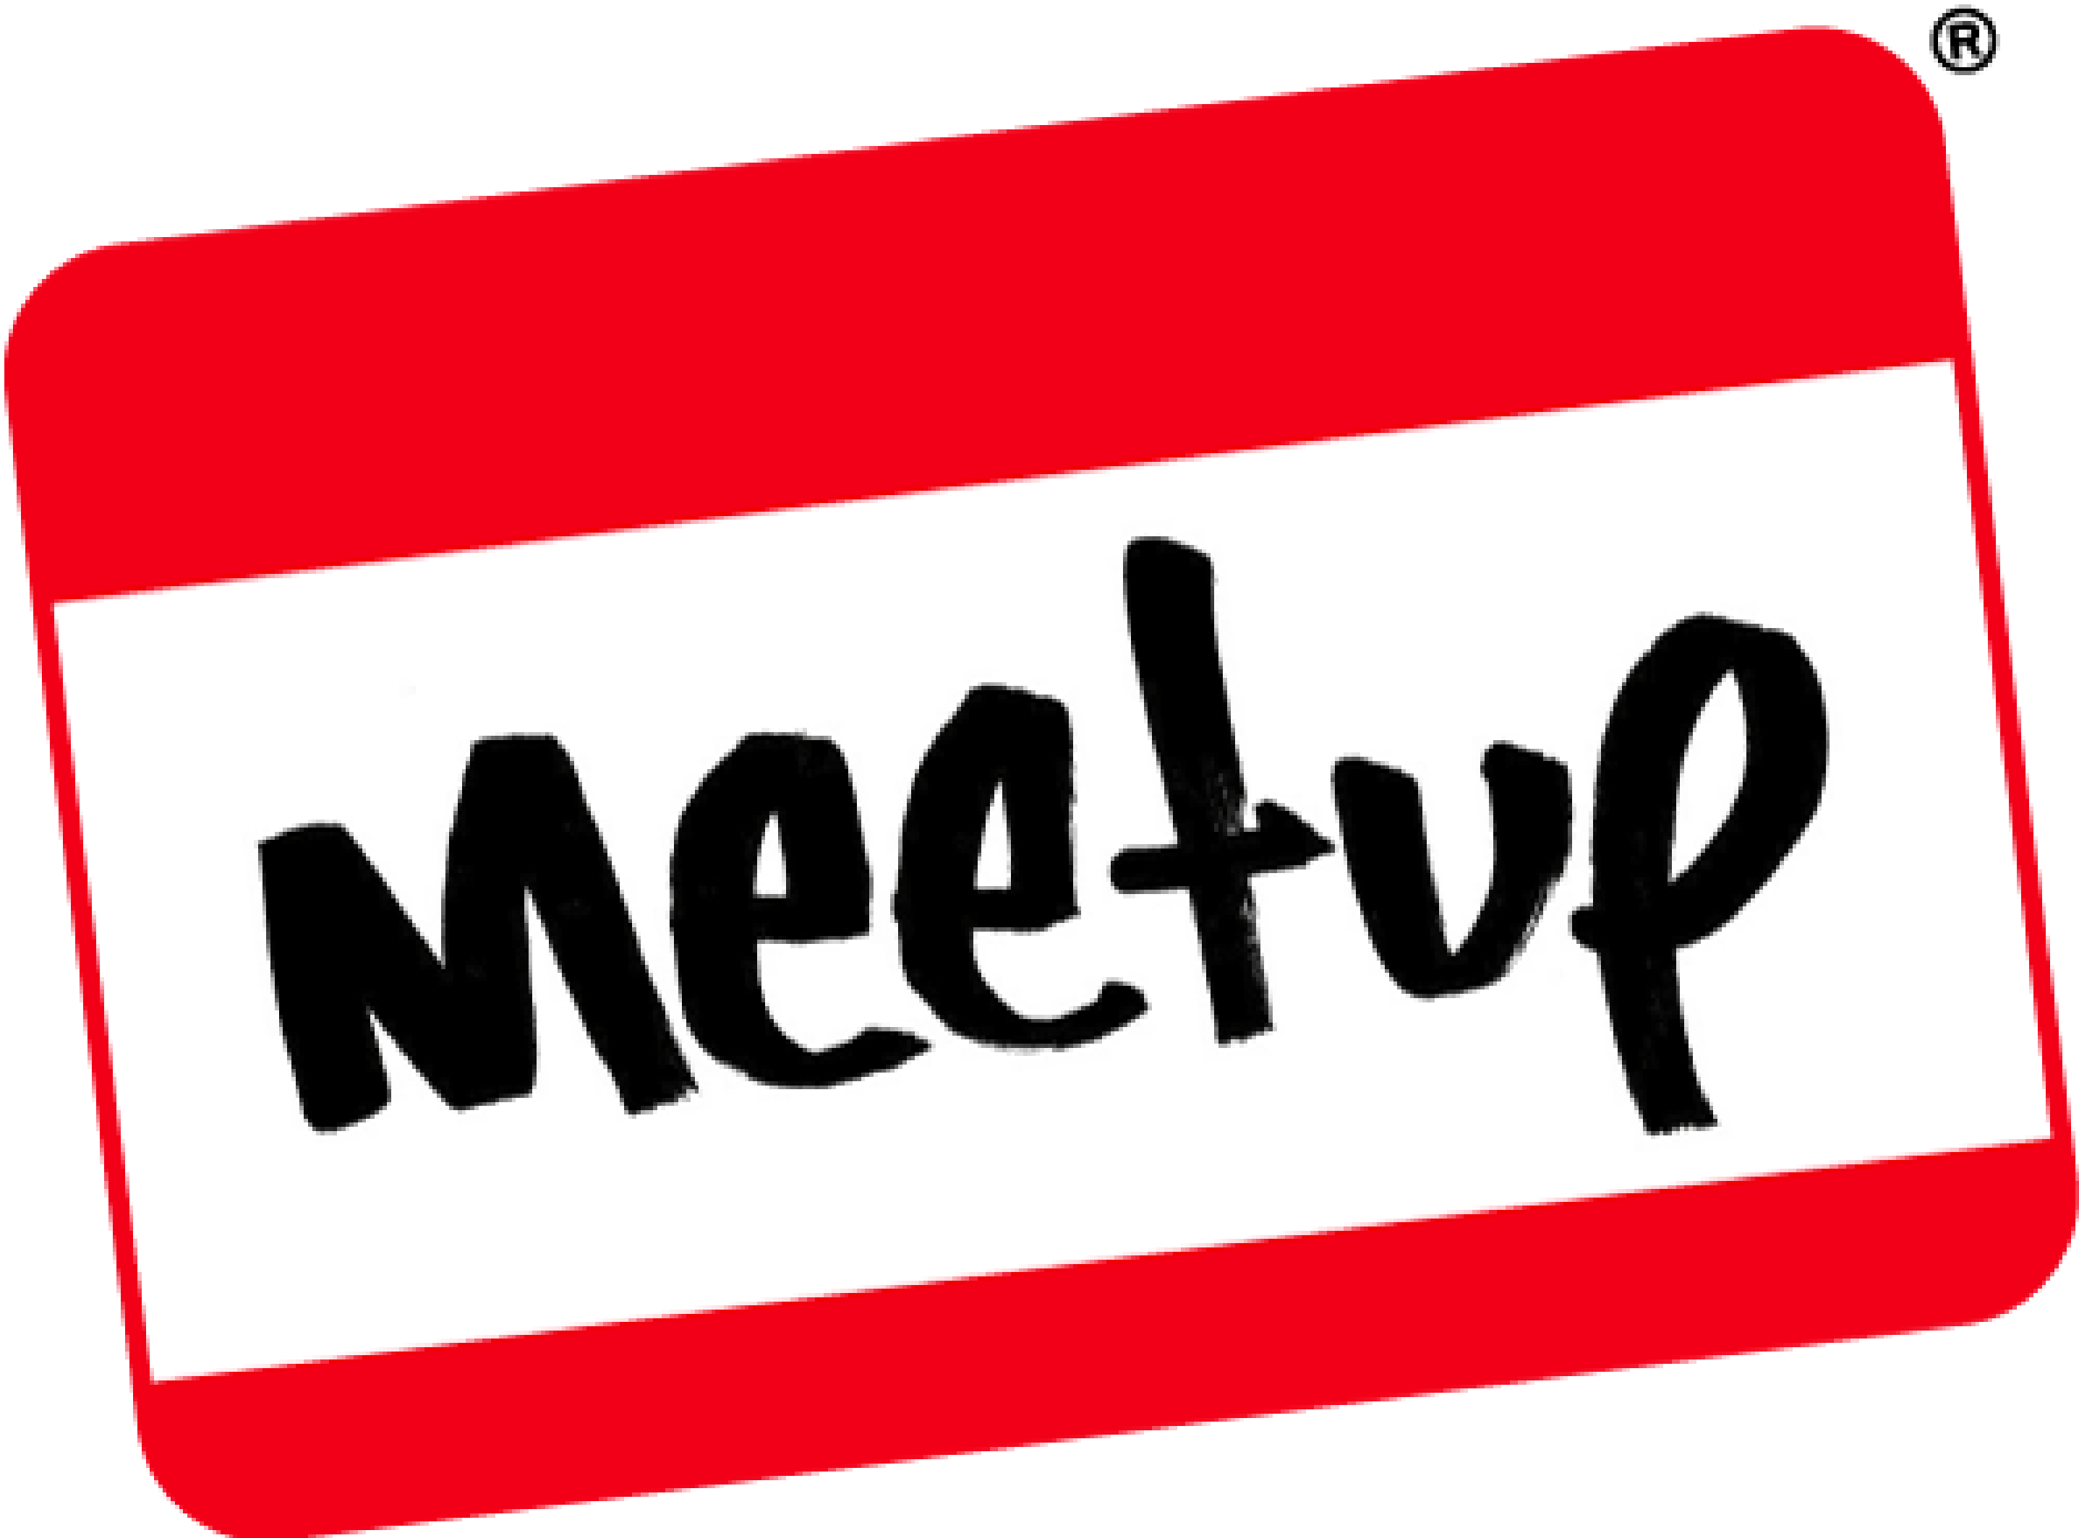
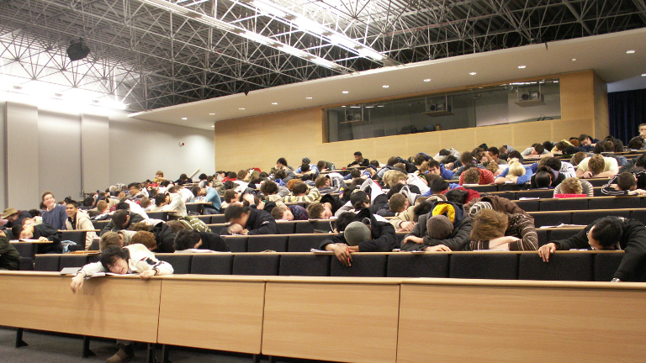
This is a
Not a

Slide 4
There are meetup rules...
Talk to people that you do not know
Ask lots of questions
Be respectful
Keep slides to a minimum
Demo and then demo some more
Don't judge! Things won't go to plan.. etc.

Slide 5
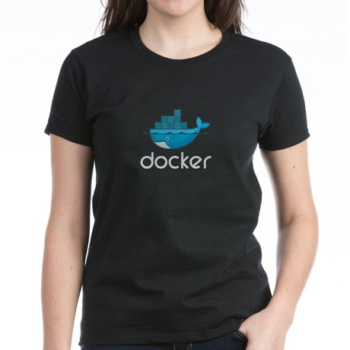
Photo Tweets ==
#dockermeetup

Slide 6
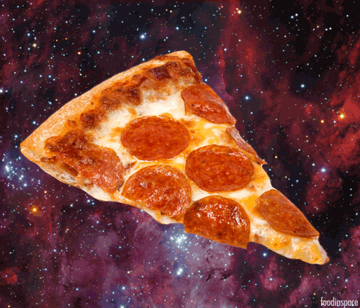

Thank you to...
Eoghan Shields
&

Slide 7
What's new?
Docker 1.9 Released
docker network exits experimental and is part of standard release
New top-level volume subcommand and API
Add a new unless-stopped restart policy
DockerCon EU
Tutum
Docker Content Trust
Nautilus
New Docker Trusted Registry
Public beta availability Docker Universal Control Plane
Dockercraft
Unikernels

