Slide 1


Slide 2
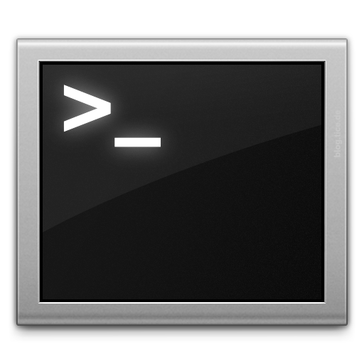
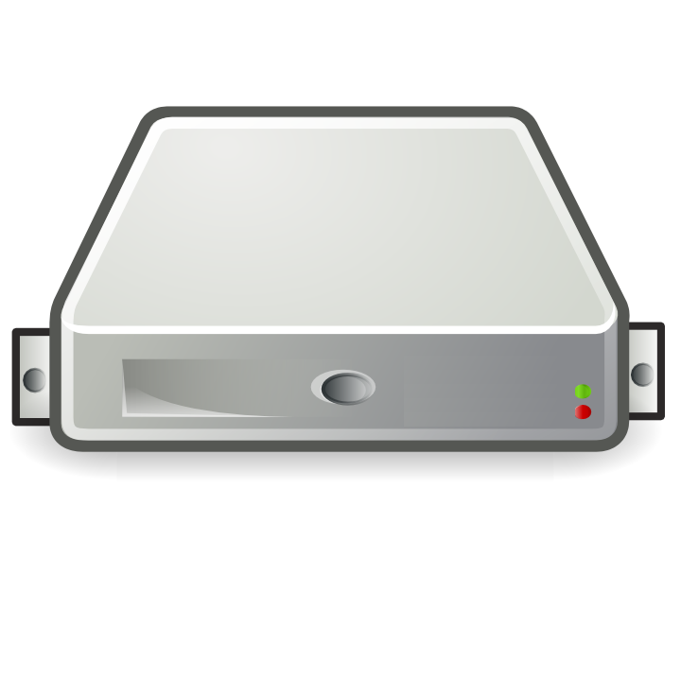
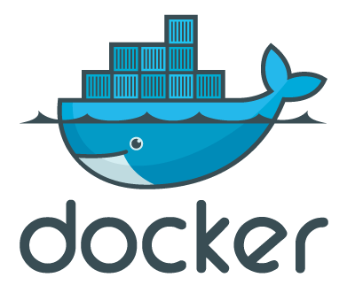
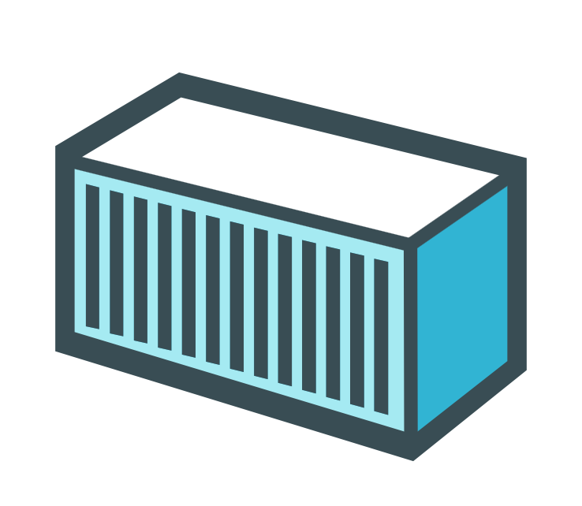
Single docker engine
Docker
CLI

Slide 3
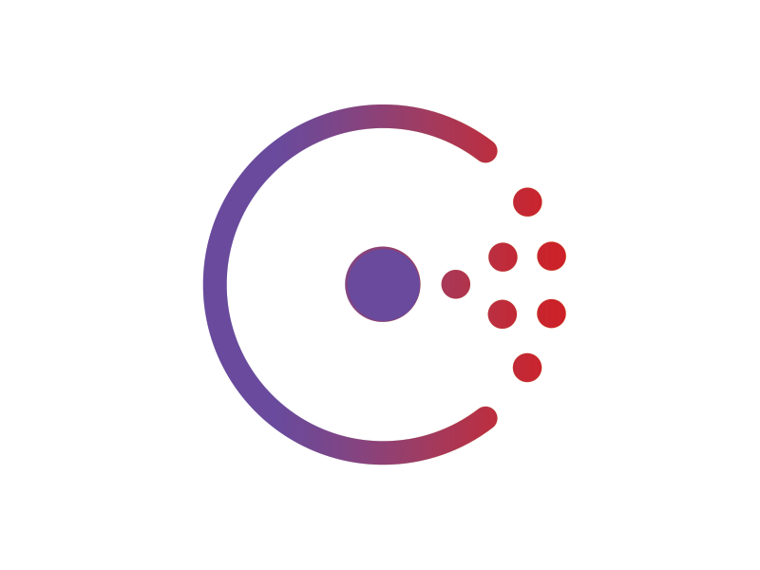


Multiple Docker Engines == Swarm
etcd
zookeeper
libkv
CLI
consul
Docker
CLI
Machine discovery
Simple File
Docker Hub Token service
Managers
Agents

Slide 4
Swarm in General
Turns a set of Docker Engines into a single pool of resources
Supports the Docker REST API (99%)
Resource management (CPU, Mem, Networking)
Advanced scheduling with constraints and affinities
Multiple Discovery Backends (hub, etcd, consul, zookeeper)
TLS: Encryption & Authentication
Multi Tenancy / Leader Election

Slide 5
Production ready
Stable, can be used in production environment
Stress tested on 1000 EC2 nodes
Still lots of improvements to come, on the roadmap for 1.1:
container rebalancing
global scheduling
Rationale: Keep it simple to use/operate. Hear back from users and only include what is wanted/needed by the community
example: networking, build time constraints, etc.

Slide 6
Create a Swarm
$ TOKEN=$(docker run --rm -ti swarm create)
$ docker-machine create -d virtualbox \
--swarm \
--swarm-master \
--swarm-discovery=”token://${TOKEN}” \
swarm-master
$ docker-machine create -d virtualbox \
--swarm \
--swarm-discovery=”token://${TOKEN}” \
swarm-agent

Slide 7
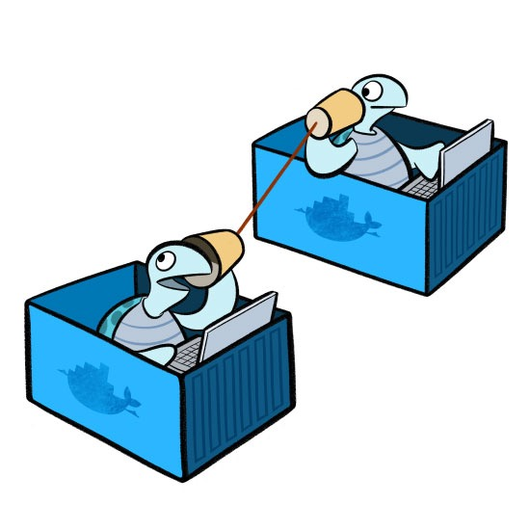
Multi-Host Networking

Slide 8
Multi-Host networking
Announced as part of the experimental release in DockerCon SF June
Now in docker stable!
Allows you to create overlay networks between containers using the vxlan driver
Each container connected to the same overlay network are able to see and discover each other

Slide 9
Create a Swarm
$ docker network
Usage: docker network [OPTIONS] COMMAND [OPTIONS]
Commands:
create Create a network
connect Connect container to a network
disconnect Disconnect container from a network
inspect Display detailed network information
ls List all networks
rm Remove a network
Run 'docker network COMMAND --help' for more information on a command.

Slide 10
etcd
zookeeper
Swarm / Networking
libkv
CLI
consul
Docker
CLI
Machine discovery
Simple File
Docker Hub Token service
Managers
Agents
Overlay networking (vxlan)

Slide 11
Demo time!

Slide 12
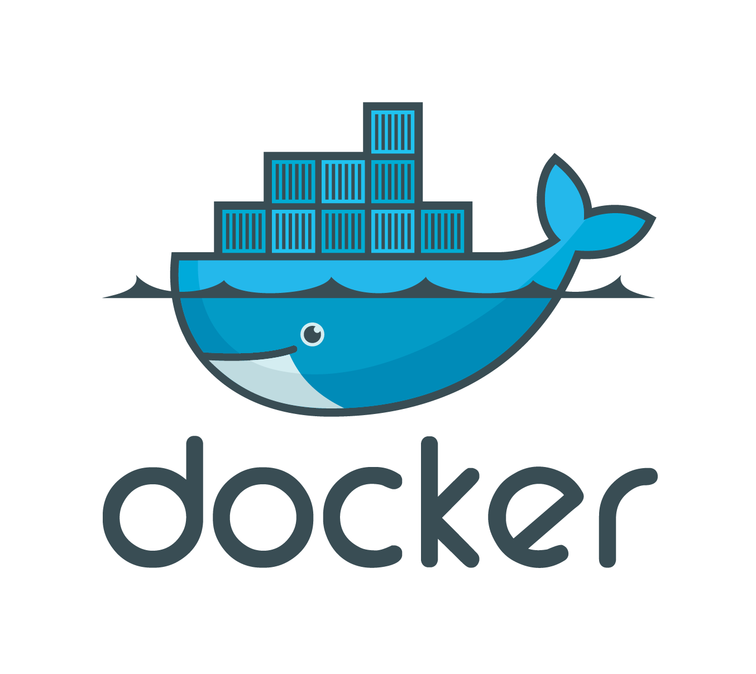
Questions?
@tomwbarlow

Slide 13
Future Meetup Topics?
- Using containers for build/test
- Lightweight runtime containers
- Log Management (Log drivers + options, Logspout, Elasticsearch Kibana)
- Securing Docker in Production
- Managing stateful containers
- Data volumes & data volume plugins (vault, Flocker, etc.)
- Keeping docker images up to date (tooling for CVEs / bad practices would be good)
- Supervision of docker instances
- Ways we can reduce energy consumption by only running services on demand
- Zero-downtime deployments/upgrades with Docker
- Making devicemapper usable
- Interlock

