Slide 1
Docker Best Practices
#DockerGalway - 13/10/2015
Tom Barlow
@tomwbarlow

Slide 2
CLI Tips and Tricks
Remove Container and Docker Managed Volumes
  docker rm -v <container-id-or-name>
Cleanup Exited Containers
  docker rm -v $(docker ps -f status=exited -qa)
Cleanup Untagged Images
  docker rmi $(docker images --filter "dangling=true” -q)

Slide 3
CLI Tips and Tricks (Continued)
Real time stats from all running containers
  docker stats $(docker ps -q)
Start another process in a running container
  docker exec -it <container-id-or-name> <command>
Run a container with the root file system mounted read-only
  docker run --read-only…

Slide 4
CLI Tips and Tricks (Continued)
Run Docker Bench to test your host and running containers:
docker run -it --net host --pid host --cap-add audit_control \
-v /var/lib:/var/lib \
-v /var/run/docker.sock:/var/run/docker.sock \
-v /usr/lib/systemd:/usr/lib/systemd \
-v /etc:/etc --label docker_bench_security \
docker/docker-bench-security
https://dockerbench.com

Slide 5
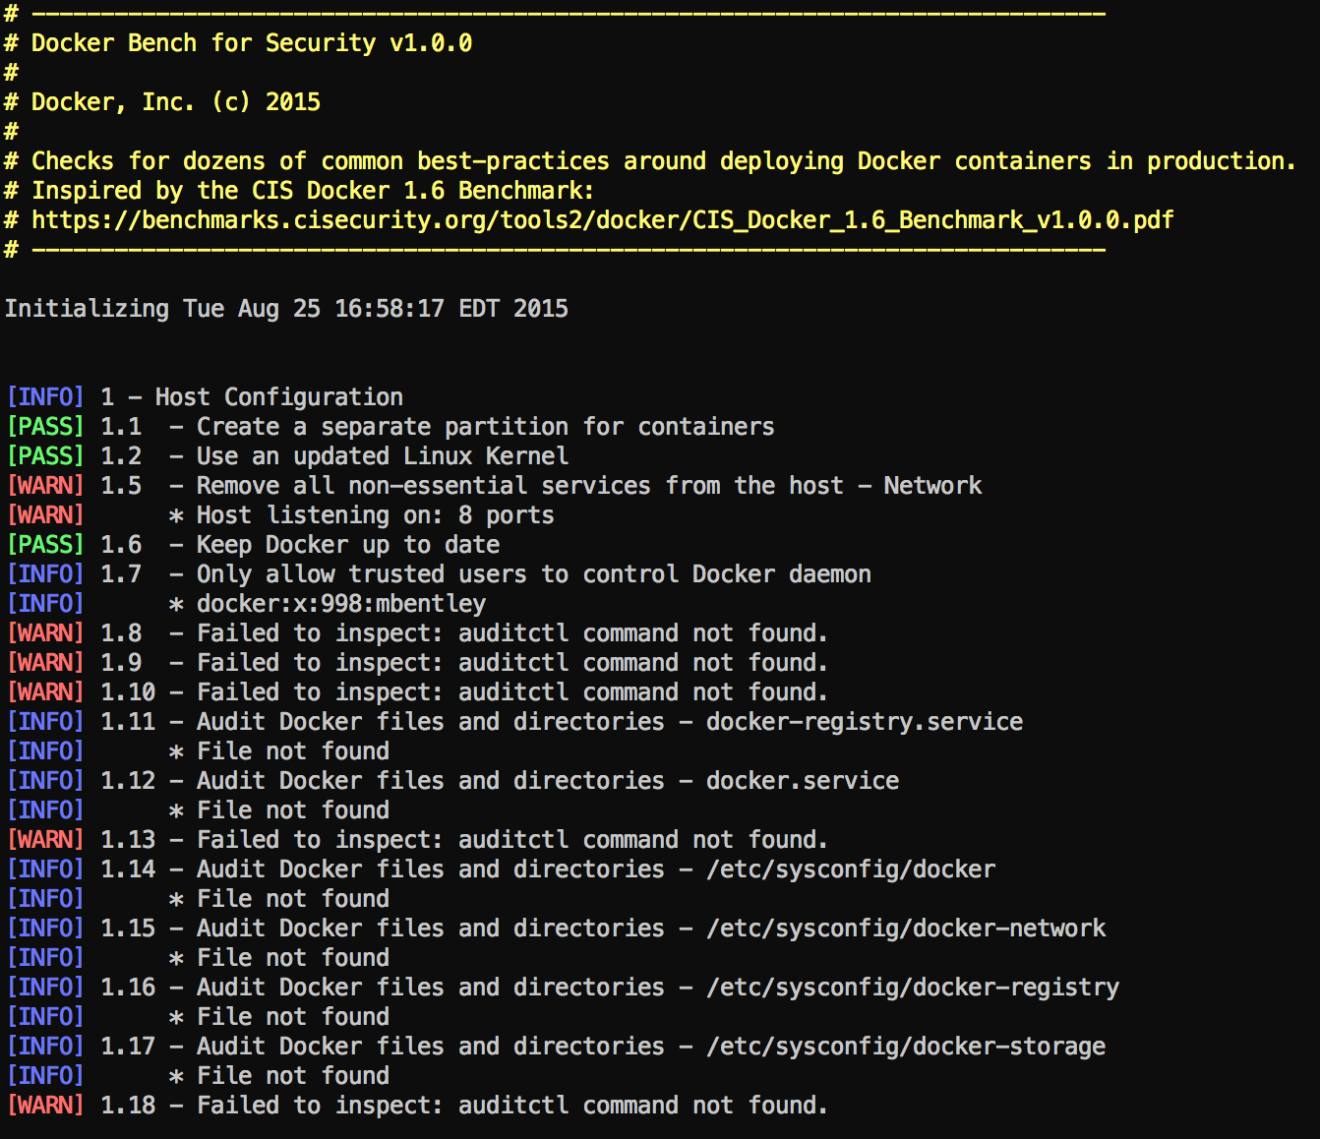
Docker Bench Demo

Slide 6
Building Efficient Dockerfiles
Utilize minimal Linux distributions
  Alpine Linux
  Build from scratch
Only install what you need
  Smaller footprint & attack service
Run one process per container
  Easier to scale and re-use images
Run processes as non-root whenever possible

Slide 7
Building Efficient Dockerfiles (Continued)
Minimize the number of layers
  Combine like RUN commands to a single command
Bad!
Good!
RUN apt-get update
RUN apt-get install -y wget
RUN rm -rf /var/lib/apt/lists/*
RUN apt-get update &&\
apt-get install -y wget &&\
rm -rf /var/lib/apt/lists/*

Slide 8
Building Efficient Dockerfiles (Continued)
Optimize image size
  Remove caches and archives during a single RUN command so they are not included in your final image
RUN wget -O /tmp/tomcat7.tar.gz http://www.us.apache.org/dist/tomcat/tomcat-7/v7.0.63/bin/apache-tomcat-7.0.63.tar.gz &&\
cd /opt &&\
tar zxf /tmp/tomcat7.tar.gz &&\
mv /opt/apache-tomcat* /opt/tomcat && \
rm /tmp/tomcat7.tar.gz

Slide 9
Building Efficient Dockerfiles (Continued)
Better optimize builds to utilize layer caching
  Separate changes that break the cache
Bad!
Good!
COPY . /usr/src
RUN npm install
COPY package.json /usr/src/package.json
RUN npm install
COPY . /usr/src

Slide 10
Using containers for your build
Containers are pretty good at isolating build-time depedencies
Sometimes we don't even need to make our own image...

Slide 11
Using build containers for your runtime..
Build containers are often large and contain a ton of dependencies
We can build lightweight runtime images in this case

Slide 12
Questions?

