Slide 1
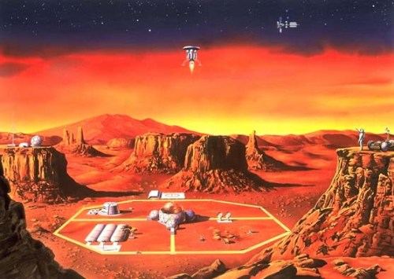
The Colony
A Fast-Paced, Role-Based Bluffing Game By:
Amy Harris, Casey Graser, Merek Smith, Thomas Benedict, Tyler Schmauch

Slide 2
The Colony: Overview
Provides value in the form of an entertaining, multi-player game
In similar games (Werewolf, Mafia, Bang!, etc.), one individual must moderate, and thus does not play
Our React App will serve as the game moderator

Slide 3
The Colony: Team Responsibilities
Amy: React front end, CSS
Casey: Google Authentication, Character JSON (images, creative text)
Merek: socket.io, React front end
Thomas: Redux research, socket.io
Tyler: Mongoose Schemas, MongoDB setup, backend routing (controller)

Slide 4
The Colony : Development Schedule
Phase 1: MVP – Due Week II
Create React App

Slide 5
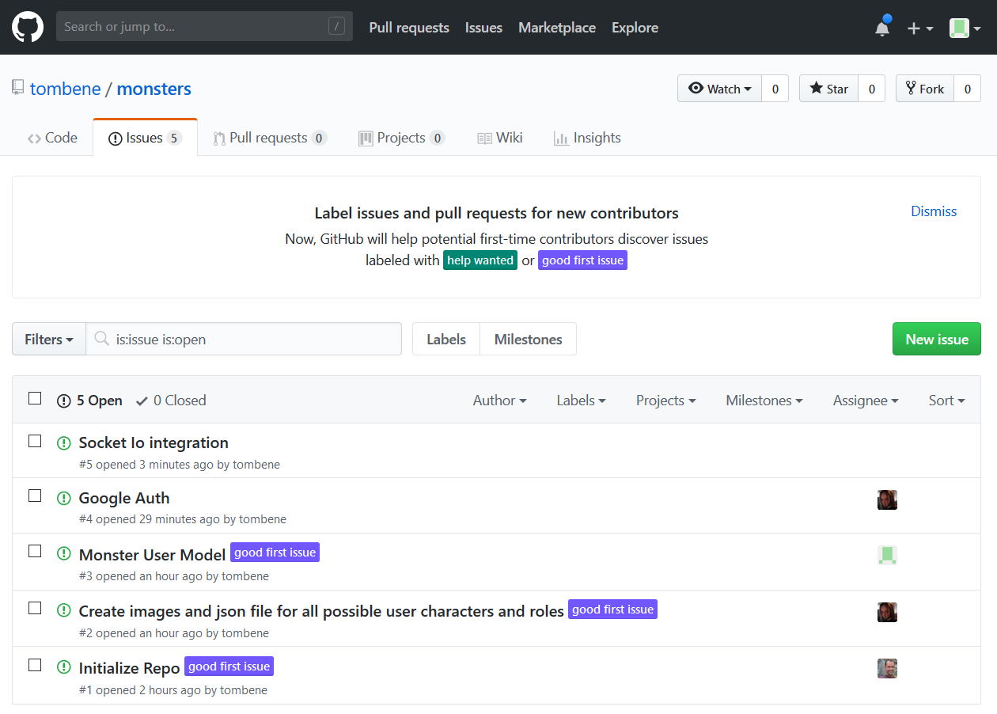
The Colony: Task Management
Using GitHub Issues to assign tasks and track App progress

Slide 6
The Colony: Wireframe 1
The Colony
Initialize Game
Login / Logout
User clicks this button, prompts Google Authentication if not logged in, creates new game document in DB with unique ID

Slide 7
The Colony: Wireframe II
Main Screen
User Screen
THE COLONY
GO TO
THOMAS.IO/:ID
TO JOIN GAME
THE COLONY
Name: __________
Gender: F o M o N o
JOIN
Players:
Xxxxx
Yyyyy
Zzzzz
…….

Slide 8
The Colony: Wireframe III – Night Time
Main Screen
User Screen
THE COLONY
TIMER
:59 Seconds Remain
THE COLONY
I’m the (cosmonaut, alien, scanner, etc.)
My Action is ______:
_______ does xxxxxxxxxxxxxxxxxxxxx.
Players:
Xxxxx
Yyyyy
Zzzzz
…….

Slide 9
The Colony: Wireframe IV – Day Time
Main Screen
User Screen
THE COLONY
TIMER
2:XX Remain
THE COLONY
Talk amongst yourselves to determine who is (whatever role you are looking to kill)
TIMER
2:XX
Players:
Xxxxx
Yyyyy
Zzzzz
…….

Slide 10
The Colony: Wireframe V – Voting
Main Screen
User Screen
THE COLONY
TIMER
2:XX Remain
THE COLONY
Talk amongst yourselves to determine who is (whatever role you are looking to kill)
TIMER
2:XX
Players:
Xxxxx
Yyyyy
Zzzzz
…….
Votes:
Xxxxx ---------
Yyyyy -----
Zzzzz ----
……. --

Slide 11
The Colony: Wireframe VI – Results
Main Screen
User Screen
THE COLONY
Winner:
Aliens (Colonists)
Xxxxx got the most
votes and was a _______
Play Again
THE COLONY
You finished the game as ______________
and WON! (LOST!)
Players / Voted for:
Xxxxx / ooooo
Yyyyy / ppppp
Zzzzz / lllllll
……. / ,,,,,,,

Slide 12
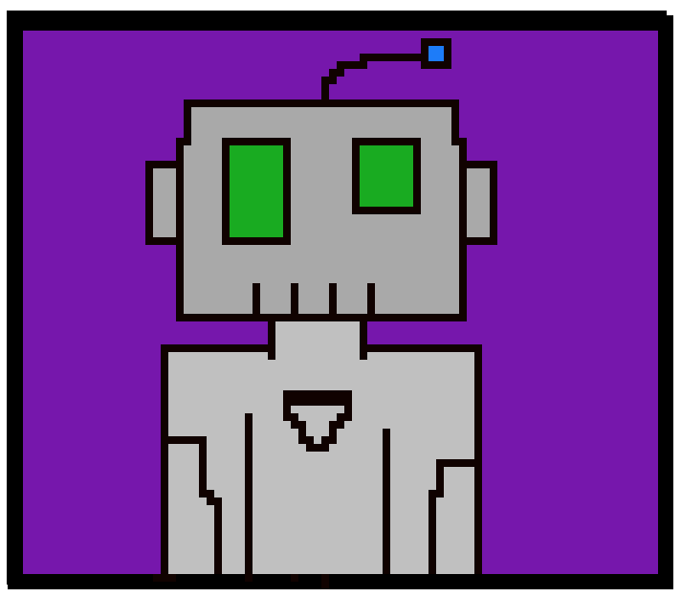
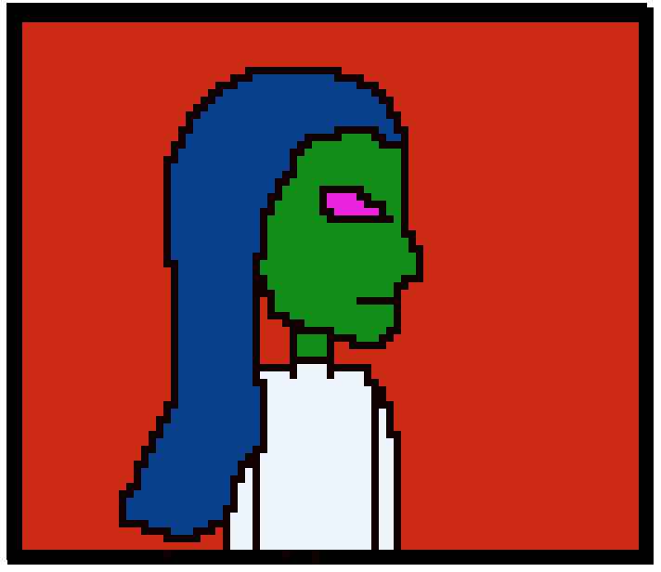
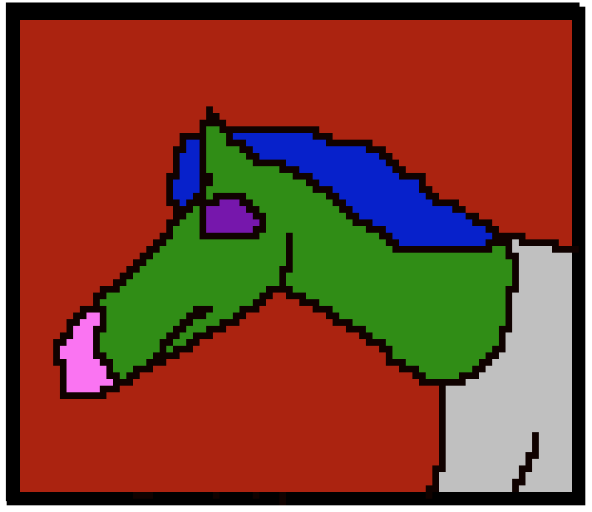

The Colony: Avatars

