Slide 1
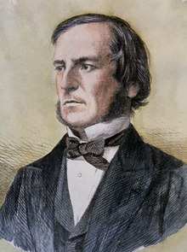


George Boole (1815 – 1864)

Slide 2
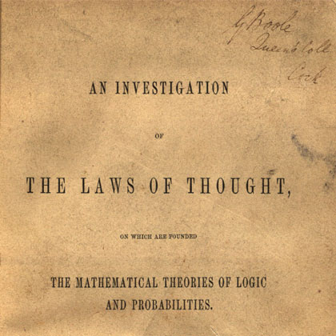
First book on Boolean Algebra in 1854

Slide 3
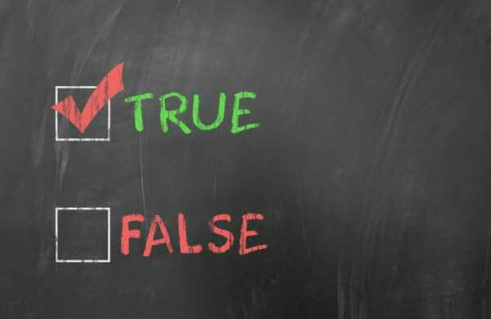

Boolean algebra
2 values – True / False
3 Operator – And / Or / Not

Slide 4
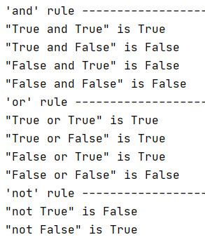
Basic rule

Slide 5
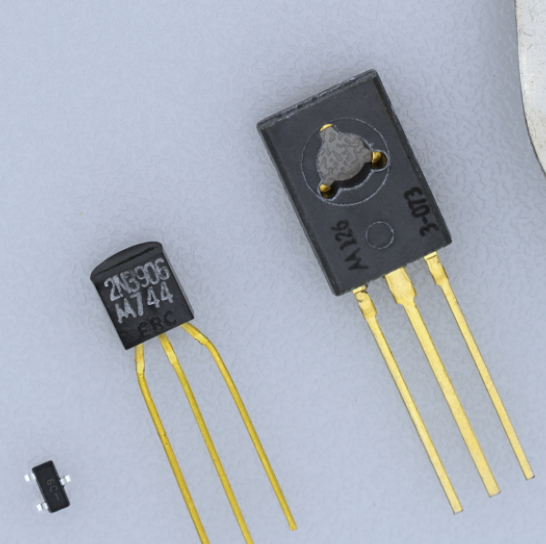
Boolean algebra is the foundation of computer Transistor

Slide 6
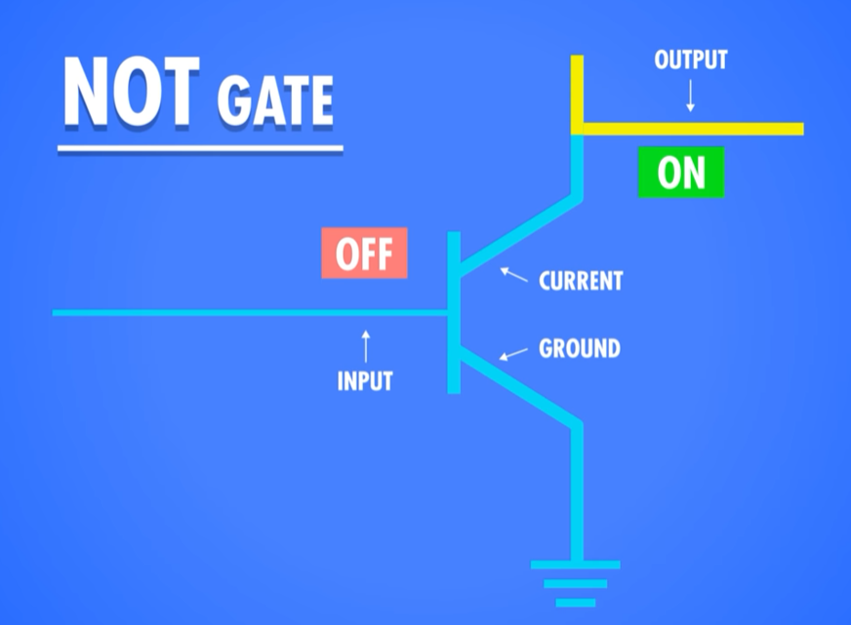
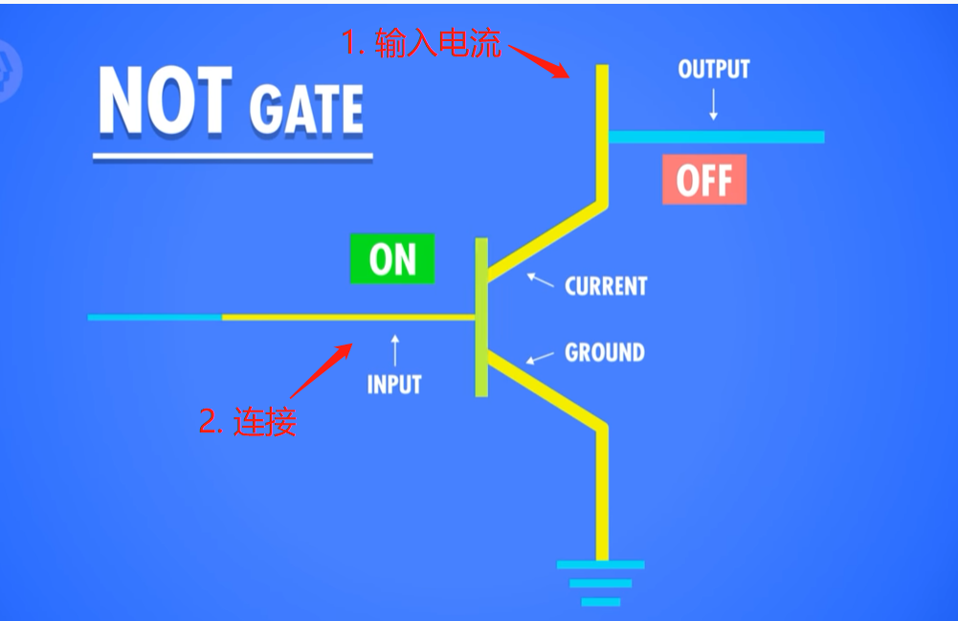
Not gate

Slide 7
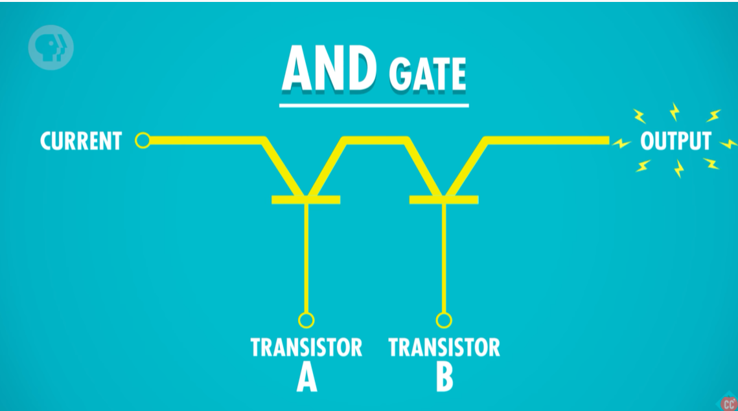
And gate

Slide 8
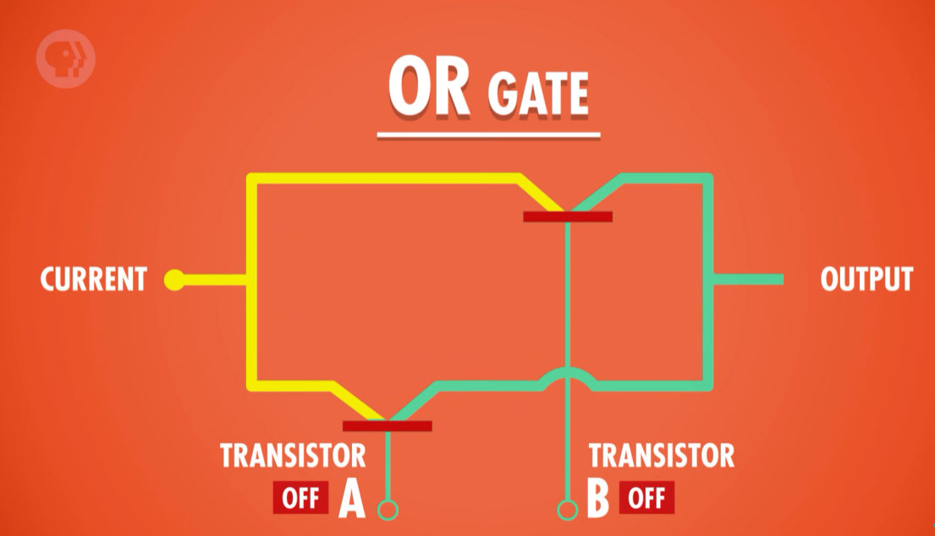
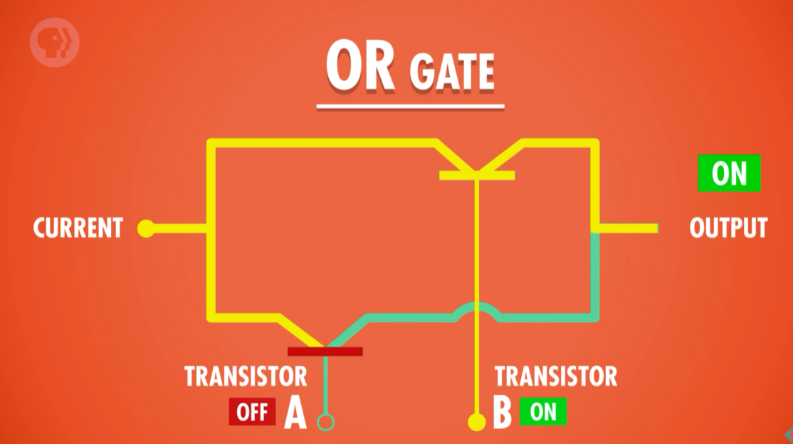
Or gate

Slide 9

And gate / Or gate / Not gate

Slide 10
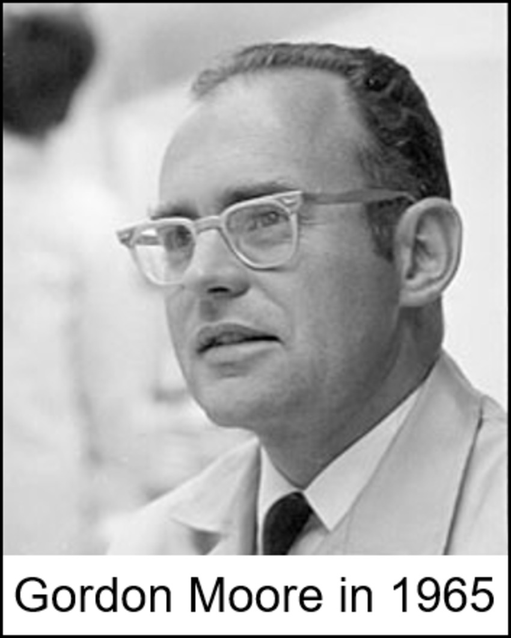
Moore’s law
Gordon Moore said in 1965:
The number of transistors on a microchip
doubles every two years.

Slide 11
