Slide 1
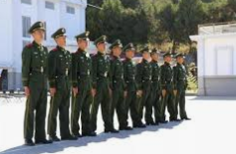
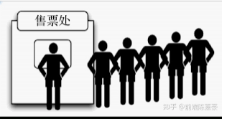

What is list?
A sequence of elements.

Slide 2
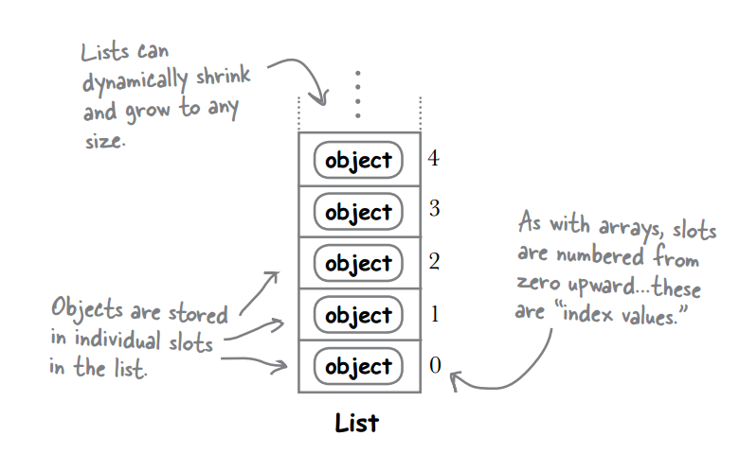
What is a list?
A list is like a cabinet.
It can contain a lot of values in it.

Slide 3
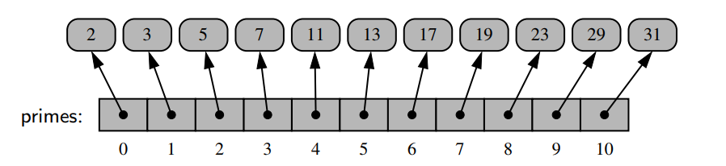
List is referenced by index
prime = [2, 3, 5, 7, 11, 13, 17, 19, 23, 29, 31]

