Slide 1
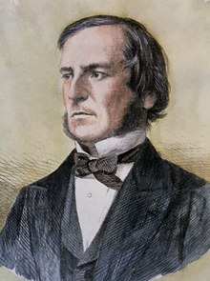


George Boole (1815 – 1864)

Slide 2

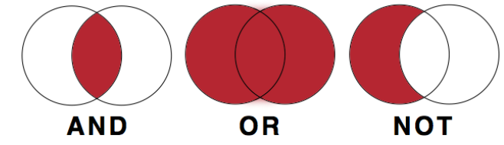
Boolean algebra
2 values – True / False
3 Operator – And / Or / Not

Slide 3
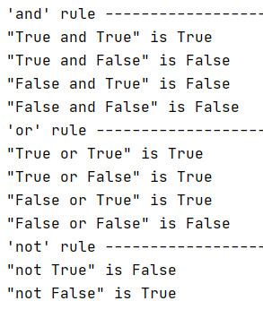
Basic rule

