Slide 1
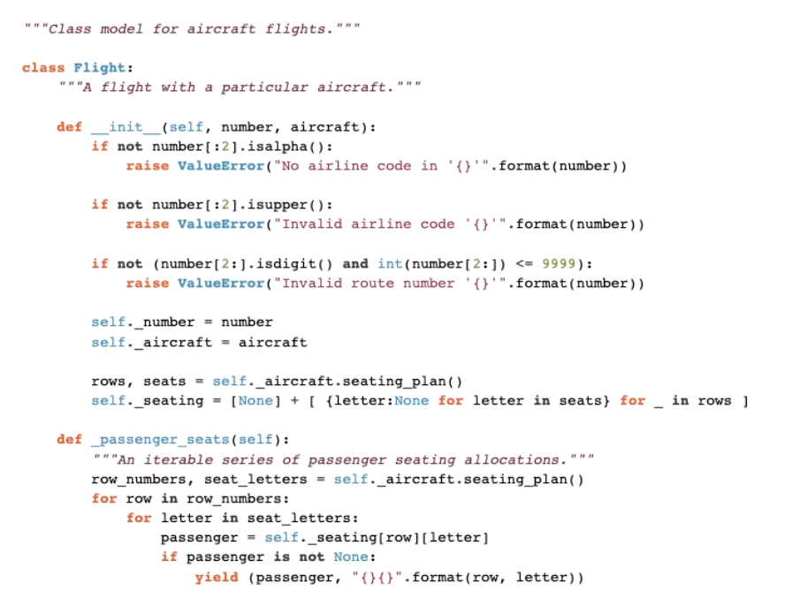
4 spaces (Indentation / 缩进)
冒号表示body 开始

Slide 2

4 spaces (Indentation / 缩进)

Slide 3
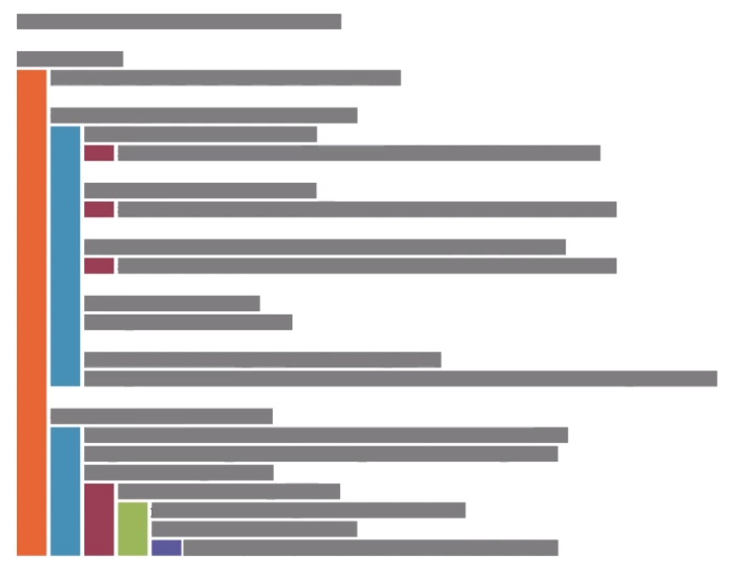
4 spaces (Indentation / 缩进)

Slide 4
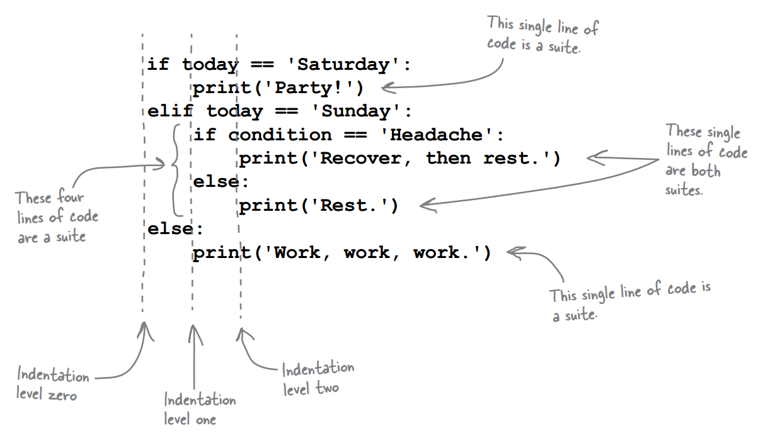
Nested if / elif / else

