Slide 1
while loop

Slide 2
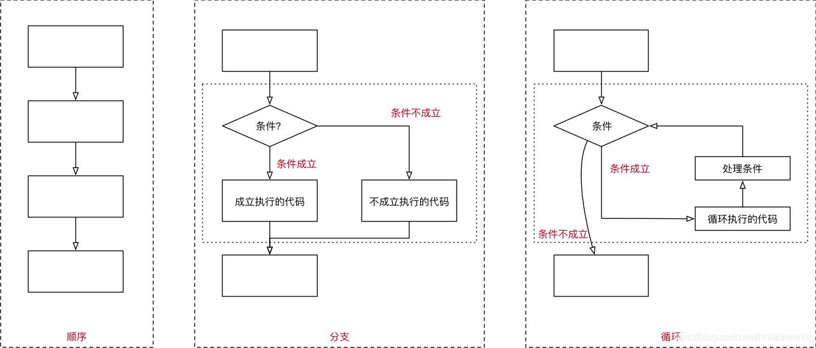
3 种代码执行方式
Notes:
目前我们已经学了顺序和分支，接下来我们要开始学习循环。

Slide 3
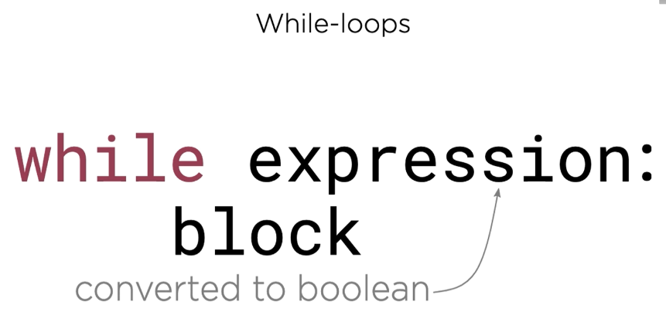
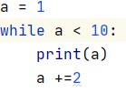
while loop repeats a code block until the while condition becomes False
Requirement:
Print all odd numbers below 10
Code:
Notes:
让我们大家来看一下代码的执行过程

Slide 4

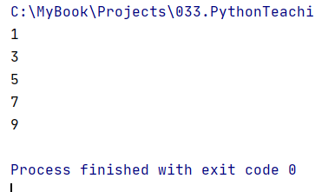
Requirement: Print all odd numbers smaller than 10 - 1,3,5,7,9
Output :

Slide 5
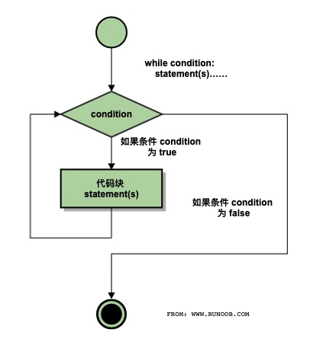
用流程图来理解while loop
If the condition is False in the beginning,
Then the whole code block will be ignored.

Slide 6
Another example – tell me odd or even

