Slide 1
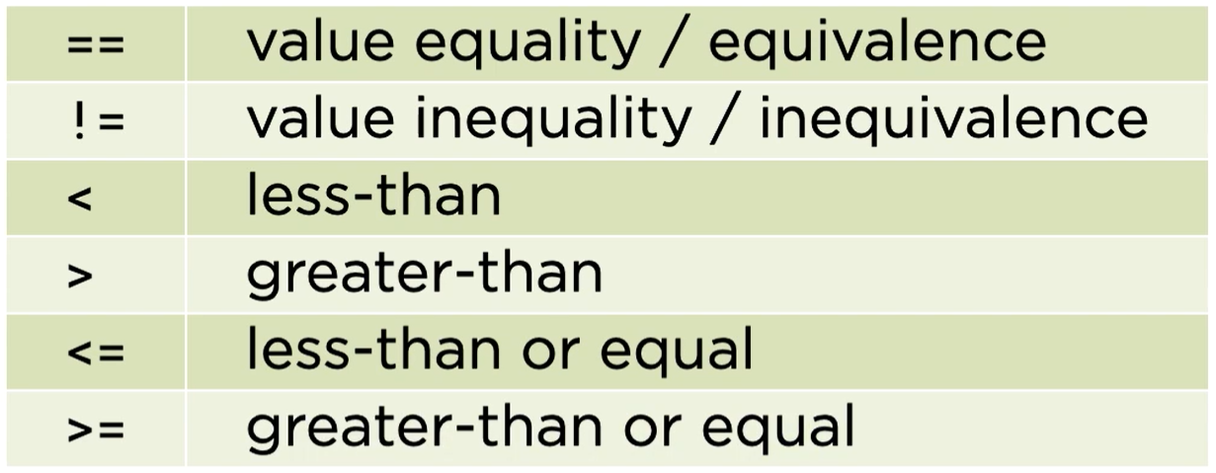
Rational Operator

Slide 2
