Slide 1

Midterm Project
Predicting flight delays with supervised learning
By: Mohamed Ali & Tombra Akana

Slide 2
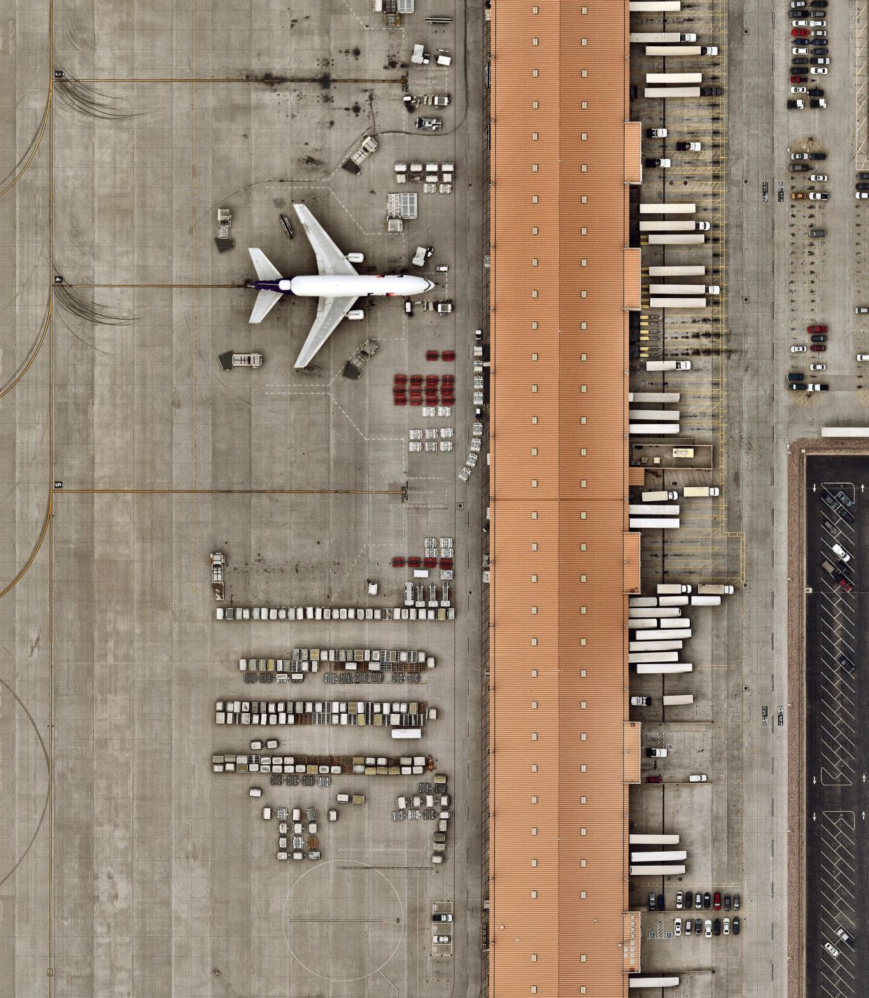
PROJECT STRUCTURE
The goal of this project is to predict arrival delays of commercial flights in order to improve customer satisfaction and income of the airlines.
Data Collection and Preprocessing:
Exploratory Data Analysis (EDA):
Feature Engineering:
Modeling Approach:
Model Training and Evaluation:
Results and Interpretation:
Conclusion and Future Work

Slide 3
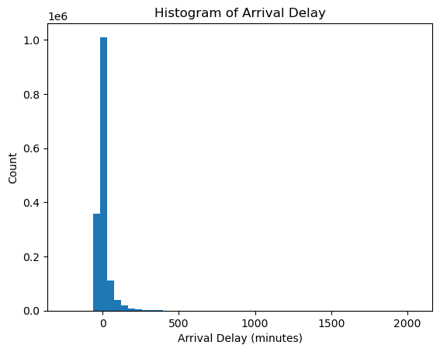
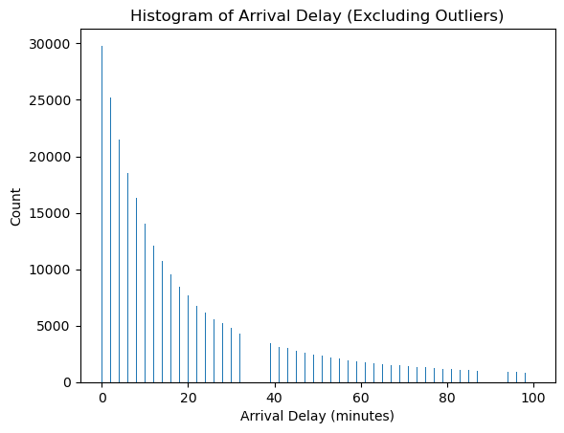
EDA
The arr_delay within the range [0, 100] does not follow a normal distribution (p-value = 0.0). Test Statistic: 0.8296969532966614 .The null hypothesis is rejected

Slide 4
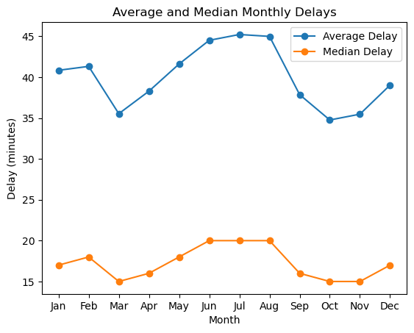
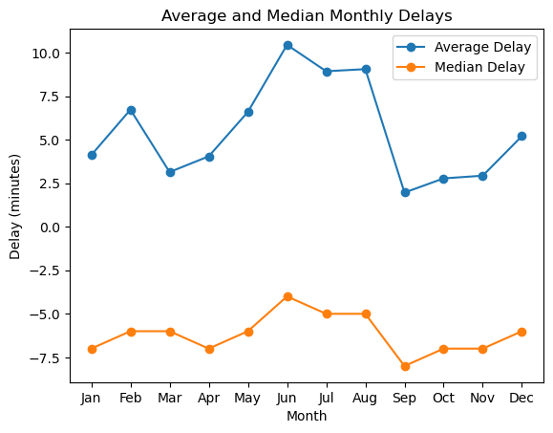
EDA
In the summer months the average delays are highest which may be from individuals travelling during holidays. There is also a peak in December and February.

Slide 5
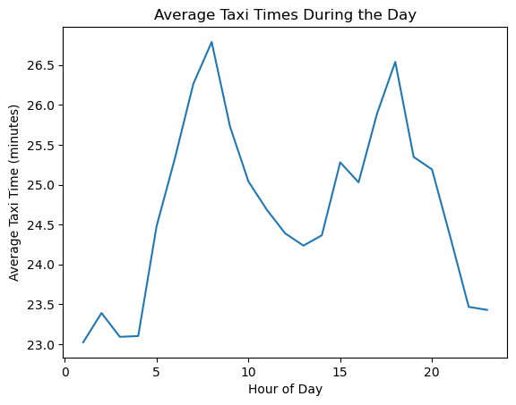
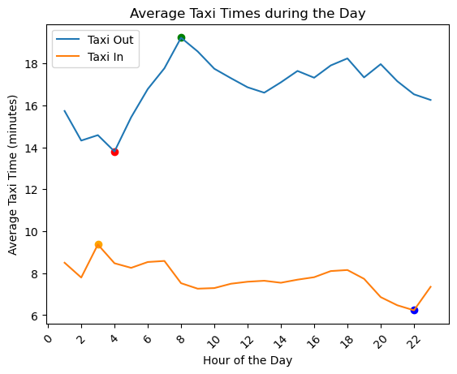
Taxi time changes
As the hour of the day increases, there is a tendency for the taxi_out time to also increase, but the relationship is not extremely strong.. Correlation between hour_of_day and taxi_out: 0.47.
Correlation between hour_of_day and taxi_in of -0.68 shows a negative moderate correlation.This implies that as the day progresses, the time taken for aircraft to taxi from the runway to the gate tends to decrease.

Slide 6
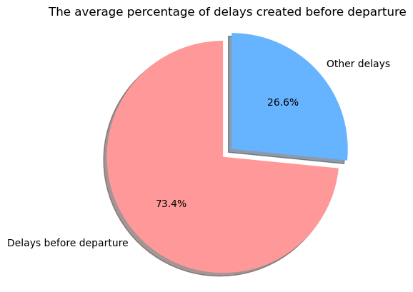

Slide 7
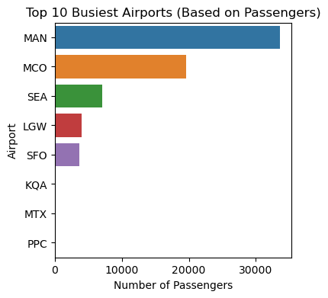
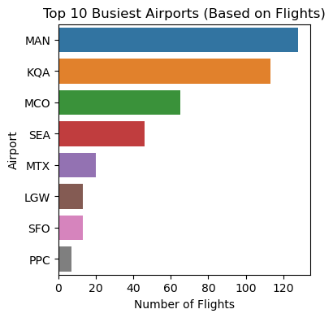
Busiest Airports: (Using passengers_df)

Slide 8
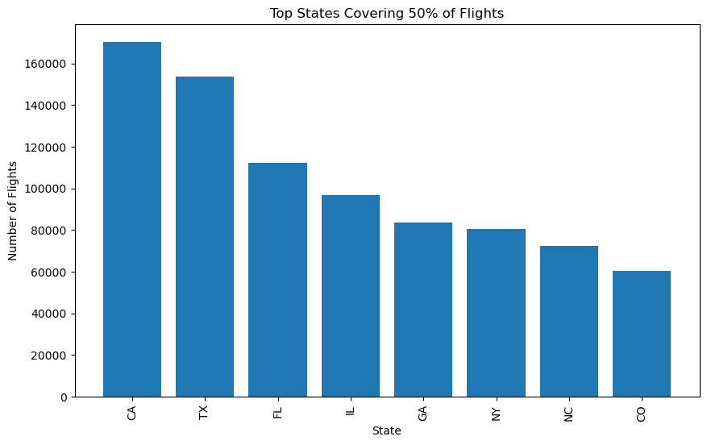
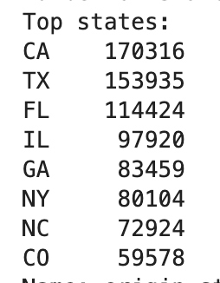
Top states covering 50 % of all flights
There are 8 states that cover 50% of all flights with California covering the most flights in our dataset.

Slide 9
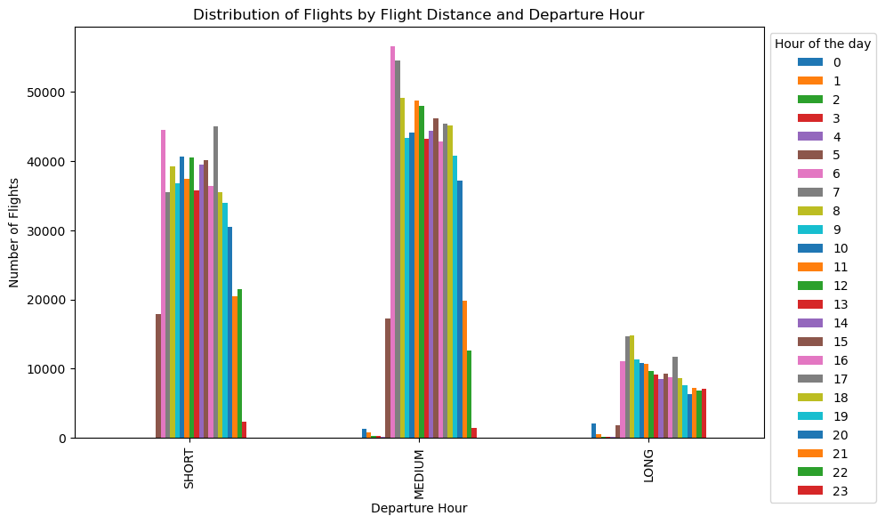
Distribution of Flights by flight distance and departure hour
The largest count of flights for:
Short distance flights leave at 5:00 pm
Medium distance flights leave at 6:00 am
Long distance flights at 7:00 am

Slide 10
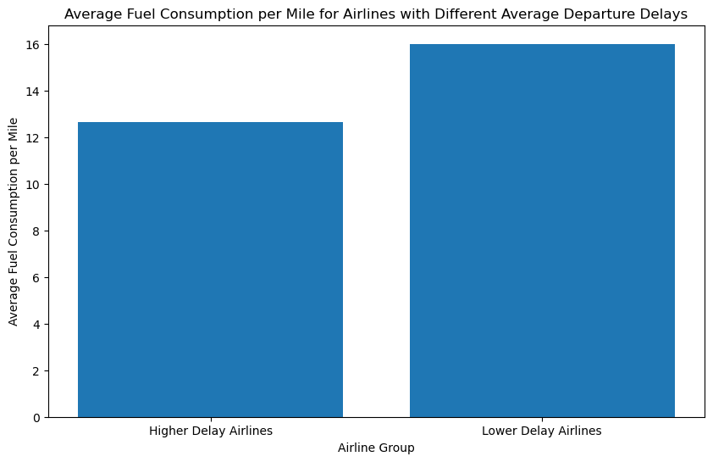
Average fuel consumption per mile
We split the data into two based on different airlines and the average delay for each.
Our results show that airlines with higher delays have lower fuel consumption.

Slide 11

NEW FEATURES CREATED FROM EDA
Origin states
Departure hour
Arrival hour
Month
Average monthly delay
Traffic (not busy, moderate, busy, very busy)
Flight Distance Category ( short, medium , long)

Slide 12
EDA SUMMARY
The arrival delay within the range [0, 100] does not follow a normal distribution. The null hypothesis is rejected
In the summer months the delays are highest
Negative correlation occurs between hour_of_day and taxi_in and a moderate positive correlation occurs between hour_of_day and taxi_out.
Manchester Airport is the busiest based on passengers and flights.
Approximately 73% of delays are created before departure.
The state of California in the USA has the highest number of flights.
Short haul flights mostly leave at 17:00, medium haul flights leave at 6:00 and most long haul flights leave at 7:00.
United Airlines has the highest average monthly delay.
The fuel consumption per mile for flights with higher average delays are lower than flights with lower average delays.

Slide 13
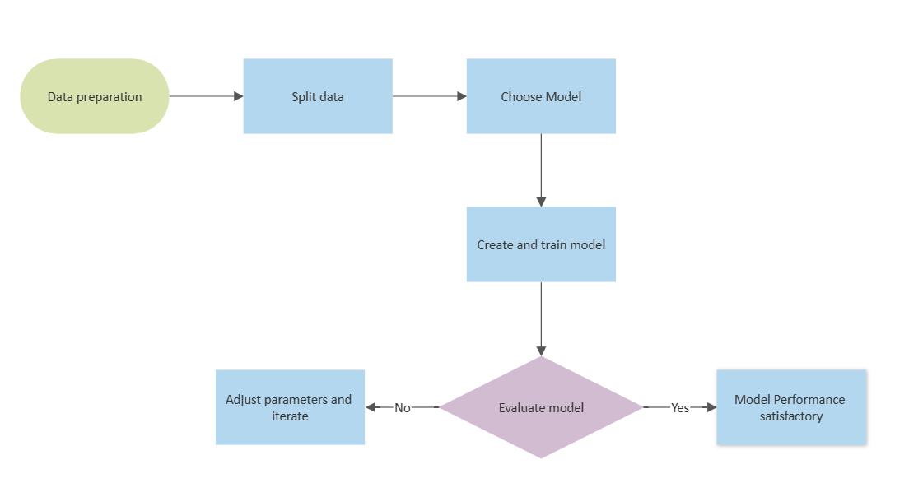
Modelling workflow

Slide 14
Models & Results (1st Round)
Features used: 'avg_taxi_times_arr', 'avg_monthly_arr_delay’, 'flight_distance_category_LONG','flight_distance_category_MEDIUM', 'flight_distance_category_SHORT','arr_hour', 'month_1','month_2', 'month_3', 'month_4', 'month_5', 'month_6', 'month_7','month_8', 'month_9', 'month_10', 'month_11', 'month_12','distance', 'air_time', 'traffic_Not Busy', 'traffic_Moderate', 'traffic_Busy', 'traffic_Very Busy', 'holiday’
Sample size: 150,000
Linear regression, Log regression, Multinomial regression:
Accuracy was between 0.02 – 0.03
Kfolds created results in the same range
Xgboost model had negative values
PCA results were similar, no significant changes
Normalization had no effect

Slide 15
Feature Importance
We increased the number of features which had a positive effect on the R2 for linear regression:
Features added: avg_taxi_times_arr', 'day_of_week', 'avg_hourly_arr_delay', 'avg_mktcarrier_arr_delay', 'avg_airport_arr_delay', 'avg_plane_arr_delay', 'avg_destcity_arr_delay', 'avg_state_arr_delay', 'avg_dow_arr_delay’
Created another model with significantly higher amount of categorical columns and did dimensionality reduction with PCA.
However after running these models it was still relatively low.

Slide 16

Final Model
We decided that we could better predict our models if we categorized arrival delay into sections of: no delay, 5 minute, 15 minute, 30 minute+
We used a blended ensemble model using a voting strategy with base models of: Random Forest Classifier, Logistic Regression, and Gaussian Naïve bayes.
The accuracy of this model was .72%

Slide 17
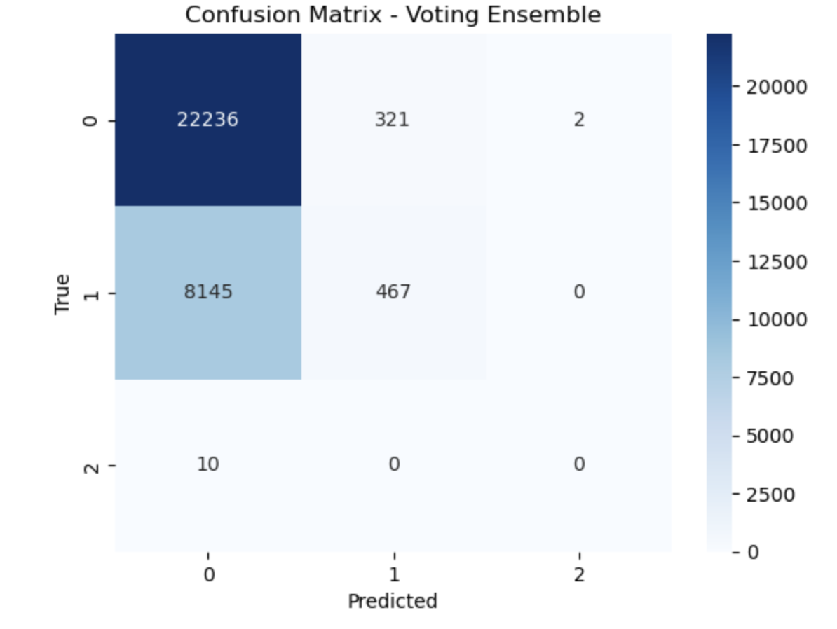
Results:
The data was very imbalanced which lead to a score of .72

Slide 18
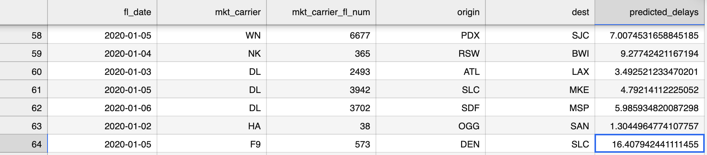
Model predictions with flight test data
Predictions from our linear regression model showed that on 2020/01/05 flight F9 from DEN to SLC will have a higher delay.

Slide 19
Challenges
Loading the datasets: Very large dataset.
Imbalanced data (majority of arrival delays have negative values)
Outliers
Feature engineering:
getting the right features that improve model performance.
Github collaboration conflicts
Memory issues with the models (crashing kernel etc.)
Choosing the right model

Slide 20


