Slide 1
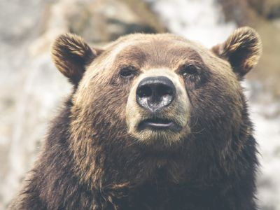
PET STORE
Looking for a new Friend
Check out our Pet Store here
I’m sure you will find what you are looking for
Copyright © By Aremieye Tamaratombra
A Publisher and a Developer

Slide 2
PET CATALOG
Home
Catalog
Cat
Cats are lovely creatures.
Dog
Dogs are carnivorous creatures.
Select

