Slide 1
Human Activity Recognition Using Smartphones Data Set

Slide 2
Goal
To understand in detail about the working of the various classifiers on Human Activity Recognition Dataset

Slide 3
Data Set
UCI link is: https://archive.ics.uci.edu/ml/datasets/Human+Activity+Recognition+Using+Smartphones
Group of 30 volunteers within an age range of 19-48 years participated wearing a smartphone.
Each person performed six activities (SITTING, STANDING, LYING, WALKING, WALKING_UPSTAIRS, WALKING_DOWNSTAIRS)
The six activities as six classes are corresponding to each data point with 561 features.

Slide 4
Approach
Linear Discriminant Analyses (LDA)
Multinomial Logistic Regression
Support Vector Machines (SVM)
KNN

Slide 5
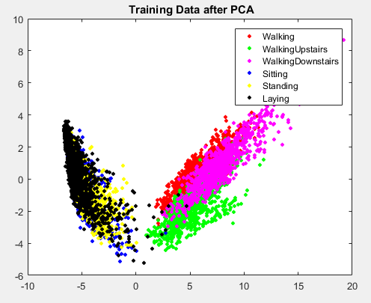

Slide 6
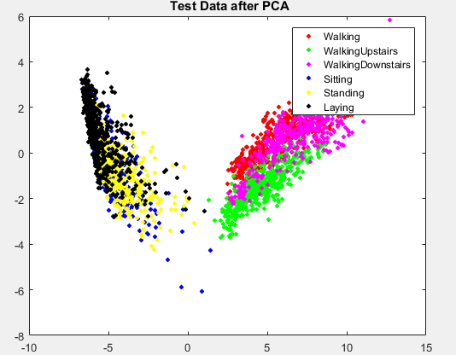

Slide 7
LDA: Confusion Matrix of the classification results on the test data using the LDA classifier
Activity | Walking | Upstairs | Downstairs | Sitting | Standing | Laying | Recall %
Walking | 490 | 6 | 0 | 0 | 0 | 0 | 98.79
Upstairs | 11 | 460 | 0 | 0 | 0 | 0 | 97.66
Downstairs | 1 | 14 | 405 | 0 | 0 | 0 | 96.43
Sitting | 0 | 1 | 0 | 434 | 56 | 0 | 88.39
Standing | 0 | 0 | 0 | 22 | 510 | 0 | 95.86
Laying | 0 | 0 | 0 | 0 | 0 | 537 | 100
Precision % | 97.61 | 95.63 | 100 | 95.18 | 90.11 | 100 | 96.23

Slide 8
Logistic Regression: Confusion Matrix of the classification results on the test data using the Logistic Regression classifier
Activity | Walking | Upstairs | Downstairs | Sitting | Standing | Laying | Recall %
Walking | 494 | 0 | 2 | 0 | 0 | 0 | 99.6
Upstairs | 23 | 448 | 0 | 0 | 0 | 0 | 95.12
Downstairs | 4 | 9 | 407 | 0 | 0 | 0 | 96.9
Sitting | 0 | 4 | 0 | 432 | 55 | 0 | 87.98
Standing | 2 | 0 | 0 | 13 | 517 | 0 | 97.18
Laying | 2 | 0 | 0 | 0 | 0 | 537 | 100
Precision % | 94.46 | 97.18 | 99.51 | 97.08 | 90.38 | 100 | 96.2

Slide 9
KNN: Confusion Matrix of the classification results on the test data using KNN classifier
Activity | Walking | Upstairs | Downstairs | Sitting | Standing | Laying | Recall %
Walking | 486 | 1 | 9 | 0 | 0 | 0 | 97.98
Upstairs | 42 | 426 | 3 | 0 | 0 | 0 | 90.45
Downstairs | 51 | 42 | 327 | 0 | 0 | 0 | 77.86
Sitting | 0 | 4 | 0 | 420 | 67 | 0 | 85.54
Standing | 0 | 0 | 0 | 51 | 481 | 0 | 90.41
Laying | 0 | 0 | 0 | 2 | 1 | 534 | 99.44
Precision % | 83.94 | 90.46 | 96.46 | 88.79 | 87.61 | 100 | 90.74

Slide 10
SVM for 'rbf' kernel Confusion Matrix of classification results on the testdata using SVM classifier(rbf kernel)
Activity | Walking | Upstairs | Downstairs | Sitting | Standing | Laying | Recall %
Walking | 492 | 0 | 4 | 0 | 0 | 0 | 99.19
Upstairs | 17 | 452 | 2 | 0 | 0 | 0 | 95.19
Downstairs | 13 | 29 | 378 | 0 | 0 | 0 | 90
Sitting | 0 | 2 | 0 | 424 | 65 | 0 | 86.35
Standing | 0 | 0 | 0 | 44 | 488 | 0 | 91.73
Laying | 0 | 0 | 0 | 0 | 0 | 537 | 100
Precision % | 94.25 | 93.58 | 98.44 | 90.6 | 88.25 | 100 | 94.03

Slide 11
SVM for 'linear' kernel Confusion Matrix of the classification results on the test data using the SVM classifier (linear kernel)
Activity | Walking | Upstairs | Downstairs | Sitting | Standing | Laying | Recall %
Walking | 492 | 1 | 3 | 0 | 0 | 0 | 99.19
Upstairs | 18 | 451 | 2 | 0 | 0 | 0 | 95.75
Downstairs | 4 | 6 | 410 | 0 | 0 | 0 | 97.62
Sitting | 0 | 2 | 0 | 435 | 54 | 0 | 88.59
Standing | 0 | 2 | 0 | 16 | 516 | 0 | 96.99
Laying | 0 | 0 | 0 | 0 | 0 | 537 | 100
Precision % | 95.72 | 9804 | 98.8 | 96.45 | 90.53 | 100 | 96.4

Slide 12
SVM for 'poly' kernel Confusion Matrix of the classification results on the test data using the SVM classifier (poly kernel)
Activity | Walking | Upstairs | Downstairs | Sitting | Standing | Laying | Recall %
Walking | 491 | 0 | 5 | 0 | 0 | 0 | 98.99
Upstairs | 38 | 424 | 9 | 0 | 0 | 0 | 90.02
Downstairs | 54 | 44 | 322 | 0 | 0 | 0 | 76.67
Sitting | 0 | 4 | 0 | 410 | 77 | 0 | 83.5
Standing | 0 | 1 | 0 | 41 | 490 | 0 | 92.11
Laying | 0 | 0 | 0 | 0 | 0 | 537 | 100
Precision % | 95.53 | 92.17 | 77.59 | 90.91 | 85.96 | 100 | 90.74

Slide 13
Comparison: The table shows the comparison of the classification results on the test data using the training related classifiers.
Classifier | Accuracy | Error Rate
SVM with linear kernel | 96.4 | 3.60
LDA | 96.23 | 3.77
Logistic Regression | 96.2 | 3.80
KNN | 90.74 | 9.26
SVM with linear kernel gives the best performance for all the accuracies and error rates

Slide 14
Note:
SVM with linear kernel being a flexible approach, is capable to reduce overfitting.
SVM with linear kernel performs astonishingly well for this dataset as linear separable data.
But for other different data, it would not have such good performance.

Slide 15
Conclusion:
Discussed and examined various classifiers and their performance in classifying human activities using smartphones.
Found that their accuracies are quite different from each other.
Tested different approaches and algorithms on our dataset.
On changing the kernel, SVM classifier gives different results.
SVM with linear kernel has highest accuracy and KNN has the lowest.
Most of the errors are due to confusion of the activity ‘sitting’ and activity ‘standing’ labels.

Slide 16
Future Work:
We suggest that future authors should focus on creating a more effective classifier for only those classes (sitting and standing)
Focus on having additional features to distinguish these two activities (i.e. sitting from standing) could help in this aspect.

Slide 17
Acknowledgement:
We’ve taken efforts in this project. However, it would not have been possible without the kind support of many individuals. We would like to extend our sincere thanks to all of them. We thank Professor J. Braun and Teaching Assistant Xinzi Sun for their instructions, for their guidance and constant supervision as well as for providing necessary information regarding the project & also for their support in completing the project. My thanks and appreciations also go to all the people who have willingly helped us out with their abilities.

Slide 18
References:
Bishop, C. M., ‘Pattern Recognition and Machine Learning,’ Springer, 2006
Davies, N., Siewiorek, D.P., Sukthankar, R.: Activity-based computing. IEEE Pervasive Computing 7(2) (April 2008) 20-21
.R. Poppe. Vision-based human motion analysis: An overview Computer vision and image understanding, 108(1):4–18, 2007.
N. Ravi, N. Dandekar, P. Mysore, and M. L. Littman. Activity recognition from accelerometer data. In AAAI,volume 5, pages 1541–1546, 2005
J.-L. Reyes-Ortiz, L. Oneto, A. Ghio, A. Sama, D. Anguita, and X. Parra. Human activity ecognition on smartphones with awareness of basic activities and postural transitions.In Artificial Neural Networks and Machine Learning–ICANN 2014, pages 177–184. Springer, 2014
C.-C. Yang and Y.-L. Hsu. A review of accelerometry-based wearable motion detectors for physical activity monitoring. Sensors , 10(8):7772–7788, 2010.
Bao, Ling and Stephen S. Intille. Activity recognition from user-annotated acceleration data, 2004

Slide 19
Questions?

Slide 20
Thank You !

