Slide 1
Hierarchical View-Frustum Culling for Z-buffer Rendering
Tomáš Bubeníček

Slide 2
Contents
What is view frustum culling
Algorithms used
How to speed it up

Slide 3
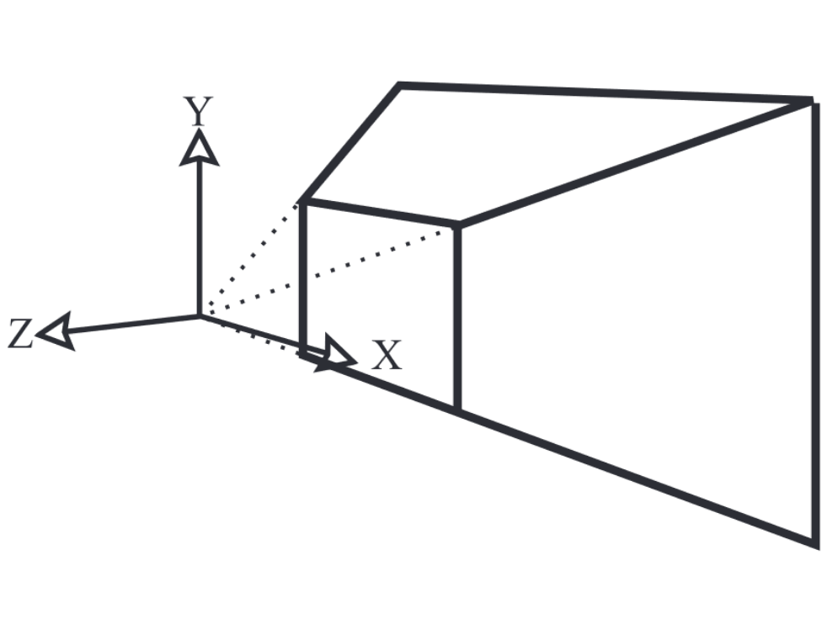
What is frustum culling
Used with rasterization
Removing objects that are outside the visible volume from the rendering process
Saves vertex shader work on the GPU
Visible volume = View frustum
Source: [1]

Slide 4
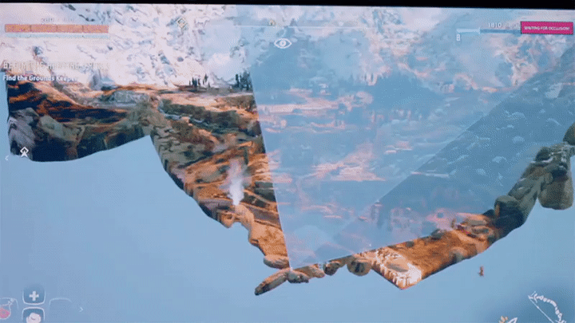
Example
Source: Horizon Zero Dawn – The making of the game (2017)

Slide 5
Hierarchical approach
Using bounding volume hierarchy
3 options when checking a BV vs frustum:
  Inside – render the entire subtree
  Outside – discard the entire subtree
  Intersects – traverse the subtree, render if leaf
We require a fast BV-frustum intersection predicate

Slide 6
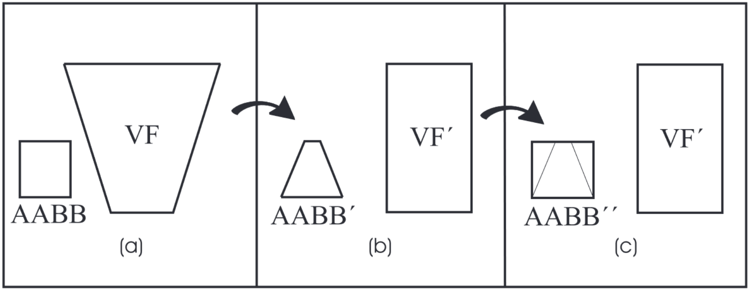
Node-Frustum intersection
One approach:
  Transform all vertices of the node with the projection transform
  Test AABB of the transformed envelope with AABB of the transformed frustum (tested in perspective coordinate system)
  Relatively expensive
    Transform requires 72 multiplications (sped up with SIMD)
    Test requires only 6 comparisons
Source: [1]

Slide 7
Node-Frustum intersection
Different approach:
  Consider frustum as six separate planes
  Requires fast box-plane intersection predicate
  Calculated in world space
  If object is inside the frustum, it is inside all six planes
  Test can correctly end if object is outside just one plane

Slide 8
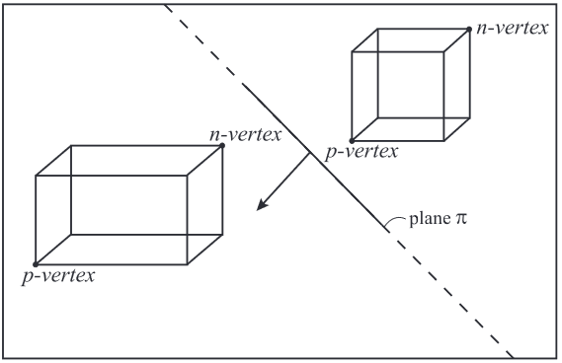
Box-plane intersection
Conservative approximation – Sphere-plane intersection
Fast box plane intersection
  Compare only 2 points instead of 8
    n-vertex (negative-far point)
    p-vertex (positive-far point)
  The points are selected as the points on the diagonal that is closest to the plane normal
    When using AABB, the selection can be done with a lookup table
  Comparing the distances of points from the plane
    If n positive, then outside
    If p negative, then inside
    Else intersects
Source: [1]

Slide 9
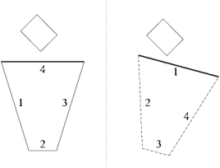
Order of plane tests
The order of planes tested can affect performance
We first want to test planes with high chance of the object being outside
Temporal coherency
  Object is outside a plane in one frame - chance of happening again
  Start the next test with that plane
Source: [2]

Slide 10
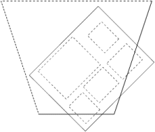
Number of plane tests
When traversing the hierarchy, we don’t need to always check all planes
Plane-masking
  Only check the planes that the parent node intersects
  When recursively traversing, keep a bit mask of which planes to check
Source: [2]

Slide 11
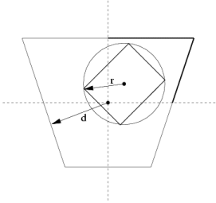
Other possible speedups
Octant test
  If radius of a bounding sphere around the AABB is smaller than smallest distance from frustum center to plane, we can discard three plane tests
Source: [2]

Slide 12
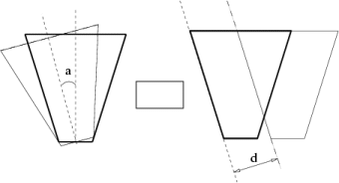
Other possible speedups
Rotation coherency
  Frustum only rotates by less than 180° on x/y/z axis between frames
  For each BV, we can return outside if outside in last frame and their distance to plane increased
Translation coherency
  Frustum only moves between frames
  For each plane, the distance to each BV changes by d
  We compare the distance in last frame with d, if d > dist, then intersection has to be computed
Source: [2]

Slide 13
Recap
View frustum culling is a way of speeding up rasterization
Can be sped up by using hierarchical data structures
Frustum-volume intersection can be computed both in world coordinates and projection coordinates
During the plane intersection tests
  Order of planes matters
  Some planes don’t need to be always tested

Slide 14
Sources
[1] Ulf Assarsson, and Tomas Moller. "Optimized view frustum culling algorithms for bounding boxes." Journal of graphics tools 5.1 (2000): 9-22. Online: http://www.cse.chalmers.se/~uffe/vfc_bbox.pdf
[2] Daniel Sýkora, and Josef Jelínek. "Efficient View Frustum Culling." Central European Seminar on Computer Graphics. 2002. Online: http://old.cescg.org/CESCG-2002/DSykoraJJelinek/index.html
Horizon Zero Dawn – The making of the game (2017). vpro documentary. Online: https://www.youtube.com/watch?v=A0eaGRcdwpo

