Slide 1
Hierarchical View-Frustum Culling for Z-buffer Rendering
Tomáš Bubeníček

Slide 2
Contents
Recap of last presentation
    What is frustum culling
My implementation
My measurements

Slide 3
What is frustum culling?
Limiting the objects which are rasterized to be just the objects that are visible
Saves vertex shader computations

Slide 4
Frustum culling using BVH
Check AABB of node
  If inside, draw all children
  If outside, discard all children
  If intersects, recurse deeper
Fast AABB-frustum incidence test
  Split into 6 AABB-plane tests
  If one fails, the test fails

Slide 5
My implementations
SDL2, OpenGL
Several simple scenes to test with
  Scene contains objects + camera animation

Slide 6
Measurements
Both Nvidia (desktop) and Intel (integrated) GPUs
Measurements
  FPS, Frametime
  # of draw calls
  GL_TIME_ELAPSED – Actual time to draw on GPU
  CPUtime – Time to traverse + driver calls
  Traversaltime – time to traverse w/o driver calls
10 measurements for each scene, averaged

Slide 7
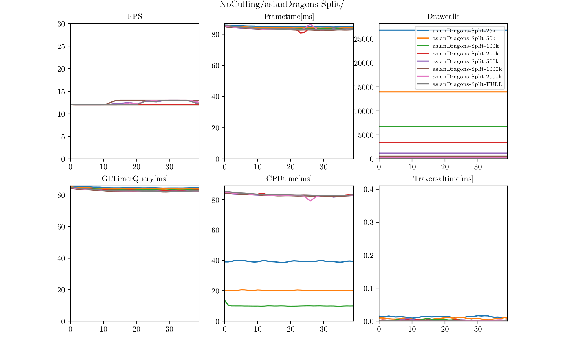
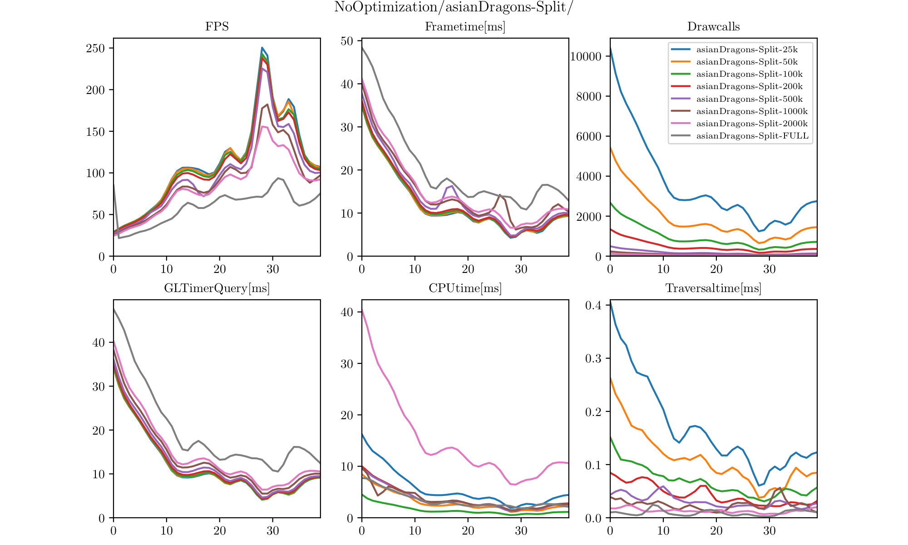
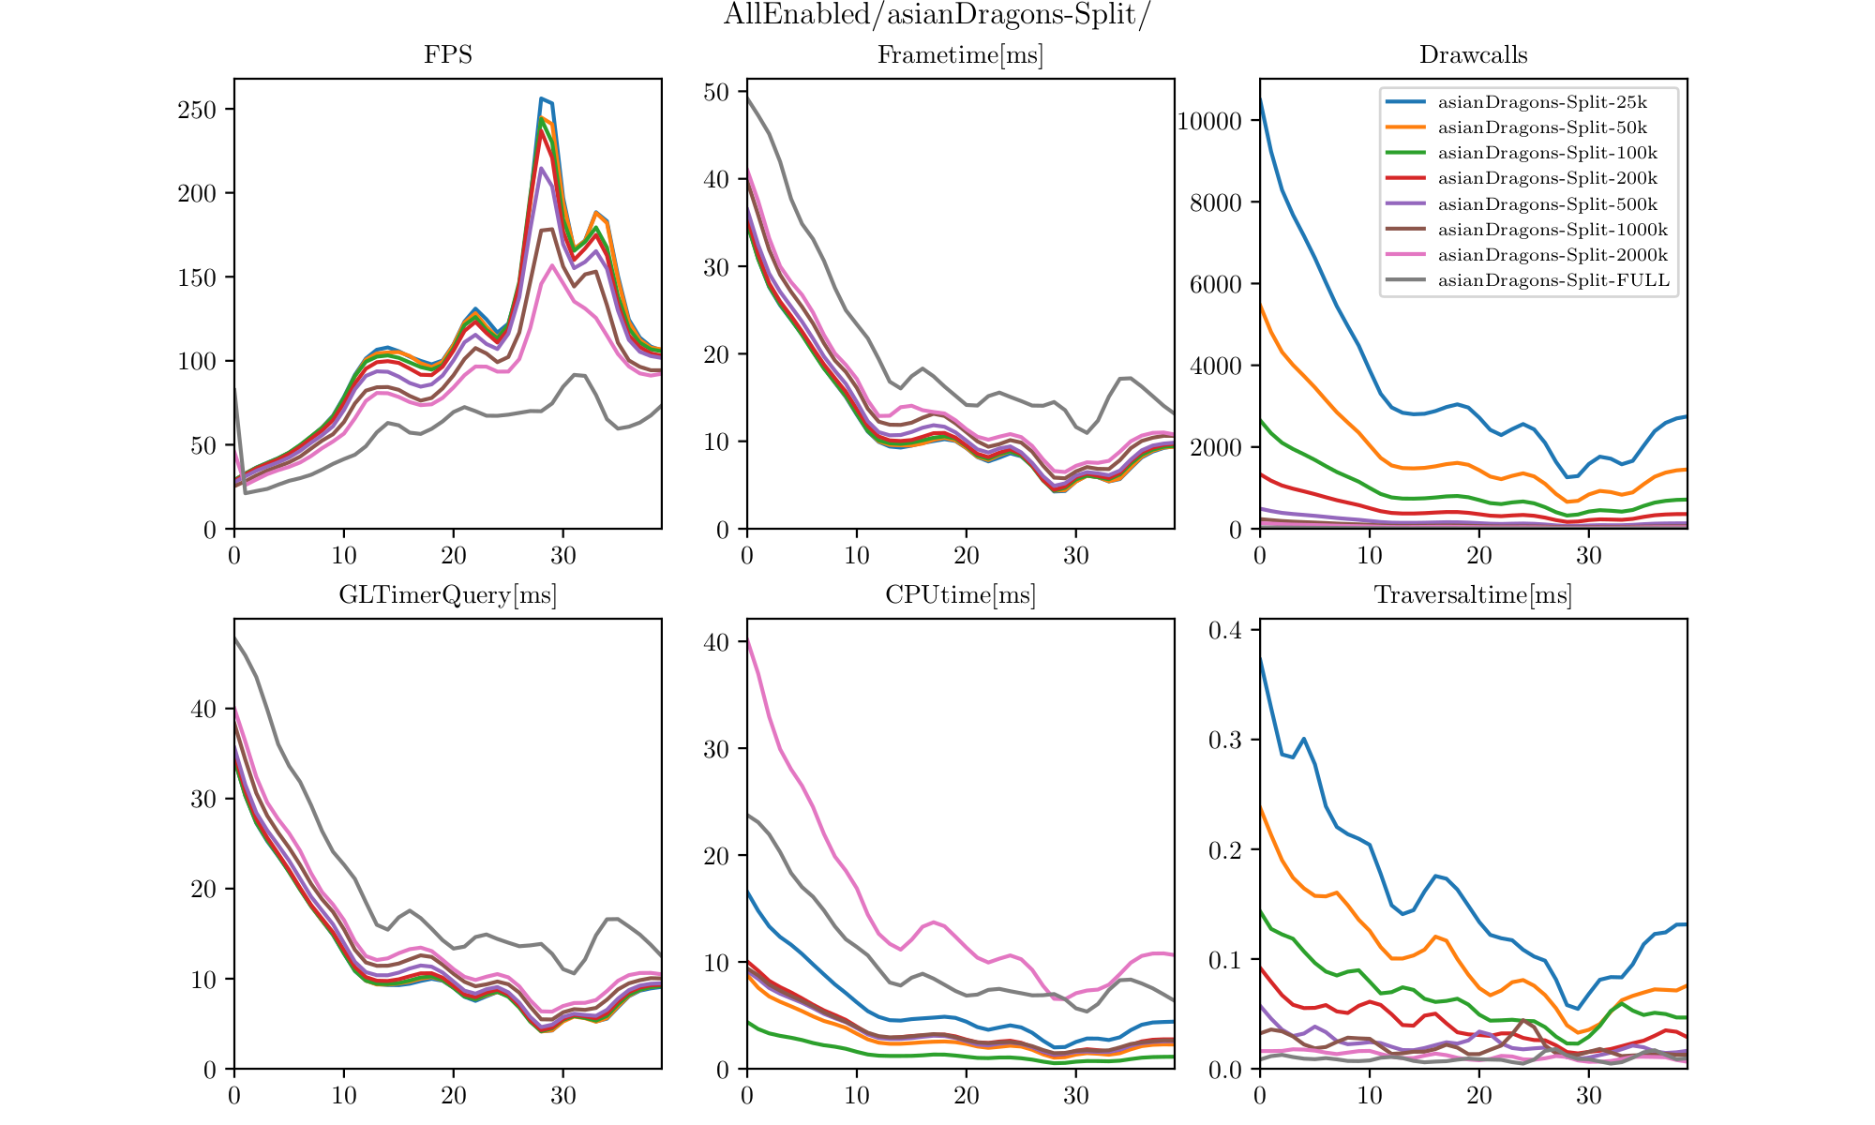
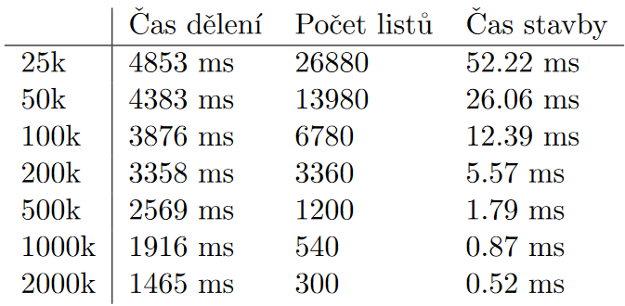
Measurements – Scene 1
60 instances of asianDragon.obj (7.6M tris each) spaced out
Windows 10
Nvidia GTX 1070

Slide 8
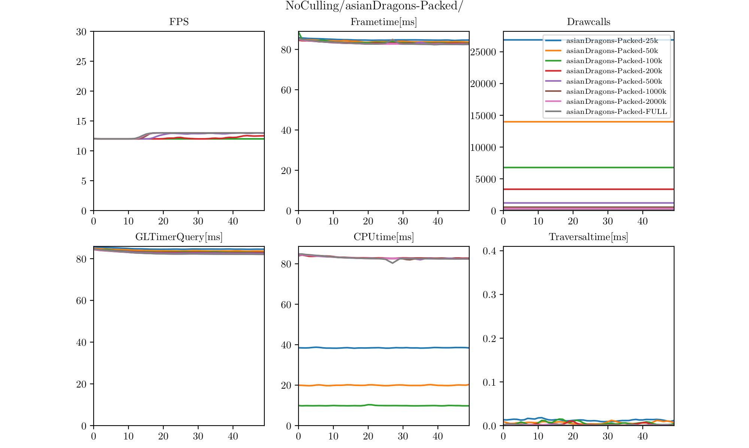
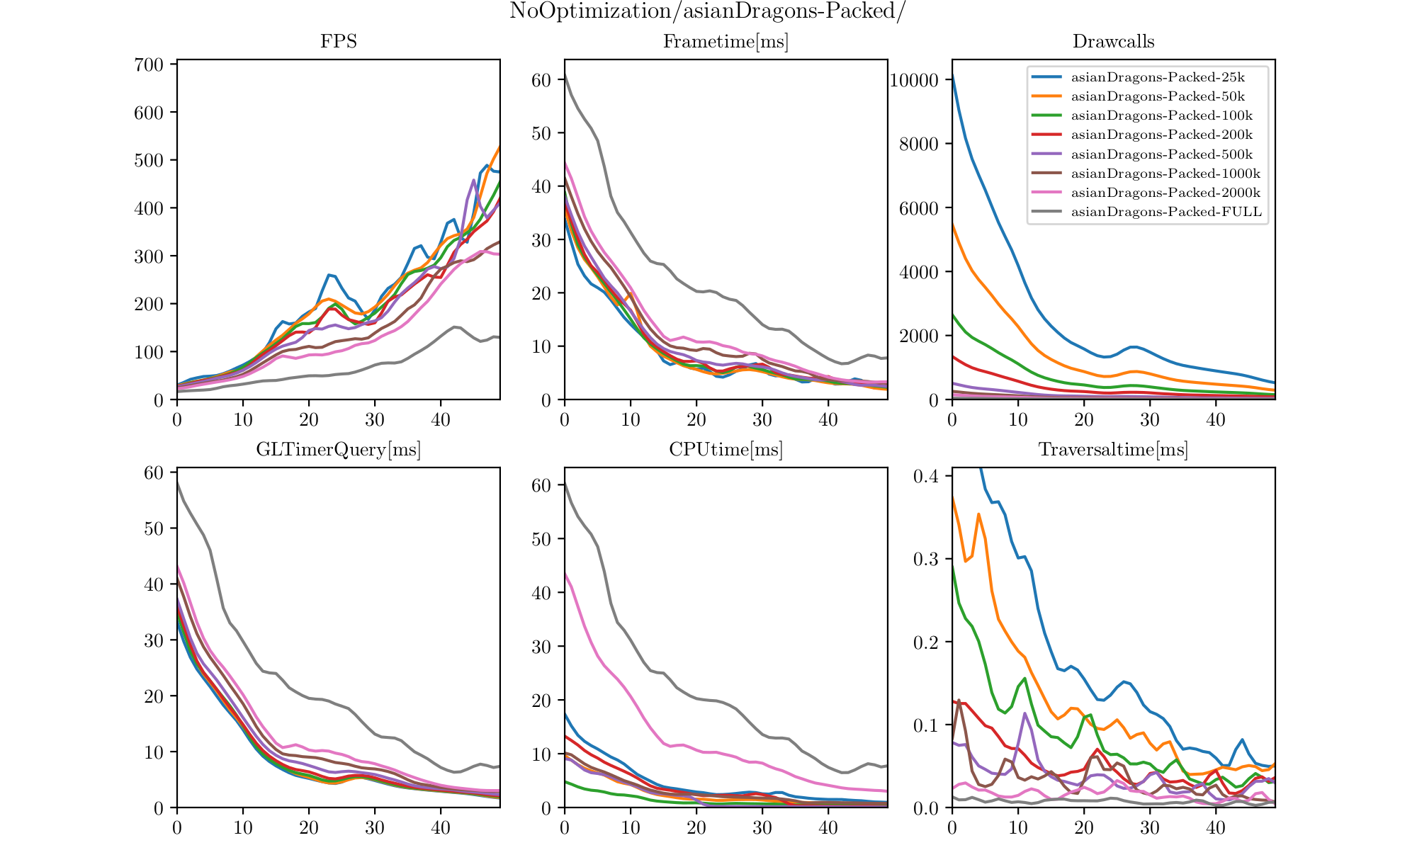
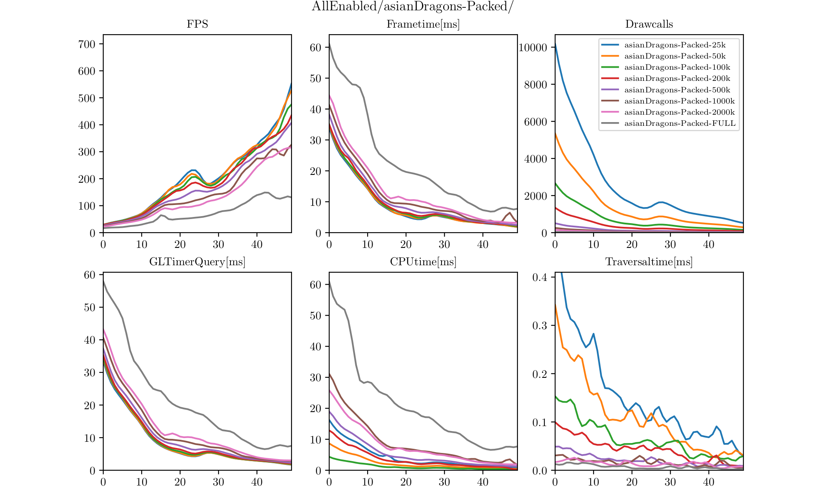
Measurements – Scene 2
60 instances of asianDragon.obj (7.6M tris each) packed
Windows 10
Nvidia GTX 1070

Slide 9
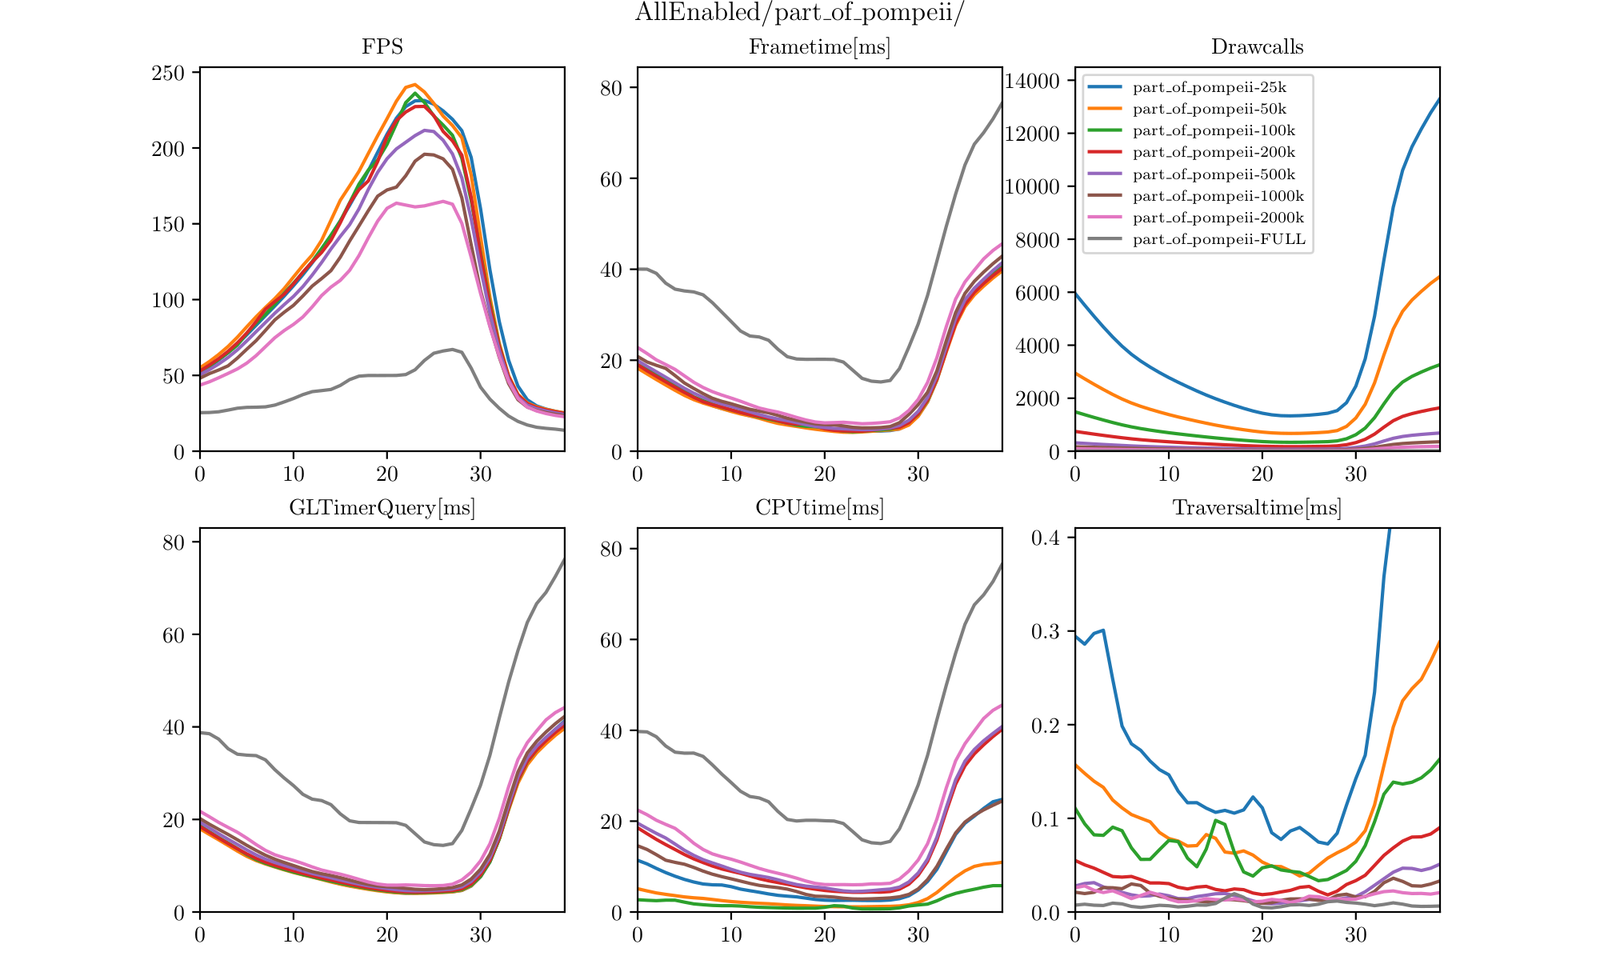
Measurements – Scene 3
20 instances of part_of_pompeii (16M tris each), flat scene
Windows 10
Nvidia GTX 1070

Slide 10
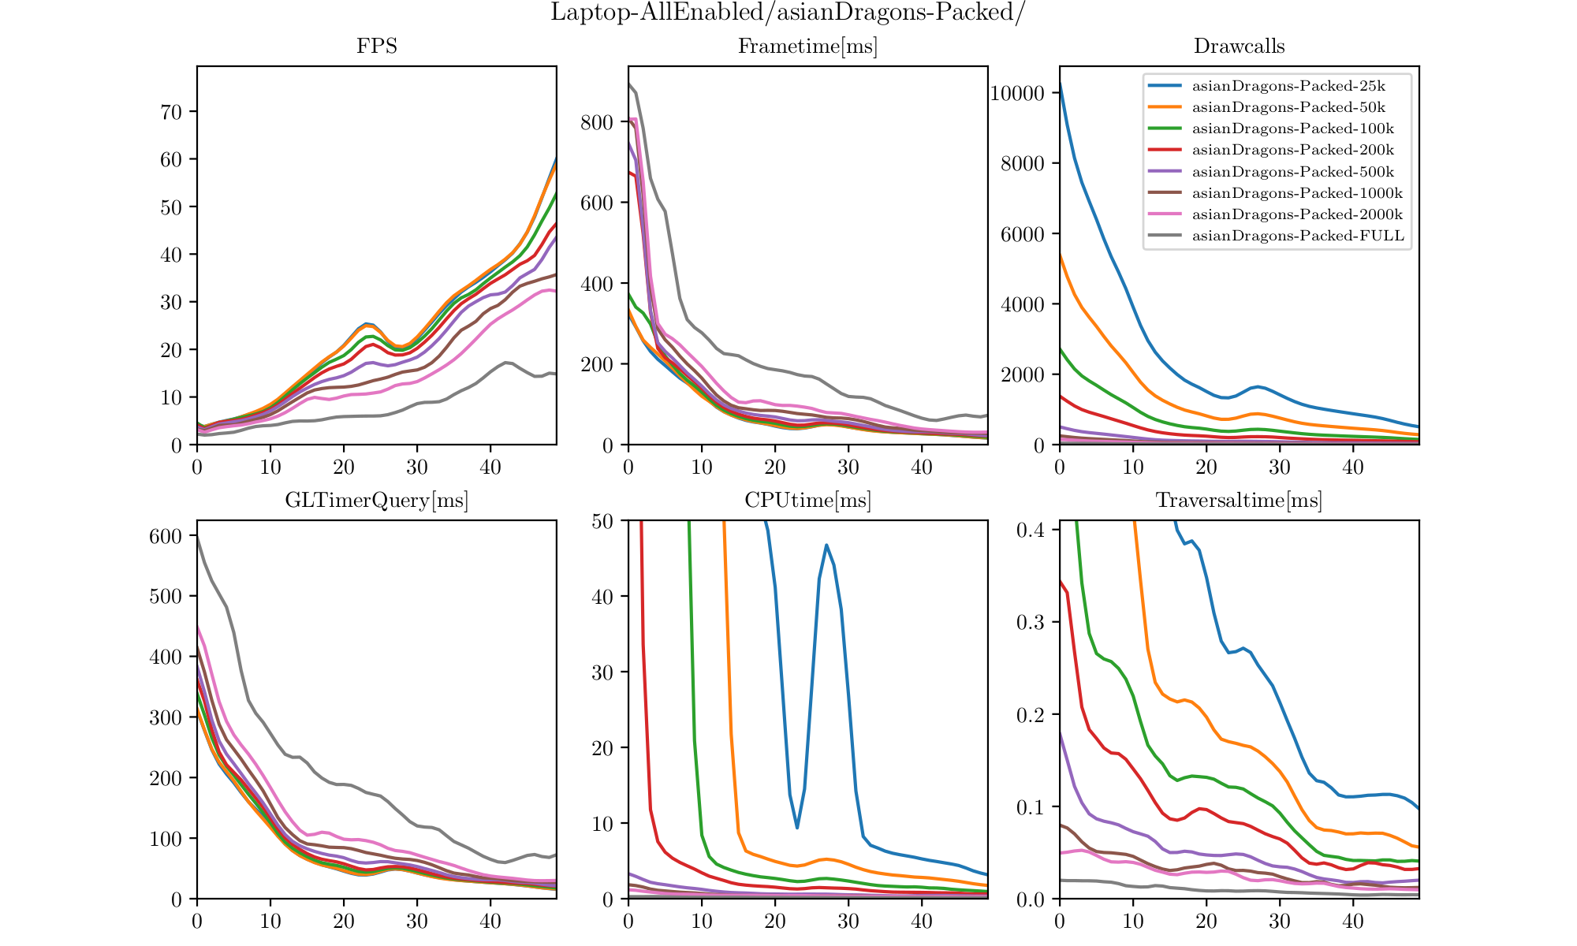
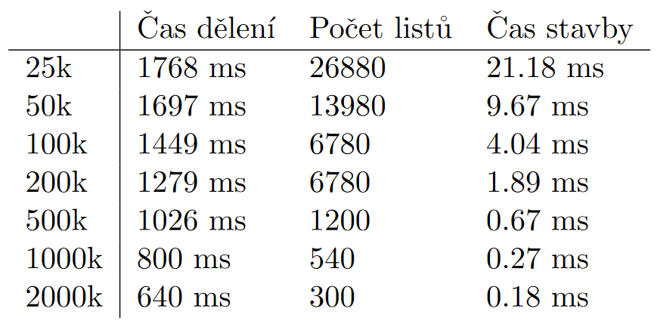
Measurements – Laptop
60 instances of asianDragon.obj (7.6M tris each) spaced out
Linux
Intel UHD Graphics 620

Slide 11
Summary
Frustum culling very effective
  Further optimalization of AABB-frustum test with modern HW not needed (profiler shows 97% of time spent in OpenGL calls)
Number of triangles in leaves of BVH should be picked based on target platform
  (Nvidia drivers cause a lot of overhead)

Slide 12
Sources
[1] U. Assarsson and T. Moller. Optimized view frustum culling algorithms for bounding boxes. Journal of graphics tools, 5(1):9–22, 2000.
[2] G. Gribb and K. Hartmann. Fast extraction of viewing frustum planes from the world-view-projection matrix. Online document, 2001.
[3] D. S`ykora and J. Jelınek. Efficient view frustum culling. In Central European Seminar on Computer Graphics, 2002.

