Slide 1

Fault3r
Honours Programme Delft

Slide 2
Intro & Outline
Background
The Core
AES & It’s DFA Attack
Fault3r
Evaluation
Simple Adder
Breaking AES
jump and link based faults
Demo
Conclusion

Slide 3
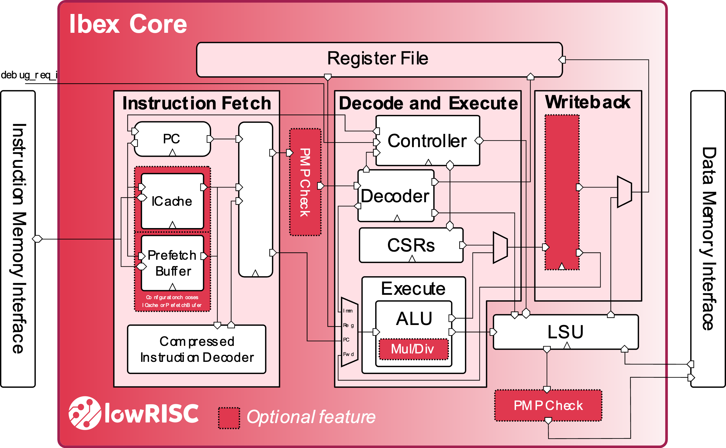
Background – The Core
Production Quality Core
RV32IC 2 Stage pipeline (IF + ID/EX)
Optional features disabled
Well documented
SystemVerilog
Simple SoC available

Slide 4
Background - The Core
Memory
request / grant / valid protocol

Slide 5

Background - The Core
Memory
request / grant / valid protocol
instr_rdata_i injection point, instruction word returned to the core

Slide 6
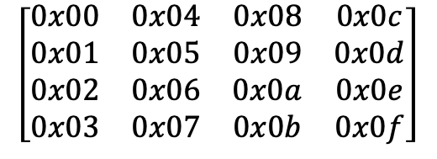
Background - AES
SubBytes: Byte substitution through an S-Box lookup table
ShiftRows: cyclic row rotation
$$\left[\begin{matrix}0x00 & 0x04 & 0x08 & 0x0c \\ 0x01 & 0x05 & 0x09 & 0x0d \\ 0x02 & 0x06 & 0x0a & 0x0e \\ 0x03 & 0x07 & 0x0b & 0x0f\end{matrix}\right]$$
Repeated 10x for AES128
MixColumns: GF(2^8) column mixing, omitted in the last round
4x4 State Matrix
AddRoundKey: XOR with the round key derived from the original key

Slide 7
Background – AES DFA Attack
Inject a single-byte fault at the input of the ninth MixColumns
MixColumns spreads it across exactly 4 bytes of the state - and into 4 known ciphertext positions
For each of those 4 positions, sweep all 256 candidates for the round-10 key byte and keep only those consistent with both the faulted and reference ciphertext
Fault the same column 4 times and intersect the candidate sets - this narrows each key byte down to one value
Repeat across all 4 columns to recover the full round-10 key k₁₀
Run the key schedule in reverse to obtain the original key k

Slide 8
Fault3r
instr_rdata_i
instr_gnt_i
Memory
instr_addr_o
FAULT3R
FAULT: master enable, transparent passthrough when deasserted
FAULT_ADDR: target instruction address to intercept
FAULT_INSTR: replacement instruction word
FAULT_ADDR_CNT: visit count before fault becomes active
FAULT_REPEAT: repeat fault on every subsequent visit if asserted

Slide 9
Evaluation - Simple Adder
C Source
int main(int argc, char *argv[]) {
int a = 4;
int b = 7;
int c = a + b;
return 0;
}
Fault3r Configuration:
FAULT: 1’b1
FAULT_ADDR: 0x0000212c
FAULT_INSTR: 0x00100793
FAULT_ADDR_CNT: 8’d0
FAULT_REPEAT: 1’b0
Compiled
Result
212c: 00400793 li a5,4
2130: fef42623 sw a5,-20(s0)
212c: 00100793 li a5,1
2130: fef42623 sw a5,-20(s0)

Slide 10
Evaluation - Breaking AES
1. Locate Injection Points In Simulation & Inject Faults
Target | FAULT | FAULT_ADDR | FAULT_INSTR | FAULT_COUNT | FAULT_REPEAT | mem[32812][31:0] | mem[32813][31:0] | mem[32814][31:0] | mem[32815][31:0]
/ | / | / | / | / | / | 0x29c3505f | 0x571420f6 | 0x402299b3 | 0x1a02d73a
Byte 0, Col 0 | 1 | 0x2728 | 0xfe040023 | 8 | 0 | 0x80c3505f | 0x57142092 | 0x4022c8b3 | 0x1acdd73a
Byte 1, Col 0 | 1 | 0x2758 | 0xfe0400a3 | 8 | 0 | 0x5bc3505f | 0x57142047 | 0x4022c7b3 | 0x1a4ed73a
Byte 2, Col 0 | 1 | 0x2788 | 0xfe040123 | 8 | 0 | 0xfac3505f | 0x571420e1 | 0x402221b3 | 0x1a81d73a
Byte 3, Col 0 | 1 | 0x27b8 | 0xfe0401a3 | 8 | 0 | 0x8dc3505f | 0x5714204d | 0x40224db3 | 0x1a6bd73a
Byte 4, Col 1 | 1 | 0x2734 | 0xfe040223 | 8 | 0 | 0x2930505f | 0x0e1420f6 | 0x4022996e | 0x1a02703a
Byte 5, Col 1 | 1 | 0x2764 | 0xfe0402a3 | 8 | 0 | 0x2959505f | 0x5d1420f6 | 0x40229985 | 0x1a02df3a
Byte 6, Col 1 | 1 | 0x2794 | 0xfe040323 | 8 | 0 | 0x294c505f | 0xf31420f6 | 0x40229953 | 0x1a02bf3a
Byte 7, Col 1 | 1 | 0x27c4 | 0xfe0403a3 | 8 | 0 | 0x29e7505f | 0x691420f6 | 0x40229940 | 0x1a02f53a
Byte 8, Col 2 | 1 | 0x2740 | 0xfe040423 | 8 | 0 | 0x29c3055f | 0x573320f6 | 0xbb2299b3 | 0x1a02d7a2
Byte 9, Col 2 | 1 | 0x2770 | 0xfe0404a3 | 8 | 0 | 0x29c3275f | 0x573d20f6 | 0x162299b3 | 0x1a02d795
Byte 10, Col 2 | 1 | 0x27a0 | 0xfe040523 | 8 | 0 | 0x29c32f5f | 0x57f320f6 | 0x632299b3 | 0x1a02d733
Byte 11, Col 2 | 1 | 0x27d0 | 0xfe0405a3 | 8 | 0 | 0x29c3345f | 0x571620f6 | 0xef2299b3 | 0x1a02d71f
Byte 12, Col 3 | 1 | 0x274c | 0xfe040623 | 8 | 0 | 0x29c35070 | 0x5714a4f6 | 0x400799b3 | 0x9302d73a
Byte 13, Col 3 | 1 | 0x277c | 0xfe0406a3 | 8 | 0 | 0x29c350b6 | 0x571452f6 | 0x40ae99b3 | 0xbb02d73a
Byte 14, Col 3 | 1 | 0x27ac | 0xfe040723 | 8 | 0 | 0x29c35062 | 0x57147ff6 | 0x405899b3 | 0x9d02d73a
Byte 15, Col 3 | 1 | 0x27dc | 0xfe0407a3 | 8 | 0 | 0x29c35058 | 0x5714caf6 | 0x408a99b3 | 0xa702d73a

Slide 11
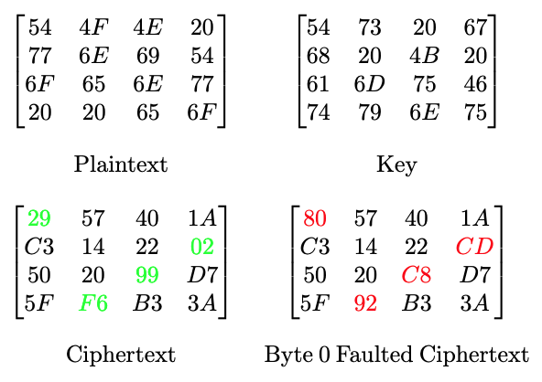
Evaluation - Breaking AES
Python Script

Slide 12
Evaluation - jump and link based faults
Memory Scanning: search memory for a zero-filled region large enough to hold the custom payload plus a return jump.
Payload Insertion: writes the user-supplied instruction sequence into this identified region.
Return Linking: appends a jal instruction to the payload, pointing back to FAULT_ADDR + 4 to ensure execution resumes immediately after the injected fault without corrupting the core's return address register.
Redirection: script generates a jal instruction targeting the new payload.

Slide 13
DEMO

Slide 14
Conclusion
Configurable single instruction fault injection achieved.
Successful DFA on AES128.
JAL-based faults allowing larger fault payloads.
Report Available.
Reflections:
Wrong approach at the start.
Did end up learning a lot and this opened me a path to other projects.
Could potentially add UART, move Python script to PS side and have it run on hardware as a next step.

