Slide 1
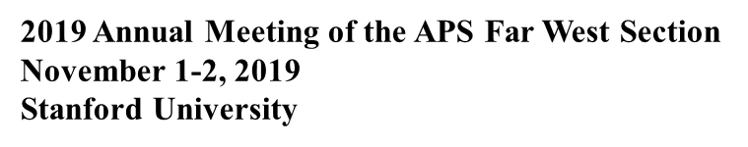
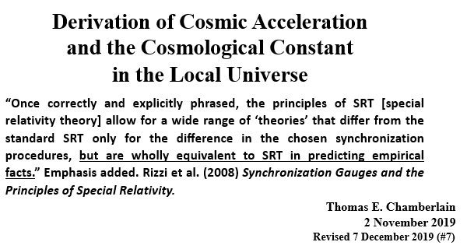

Slide 2
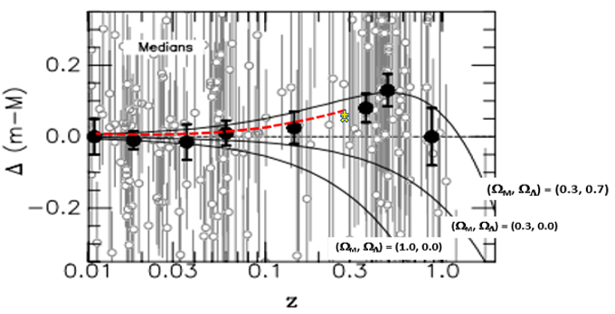
2019 Annual Meeting of the APS Far West Section November 1-2, 2019 Stanford University
SUPERNOVA MAGNITUDES—THEORY vs MEASUREMENTS

Slide 3
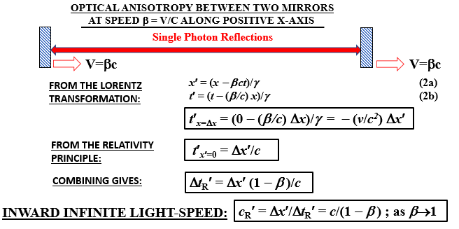
2019 Annual Meeting of the APS Far West Section November 1-2, 2019 Stanford University

Slide 4
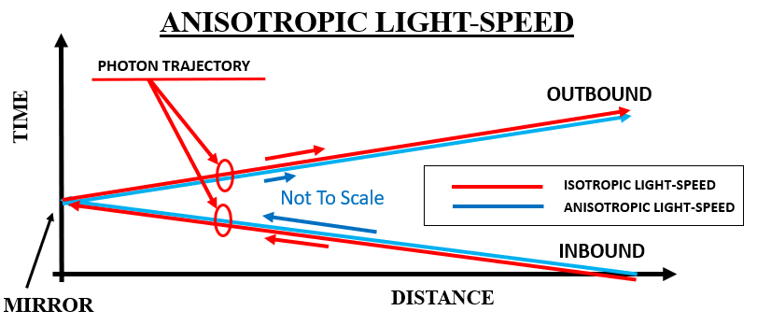
2019 Annual Meeting of the APS Far West Section November 1-2, 2019 Stanford University

Slide 5
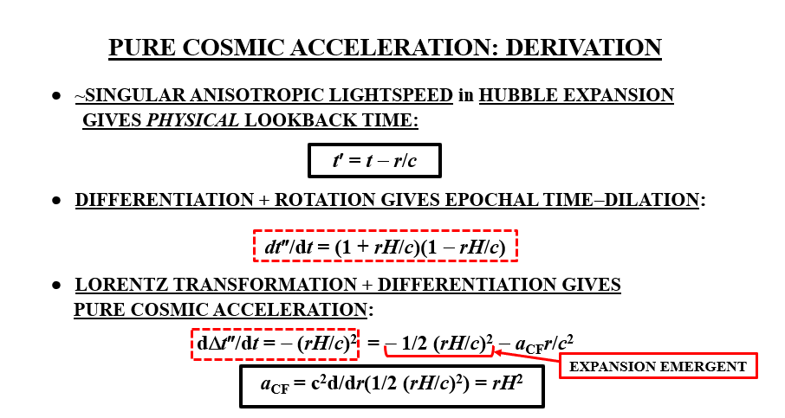
2019 Annual Meeting of the APS Far West Section November 1-2, 2019 Stanford University

Slide 6
SUPERNOVA MAGNITUDES—THEORY vs MEASUREMENTS

Slide 7
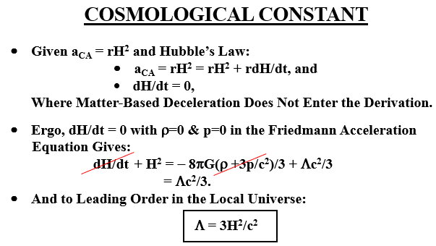

Slide 8
