Slide 1
Harris Corner Detector
Team #8
陳昱銓 陳冠豪 楊焌佑
https://github.com/yqchenee/ACA_21S_final

Slide 2
Outline
Introduction
System & Algorithms
Optimization & Experimental Result
Conclusion

Slide 3
Outline
Introduction
System & Algorithms
Optimization & Experimental Result
Conclusion

Slide 4
Introduction
Feature extraction is a common technique in computer vision and machine learning application.
Harris corner detector is a method to extract features of corners in the image.
In this project, we exploit parallel computation to accelerate the process of harris corner detector

Slide 5
Introduction
We use Xilinx Vivado HLS to implement hardware design.
Hardware can be deployed on PYNQ-Z2 board.
We explore some optimization methods.
Our target spcification: performance(latency) and precision
We try to keep calculation error low enough and optimize performance as much as possible

Slide 6
Outline
Introduction
System & Algorithms
Optimization & Experimental Result
Conclusion

Slide 7
System Overview
Harris Corner Detector Kernel
host sent image
Acquire image(at most 1920*1080)
AXI-stream
CPU computation using python API(for testing)
Show results and performance
host recieve result
AXI-stream
Host

Slide 8
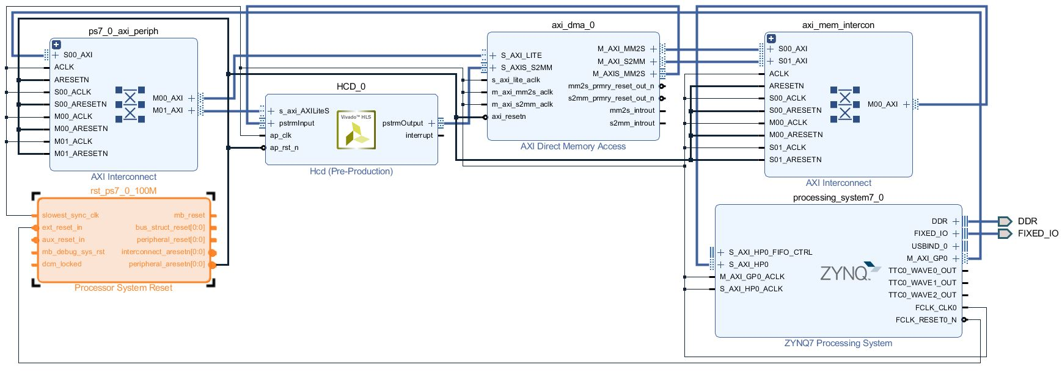
PL Block Diagram

Slide 9

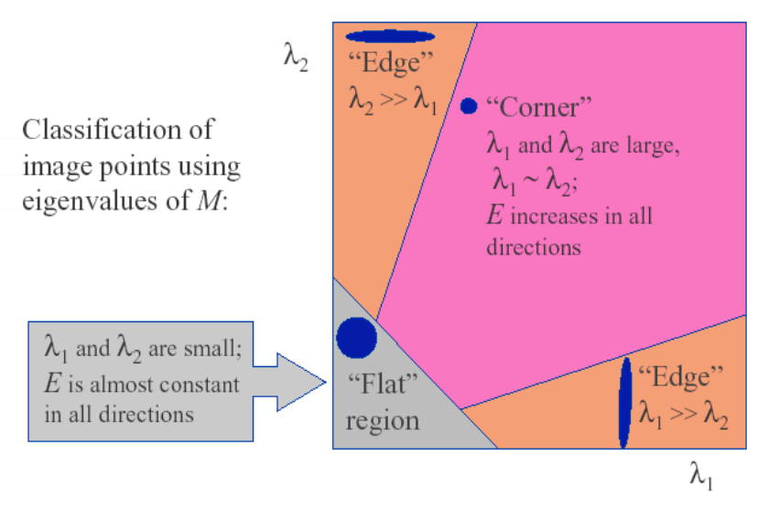
Harris Corner Detector Algorithm
Harris Corner Detector
Kernel
input image
Image filter
gaussianBlur
Ix, Iy
gradients on x, y direction
RGB to grayscale
Image filter to blur image
Calculate Ix, Iy and matrix M
calculate det(M), trace(M) and response R
Thresholding and
Find local maxima

Slide 10
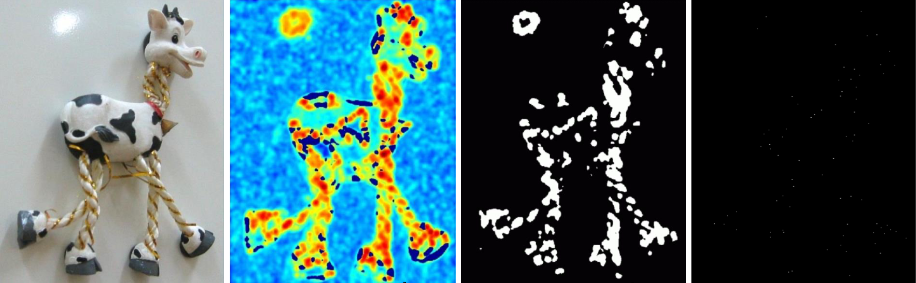
Harris Corner Detector Example
original image
response
thresholding
local maxima
image filter
& matrix operation
(final result)

Slide 11
Outline
Introduction
System & Algorithms
Optimization & Experimental Result
Conclusion

Slide 12
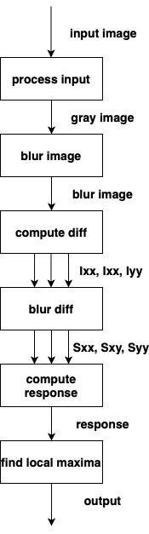
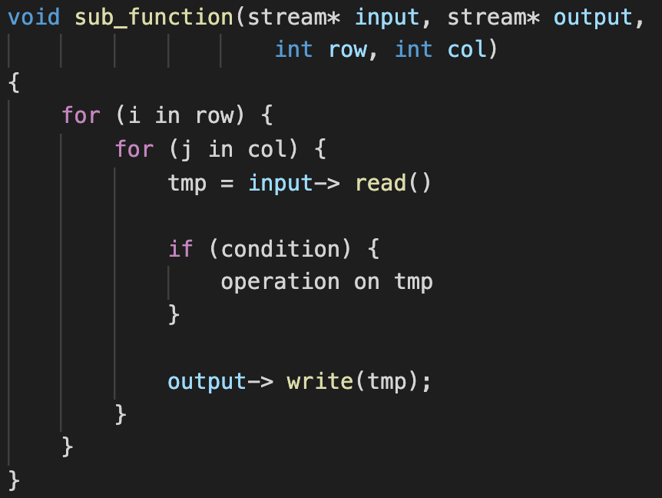
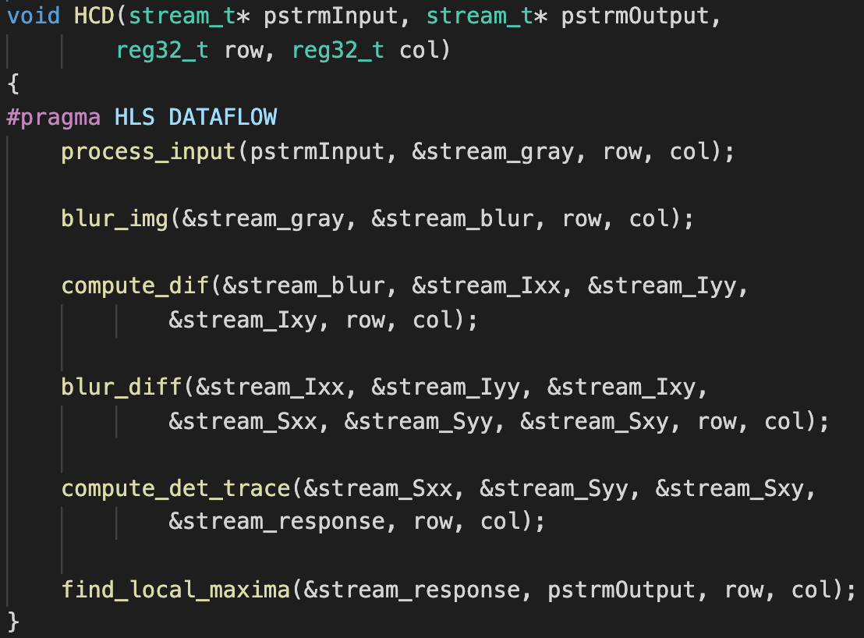
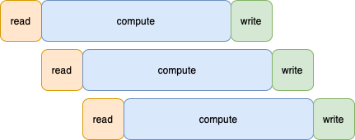
Optimize top function (HCD kernel)
HCD
HLS pragma Dataflow
Make the functions operate in parallel
to achieve high throughput

Slide 13
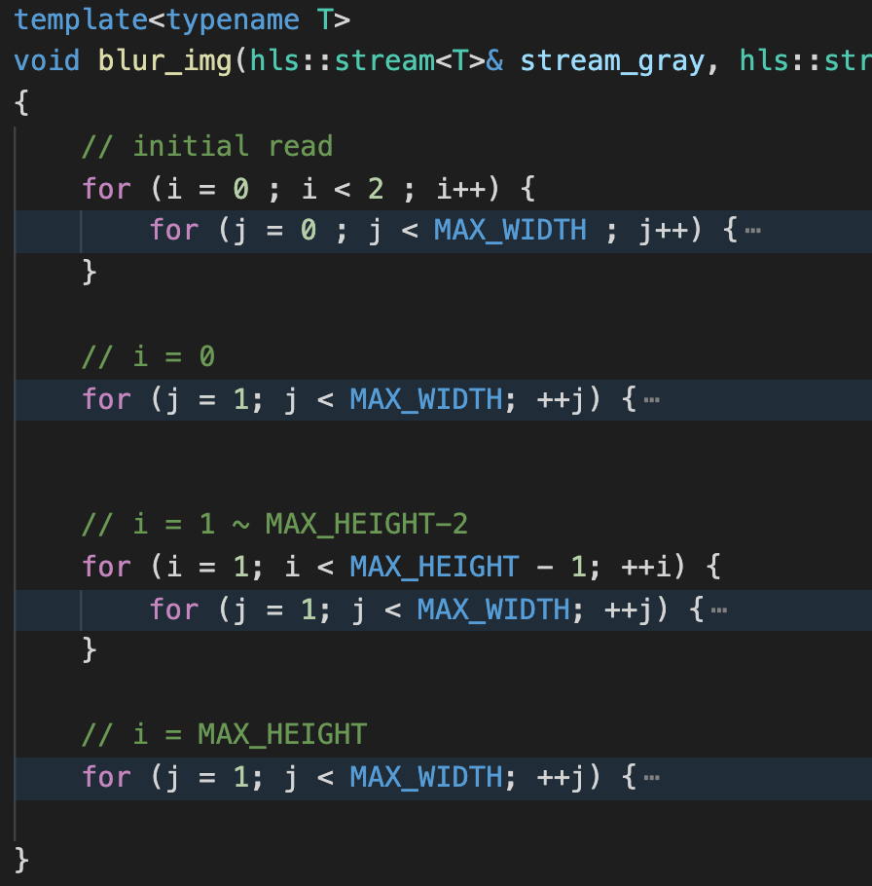
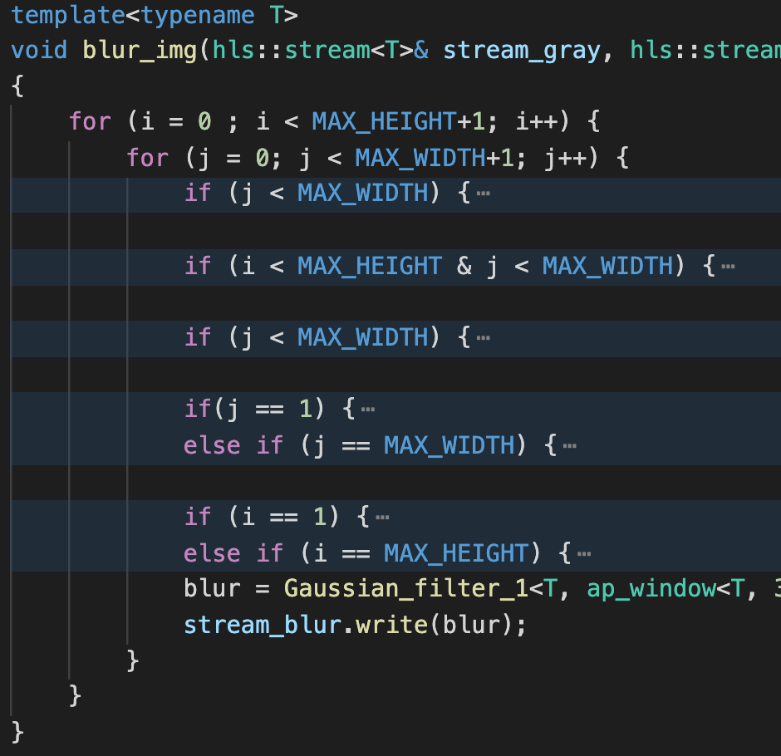
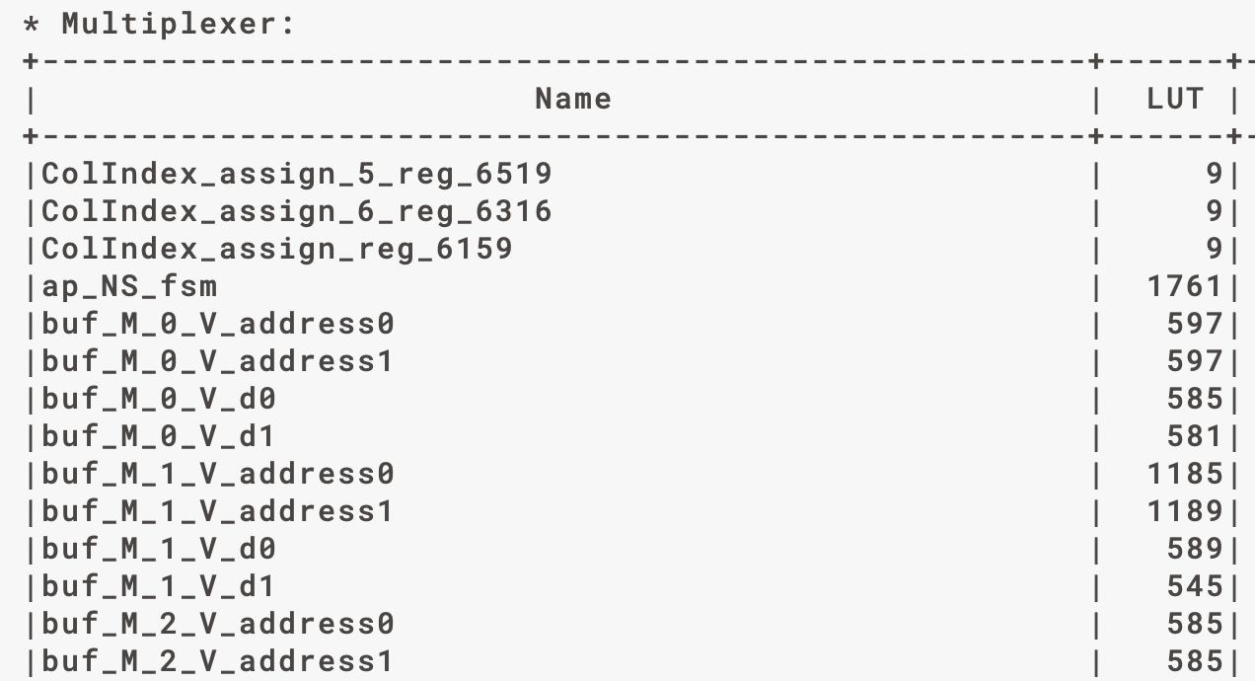
Optimization inside sub-functions
Reduce resources usage
Merge all loops into one loop to reduce the number
of unexpectable states in finite-state machine
 | FF | LUT
before | 4735 | 14867
after | 2120 | 3763

Slide 14
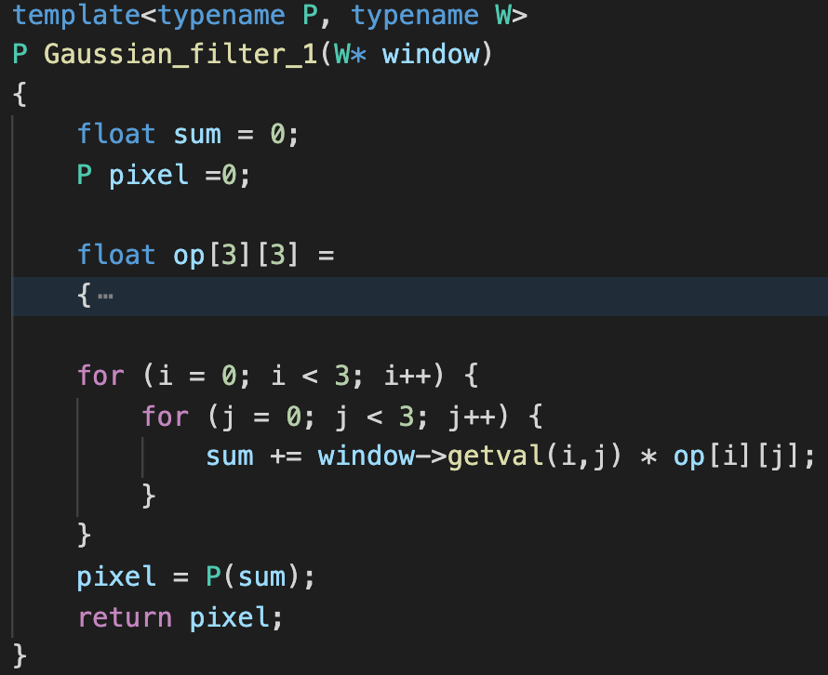
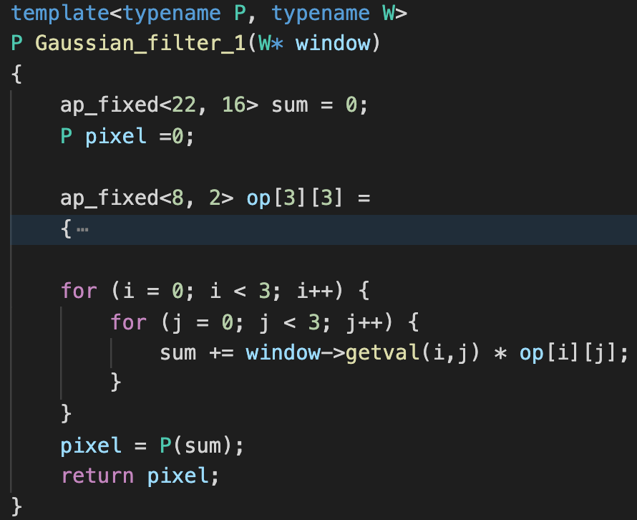
Optimization inside sub-functions
Using ap_fixed instead of floating point
Improve both utilization and timing
float operations consume
a lot of time and resources
Inside functions
blur image (gaussian blur)
compute response
 | latency (cycle) | FF | LUT
float | 159 | 960 | 1803
ap_fixed | 33 | 60 | 245

Slide 15
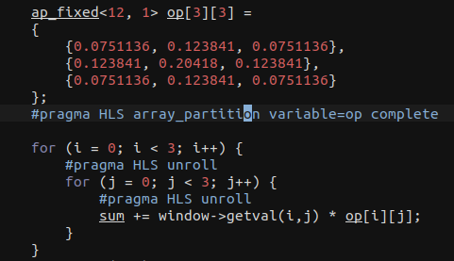
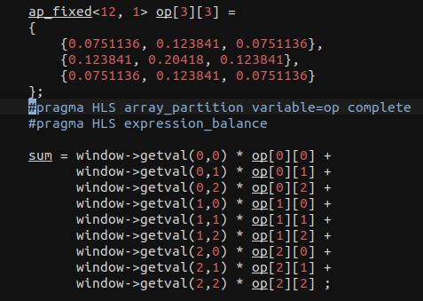
Array Partition- Gaussian Blur (Compute weighted sum of a window)
Complete partition window and const array
Entire loop can be unrolled
Expand entire loop
Reduce one cycle compared to unrolled loop

Slide 16
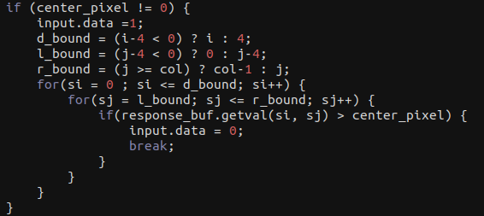
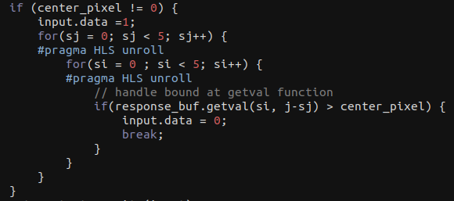
Loop Unrolling - local maxima (Find local maximum on a 5*5 region)
Condiser border condiction
Origin version that can’t be unrolled
Revised version that can be unrolled

Slide 17
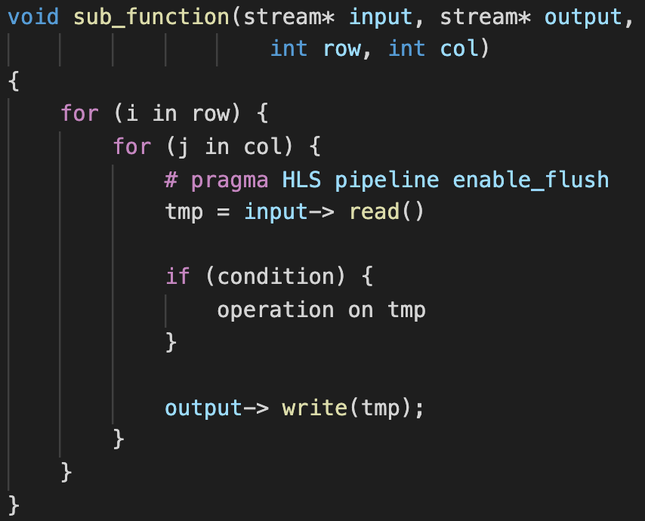
Optimization inside sub-functions
Improve timing in all sub-functions
all functions have the following structures
use pipeline to enhance the throughput

Slide 18
 | latency |  |  | utilization
 | Synthesis report | Run time 1 (256*256) | Run time 2 (1920*1080) | BRAM_ 18k | DSP48E | FF | LUT
no pragma | 58 ms | 46.96 ms [1] | 1472 ms [1] | 120 | 26 | 4433 | 11199
unroll | 5.290 ms | 5.860 ms [1] | 171.5 ms [1] | 80 | 92 | 9299 | 16640
pipeline + unroll | 2.663 ms | 3.316 ms [1] | 83.51 ms [1] | 80 | 127 | 16725 | 18057
CPU runtime |  | 235 ms [2] | 2425 ms [2]
[1] run under pynq
[2] run with python under Intel(R) Xeon(R) CPU E5-2650 v2 @ 2.60GHz

Slide 19
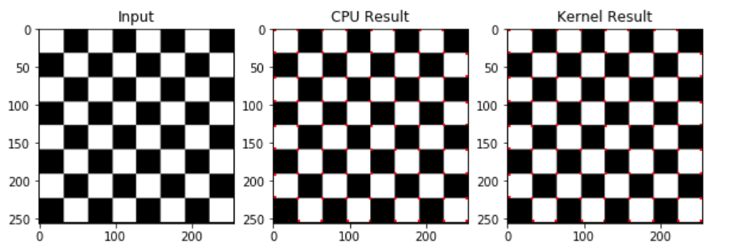
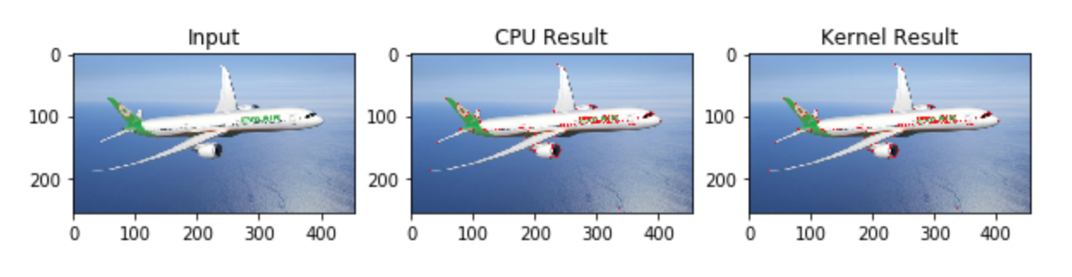
Experimental results

Slide 20
Outline
Introduction
System & Algorithms
Optimization & Experimental Result
Conclusion

Slide 21
Conclusion
We use Xilinx tools to implement Harris Corner Detector into hardware design.
Optimize the hls code to meet the resource constraint and shorten the latency.
Deploy our design on PYNQ-Z2 board.
Kernel function speed up over 30x compare to CPU.

