Slide 1

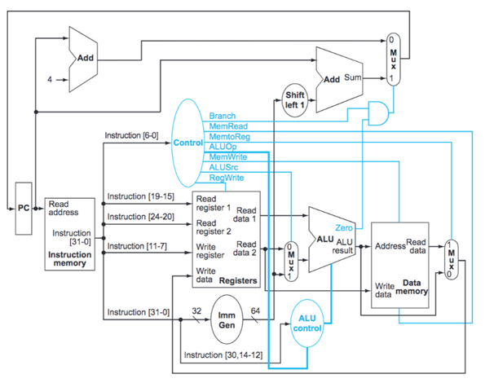


PC_nxt
0
11
10
1
00
PC+4
[Arithmetic, …]
ALUState
PC+(ImmOut <<1)
[JAL, BEQ, … ]
PCControl
0
00
0
01
10
4
11
JALR
ready
valid
multDiv
mode

Slide 2
PC_nxt
00
R
SCYCLE
0
PC+4
[Arithmetic, …]
ALUState
PC+(ImmOut <<1)
[JAL, BEQ, … ]
PCControl
1
0
0
0
00
4
JALR
ready
0
valid
multDiv
mode

Slide 3
PC_nxt
00
I
SCYCLE
0
PC+4
[Arithmetic, …]
ALUState
PC+(ImmOut <<1)
[JAL, BEQ, … ]
PCControl
1
0
0
1
00
4
JALR
ready
0
valid
multDiv
mode

Slide 4
PC_nxt
01
B
SCYCLE
0
PC+4
[Arithmetic, …]
ALUState
PC+(ImmOut <<1)
[JAL, BEQ, … ]
PCControl
1
0
0
0
00
4
JALR
ready
0
valid
multDiv
mode

Slide 5
PC_nxt
00
LI
SCYCLE
0
PC+4
[Arithmetic, …]
ALUState
PC+(ImmOut <<1)
[JAL, BEQ, … ]
PCControl
1
0
1
1
01
4
JALR
ready
0
valid
multDiv
mode

Slide 6
PC_nxt
00
S
SCYCLE
0
PC+4
[Arithmetic, …]
ALUState
PC+(ImmOut <<1)
[JAL, BEQ, … ]
PCControl
0
1
0
1
00
4
JALR
ready
0
valid
multDiv
mode

Slide 7
PC_nxt
00
U
SCYCLE
0
PC+4
[Arithmetic, …]
ALUState
PC+(ImmOut <<1)
[JAL, BEQ, … ]
PCControl
1
0
0
1
10
4
JALR
ready
0
valid
multDiv
mode

Slide 8
PC_nxt
J
10
SCYCLE
0
PC+4
[Arithmetic, …]
ALUState
PC+(ImmOut <<1)
[JAL, BEQ, … ]
PCControl
1
0
0
1
4
11
JALR
ready
0
valid
multDiv
mode

Slide 9
PC_nxt
JI
11
SCYCLE
0
PC+4
[Arithmetic, …]
ALUState
PC+(ImmOut <<1)
[JAL, BEQ, … ]
PCControl
1
0
0
1
4
11
JALR
ready
0
valid
multDiv
mode

Slide 10
PC_nxt
1
00
MCYCLE
MCYCLE
PC+4
[Arithmetic, …]
ALUState
PC+(ImmOut <<1)
[JAL, BEQ, … ]
PCControl
1
0
0
0
00
4
JALR
ready
1
mode
0: MUL
1: DIV
valid
multDiv

