Slide 1

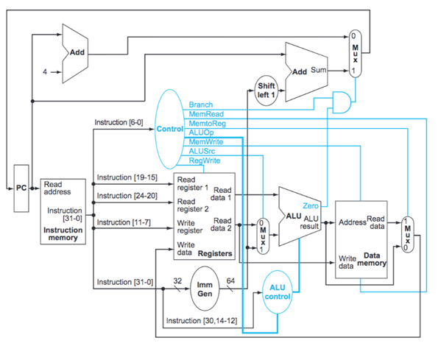

PC_nxt
PC+4
[Arithmetic, …]
ALUState
PC+(ImmOut <<1)
[JAL, BEQ, … ]
PCControl
00
01
10
4
11
JALR
ready
valid
multDiv
mode

