Slide 1


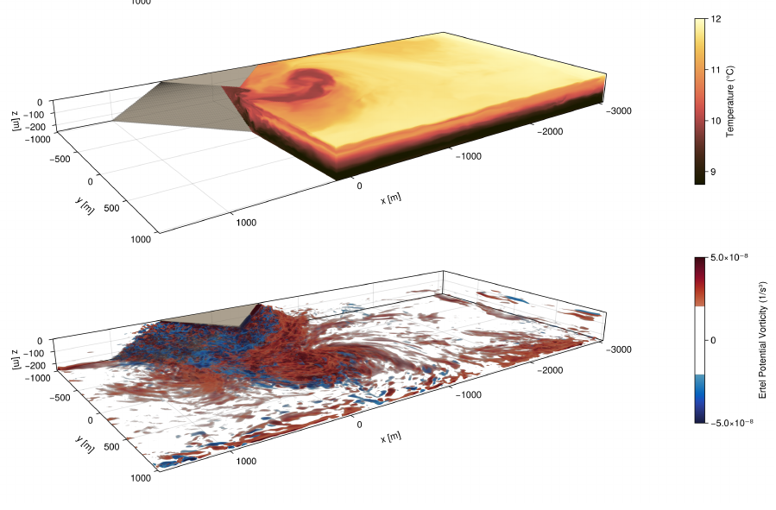

A brief intro to the Oceananigans ecosytem
Tomás Chor
Department of Atmospheric and Oceanic Science, University of Maryland
2026-06-18
tchor@umd.edu

Slide 2

Google “Tomas Chor github” go to repositories git clone git@github.com:tomchor/oceananigans_tut cd oceananigans_tutorial_20260618 julia -t2 (or julia –project -t2)
]add Oceananigans
The commands above will:
  Clone the tutorial repo and cd into it
  Download Oceananigans
  Compile whatever needs compiling

Slide 3


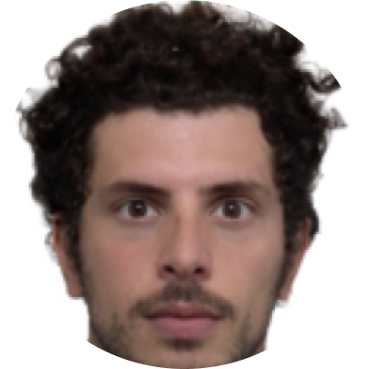






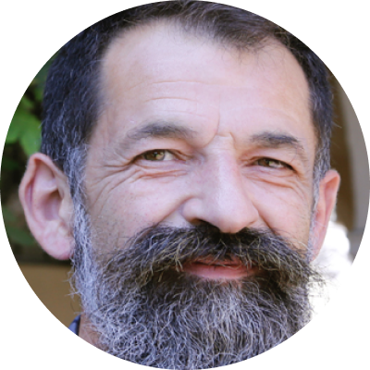
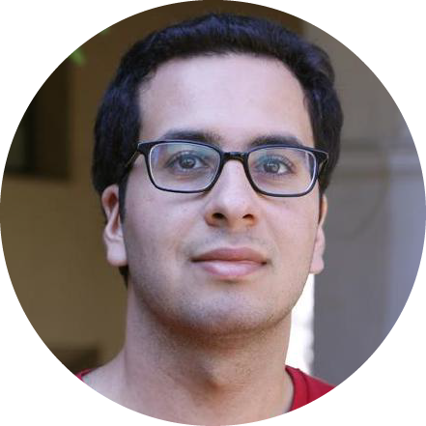

(Most of) the Oceananigans community
Navid Constantinou
Gregory Wagner
Simone Silvestri
Chris Hill
Sid Bishnu
John Marshall
Jago Strong-Wright
Tomas Chor
Francis Poulin
Jean-Michel Campin
Ali Ramadhan
Raffaele Ferrari

Slide 4
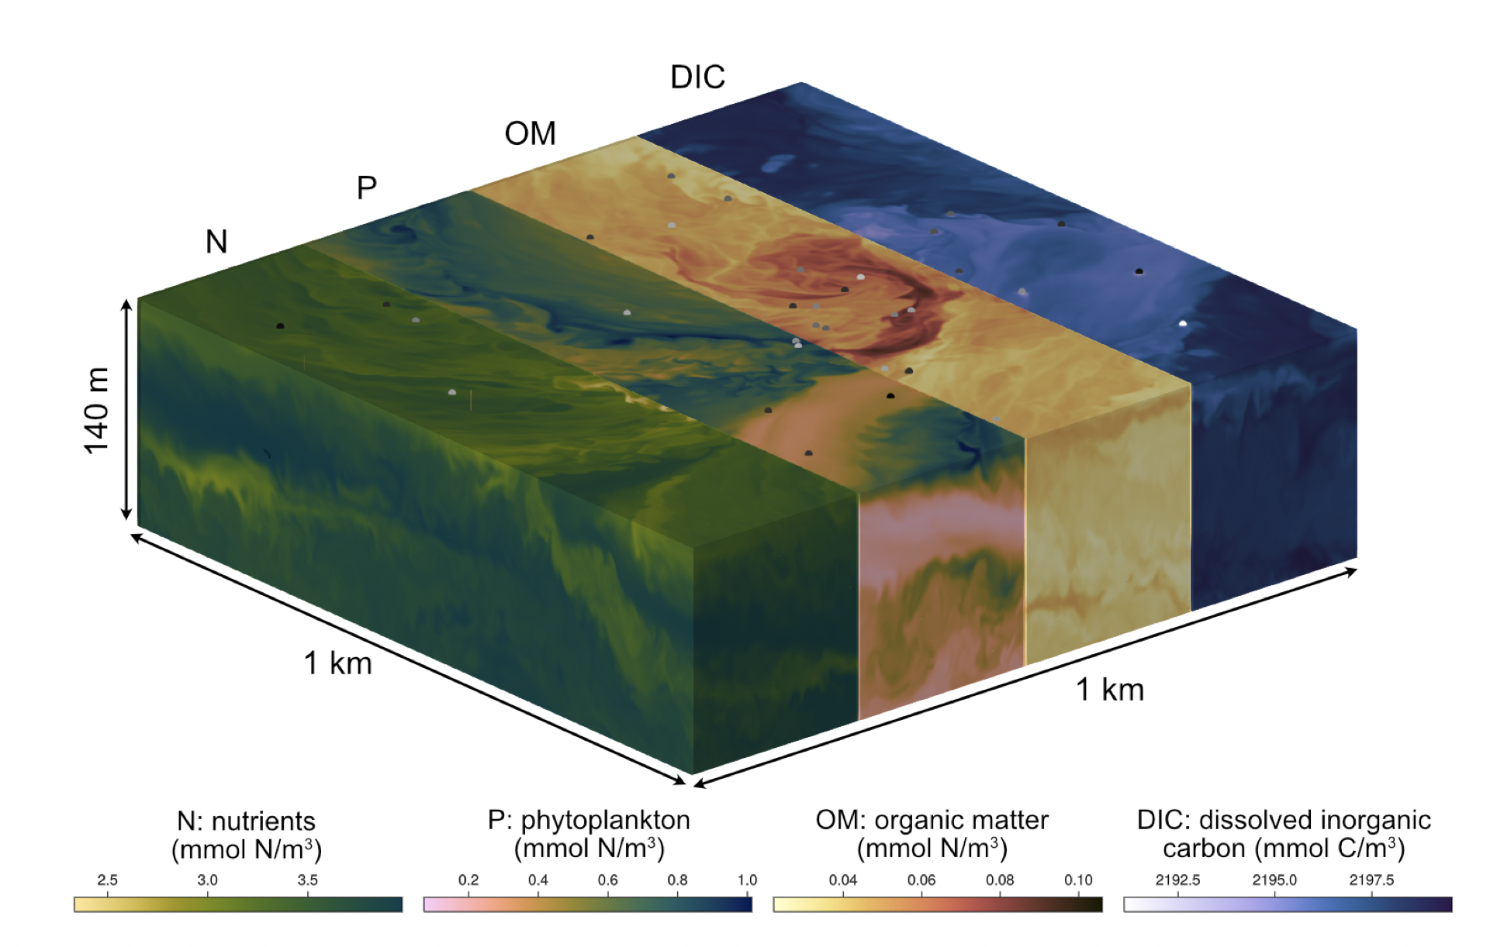
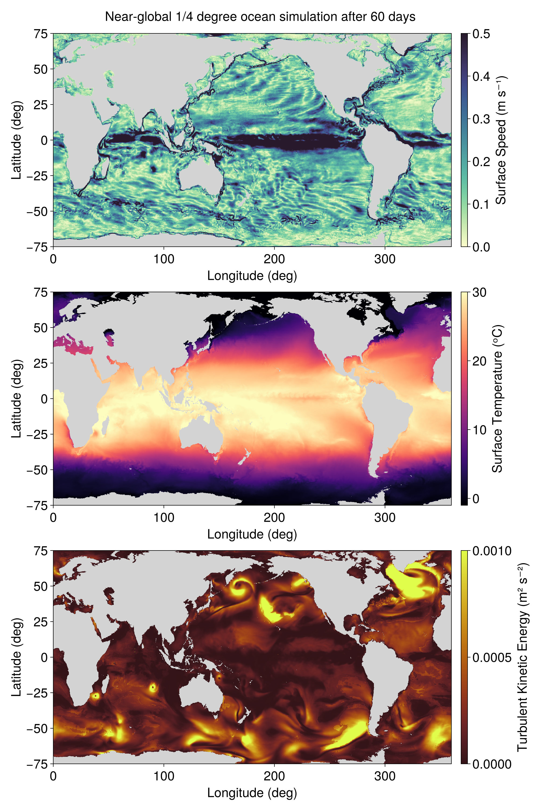
Extensions to Oceananigas
OceanBioME.jl
  BGC for marine carbon dioxide removal
ClimaOceanBiogeochemistry.jl
  BGC for climate predictions
ClimaSeaIce.jl
  Sea-ice models
ClimaOcean.jl
  Global simulations + sea-ice coupling
Oceanostics.jl
  Ready-to-use complex diagnostics
Strong-Wright et al. (2023), JOSS

Slide 5
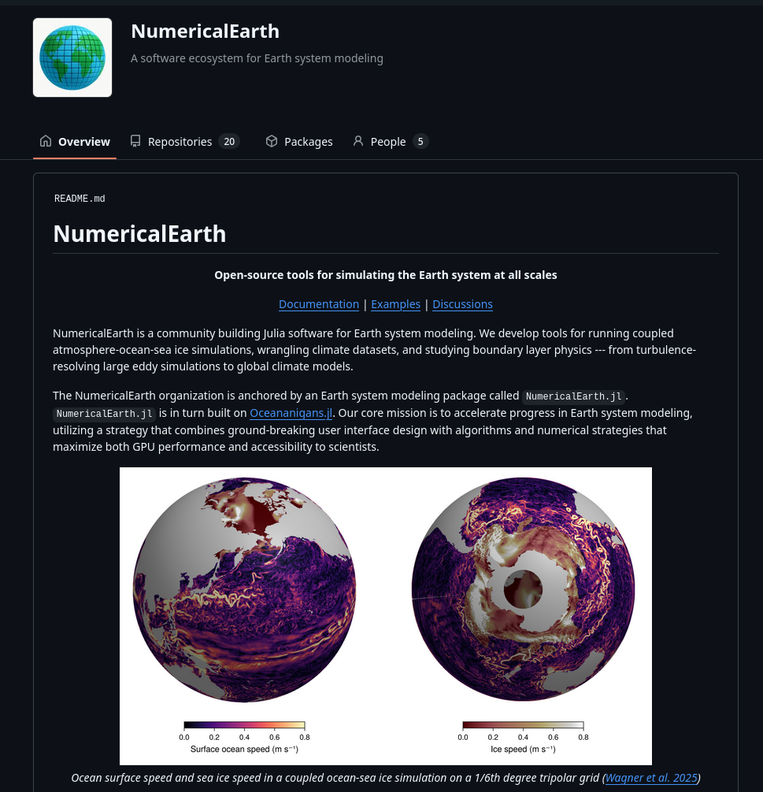
Growing ecosystem
NumericalEarth.jl
  Oceananigans.jl→ocean
    + Oceananigans add-ons
  Breeze.jl →atmosphere
  Terrarium.jl →land

Slide 6
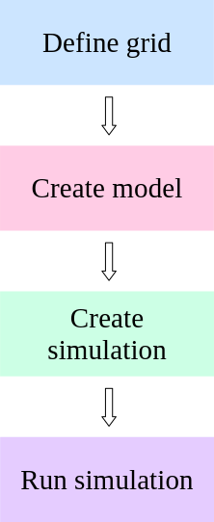
Our approach to user interface:
Using Oceananigans should
  be intuitive
  be simple
  be readable
  not use multiple-languages

Slide 7
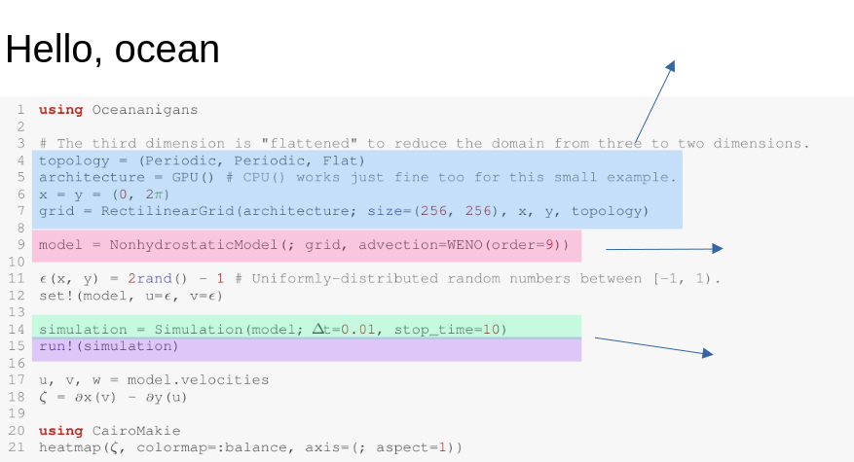
Create grid
Create grid
Create model
Create and run
simulation

Slide 8
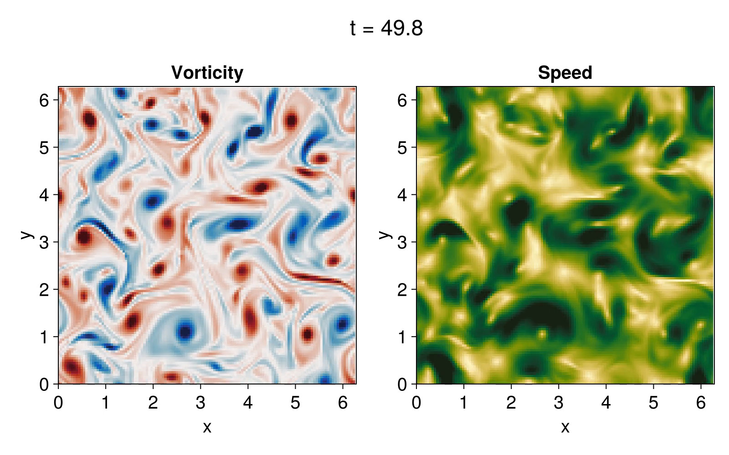
~ 1 minute runtime on my laptop

Slide 9
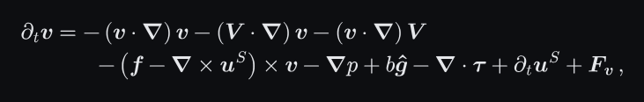
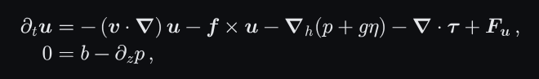
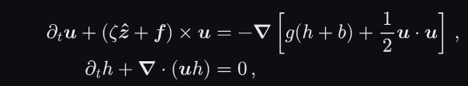
Oceananigans isn’t “a model”
Nonhydrostatic model
Hydrostatic model
Shallow water model

Slide 10
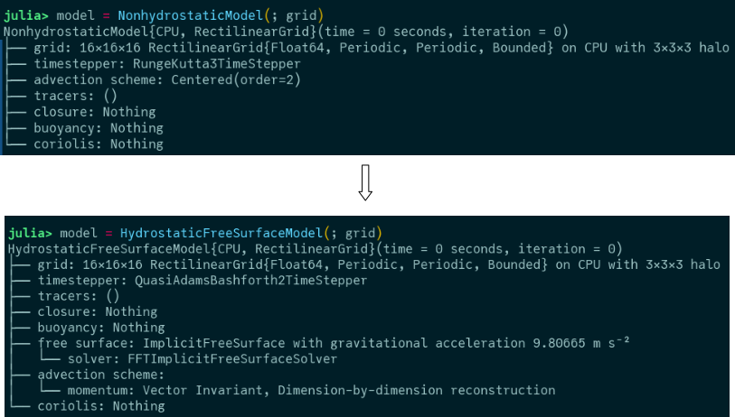
Want a different model?

Slide 11
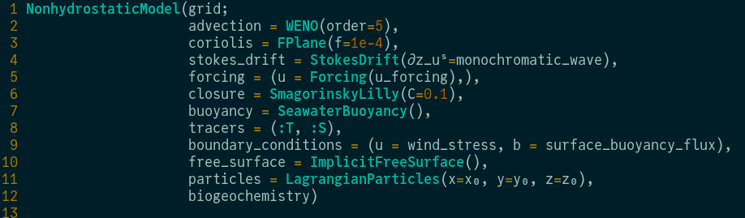
Adding physics is also easy

Slide 12

Different architectures
CPU — multi-threaded (uses Julia threads)
GPU — single-GPU via:
  CUDA (Nvidia)
  AMDGPU (AMD ROCm)
  Metal (Apple)
  oneAPI (Intel)
Distributed — multi-GPU / multi-node via MPI (Distributed + Partition)
MultiRegionGrid — multiple connected regions on a single process (XPartition, YPartition, CubedSpherePartition)

Slide 13
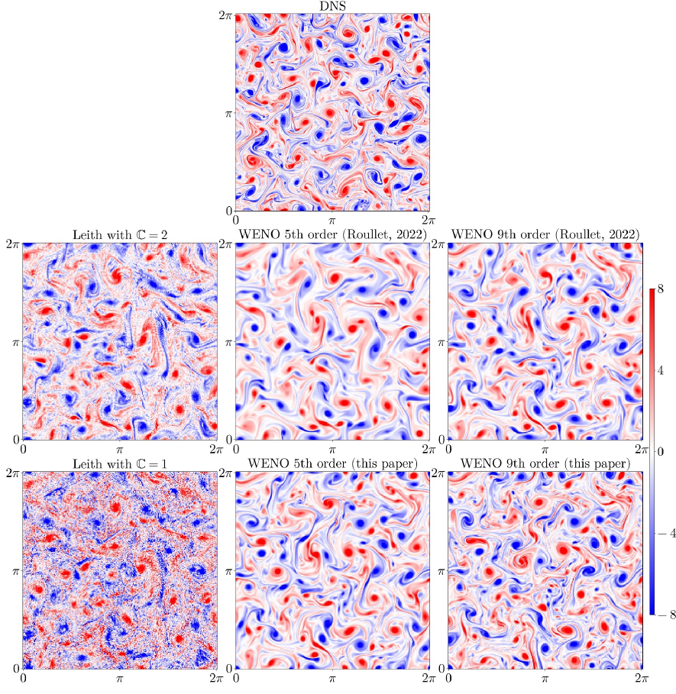
Different (including new) numerics
Centered
UpwindBiased
WENO — (bounds-preserving tracer option)
WENOVectorInvariant — (for hydrostatic on spherical grids)
VectorInvariant
FluxFormAdvection
Silvestri et al., 2024, JAMES

Slide 14
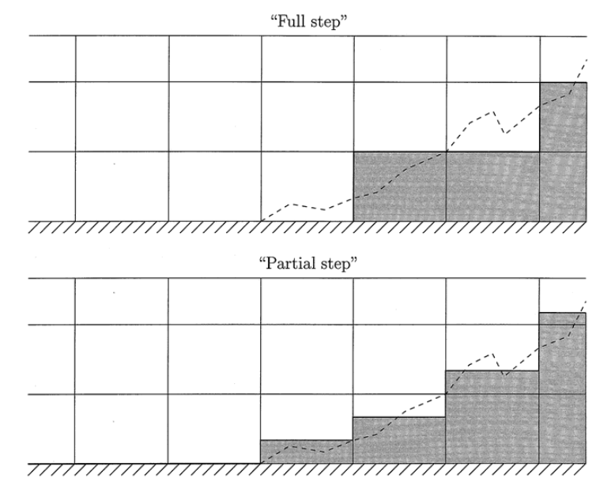

Grids and topography
RectilinearGrid — Cartesian, uniform or stretched, in any combination of x/y/z
LatitudeLongitudeGrid — spherical latitude-longitude
OrthogonalSphericalShellGrid — general orthogonal spherical shell (base for tripolar)
TripolarGrid — tripolar ocean grid (North Pole singularities moved to land)
RotatedLatitudeLongitudeGrid — rotated lat-lon for regional domains
ConformalCubedSphereGrid — cubed-sphere global grid
ImmersedBoundaryGrid — any grid wrapped with topography
  GridFittedBoundary — full-cell immersed boundary
  GridFittedBottom — 2D bottom topography (full cell)
  PartialCellBottom — 2D bottom topography (partial cells)
Adcroft et al. (1997)

Slide 15
Boundary conditions
FluxBoundaryCondition — prescribed flux (e.g., wind stress, heat flux)
ValueBoundaryCondition — prescribed value (Dirichlet)
GradientBoundaryCondition — prescribed gradient (Neumann)
NormalFlowBoundaryCondition — open/radiation boundary
  Possibility to add different physics matching schemes to radiate out
MixedBoundaryCondition — combination of gradient + value (Robin)
ImmersedBoundaryCondition — separate BCs on immersed faces (x, y, z directions)

Slide 16
Models and closures
ScalarDiffusivity — isotropic and anisotropic
ScalarBiharmonicDiffusivity — horizontal, vertical, or both
SmagorinskyLilly — 3D Smagorinsky-Lilly LES closure (with LillyCoefficient)
DynamicSmagorinsky — dynamic-coefficient Smagorinsky (with DynamicCoefficient, LagrangianAveraging)
AnisotropicMinimumDissipation — Rozema et al. (2016)
TwoDimensionalLeith — 2D Leith enstrophy diffusivity
CATKEVerticalDiffusivity — one-equation TKE-based vertical mixing (prognostic TKE)
TKEDissipationVerticalDiffusivity — two-equation k-ε vertical mixing (prognostic TKE + dissipation)
RiBasedVerticalDiffusivity — Richardson number-based vertical diffusivity
ConvectiveAdjustmentVerticalDiffusivity — convective adjustment
IsopycnalSkewSymmetricDiffusivity — Redi + GM skew diffusivity (with triad variant and FluxTapering)
Closures can be combined as tuples; VerticallyImplicitTimeDiscretization available for vertical diffusion

Slide 17
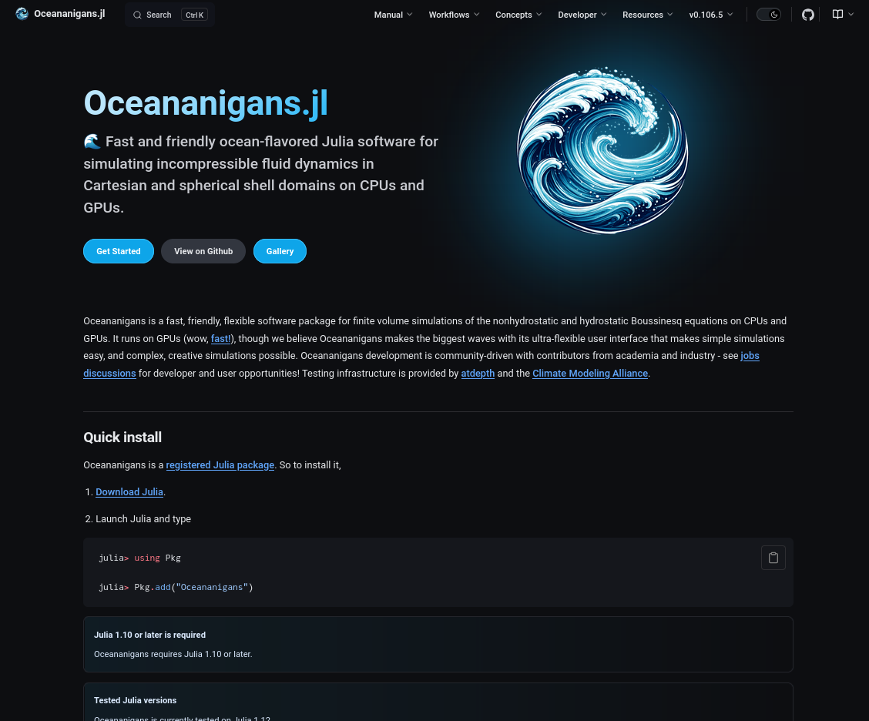

Check out the docs!
clima.github.io/OceananigansDocumentation

Slide 18
Google “Tomas Chor github” go to repositories git clone git@github.com:tomchor/oceananigans_tut cd oceananigans_tutorial_20260618 julia -t2 (or julia –project -t2)
]add Oceananigans
The commands above will:
  Clone the tutorial repo and cd into it
  Download Oceananigans
  Compile whatever needs compiling

