Slide 1

SQL Project
On
CONSUMER AD-HOC INSIGHTS
- Sarthak Maiti
1

Slide 2
Table Of Content
Company Overview
Objectives
Problem Statement
Project Overview
Report
Conclusion

Slide 3
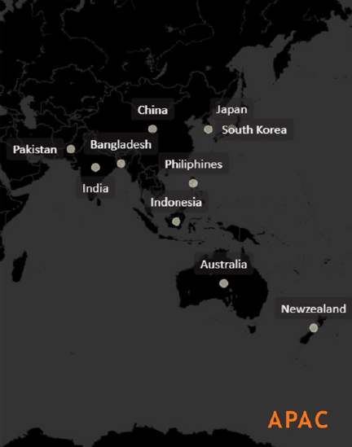
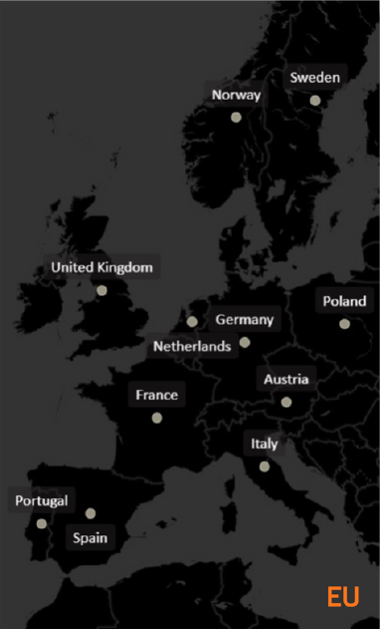
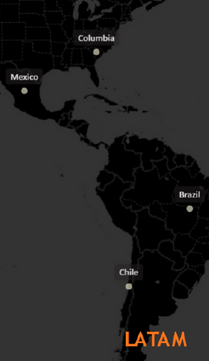
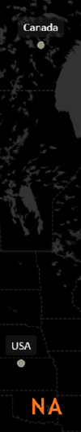
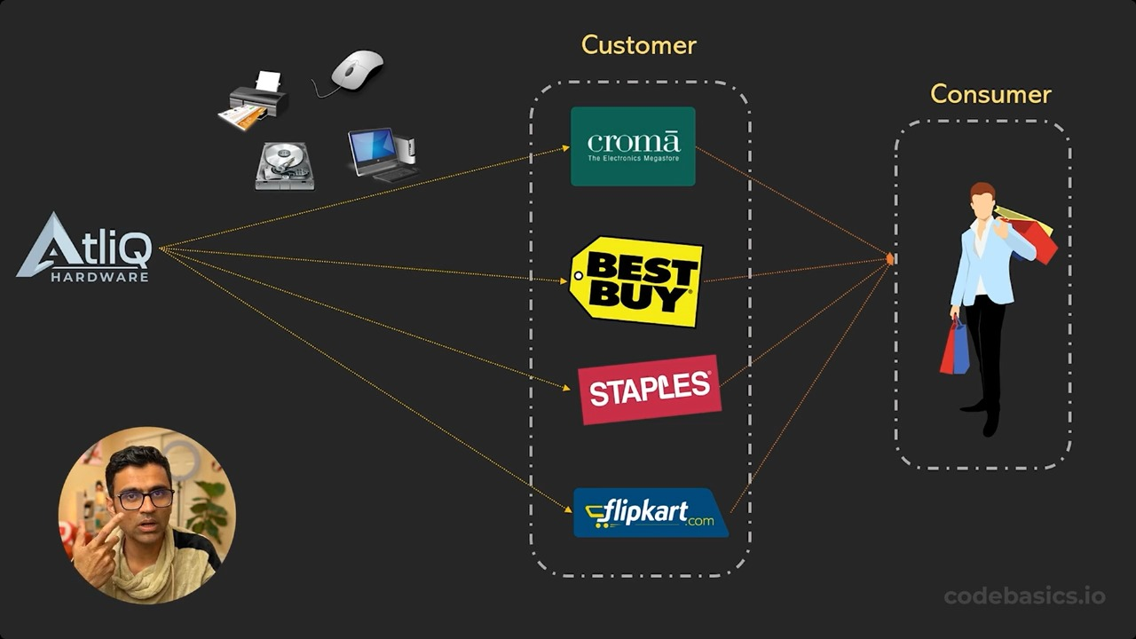

Company Overview & Market
AtliQ Hardware us a Computer Hardware and Accessory manufacturer.
The company manufactures products under 3 major divisionsi.e., Netorking & Storage, PC,Peripherals & Accessories.
AtliQ Hardware is operational inNA, LATAM, EU and APACregions.

Slide 4
Objectives
AtliQ Hardware (fictitious corporation) is one of the major computer hardware manufacturers in India, with a strong presence in other nations.
Nevertheless, the management did note that they do not have sufficient insights to make prompt, wise, and data-informed judgments.
Plan to expand the data analytics team by adding junior data analysts.
To assess candidates, Data analytics director, Tony Sharma plans to conduct a SQL Challenge to evaluate both tech and soft skills.
The company seeks insights for 9 ad hoc requests.

Slide 5
Problem Statement & Problem Overview
Problem Statement
AtliQ Hardware is currently facing performance challenges due to the increasing size and complexity of its Excel files. To address this, the company has formed a dedicated team of data analysts to leverage MySQL for extracting valuable insights and enhancing operational efficiency
Problem Overview
The Scope of this project entails conduction an in-depth analysis of the dataset provided by AtliQ Hardware. The primary goal is to derive actionable insights regarding sales performance, market dynamics, customer behavior, and to forecast supply chain trends

Slide 6
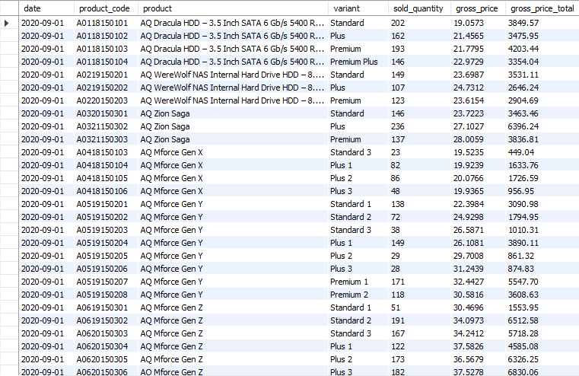
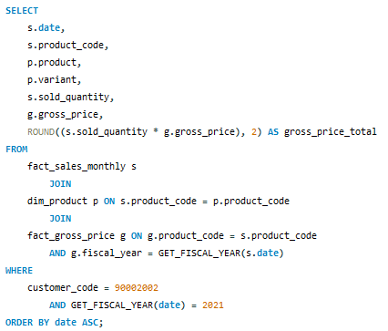
Croma Sales Report
Generate a report detailing the individual product sales for Croma India customer throughout the fiscal year 2021

Slide 7
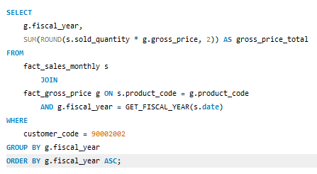
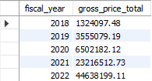
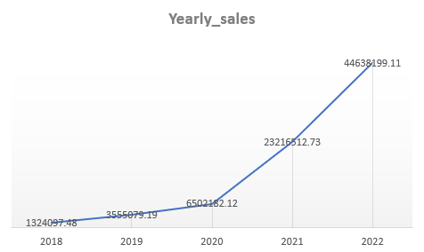
Croma Yearly Gross Sales Report
Generate a yearly report for Croma India where there are two columns.
Fiscal Year
Total Gross Sales amount
in that year from Croma

Slide 8
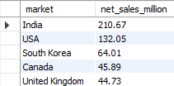
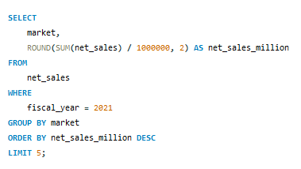
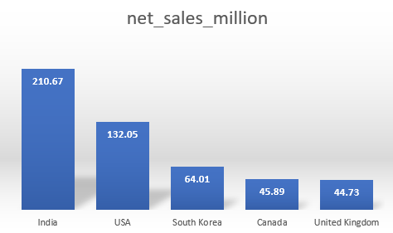
Top 5 Market
Generate a report getting Top 5 markets
by Net Sales in Fiscal Year 2021

Slide 9
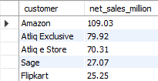
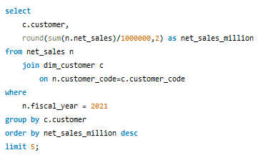
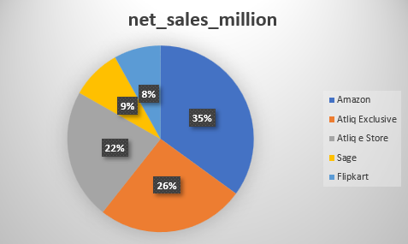
Top 5 Customers
Generate a report getting Top 5 Customers
by Net Sales in Fiscal Year 2021

Slide 10
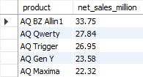
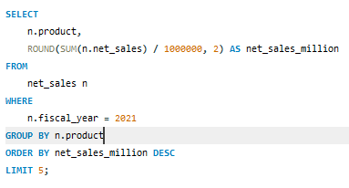
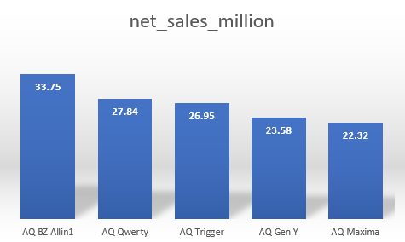
Top 5 Products
Generate a report getting Top 5 Products
by Net Sales in Fiscal Year 2021

Slide 11
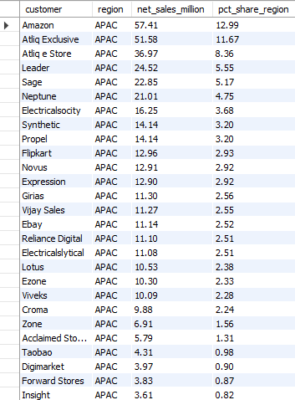
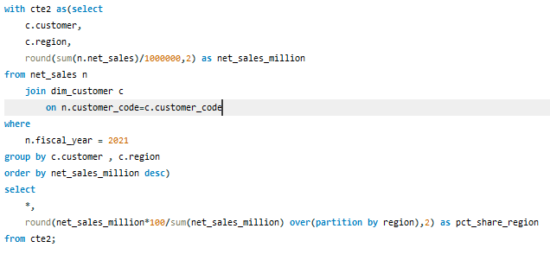
Net Sales % Report
Generate a report getting Top 5 Products
by Net Sales in Fiscal Year 2021

Slide 12
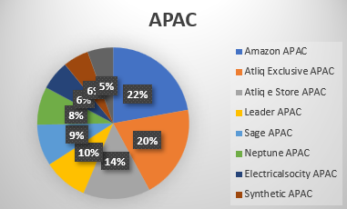
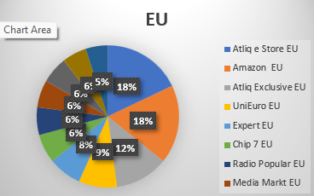
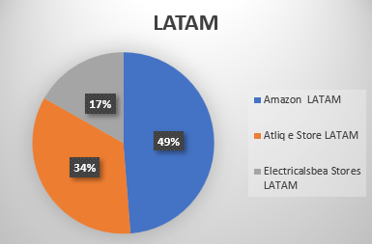
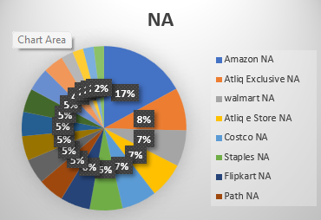
Market Share %
Top Customers in different Regions

Slide 13
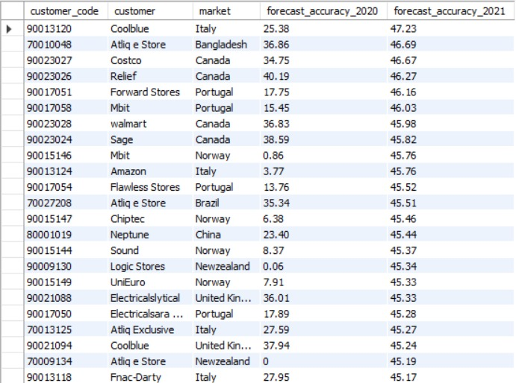
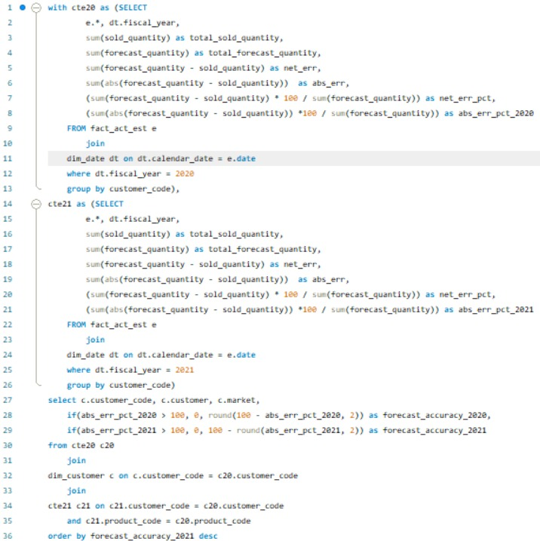
Forecast Accuracy 2020 vs 2021
Generate a Report Comparing Forecast Accuracy of 2020 and 2021 By Customer

Slide 14
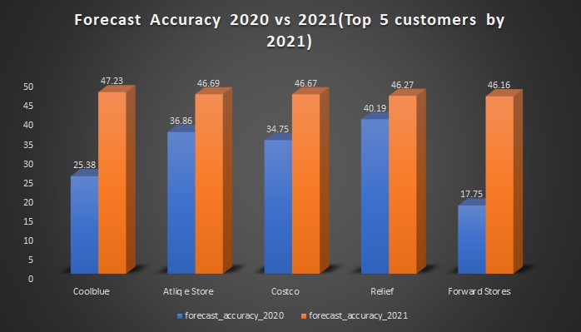
Forecast Accuracy 2020 vs 2021
Forecast Accuracy 2020 vs 2021 by Customer (Top 5 Customer by 2021 Forecast Accuracy

Slide 15
Conclusion
AtliQ Hardware achieved record sales in 2022.
India was the largest market in 2021 with sales of $210.67M
Amazon generated the highest Net Sales in 2021 with $109.03M
The AQ BZ All-in-One was the top-selling product in 2021 with the sales of $33.75M
Amazon captures the top market share% in APAX, LATAM & NA regions.
AtliQ estore topped the chart in EU region.
Forecast Accuracy of 2021 is much more accurate than 2020.

Slide 16
THANK YOU

