Slide 1
CAN THE SUPREME COURT
settle policy—and
unsettle the public?
Public reactions to Windsor and Perry in 2.5 million tweets
Using Twitter to Study Public Discourse in the Wake of Judicial Decisions
Tom S. Clark · Jeffrey K. Staton · Yu Wang · Eugene Agichtein
Law & Economics Colloquium | Presentation draft
Paper version 5
Notes:
Opening: A Supreme Court decision can be legally final and socially unsettled at the same time. The talk asks whether judicial authority produces acceptance or instead reorganizes conflict. I will use the 2013 same-sex marriage cases and high-frequency public speech to distinguish those possibilities.

Slide 2
THE PUZZLE
The Court changed the rule. What happened to the argument?
JUNE 26, 2013
United States v. Windsor
Hollingsworth v. Perry
A liberal—but incomplete—policy shift
DOMA §3 unconstitutional under Fifth Amendment principles
No standing; the judgment against Proposition 8 remained in place
The Court did not yet establish a nationwide constitutional right
CONSENT
COUNTERMOBILIZATION
Institutional authority
support rises
anger falls
or
positions harden
conflict intensifies
The legal outcome is observable. The social response is the dependent variable.
Source: Clark et al., version 5, pp. 7–8.
Notes:
Give the doctrinal background quickly. Windsor invalidated the federal definition in DOMA; Perry was a standing decision whose practical effect was to leave the district-court judgment in place. The key design fact is that the combined outcome was liberal but not maximally liberal. That creates room for both acceptance and counter-response.

Slide 3
WHY LAW & ECONOMICS SHOULD CARE
Legal finality and social settlement are different outcomes
Persuasion
Authority can lower the political cost of policy change by bringing preferences toward the result.
Backlash
COURT
RULING
A salient judgment can harden positions, increase anger, and raise downstream conflict costs.
Coordination
A clear rule can settle expectations and behavior even when underlying preferences do not move.
The paper asks which social technology judicial review actually supplies.
Interpretive frame for a law-and-economics colloquium.
Notes:
Translate the public-law question into institutional terms. Judicial legitimacy may function as persuasion, as coordination, or as a trigger for costly countermobilization. Our data primarily distinguish persuasion from conflict-structuring. Avoid claiming a welfare analysis that the paper does not estimate.

Slide 4
THEORY
Three accounts make observably different predictions
OUTCOME
Legitimation
Structural response
Thermostatic response
deference to authority
discussion reinforces groups
policy prompts counter-demand
Policy support
moves toward the ruling →
supporters ↑ opponents ↓
left and right counter-react
Anger
falls—especially among opponents ↓
opponents ↑ supporters ↓
rises at ideological extremes ↑
Intensity
likely falls ↓
may rise on both sides ↑
rises with counter-demand ↑
KEY TEST
Does institutional authority soften opposition—or sort people into more opposed camps?
Theories synthesized from Dahl; Gibson and Caldeira; Franklin and Kosaki; Ura; Wlezien.
Notes:
The most important contrast is legitimation versus structural response. Legitimation predicts movement toward acceptance and less anger. Structural response predicts that a salient decision becomes a discussion focal point and reinforces preexisting opinion groups. The thermostatic account also predicts counter-response, but more cleanly along ideology and policy distance.

Slide 5
RESEARCH DESIGN
A sharp legal event inside a high-frequency stream of speech
MARCH 26
JUNE 26
AUGUST 10
Observation window
Observation window
Windsor + Perry
2.5M+
335,399
≈700
1,400
same-sex-marriage tweets
tweets on decision day
frequent accounts in panel
human-coded training tweets
DESIGN NOTE
A before/after observational design: the ruling is the event—not a randomized treatment.
Keywords: “ssm,” “same sex marriage,” “DOMA,” “Prop8,” and “gay marriage.” English-language tweets only.
Notes:
Make the identification claim modest from the start. The event date is sharp and discourse is observed daily, but there is no untreated counterfactual. The value of the design is temporal resolution, enormous coverage of relevant speech, and replication across a daily stream and a fixed panel.

Slide 6
RESEARCH DESIGN
Two samples separate public attention from within-account change
DAILY STREAM
ACCOUNT PANEL
Who is speaking today?
How do the same speakers change?
Large, changing cross-section of issue-related tweets each day
Frequent accounts tracked continuously—without being recruited into a survey panel
When both samples move together, simple compositional turnover becomes a less satisfying explanation.
“Random sample” refers to the Twitter stream, not a national probability sample.
Notes:
The daily sample captures the discourse that is visible on a given day, including changing attention and participation. The panel captures within-account change among frequent speakers. Neither is nationally representative. Agreement across the two views helps address—but does not eliminate—concerns about changing composition.

Slide 7
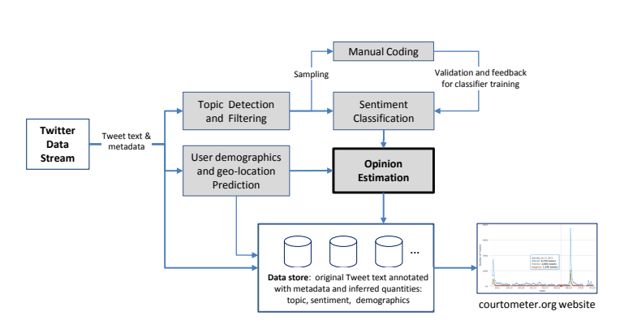
MEASUREMENT
From public speech to theoretically meaningful quantities
SUPPORT
supportive · neutral · opposed
INTENSITY
intense · dispassionate
ANGER
pleased · neutral · angry
A reusable architecture—not a one-off word count
The claim is about revealed public discourse—not private preferences.
Source: Clark et al., version 5, Figure 1 and pp. 14–16.
Notes:
Emphasize the conceptual bridge. A tweet is an utterance shaped by what is salient and activated in a network; it is not a direct readout of a stable latent preference. The classifiers recover support, intensity, and anger from human-coded examples. Those dimensions correspond to the competing theoretical predictions.

Slide 8
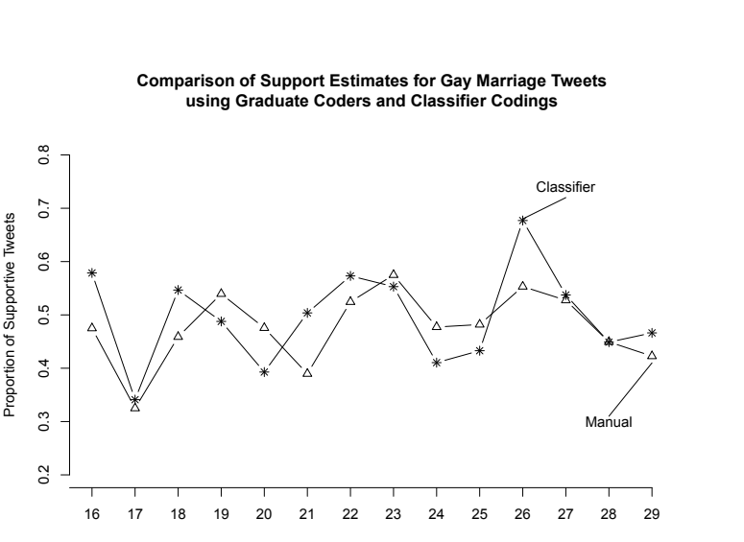
VALIDATION
Measurement is imperfect—but the errors are visible
10-fold cross-validation
68%
73%
69%
support classification accuracy
intensity classification accuracy
anger classification accuracy
What works best
Supportive and neutral tweets; intense versus dispassionate speech.
Harder cases
Rare opposition and anger categories.
Daily classifier estimates track the hand-coded series
The main inference relies on patterns and contrasts—not on pretending each label is error-free.
Source: Clark et al., version 5, Table 2 and Figure 2.
Notes:
Be candid here. The classifier is useful but not perfect, and rare classes are the hardest. The stronger evidence is that daily aggregate estimates track the hand-coded series and that key patterns recur in two samples. A colloquium audience may ask about attenuation, class imbalance, and whether error changes at the event date.

Slide 9
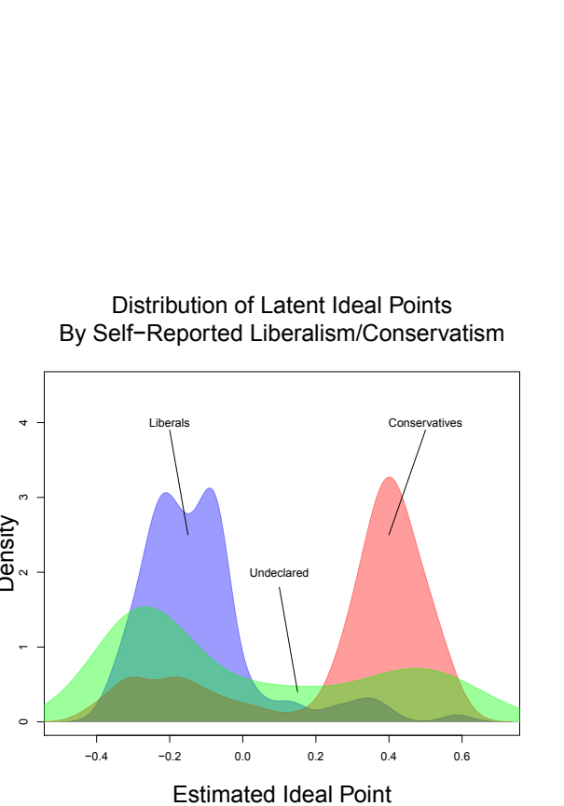
VALIDATION
Follower networks recover ideology—but ideology is not issue position
1. Infer latent distance
People are less likely to follow accounts far from them in ideological space.
2. Validate against profiles
Self-described liberals and conservatives separate strongly on the recovered scale.
3. Keep the concepts distinct
General ideology and prior support for marriage equality need not sort the same people.
That distinction becomes the central empirical result.
Source: Clark et al., version 5, Figure 4 and pp. 20–23.
Notes:
The ideology measure comes from who follows whom, using a latent-distance model. Its construct validity is supported by self-declared profiles and recognizable elite accounts at the endpoints. The conceptual warning is important: ideology and issue-specific prior opinion are different groupings. The results polarize by the latter, not the former.

Slide 10
FINDING 1
No aggregate movement toward the Court’s policy
DAILY STREAM
ACCOUNT PANEL
1.68
1.56
1.13
1.11
before
after
before
after
Supportiveness index
Supportiveness index
×
Statistically detectable because N is enormous; substantively small and in the wrong direction for legitimation.
Source: Clark et al., version 5, p. 24. Decision-day tweets excluded from pre/post comparisons.
Notes:
The aggregate support result is straightforward. Support does not move toward the Court. The means actually decline slightly in both samples. The differences are statistically meaningful because the samples are huge, but the paper correctly treats them as substantively tiny. This is no evidence for aggregate legitimation.

Slide 11
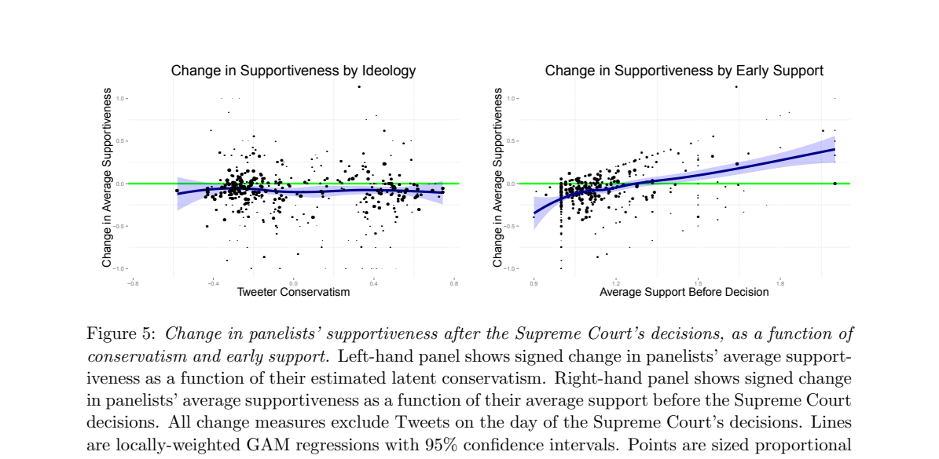
FINDING 2
Prior policy position predicts polarization; ideology does not
NEAR-FLAT
general ideology
UPWARD
prior issue support
Supporters became more supportive; opponents became more opposed.
Source: Clark et al., version 5, Figure 5. Point sizes reflect each panelist’s tweet volume.
Notes:
This is the central result. The left panel is essentially flat: general liberal-conservative location does not explain change. The right panel slopes upward: people who were supportive before become more supportive, while those opposed become more opposed. The Court appears to structure conflict among issue groups, not simply push everyone toward its result.

Slide 12
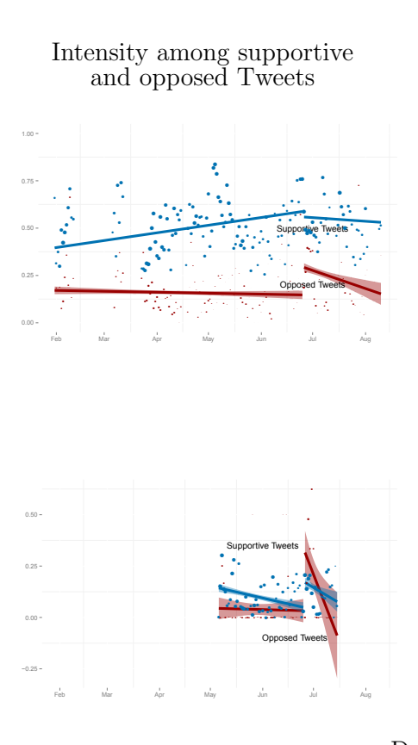
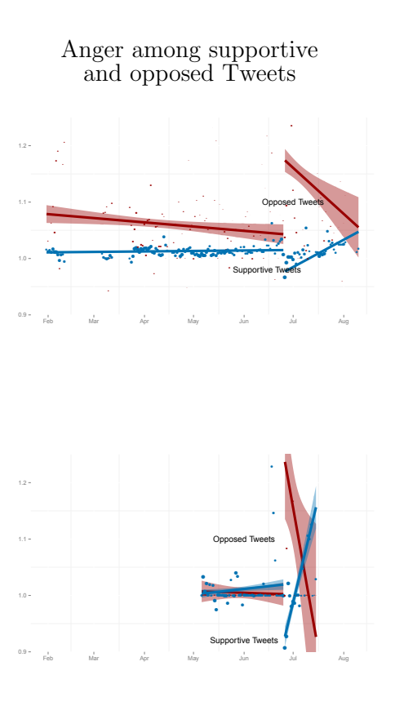
FINDING 3
Emotion moves faster—and more sharply—than policy support
INTENSITY
Both supportive and opposed speech spike, then fade.
ANGER
Opposition spikes; supportive speech becomes less angry at first.
The response is pronounced but short-lived—exactly the kind of burst surveys are likely to miss.
Source: Clark et al., version 5, Figure 6 and pp. 26–30. Blue = supportive; red = opposed.
Notes:
Focus on the discontinuity around the decision rather than every wiggle. Intensity rises on both sides and then declines. Anger drops among supportive tweets and rises among opposed tweets immediately after the decision. The later reversal is consistent with an interactional dynamic: one side’s angry response becomes material for the other side’s response.

Slide 13
MECHANISM
The likely mechanism is structured response—not deference
1 Salient ruling
2 Opponents react
3 Supporters answer
4 Conflict persists
A common legal event supplies a focal point for discussion.
Discontent has a responsible institutional target.
Counter-speech reacts to the opposing side’s anger.
Positions harden even as the emotional burst dissipates.
Inference: the observed sequence is consistent with Franklin and Kosaki’s discussion-group mechanism; the design does not directly identify each conversational link.
A decision can end litigation while beginning a new round of social interaction.
Mechanism discussion: Clark et al., version 5, pp. 28–30.
Notes:
Treat this as a mechanism interpretation, not a directly identified mediation analysis. The ruling makes the issue salient, opponents direct anger toward an accountable institution, and supporters react to that opposition. The sequence fits the structural-response account. A stronger design would trace replies and retweets or compare interaction networks around multiple decisions.

Slide 14
HETEROGENEITY
Why no liberal–conservative split? Look at age within party
Support for same-sex marriage, spring 2013
Structural response needs group separation
All Republicans
33%
Republicans 18–29
54%
within-group
variation
between-group
difference
All Democrats
62%
Democrats 18–29
76%
A younger Twitter population compresses the partisan gap on this issue.
The result is not “no polarization.” It is polarization along the grouping that is actually coherent on the policy.
Source: Clark et al., version 5, Table 3; Pew Research Center data aggregated March–May 2013.
Notes:
The paper’s interpretation is demographic. Twitter users skew younger, and young Republicans were much more supportive of marriage equality than Republicans overall. That weakens the relationship between general ideology and this particular issue. Structural response predicts polarization only when the relevant groups have low within-group variation and high between-group separation.

Slide 15
LEGAL INTERPRETATION
What the Court settled—and what it left unsettled
LEGAL SETTLEMENT
SOCIAL SETTLEMENT
The judgment changed
The judgment did not settle
✓
Federal recognition rules under DOMA §3
×
The public meaning or legitimacy of marriage equality
✓
The practical status of California’s Proposition 8
×
Agreement among the most committed issue groups
✓
Immediate rights, obligations, and administrative expectations
×
A nationwide constitutional right—that came later in Obergefell
Judicial authority can coordinate behavior without producing opinion convergence.
Interpretation of Windsor and Perry; Obergefell v. Hodges followed in 2015.
Notes:
This is the doctrinal and institutional takeaway. The decisions changed legal relations and administrative expectations. They did not create consensus about the policy, and Perry did not resolve a nationwide right. Coordination and persuasion should not be collapsed into one concept of “legitimation.”

Slide 16
CREDIBILITY
What this design can—and cannot—support
STRENGTHS
LIMITS
Real-time behavior
Daily speech captures short-lived reactions that survey waves miss.
No national sample
Twitter participants—especially frequent speakers—are selected.
Two samples
Cross-section and fixed panel offer complementary checks.
No untreated counterfactual
Before/after patterns are not a fully identified causal effect.
Theory-linked measures
Support, intensity, anger, and ideology map to explicit predictions.
One issue and era
Marriage equality in 2013 may not travel to other rulings or platforms.
Transparent error
Human coding and validation reveal classifier weaknesses.
Measurement error
Rare opposition and anger are the hardest classes to detect.
Defensible claim: the decisions reorganized discourse among Twitter participants—not “the Court caused national opinion to polarize.”
Scope conditions and limitations synthesized from Clark et al., version 5.
Notes:
This slide should defuse the obvious objections. The paper is strongest as evidence about the content and dynamics of public discourse among platform participants. It is not a national causal estimate. The panel, temporal resolution, and validation matter; they do not solve selection or the missing counterfactual.

Slide 17
CONTRIBUTION
Three contributions—and a sharper next test
1
2
3
Institutional
Methodological
Normative
Judicial legitimacy need not become policy legitimation.
Language data recover emotional dynamics absent from sparse surveys.
Brief emotional shocks may reshape mobilization and deliberation.
Compare many rulings that vary in salience, ideological direction, unanimity, remedy, and implementation costs—then trace replies, retweets, and offline participation.
NEXT TEST
Proposed extension for discussion.
Notes:
The institutional contribution is to separate legitimacy of the institution from persuasion about policy. The methodological contribution is fine-grained measurement of speech and emotion. The normative contribution is that short emotional bursts may matter for mobilization even if they fade quickly. The next design should compare a population of rulings and directly model conversational networks.

Slide 18
TAKEAWAY
Courts can win the case
without winning the argument.
01
No aggregate legitimation of the policy
02
Opinion groups polarize—even when ideological groups do not
03
Emotion responds immediately, asymmetrically, and briefly
Questions
Tom S. Clark · Jeffrey K. Staton · Yu Wang · Eugene Agichtein
Notes:
Close on the distinction between legal victory and social agreement. The Court did not produce aggregate movement toward its result. It did structure disagreement among people already divided on the policy, and it produced a fast emotional response. Invite questions about causal identification, platform selection, the ideology measure, and how the framework might apply to contemporary decisions.

