Slide 1

CyberSecurity in UK Higher ed. James H. Davenport
18 October 2019
(With Tom Crick, Alastair Irons, Tom Prickett;
all four are British Computer Society )

Slide 2

Who are we?
British Computer Society: the Chartered Institute for IT. Mission “Make IT good for society”. See https://www.bcs.org/
A learned and professional society, that also does accreditation: think ACM+ABET.
The Institute of Coding: a joint Government and industry initiative to improve digital skills at university level (not necessarily in universities) in England: funded 2018-2020, led from Bath. See https://instituteofcoding.org/

Slide 3
There’s a dichotomy in demand
Cybersecurity specialists: many estimates of the size of the shortage, but always huge
The “generalist” programmer, designer etc. needs to know “some Cybersecurity” (recognised in ACM 2013 and BCS equivalent)
Note that there’s a limit to the mess that a Cybersecurity expert can clean up retrospectively:
check for buffer overflows and certain leakages
X fix bad design decisions (no framework to check for CSRF; unencrypted passwords, logging in the wrong place [Facebook!] etc.)

Slide 4
Educational Resources
Case Study: SQL Injection
A study of the 7 database textbooks used by 44 of the top 50 US departments.
5 had no mention of the SQL Injection, which is #1 in the OWASP “Top 10” list of weaknesses, and the cause of many current breaches
Of the two that did, the discussion in the more popular one was seriously flawed

Slide 5
Educational Resources
Case Study: Java
Many Java textbooks go nowhere near security applications (credit card processing, username/ password handling etc.) despite their ubiquity
The documentation of the APIs for the various packages tend to assume that the reader knows the basics, and wants to use this API.
Hence the novice programmer is driven back to informal resources.

Slide 6
Informal Resources such as StackOverflow
Focused on functionality and “getting it working”
Consider Cross-Site Request Forgery (CSRF)
By default, Spring protects against this
All the accepted answers to CSRF-related failures simply suggested disabling the check, with no comments on the downsides
[4] took top 30 tutorials (via Google)
6 had SQL Injection weaknesses, 3 CSRF
820 instances of these fragments on Github, of which 117 were verified manually to be vulnerable

Slide 7
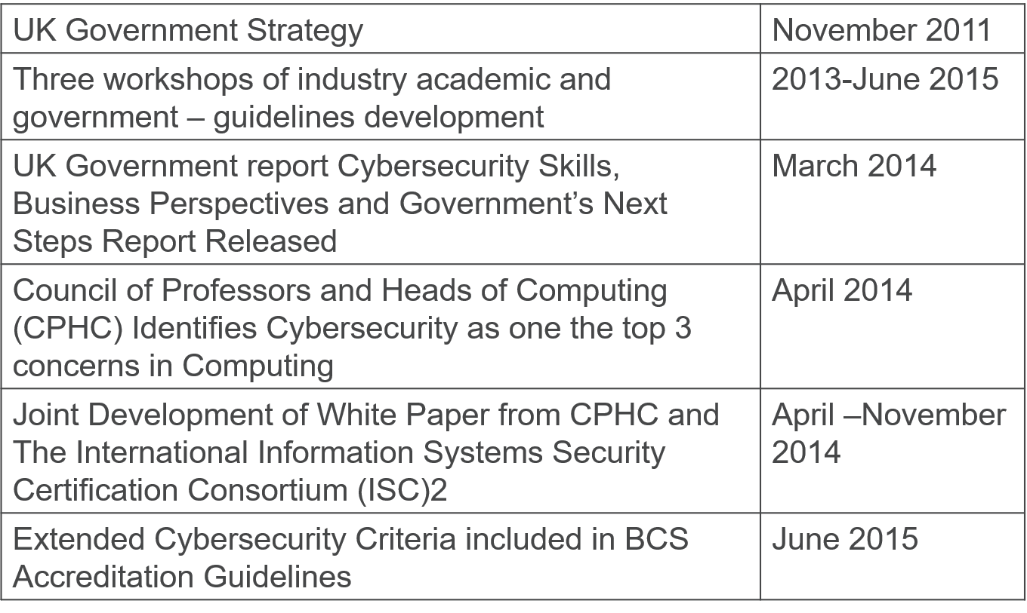
UK Timeline for CyberSec

Slide 8
Timeline for implementation
Cybersecurity Principles Roadshow: March-April 2016
All institutions expected to be fully compliant: Sept 2020
Status (autumn 2018)
70 Higher Education Institutes visited under this regime
54 Higher Education Institutes compliant
12 Higher Education Institutes requiring long actions (for next visit)
4 Higher Education Institutes requiring short term actions

Slide 9
Curricula guidelines (2015)
Coverage is mandated of:
Information and risk
Threats and attacks
Cybersecurity architecture and operations
Secure systems and products
Cybersecurity management.
In the light of our findings, where should this go?

Slide 10
What next for accreditation??
Check appropriateness of books (or how deficiencies are handled). Shouldn’t be necessary, but see SQL and [1]
Check students’ attitudes to informal resources
?? Insist that there’s some practical Cybersecurity work, e.g. implementing a password system ??

Slide 11


Any questions?

Slide 12
References
[1] Cynthia Taylor and Saheel Sakharkar. ';DROP TABLE textbooks; ― An Argument for SQL Injection Coverage in Database Textbooks. In Proc. of SIGCSE 2019, pages 191-197, 2019.
[2] N. Meng, S. Nagy, D. Yao, W. Zhuang, and G. Arango Argoty. Secure coding practices in Java: Challenges and vulnerabilities. In IEEE/ACM 40th Int. Conf. on Software Engineering, pages 372-383, 2018.
[3] F. Fischer, K. Böttinger, H. Xiao, C. Stransky, Y. Acar, M. Backes, and S. Fahl. Stack Overflow Considered Harmful? The Impact of Copy&Paste on Android Application Security. In 38th IEEE Symposium on Security and Privacy, pages 121-136, 2017.
[4] T. Unruh, B. Shastry, M. Skoruppa, F. Maggi, K. Rieck, J.-P. Seifert, and F. Yamaguchi. Leveraging Flawed Tutorials for Seeding Large-Scale Web Vulnerability Discovery. In Proc. of 11th USENIX Workshop on Offensive Technologies (WOOT 2017), 2017.
[5] Alastair Irons, Nick Savage, Carsten Maple, Adrian Davies, and Lyndsay Turley. Cybersecurity in CS Degrees. ITNow, 58:56-57, 2016.

