Slide 1
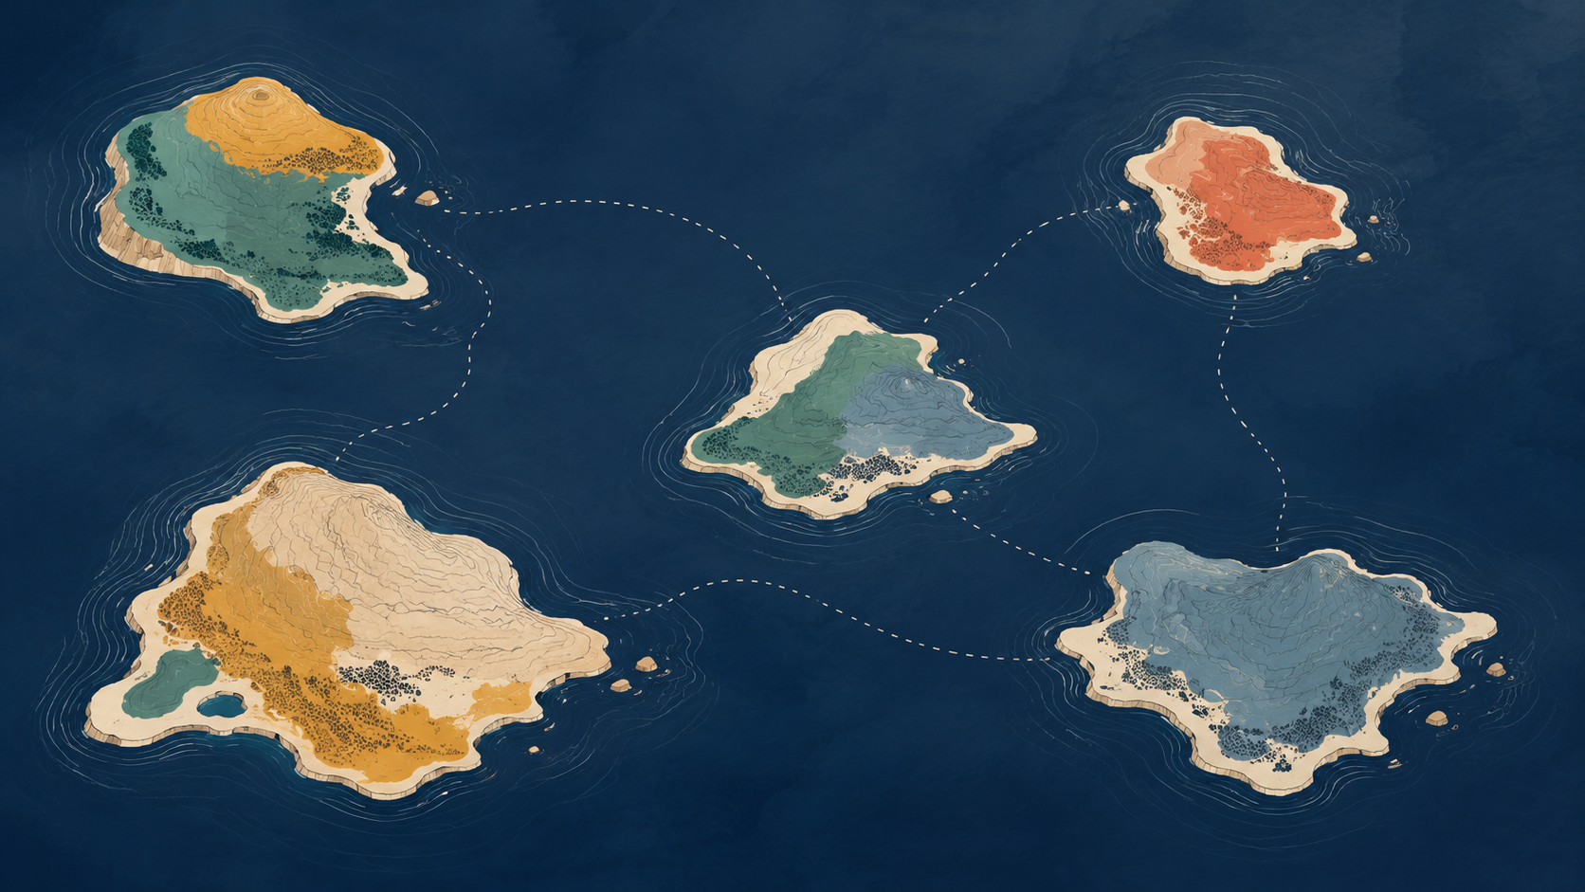
THE GOOD SHIP · FRAMEWORK
Designing how
we work together
Not everything needs collaboration.
Five modes for designing relationships, openness, control, reciprocity, governance and exit.
More isn't better. Choose what the work actually needs.
the good ship · framework
1

Slide 2

The archipelago
Five modes. Not stages. You can use several at once, and move between them.
CONNECT
COMMONS
Know, learn, refer, exchange.
Contribute to and steward something others can use.
COLLABORATE
Make and own important things together.
COORDINATE
COOPERATE
Adjust what you do around one another.
Contribute distinct things towards something shared.
NOT A MATURITY MODEL
the good ship · framework
2

Slide 3
DESIGN PRINCIPLE
Choose the lightest mode the work needs
The modes differ in how interdependent people are, what has to be shared, and what infrastructure is worth paying for.
CONNECT
COORDINATE
COOPERATE
COLLABORATE
COMMONS
We benefit from knowing and learning from one another.
We adjust what we do because of what others are doing.
We contribute distinct things towards something shared.
We make and own important things together.
We contribute to and steward something others can use and shape.
Needs
Needs
Needs
Needs
Needs
Useful contact · trust · easy exchange
Visibility · roles · hand-offs · boundaries
Outcome · commitments · ownership of pieces
Shared decisions · trust · time · repair
Licences · standards · stewardship · contribution rules
Sometimes a referral is exactly what is needed. Turning it into a “collaboration” would just add meetings.

Slide 4
TWO ORTHOGONAL CHOICES
Design the environment around the mode
Open is not the same as collaborative. Distributed is not the same as open.
HOW OPEN?
WHERE DOES CONTROL SIT?
Closed
Visible
Participatory
Reusable
Led
Shared
Federated
Distributed
Process: open working
Outputs: Creative Commons
Software: open source
Central authority can be right. Federation is often useful when people need common rules and local autonomy.
Decentralised ≠ collaborative · Open ≠ decentralised · Reusable ≠ participatory
the good ship · framework
4

Slide 5

CONTRIBUTION & RECIPROCITY
What flows between us?
The mode describes how you are relating. Reciprocity describes what flows.
Reciprocity does not mean equal exchange.
A healthy arrangement can involve very different contributions — as long as they are intentional, understood and reasonably fair.
KNOWLEDGE
TIME
MONEY
LABOUR
ACCESS
RELATIONSHIPS
LEGITIMACY
INFRASTRUCTURE
One-way exchange presented as “collaboration” deserves scrutiny.
the good ship · framework
5

Slide 6
GOVERNANCE & PRACTICE
Different modes need different infrastructure
The question is not “how collaborative are we?” but “what do we need to make this mode work well?”
MODE
WHAT IT NEEDS
GOVERNANCE QUESTION
WATCH OUT FOR
CONNECT
Light social infrastructure
Who stays connected? How?
Weak ties disappear when key people leave.
COORDINATE
Information + role infrastructure
Who does what? What needs visibility?
Hidden work, duplication and broken hand-offs.
COOPERATE
Commitment + delivery infrastructure
Who owns which piece? What is promised?
Shared goal, but unequal load or vague accountability.
COLLABORATE
Relational + decision infrastructure
Who can decide? How do we disagree and repair?
One party controls the important choices.
COMMONS
Stewardship + contribution infrastructure
Who can use, change, contribute, maintain or fork?
Open to use, but closed to meaningful influence.
Name the arrangement honestly. A commission, grant, procurement or consultation can be perfectly legitimate without pretending to be collaboration.

Slide 7
A USEFUL DISTINCTION
Collaboration and commons are different
You collaborate with people. You contribute to, draw from and steward a commons.
COLLABORATE
COMMONS
Centre of gravity
The relationship
Centre of gravity
The shared thing
Basic action
Make + decide together
Basic action
Contribute · use · steward
Dependency
On one another
Dependency
On the shared resource / infrastructure
Infrastructure
Relationships · meetings · decisions · conflict/repair
Infrastructure
Licences · standards · repositories · documentation · contribution rules
Power question
Whose voice counts?
Power question
Who controls the commons?
DIFFERENT INFRASTRUCTURE
Exit
Change, loosen or leave the relationship
Exit
Leave · hand over · archive · fork

Slide 8
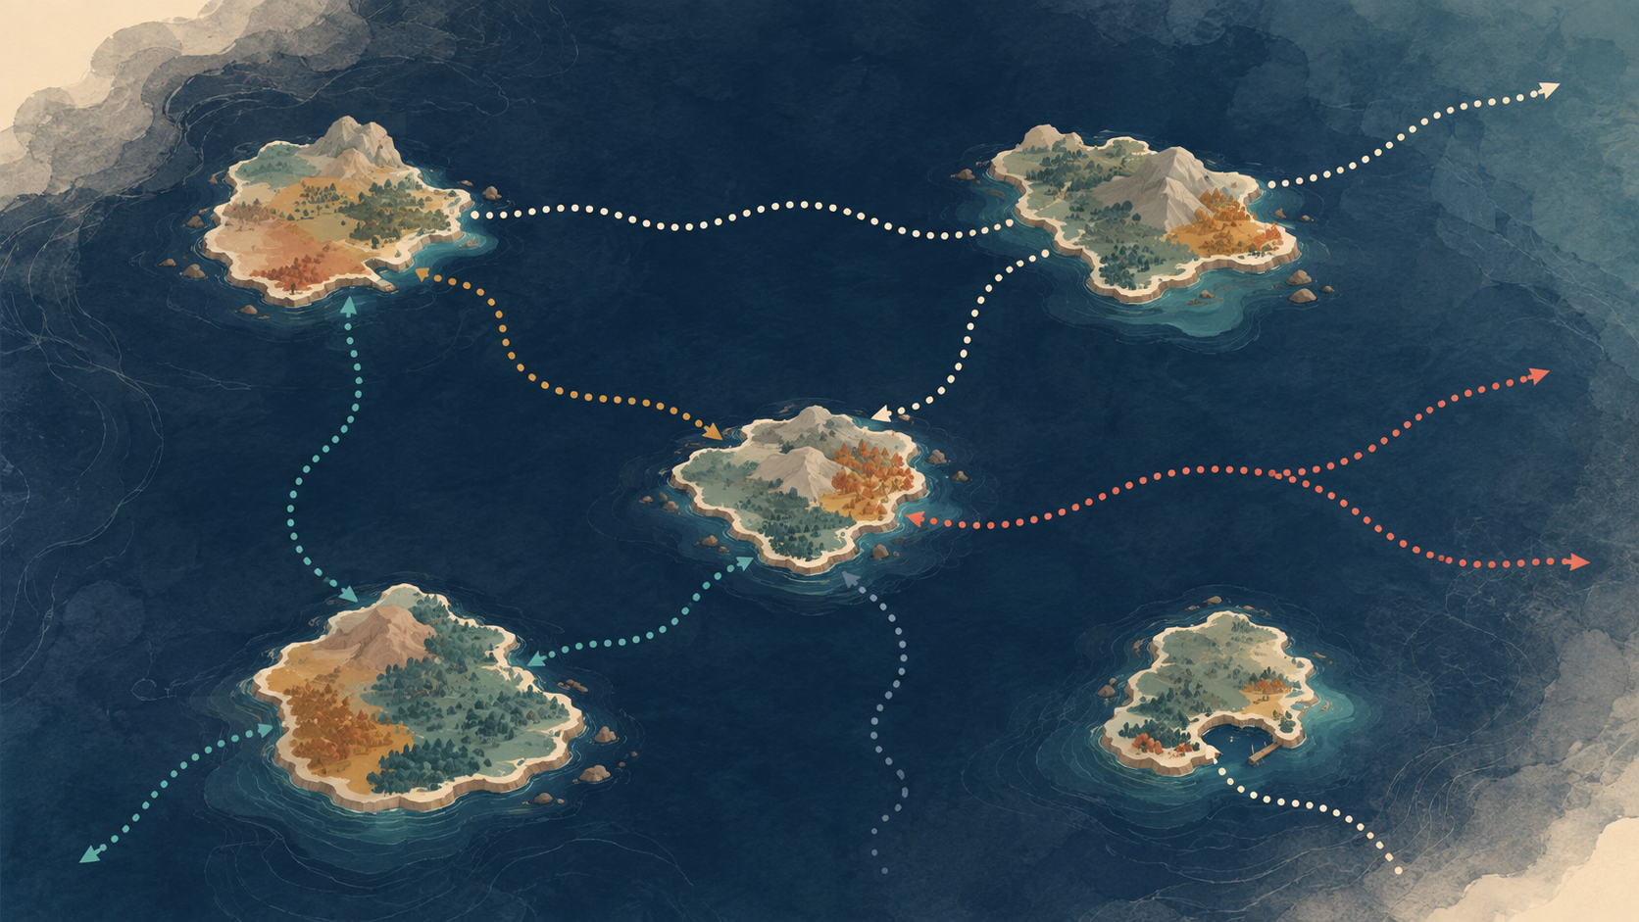
CHANGE & EXIT
Every island needs a way off
Design how the relationship can change — before changing it becomes contentious.
FINISH
PAUSE
LEAVE
LOOSEN
DEEPEN
HAND OVER
FORK
CLOSE
How will we know when?
Purpose achieved · conditions changed · costs outweigh value · participation no longer meaningful · another mode now fits better.
How do we actually do it?
Why?
Complete · changed · unsustainable · misaligned · unhealthy · evolving
Decision · notice · commitments · data/IP/access · stewardship · communication
For a commons: can it be forked?
the good ship · framework
8

Slide 9
WORKSHOP CANVAS
Before you set sail
Use these six questions to design the arrangement — then choose the mode, openness and distribution of control that fit.
1
PURPOSE
2
POWER
What are we actually trying to achieve together?
Who has money, authority, information and the ability to walk away?
What would be different if this worked?
What power differences need naming or balancing?
3
DECISIONS
4
CONTRIBUTION & RECIPROCITY
What gets decided together — and what does not?
What does each participant put in, and what can they draw from?
Who can commit the organisations involved?
What would feel unfair or extractive?
5
OPENNESS & OWNERSHIP
6
CHANGE & EXIT
Who can see, use, change and share the work or outputs?
How will we know when this arrangement should change?
What should remain private — and why?
Who decides, and what happens to the work, money, data and relationships?
Then choose:
MODE · OPENNESS · WHERE CONTROL SITS · WHAT FLOWS · HOW IT CHANGES

