Slide 1
Progress Report
April X, 2026
Yongjie Duan

Slide 2
EEG-moments dataset introduction

Slide 3
Experimental design
Trial: 1s baseline + 3s video + 0.25s baseline + 2s blink (=6.25s)
Run: 66 trials (~=7m).
Session: 16 runs (~=112m + 15 breaks). At each session there are 3 repeats of 250 train videos + 3 repeats of 102 test videos.
Whole experiment: 8 sessions, for a total of 6 repeats for each of the 1000 train videos, and 24 repeats for each of the 102 test videos.
EEG recordings: 128 electrodes

Slide 4
EEG preprocessing
Filtering: between 0.01Hz and 100Hz
Epoching: between -0.2s and +3.5s with respect to stimulus onset
Baseline correction: using mean of prestimulus interval
Frequency downsampling: to 50Hz
MVNN: covariance matrices computed at each EEG time point

Slide 5
ToDo 3: Brightness Decoding — Method
Goal
Decode a simple, low-level visual feature: overall video brightness (luminance)
If EEG captures basic visual properties, bright vs. dark videos should be distinguishable
Method
Compute mean luminance for each test video (average pixel intensity across frames)
Select top-20 brightest and top-20 darkest videos as two classes
Binary SVM classification at each time point, LOO on pseudo-trials
6 channel groups × 6 subjects, same pipeline as pairwise decoding
Notes:
ITU-R Recommendation BT.601（Studio encoding parameters of digital television for standard 4:3 and wide-screen 16:9 aspect ratios）
`L = 0.299*R + 0.587*G + 0.114*B`

Slide 6
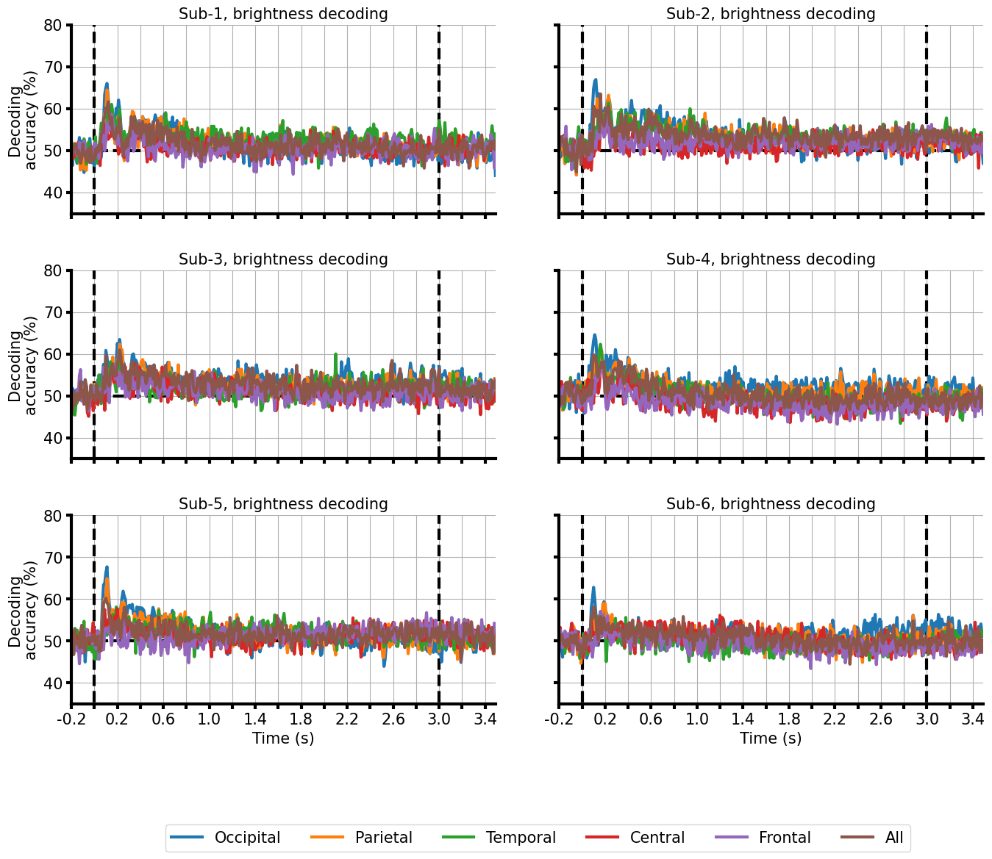
ToDo 3: Brightness Decoding — Results
Observations:
Accuracy fluctuates around 50–60% (chance = 50%)
Weak early peak at ~100–200ms in some subjects, but inconsistent
No clear sustained above-chance signal across subjects or channels
Interpretation:
Brightness alone is not robustly decodable with this approach
Possible reasons: EEG decoding is not driven purely by luminance
When 20 videos are aggregated, the underlying information is confounded

Slide 7
Brightness Decoding Optimization — Method
Motivation
Time-resolved single-timepoint approach failed — can we improve by using a multi-timepoint window?
Focus on the extreme case: brightest vs. darkest single video (1046 vs 1093)
4-Phase Systematic Optimization
Fixed Configuration
Phase 1: Window length sweep — fix start at t=0, vary end (0.1s to full trial)
Phase 2: Sliding window — fix optimal length (1.2s), slide position across trial
Phase 3: Fine-grained tuning — 0.05s then 0.02s step precision
Phase 4: Classifier tuning — C parameter sweep, LinearSVC vs LogReg
All 127 EEG channels (no channel selection)
Classifier: StandardScaler → LinearSVC
No PCA dimensionality reduction
Samples: 288 trials (144 bright + 144 dark, from 6 subjects × 8 sessions)
CV: Leave-One-Subject-Out (LOSO, 6-fold) for cross-subject generalization
Notes:
C： Regularization Parameter

Slide 8
Brightness Decoding Optimization — Results (LOSO Best)
LOSO Best (Cross-Subject)
Time window: 0.06 – 1.26s (1.2s width)
Channels: all 127 EEG channels
Features: ~15,240 (flattened time×channels, no PCA)
Classifier: StandardScaler → LinearSVC
LOSO accuracy: 88.5%
Per-subject: 89.6%, 91.7%, 81.2%, 87.5%, 89.6%, 91.7%

