Slide 1
Talk with RE/MAX Crest
Tom Davidoff
Sauder, UBC
November, 2026

Slide 2
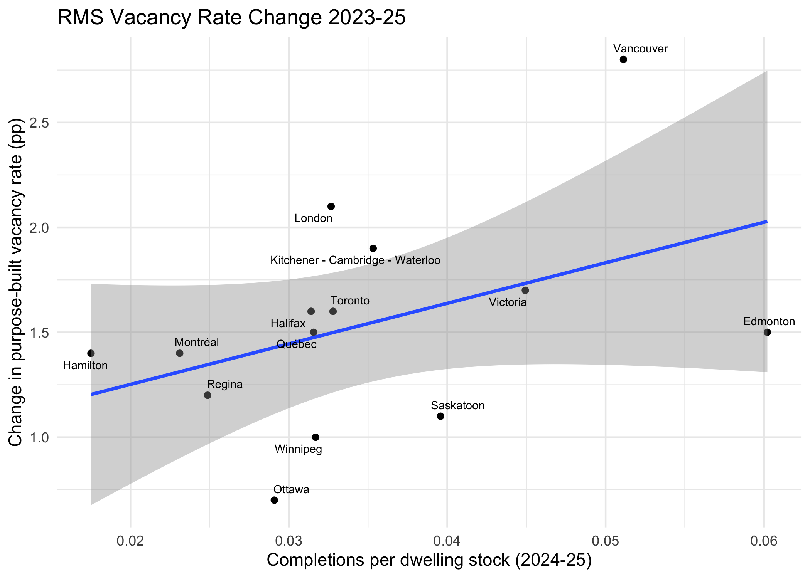
Market overview: rents (stale from CMHC)

Slide 3
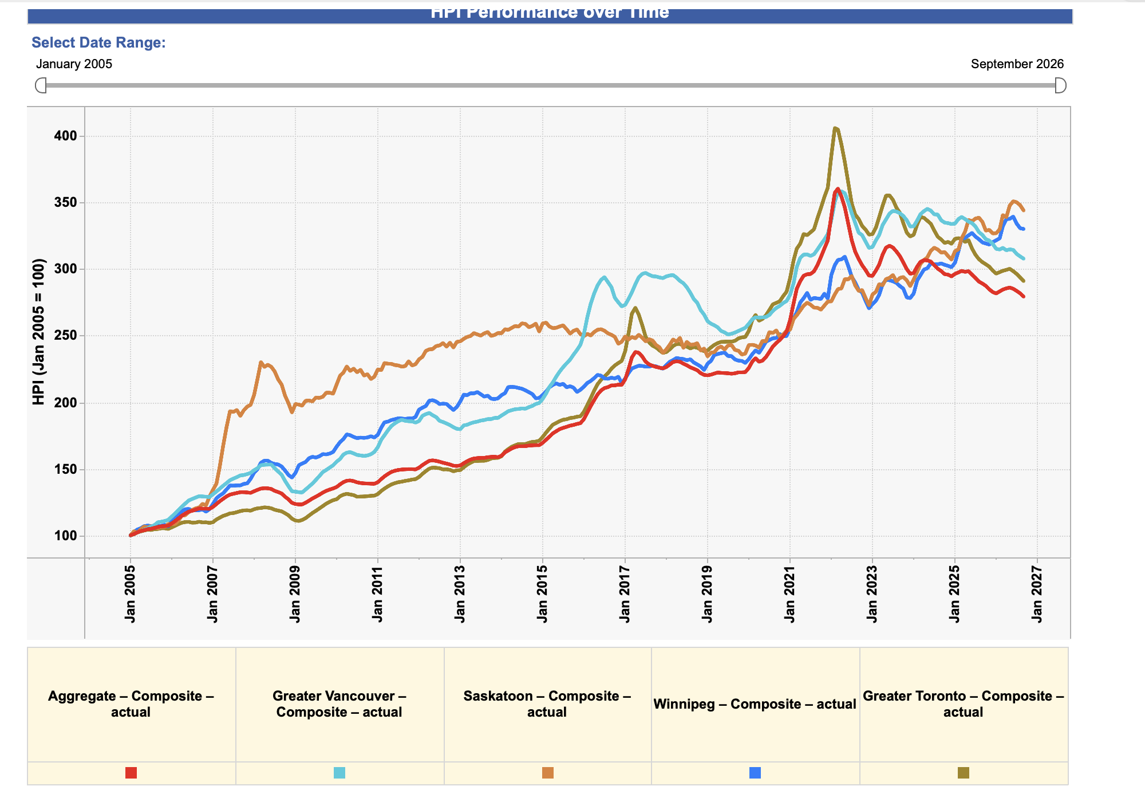
Market overview: prices per CREA

Slide 4
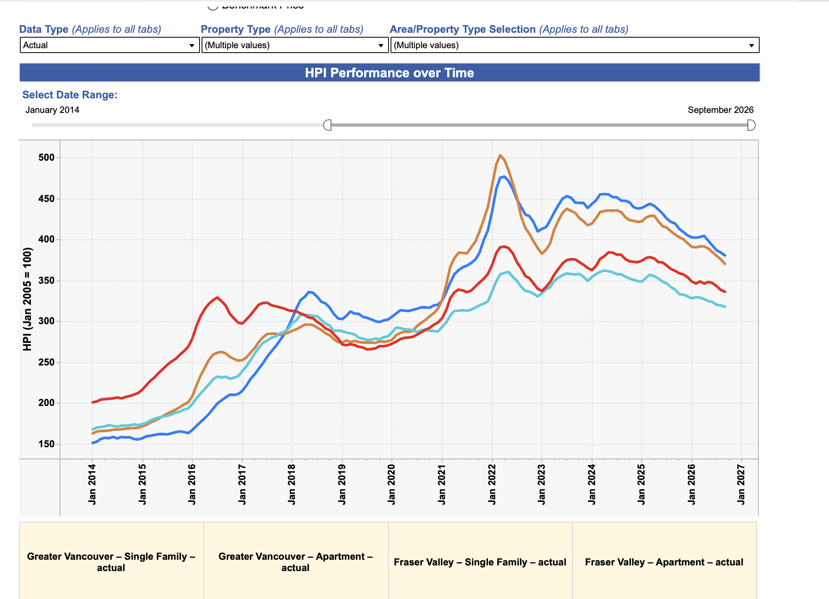
Foreign buyers and the market

Slide 5
Foreign buyer ban
Lifted on new build as in Australia
For Greater Vancouver no limit needed
  Empty homes tax / Spec tax suffice
    Empty home better than occupied at current tax levels
  Extra 20% from foreign buyer tax

Slide 6
The “right supply” debate
“Tiny investor boxes not what end users want!”
Problems:
  New rentals are even tinier
  Rental price/sqft falls in sqft
    End users want to economize on space, collectively

Slide 7
The coming repeal of Bill 44.
Angry Lobster anecdote
Free-riding problem with 21+ jurisdictions
  Bear all the cost of congestion
  Share the benefit of affordability
  Need senior government to discipline NIMBYism

Slide 8
Should CMHC be more active in financing multi unit buildings?
CMHC rental pivot to rental has been hugely consequential
Let’s see how these loans perform
  Very aggressive lending standards a few years ago when projects started
  Deterioration of conditions since
  Low losses so far, AFAIK

Slide 9
Alternatives to a foreign buyer ban.
The “Australian” model for foreign buyers.
Supply & demand and the type of product developers have been building (and should build).
The possible repeal of Bill 44.
Should CMHC be more active in financing multi unit buildings.
The model that I have heard about in Toronto regarding ‘bulk” purchase of condos at a discount by investors.
Any thoughts and solutions that you have regarding the local real estate market for 2026 – 2027

Slide 10
Bulk condo purchases
Good model
  Even worked for scatter-site single family in the US
  Surely can work in a condo building
  Not crazy for government to facilitate
  GST cut in Ontario not sufficiently heckled

Slide 11
Any thoughts and solutions that you have regarding the local real estate market for 2026 – 2027
More immigration
Less Trump (lower interest rates, stronger economy)
As usual
  More property tax
  Less income and sales tax
  Alternative minimum tax of 1% of property value
    Gross rent deductible
    Income tax paid deductible

