Slide 1
Senakw and the Vancouver Landscape
Tom Davidoff
UBC

Slide 2
Agenda
Discussion of project and context
Background on Vancouver residential market
Some quick notes on real estate finance
Speculation on economics of phase 1
Conjectures about future phases

Slide 3
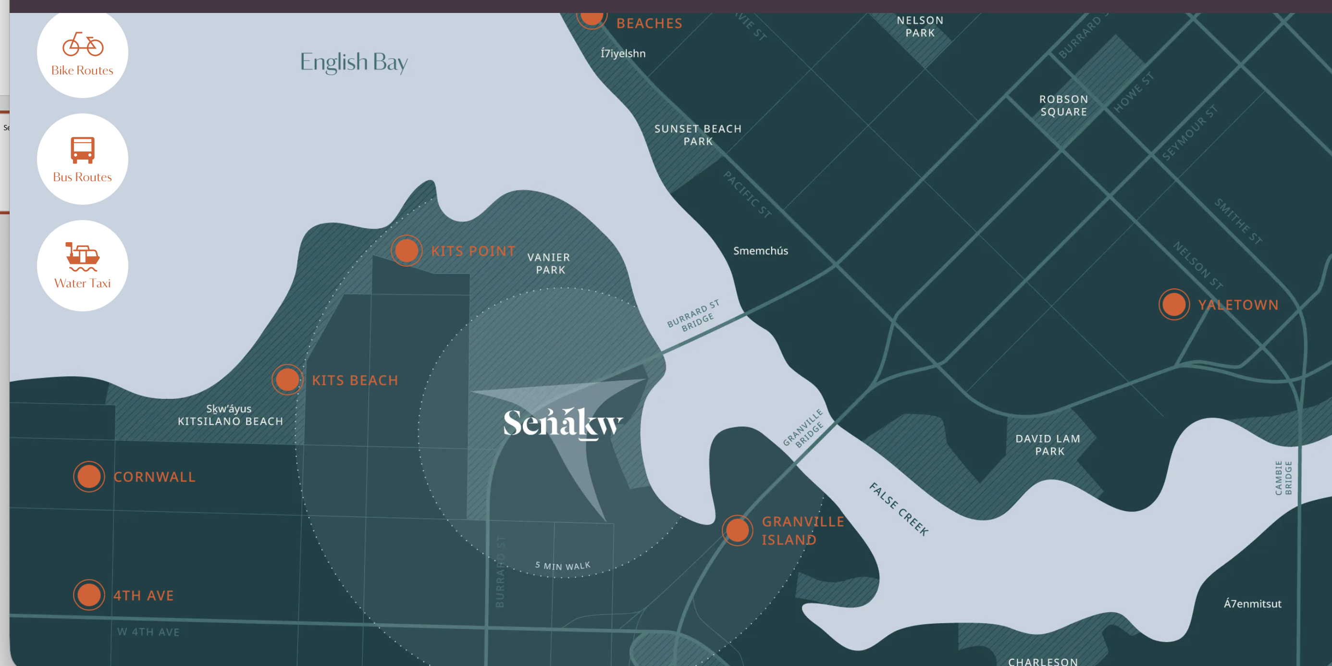
Senakw Location

Slide 4
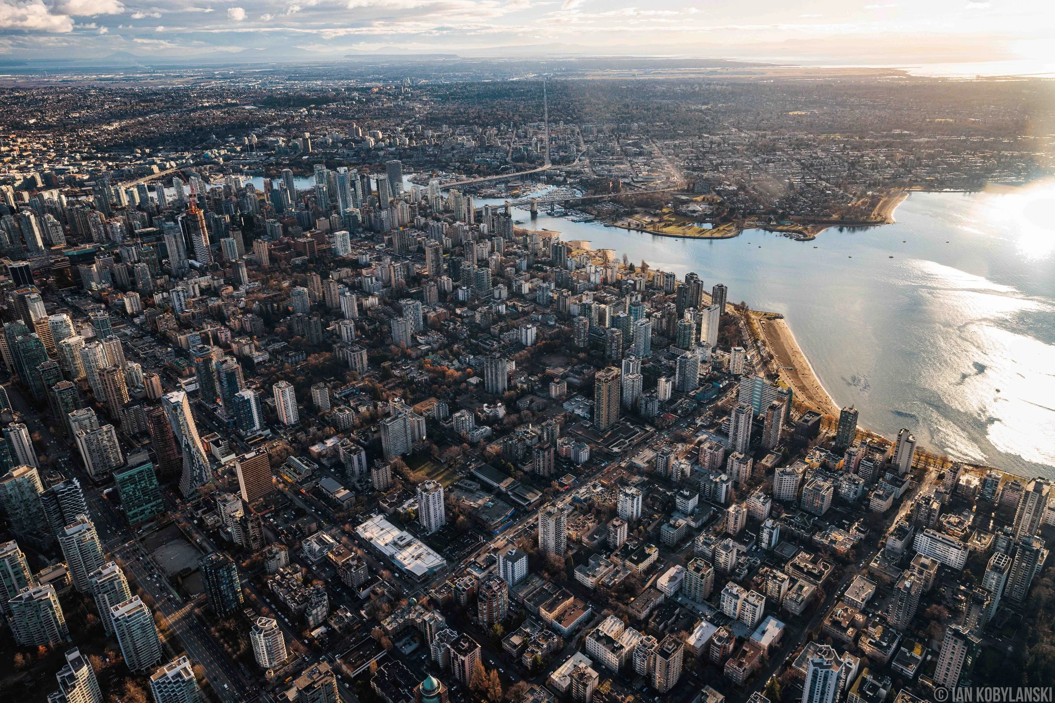
Notable feature of Vancouver skyline
Intense development downtown
Quite low density in A locations

Slide 5
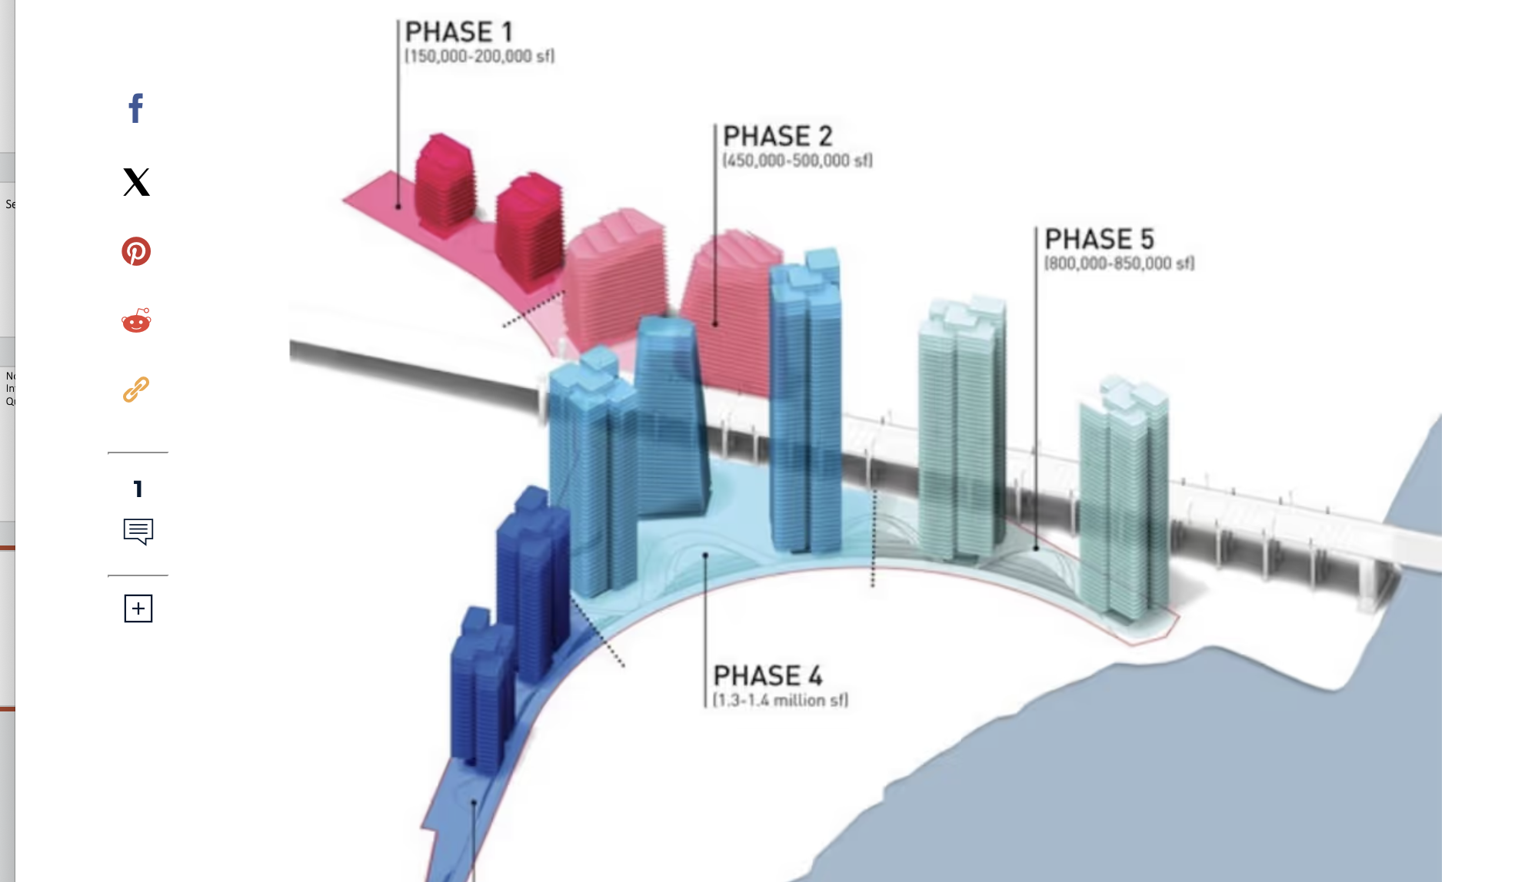
Phasing: 1 done, 2-4???

Slide 6
My poor understanding of project history
Today is national Truth and Reconciliation holiday
The Royal Decree versus BC absence of treaties
Senakw site given to one local group, the Squamish
First Nations land being developed intensely in and around Vancouver
Indigenous land features
  Not subject to local zoning
  Can’t be sold
  Nearby Jericho Lands megaproject will be condo hence freehold land
    Might not have gone this route had they seen trajectory of pricing/financing

Slide 7
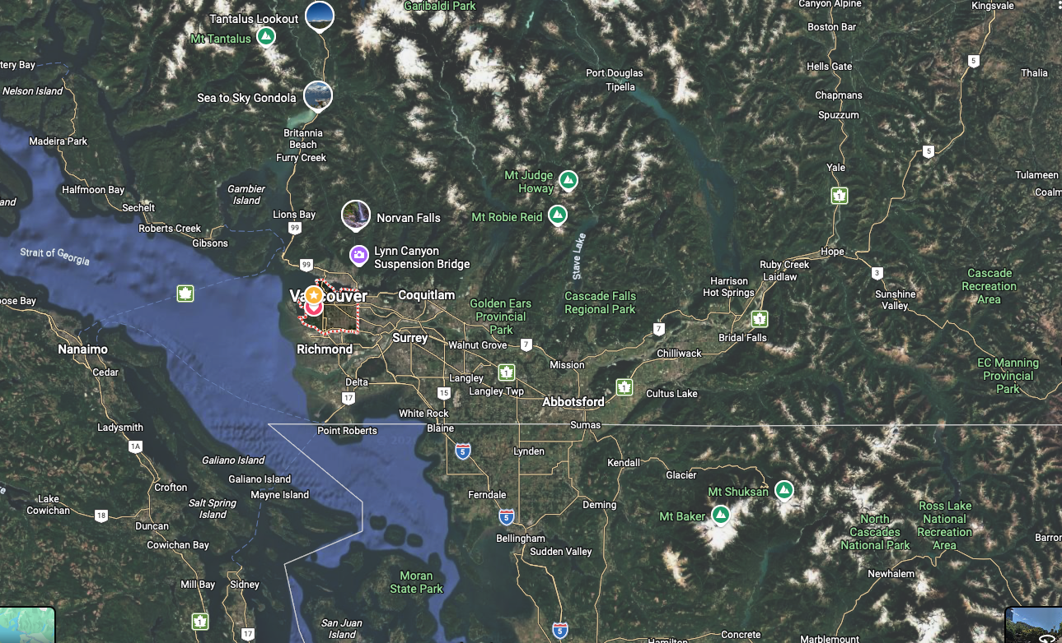
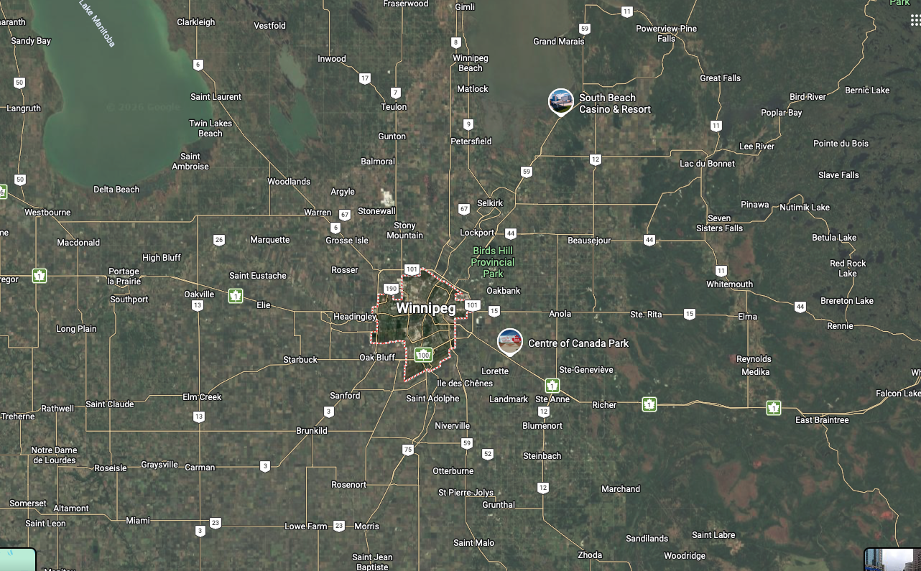
Why is Affordability So Bad in Vancouver?

Slide 8
Mountains and Ocean Make High prices 1
They are nice
Vancouver is (to most people) a nicer place to live than Winnipeg
So Vancouver can’t have both of:
  Same or better income for same skill level
  Same or lower housing costs
If Vancouver were nicer, cheaper, higher wage:
  Everyone would move out of Winnipeg, so prices would fall
  Too many people would move to Vancouver so
    Prices would rise
    Wages might fall
Special case of “no such thing as a free lunch”

Slide 9
The “Rosen-Roback” model
Vancouver is (to most people) a nicer place to live than Winnipeg
So Vancouver can’t have both of:
  Same or better income for same skill level
  Same or lower housing costs
If Vancouver were nicer, cheaper, higher wage:
  Everyone would move out of Winnipeg, so prices would fall
  Too many people would move to Vancouver so
    Prices would rise
    Wages might fall
Special case of “no such thing as a free lunch”

Slide 10
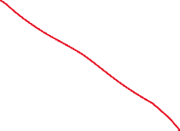
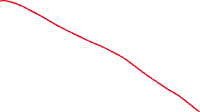

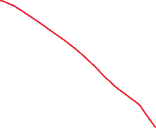
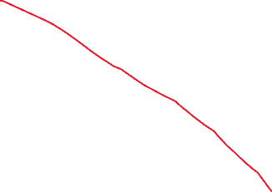
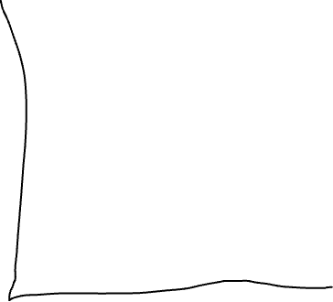
Mountains and Oceans Make High Prices 2:
”Inelastic Supply"

Slide 11
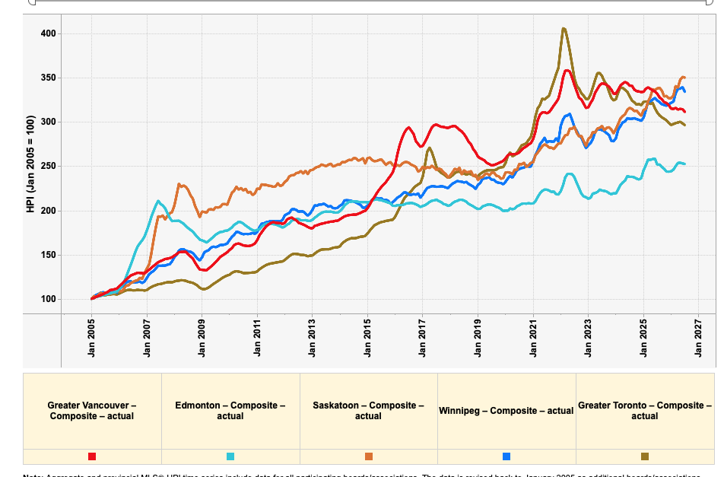
Lesson from supply-demand graph
If you want to improve affordability
  Add quantity or delete people
What has happened with lots of completions and immigration cuts?

Slide 12
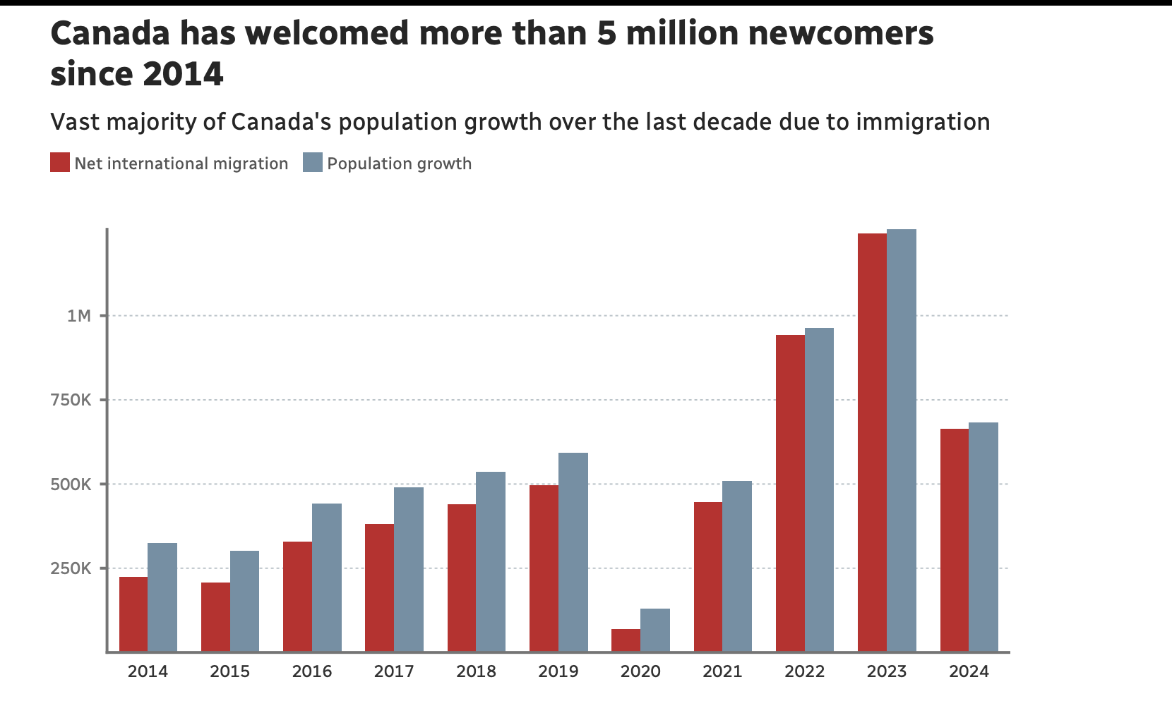
Demand: Immigration and population growth
Note further cuts in 2025 and 2026
Canadian population declining last 2 years!
Source: CBC

Slide 13
Demand policy:
What tax rates should be high or low?
Theory: relatively high tax rates if
  Supply is inelastic
  Demand is inelastic
  Complementary to the existing tax base
    (Tax skis, not neck ties)
Greater Vancouver
  Very low property tax rates
  Notoriously low supply elasticity
  Instructions from government
    Invest in real estate
    Don’t work for a living
    Mission accomplished: very high ratio of price to income

Slide 14
Raising property taxes is a political loser
But creative hacks may work
Up there with tolls and parking fees (which should be raised!)
Empty homes tax is popular
Foreign buyer tax is popular (I don’t love it)
Taxes on very high value homes are popular
My preference
  ”Alternative minimum tax” 1% of value (say)
  If income tax > 1% * property value: no surcharge
  Exempt seniors
  Could raise $2B/year just from fancy houses in Greater Vancouver
Almost certainly should tax Airbnb etc, not ban
  Empty homes taxes already 4%+ of value!
  Does society want a $1M condo rented out, or $40K + Airbnb tax?

Slide 15
Supply policy: Missing middle is popular, but hard to implement
Consider single family owner with $3M home
Upzoning to “multiplex” adds very little to value
Neighbours building multiplex is a nuisance
Upzone to 50 stories yields land value bonanza
  Sad: lose neighbourhood
  Happy: make millions of dollars and add more homes
  *Might* make more sense in infrastructure planning

Slide 16
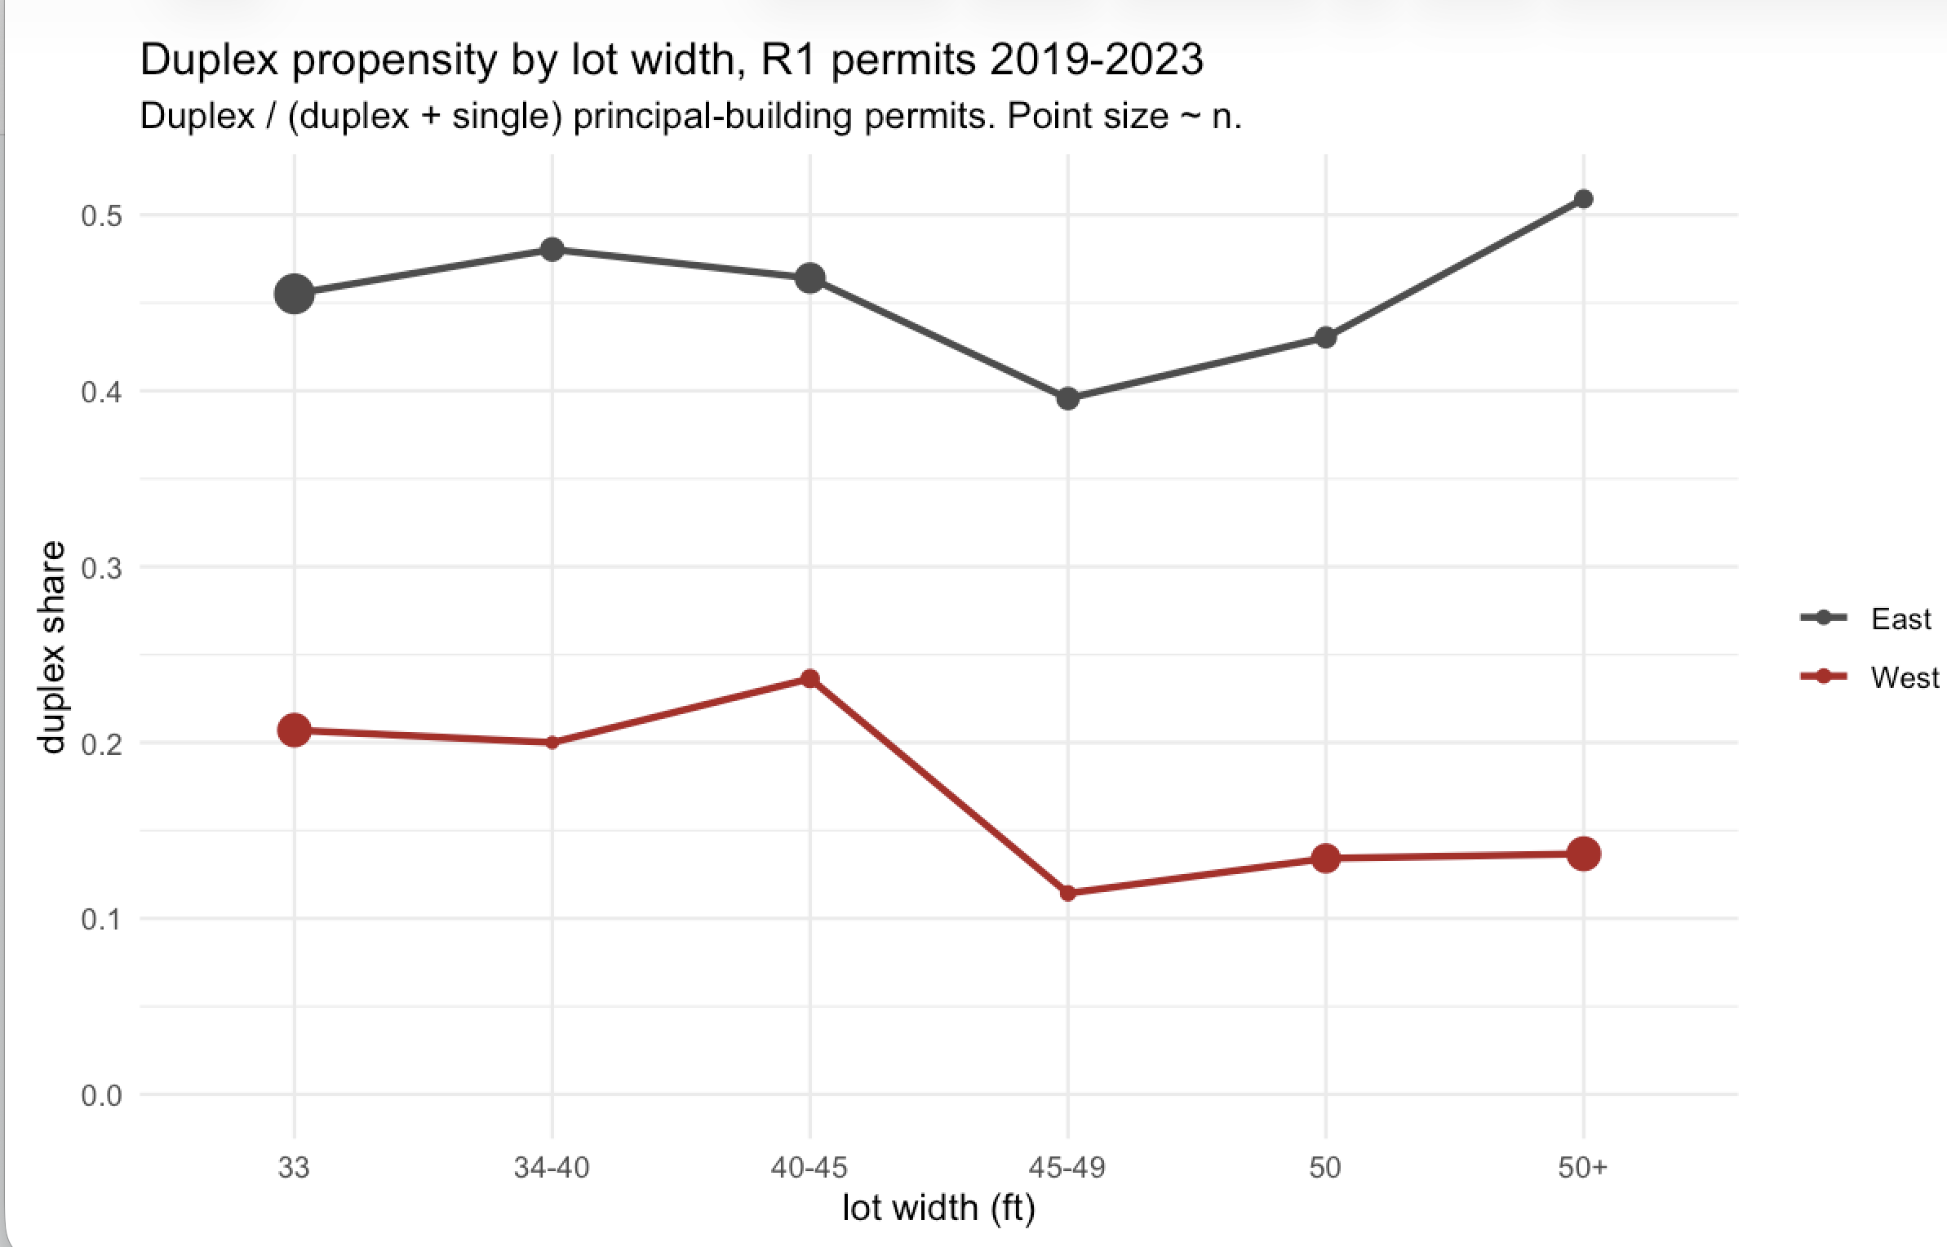
A problem with missing middle
Infill goes on the less valuable land!

Slide 17
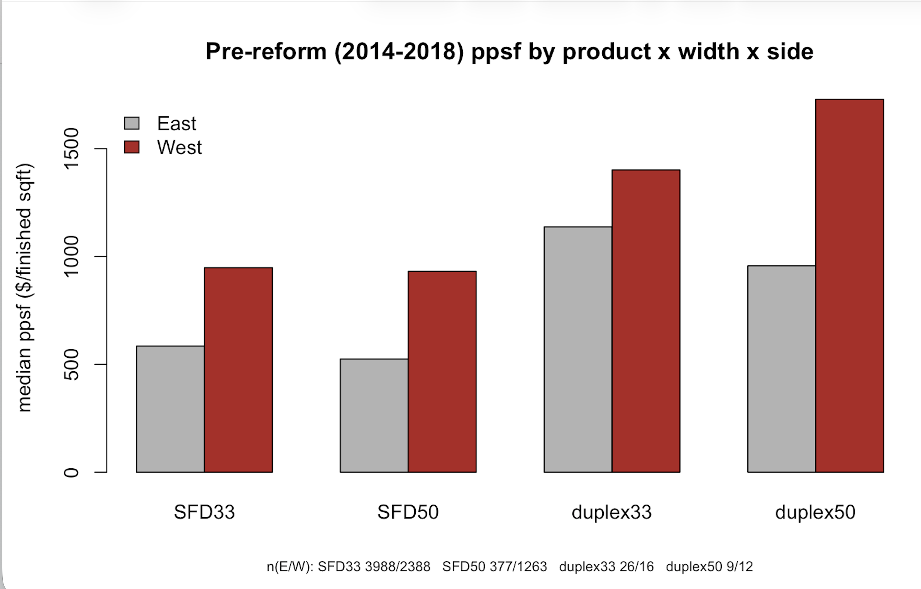
Why not more infill on valuable W side?
Hard to beat single family where incomes high

Slide 18
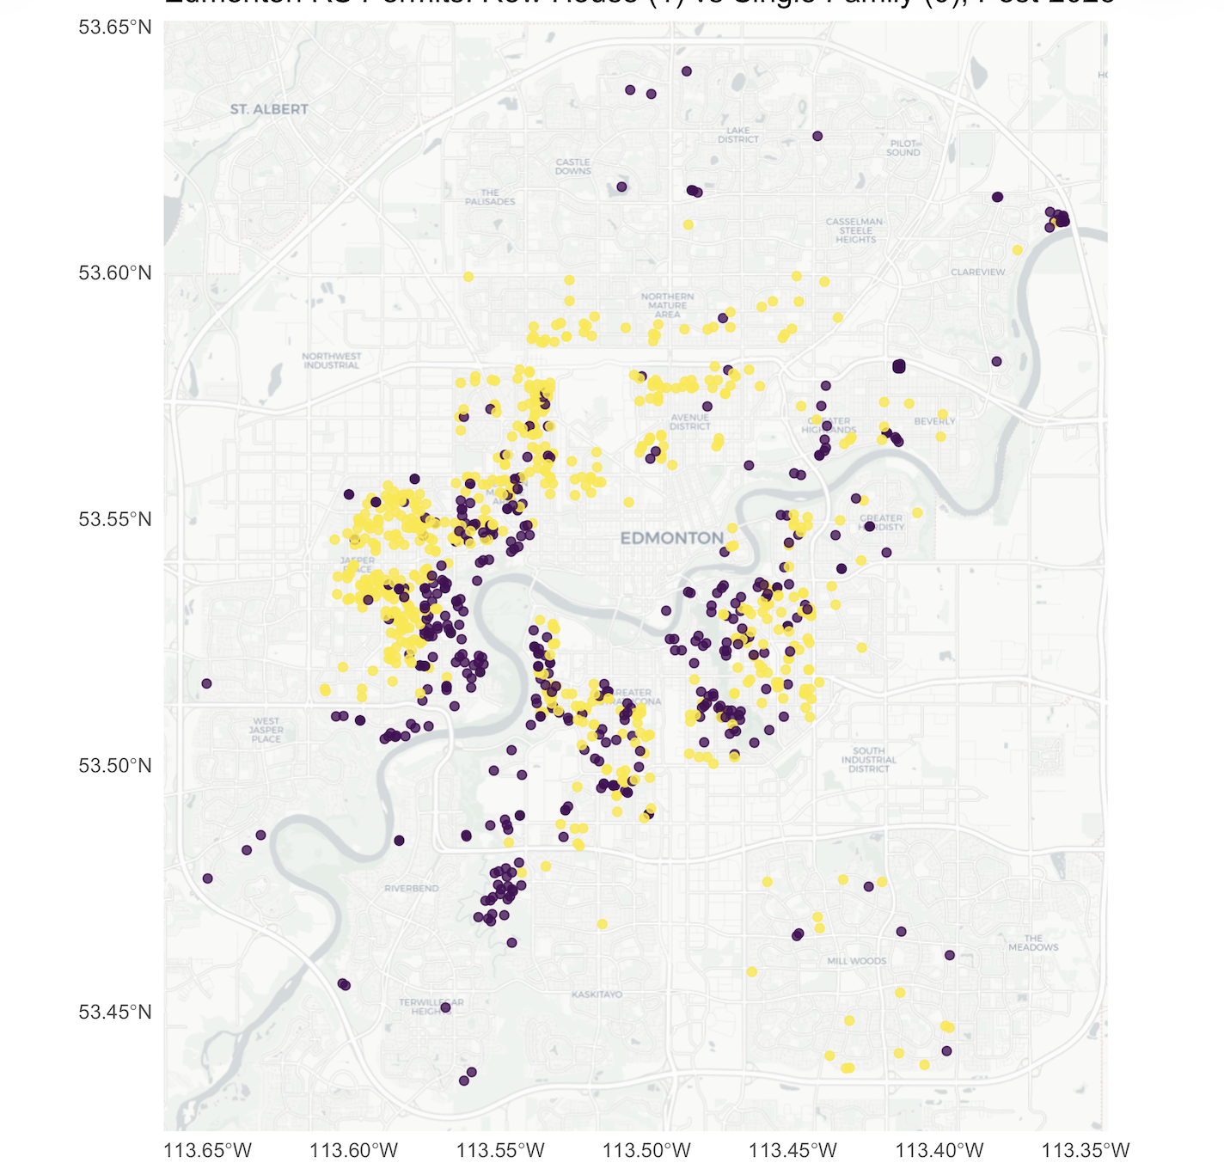
Similar Story in Edmonton
New Row House Option not taken
In best locations
Purple: single family
Yellow: row house
Data: Edmonton building permits

Slide 19
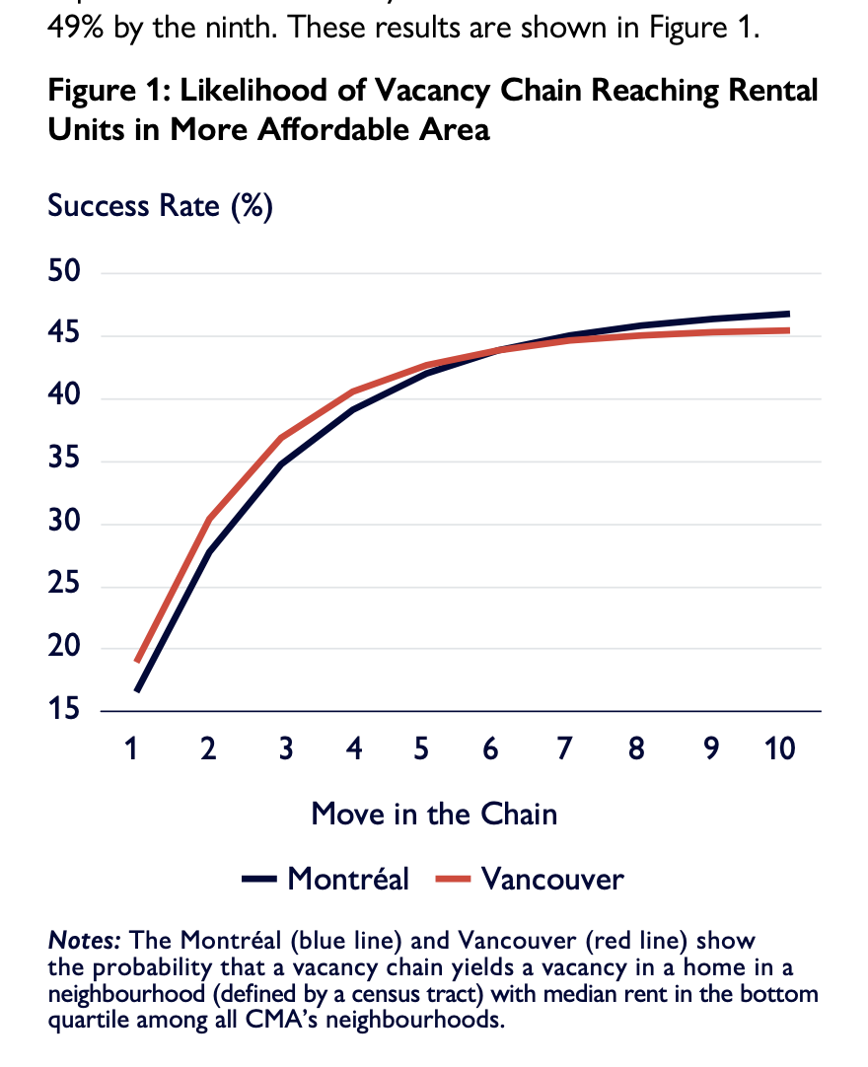
Do new homes “filter” to affordability
Yes, says the “vacancy chain” literature

Slide 20
Real Estate Investing 101
Borrow money and hope prices rise
  Discount rate: “r”. Governs how you value future vs present
    A dollar in t years is worth (1/(1+r)) * (1/(1+r)) … t times
    Higher r – money in the future worth relatively less in today’s $
    A key role in parenting: inculcate low r
  Yield is a cashflow x divided by cost or value of asset
  In real estate this is called a “cap rate”
  Cap rates should look like riskless rate minus expected growth + risk premium
  Riskless rate sort of easy to measure, up to maturity
  Risk premium and expected growth very hard to measure
  Evident that r has risen and g has fallen recently in Vancouver

Slide 21
Senakw Economics
Cost may have been $800 per square foot per estimates
  Not including land!?
  $500 high end concrete, here limited underground parking
  Considerable infrastructure costs
  I have high uncertainty on this key number
Rents: asking very high, e.g. $2500+ for 350 sqft
  That may yield vacancy.
  Suppose $5/sqft/month stabilized
  $4 per buildable with common areas -> $50/year gross
  Say $40 net on high end
  => $40 NOI / $800 costs = 5% cap rate going in ignoring land opportunity cost
Celebrity developer partner has sold interest, unlikely seeing much return

Slide 22
Land opportunity cost: don’t ignore
Common statement
  “Government land should go to affordable housing because it’s free”
  False: government has a valuable asset in land
  Senakw opportunity cost
    At least could try to get out of Indigenous status and develop luxury low-rise housing
    Even now, a 1,250 square foot duplex in worse location sells for $2 million
    Suppose, then $2,000 psf sale price, $500 all-in-costs
    Plausibly $1,000 per built square foot profit at, say, 1 FSR for multiplex
    Say senakw phase 1 is 6 FSR, $1,000/6 = $167/foot
    So maybe $40/(800 hard and soft + 167 land) = 4.13 cap
    That’s on the low end of residential cap rates with complexity of land status
Don’t expect phases 2-4 completion anytime too soon

