Slide 1
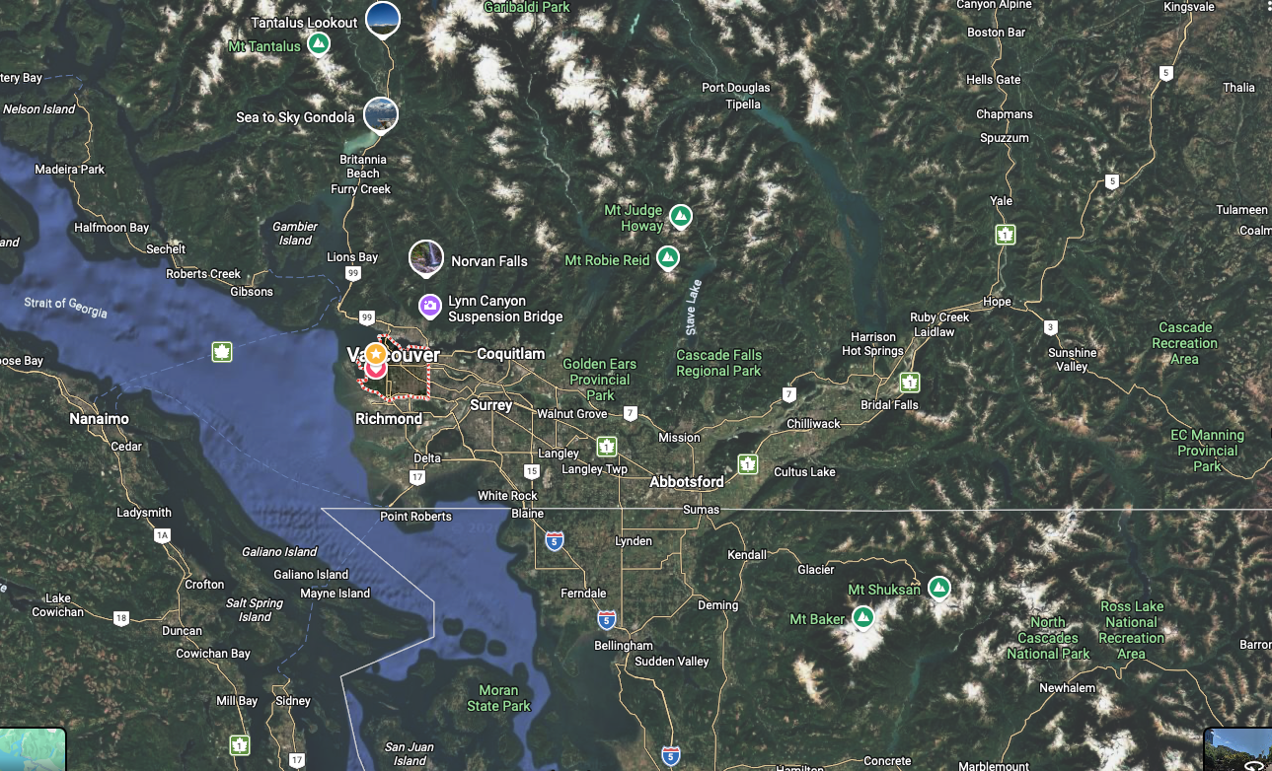
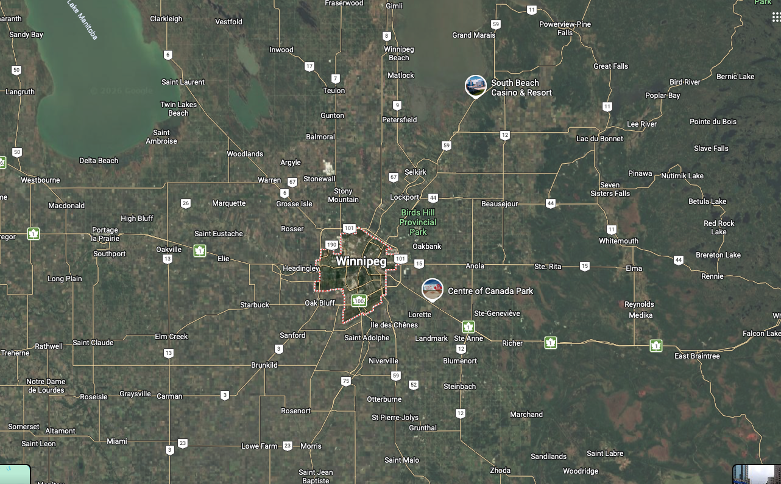
Why is Affordability So Bad in Vancouver?
Tom Davidoff
Sauder School of Business, UBC

Slide 2
Mountains and Ocean Make High prices 1
They are nice
Vancouver is (to most people) a nicer place to live than Winnipeg
So Vancouver can’t have both of:
  Same or better income for same skill level
  Same or lower housing costs
If Vancouver were nicer, cheaper, higher wage:
  Everyone would move out of Winnipeg, so prices would fall
  Too many people would move to Vancouver so
    Prices would rise
    Wages might fall
Special case of “no such thing as a free lunch”

Slide 3
The “Rosen-Roback” model
Vancouver is (to most people) a nicer place to live than Winnipeg
So Vancouver can’t have both of:
  Same or better income for same skill level
  Same or lower housing costs
If Vancouver were nicer, cheaper, higher wage:
  Everyone would move out of Winnipeg, so prices would fall
  Too many people would move to Vancouver so
    Prices would rise
    Wages might fall
Special case of “no such thing as a free lunch”

Slide 4
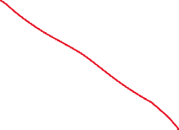
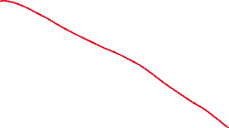

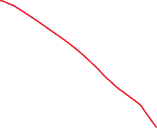
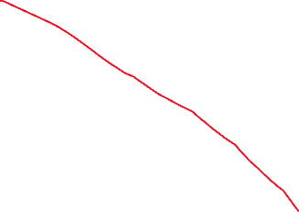
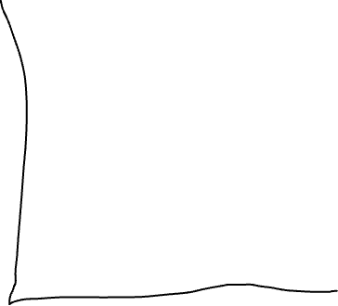
Mountains and Oceans Make High Prices 2:
”Inelastic Supply"

Slide 5
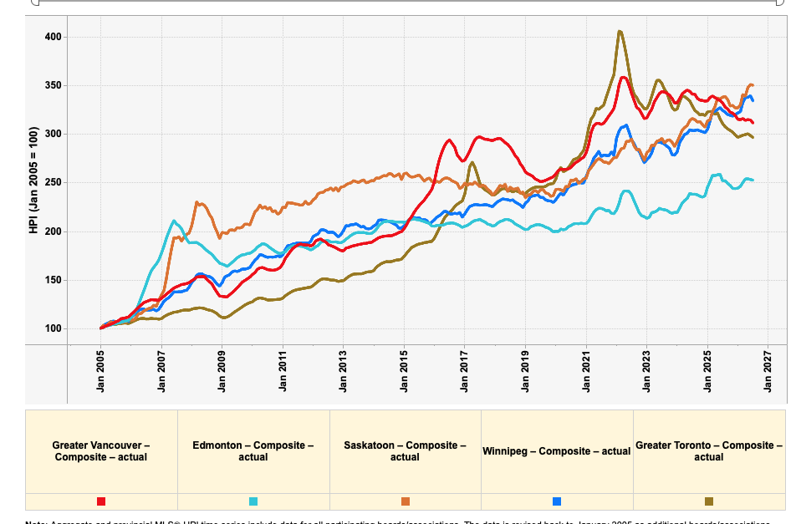
Lesson from supply-demand graph
If you want to improve affordability
  Add quantity or delete people
What has happened with lots of completions and immigration cuts?

Slide 6
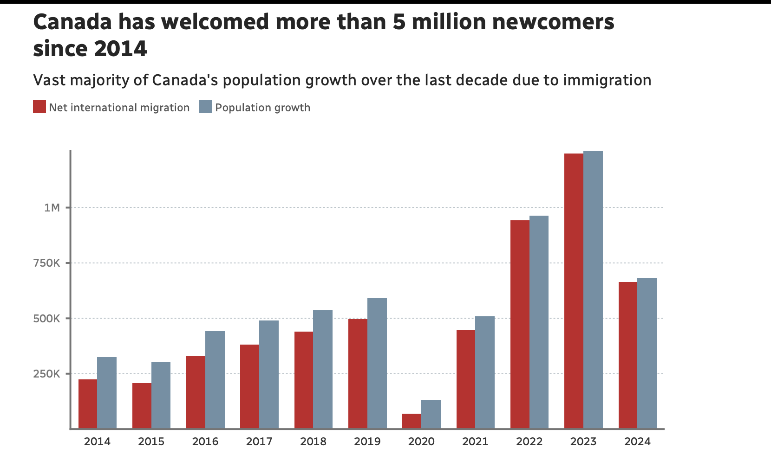
Demand: Immigration and population growth
Note further cuts in 2025 and 2026
Canadian population declining last 2 years!
Source: CBC

Slide 7
Demand policy:
What tax rates should be high or low?
Theory: relatively high tax rates if
  Supply is inelastic
  Demand is inelastic
  Complementary to the existing tax base
    (Tax skis, not neck ties)
Greater Vancouver
  Very low property tax rates
  Notoriously low supply elasticity
  Instructions from government
    Invest in real estate
    Don’t work for a living
    Mission accomplished: very high ratio of price to income

Slide 8
Raising property taxes is a political loser
But creative hacks may work
Up there with tolls and parking fees (which should be raised!)
Empty homes tax is popular
Foreign buyer tax is popular (I don’t love it)
Taxes on very high value homes are popular
My preference
  ”Alternative minimum tax” 1% of value (say)
  If income tax > 1% * property value: no surcharge
  Exempt seniors
  Could raise $2B/year just from fancy houses in Greater Vancouver
Almost certainly should tax Airbnb etc, not ban
  Empty homes taxes already 4%+ of value!
  Does society want a $1M condo rented out, or $40K + Airbnb tax?

Slide 9
Supply policy: Missing middle is popular, but hard to implement
Consider single family owner with $3M home
Upzoning to “multiplex” adds very little to value
Neighbours building multiplex is a nuisance
Upzone to 50 stories yields land value bonanza
  Sad: lose neighbourhood
  Happy: make millions of dollars and add more homes
  *Might* make more sense in infrastructure planning

Slide 10
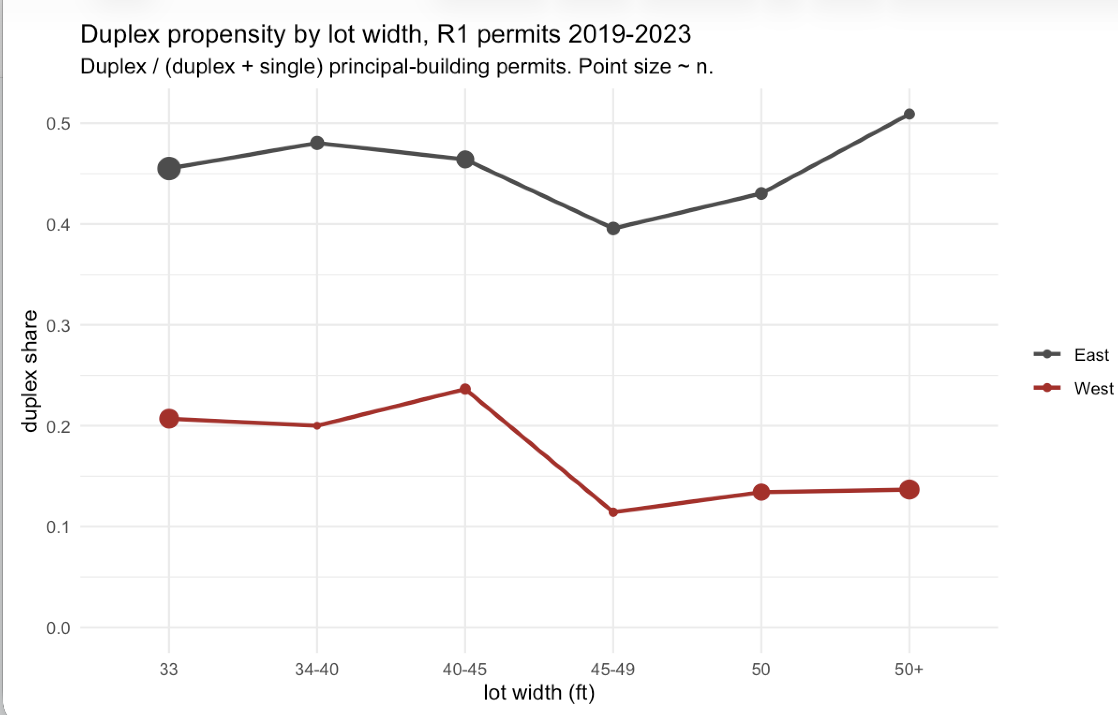
A problem with missing middle
Infill goes on the less valuable land!

Slide 11
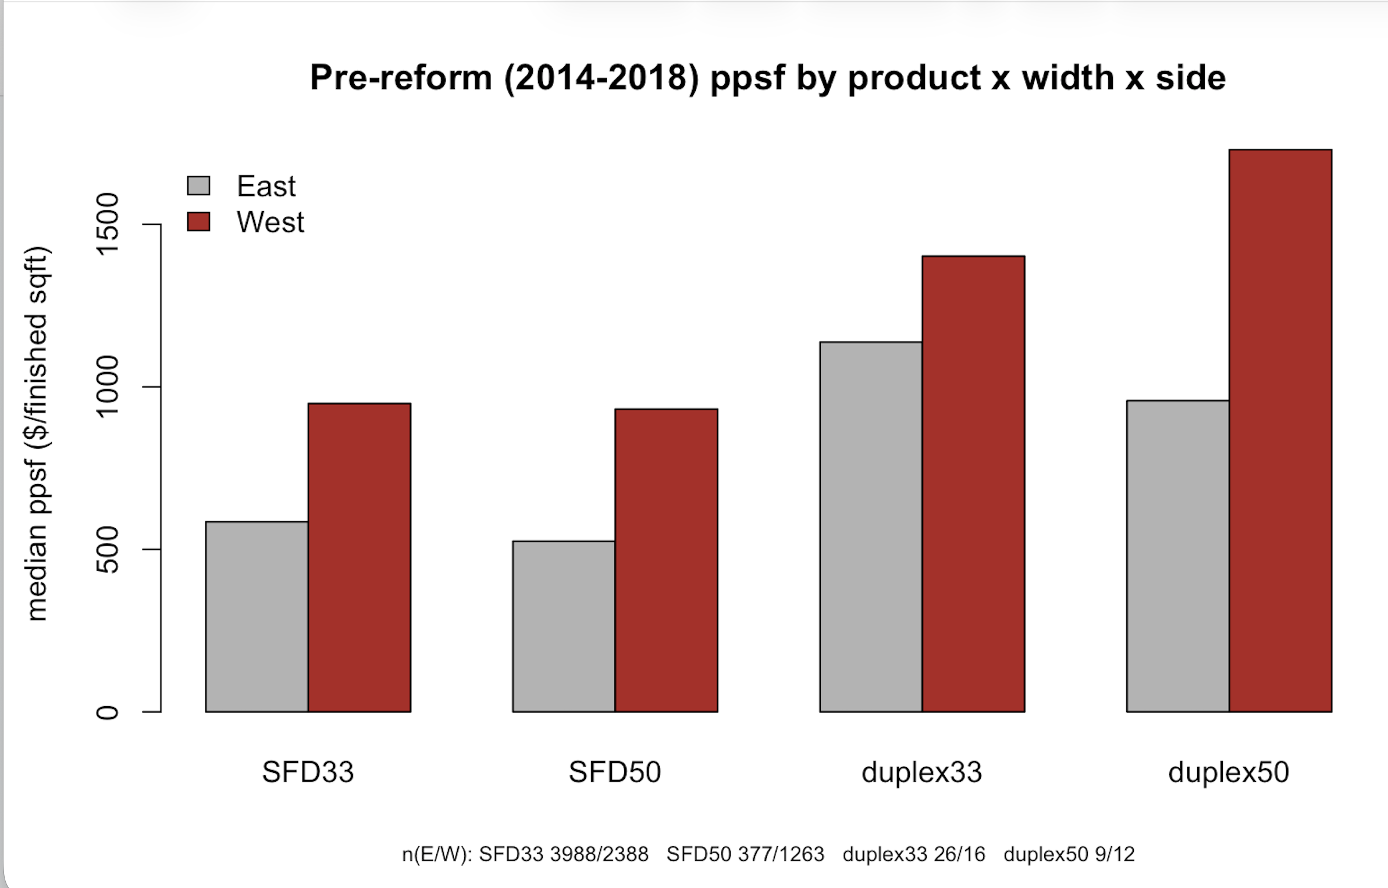
Why not more infill on valuable W side?
Hard to beat single family where incomes high

Slide 12
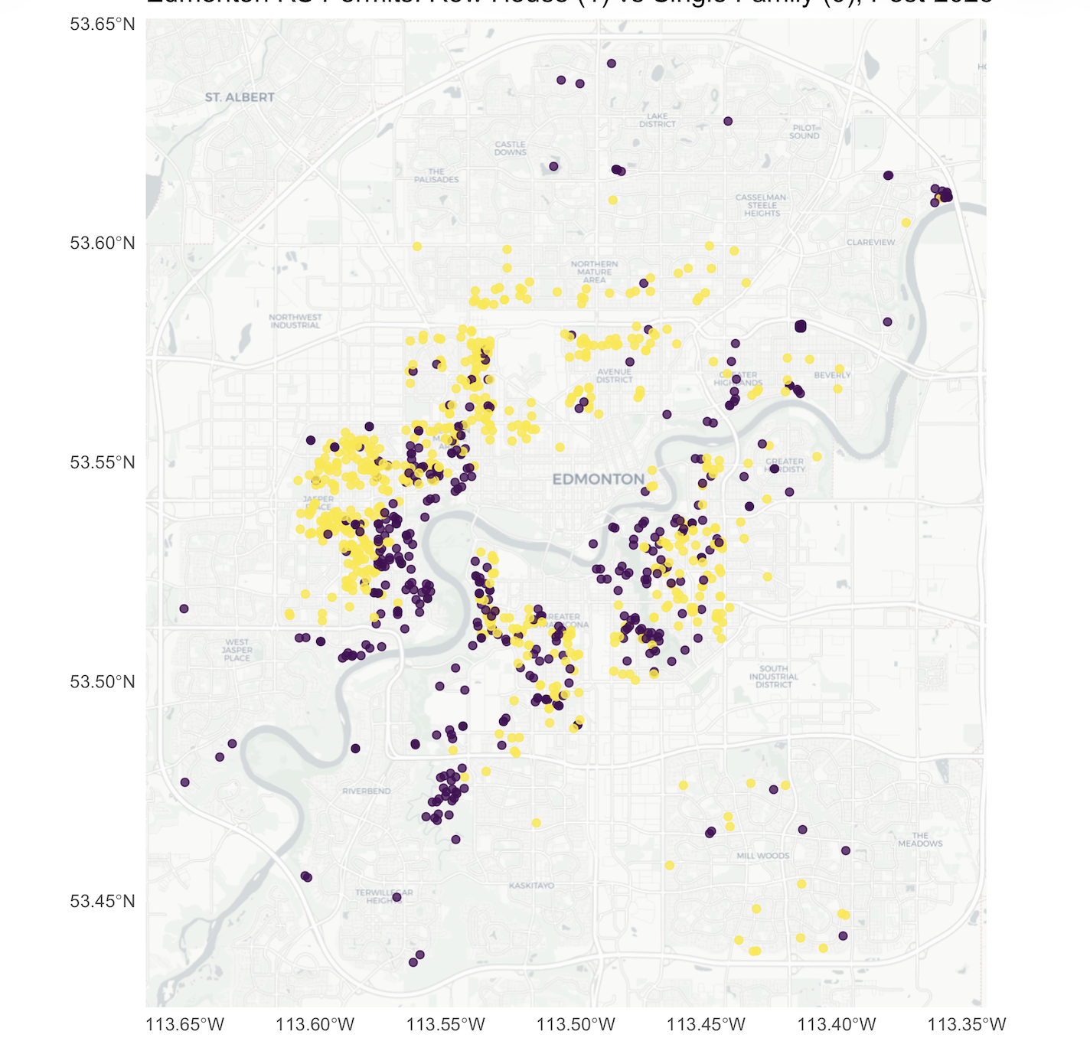
Similar Story in Edmonton
New Row House Option not taken
In best locations
Purple: single family
Yellow: row house
Data: Edmonton building permits

