Slide 1
Control a double MCK

Slide 2













Dynamical system
$$x_{1}$$
$$x_{2}$$
$$k_{1}$$
$$k_{2}\left(u\right)$$
$$F_{ext}=F_{0},t<t_{0}$$
$$F_{ext}\left(t\right)$$
$$m_{1}$$
$$m_{2}$$
$$F_{0}=1, t_{0}=0.5$$
$$c_{c}$$
$$c_{1}$$
$$c_{2}$$

Slide 3
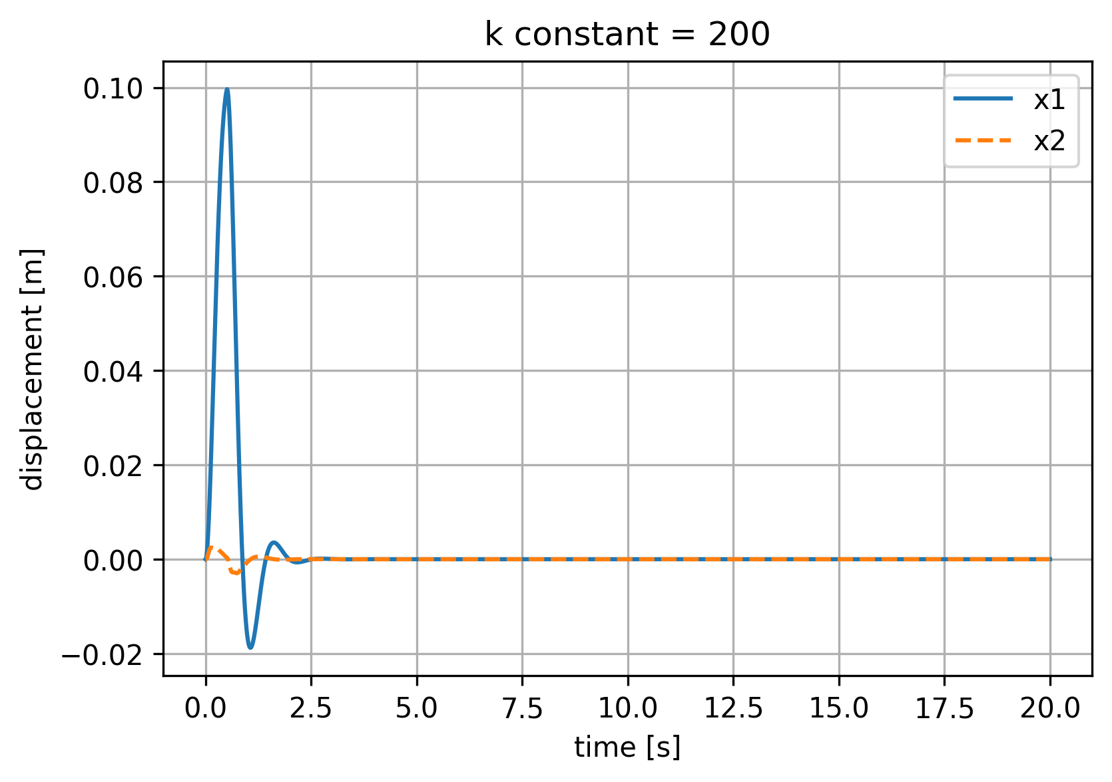
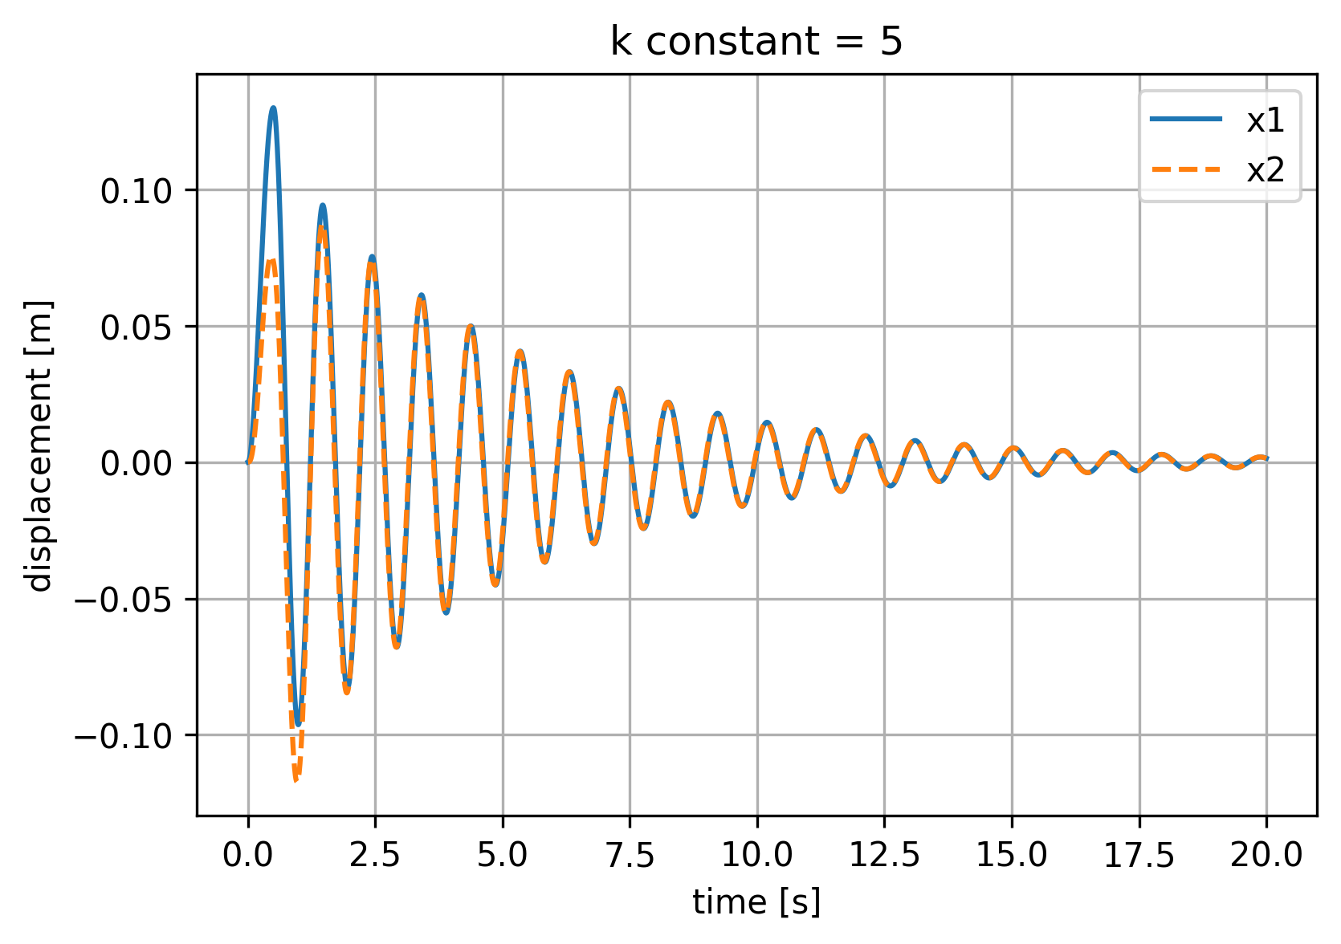
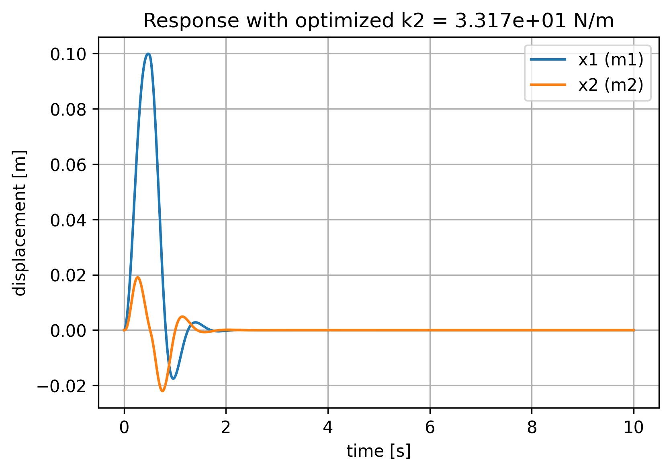
K2 constant, has influence on x1

Slide 4
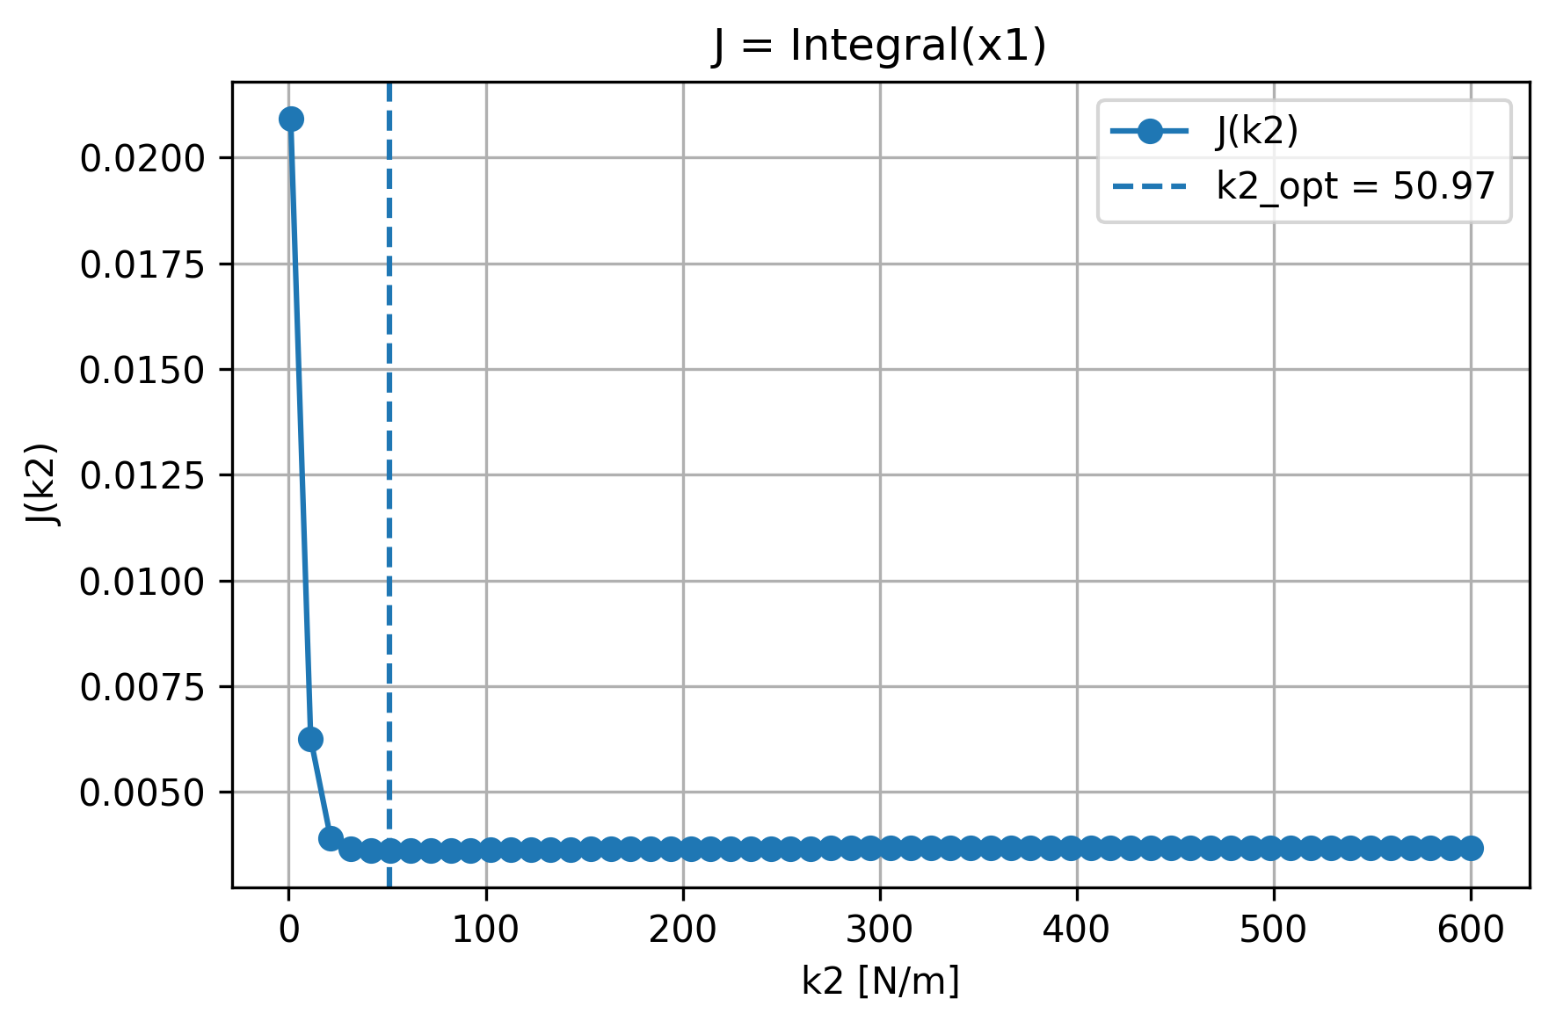
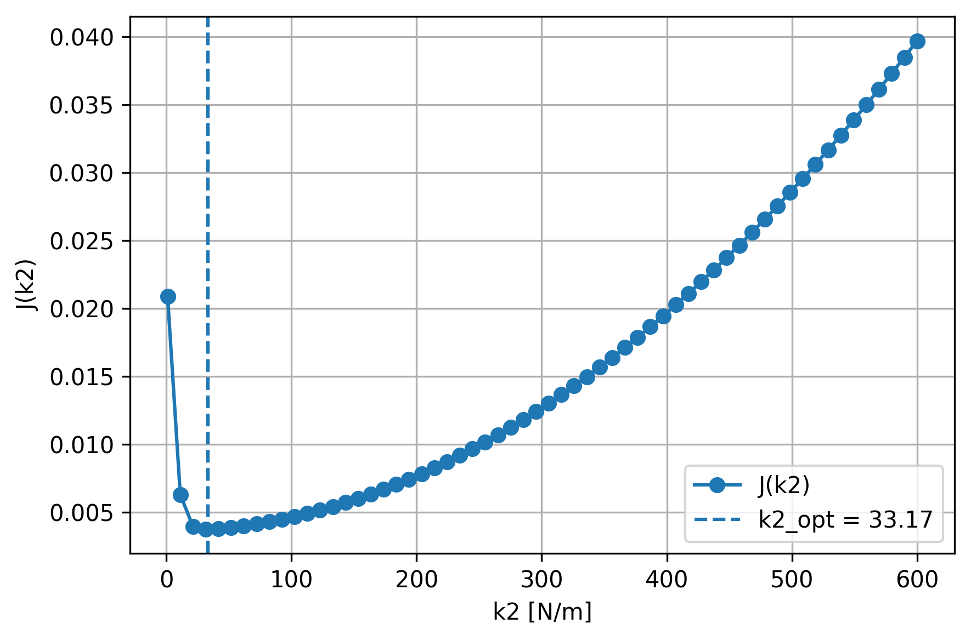
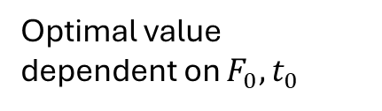

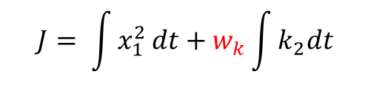
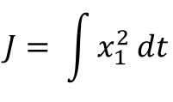
k2 constant, what is the best k2?
Optimal value dependent on $F_{0},t_{0}$
k2 range = [2,600]
$$w_{k}=1e−8$$
$$J= \int{x_{1}^{2}}dt$$
$$J= \int{x_{1}^{2}}dt+w_{k}\int{k_{2}dt}$$
J = 3.751263e-03

Slide 5
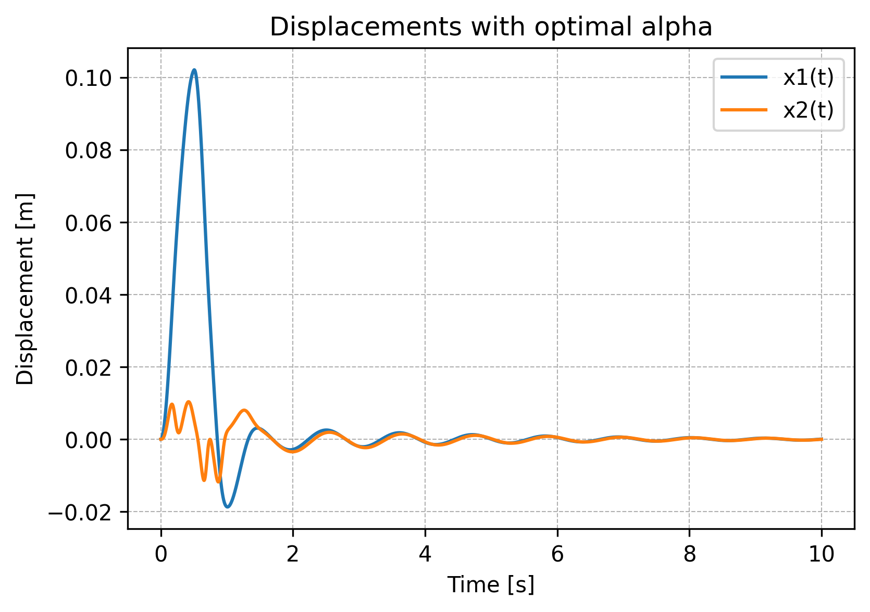
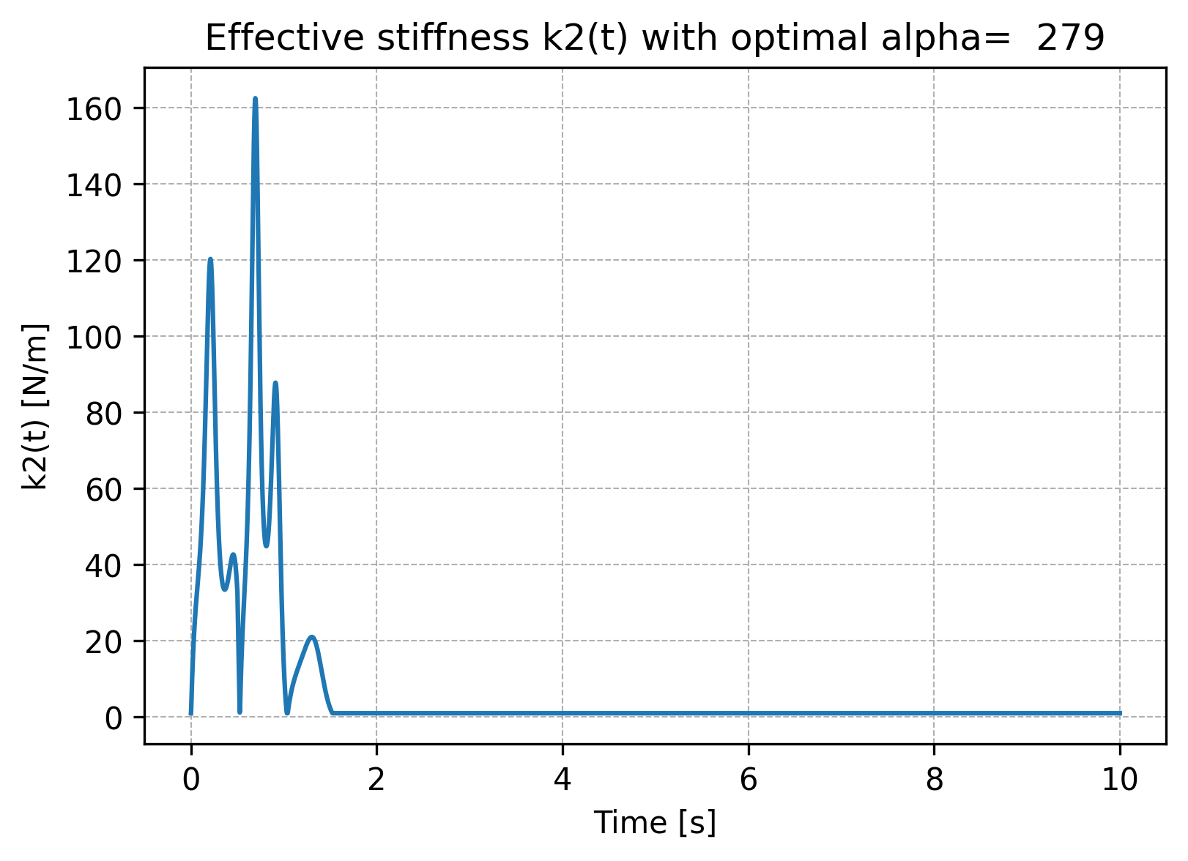

Controlled k2, optimization for alpha
$k_{2}=α|$ ${(\dot{x}}_{1}−{\dot{x}}_{2})|$
k2 clipped between [1, 600]
J = 3.754276e-03

Slide 6
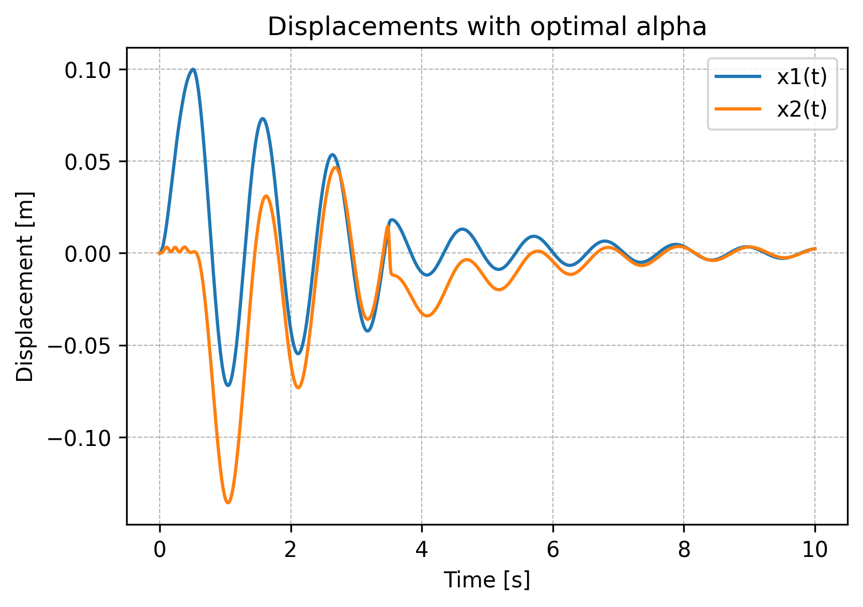
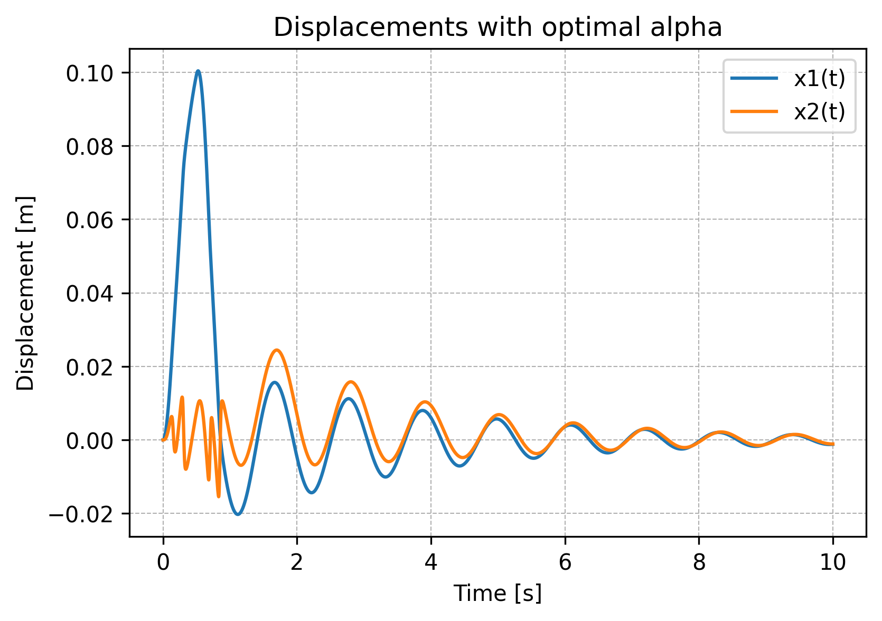
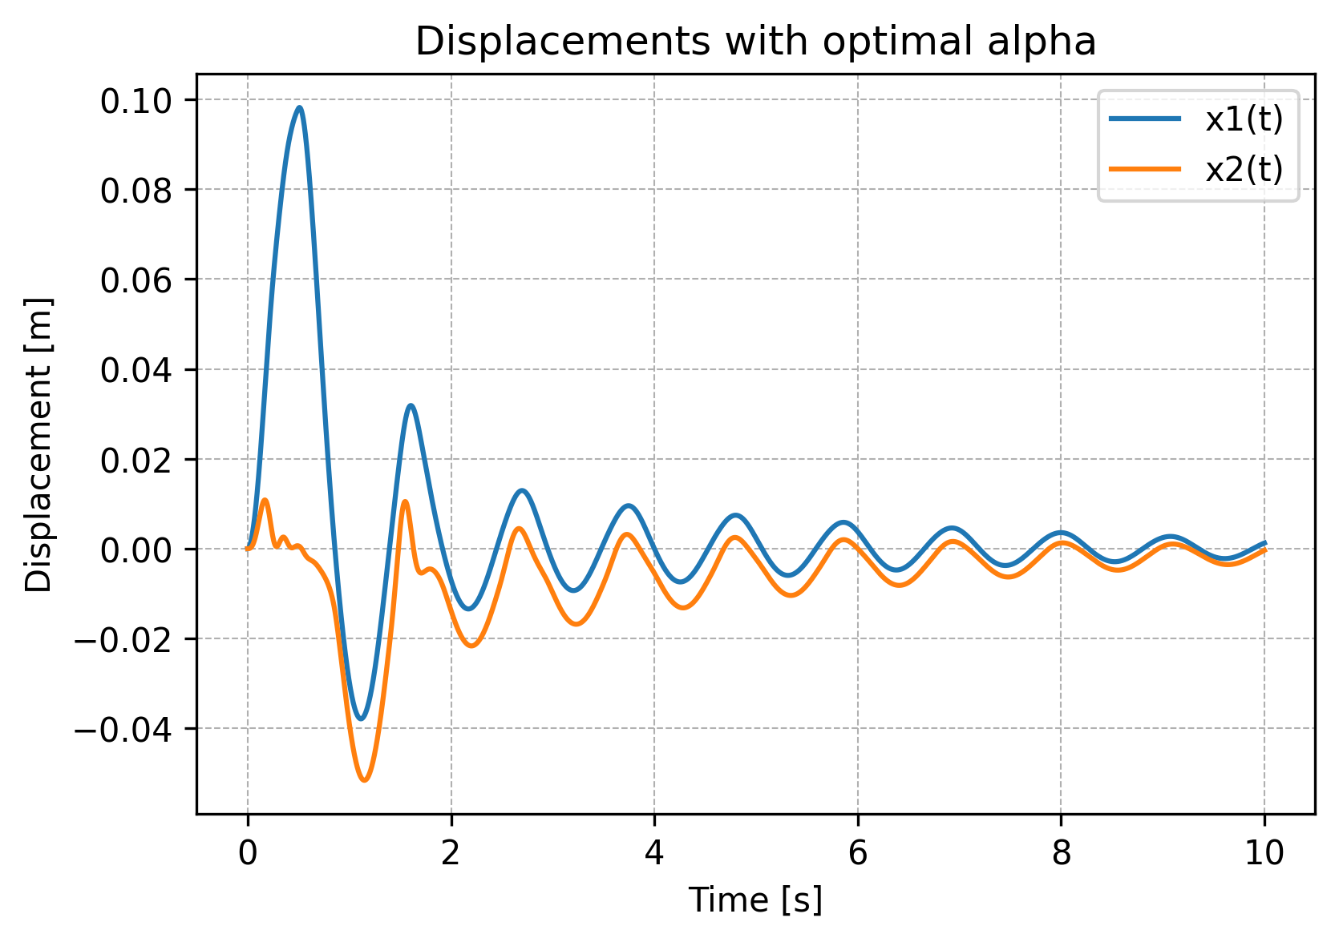



Other control laws
$$k_{2}=α{(\dot{x}}_{1}−{\dot{x}}_{2})$$
$$k_{2}=α{(\dot{x}}_{1}−{\dot{x}}_{2})^2$$
$$k_{2}=αx_{1}$$

Slide 7
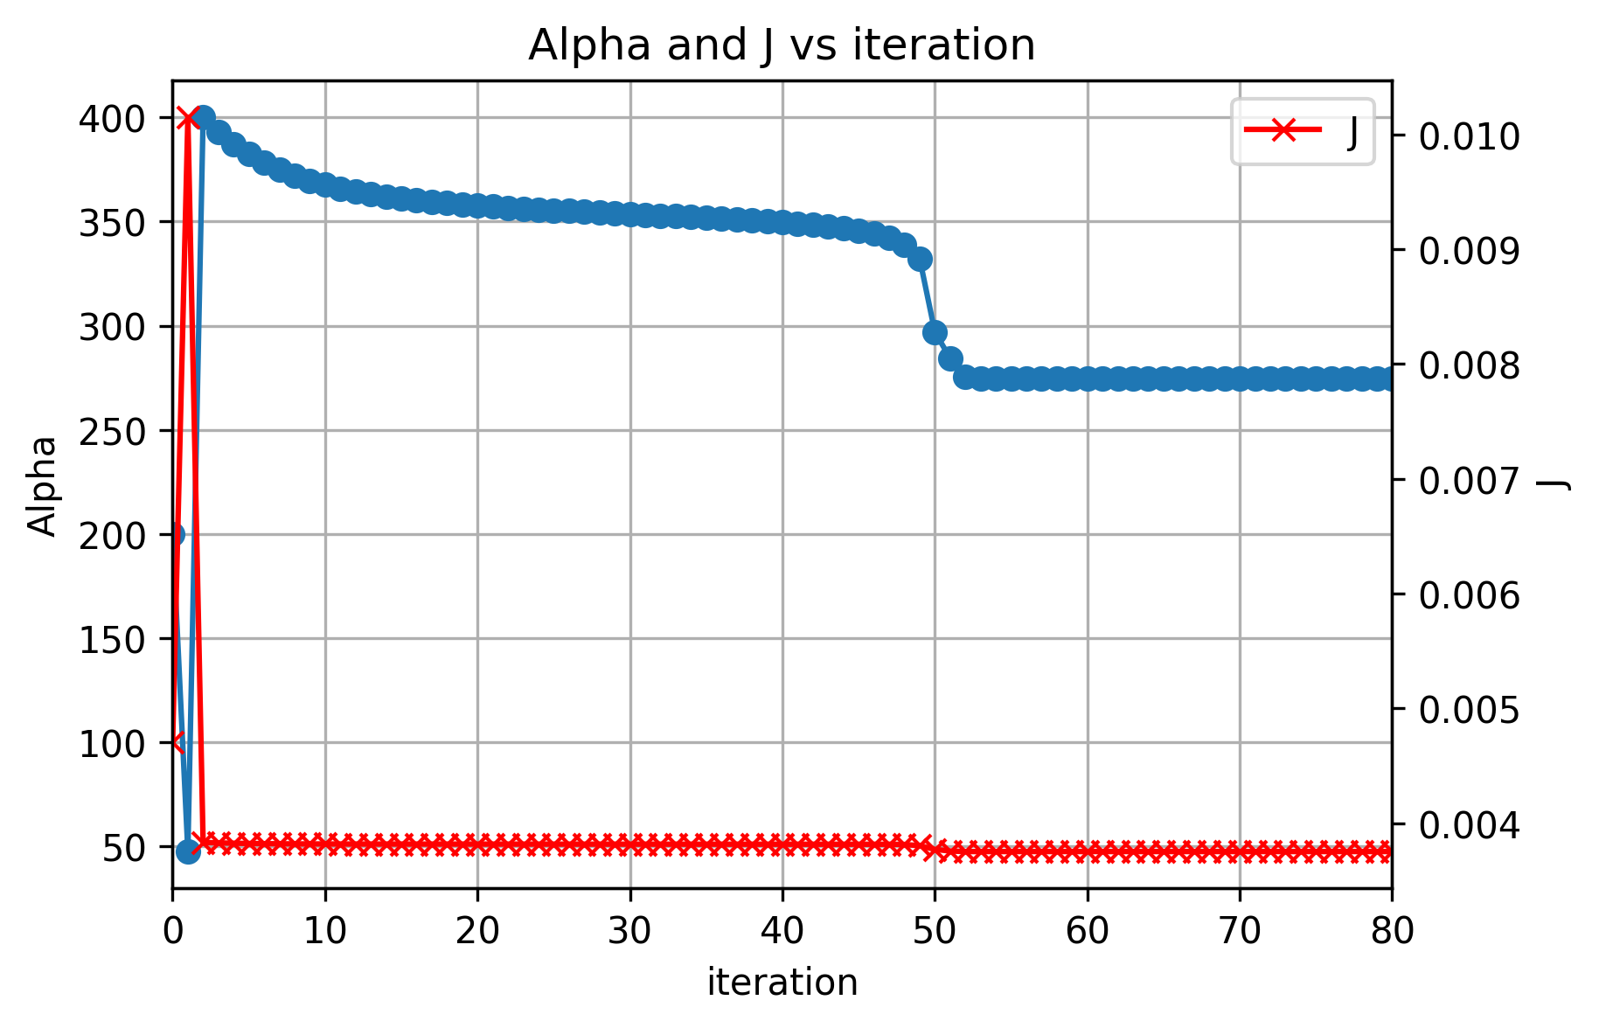
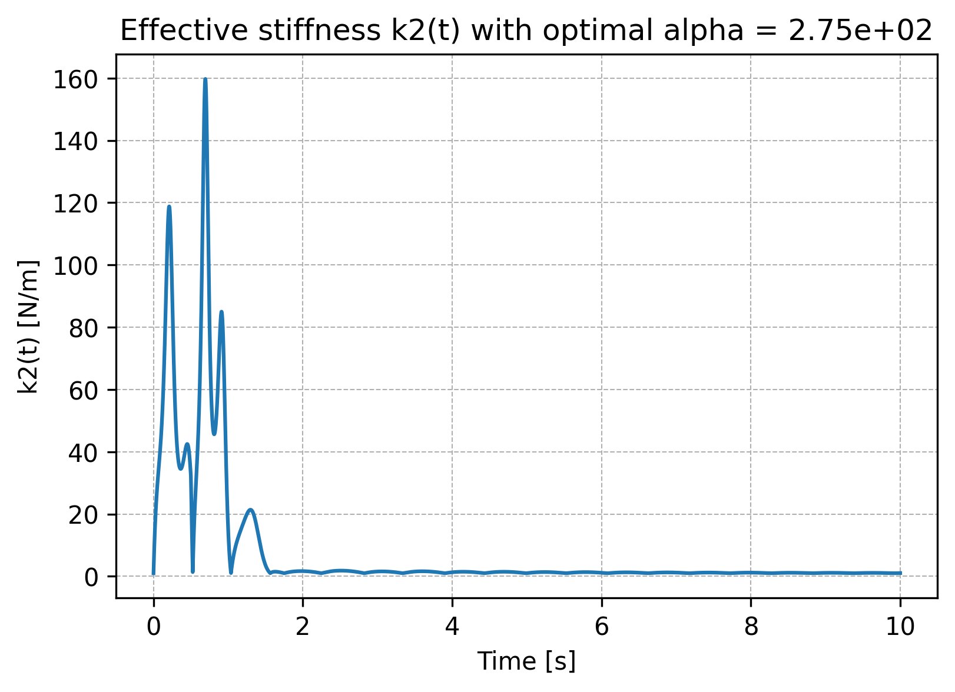
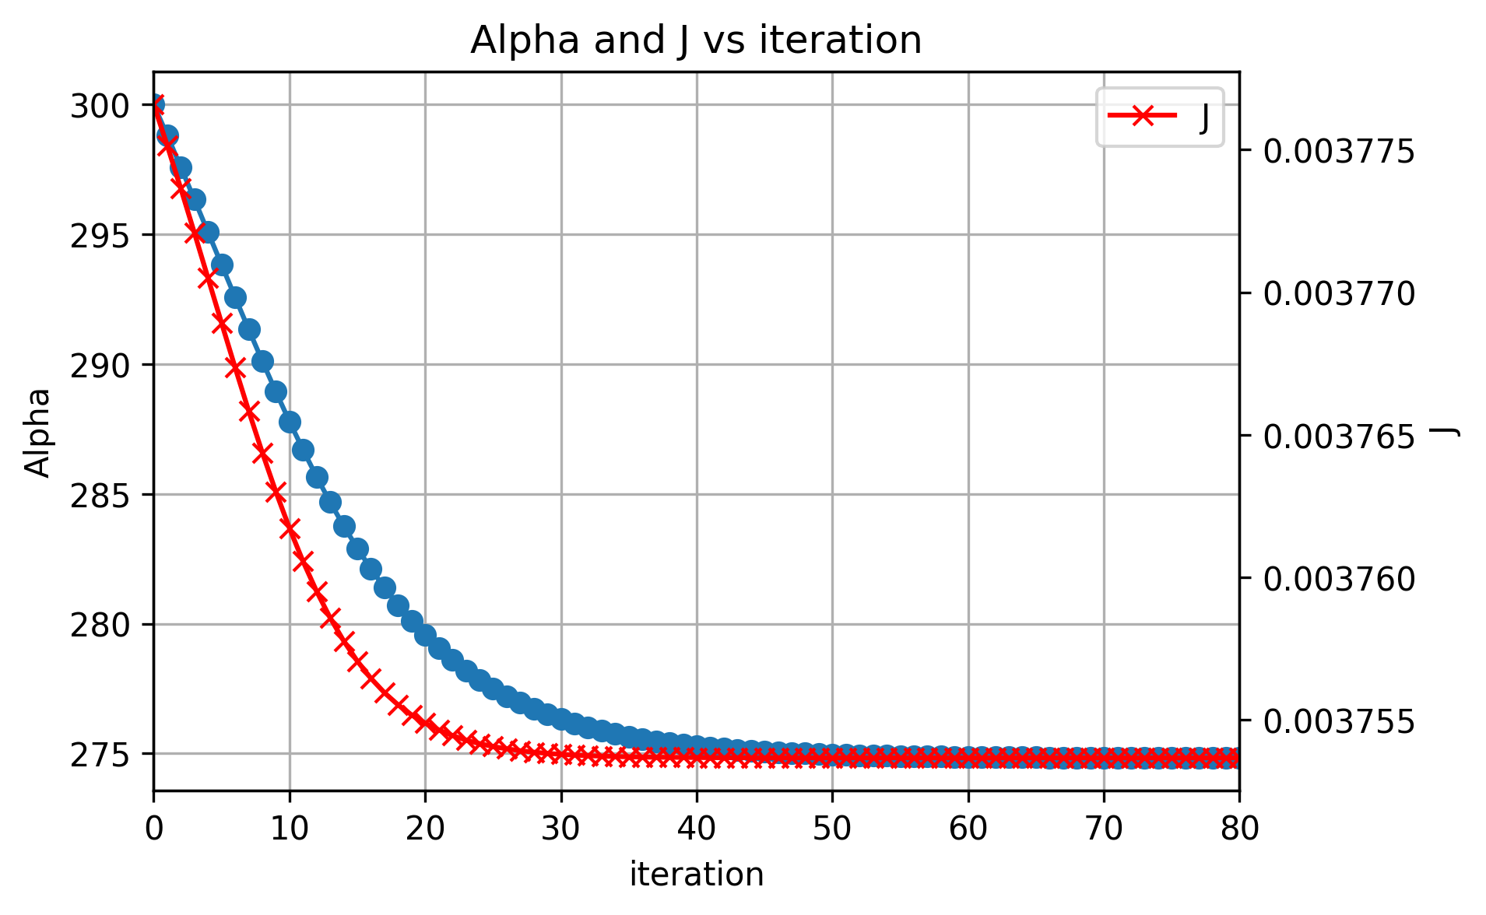

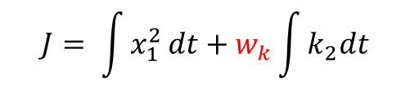
Adjoint optimization
$k_{2}=α|$ ${(\dot{x}}_{1}−{\dot{x}}_{2})|$
$$J= \int{x_{1}^{2}}dt+w_{k}\int{k_{2}dt}$$

Slide 8
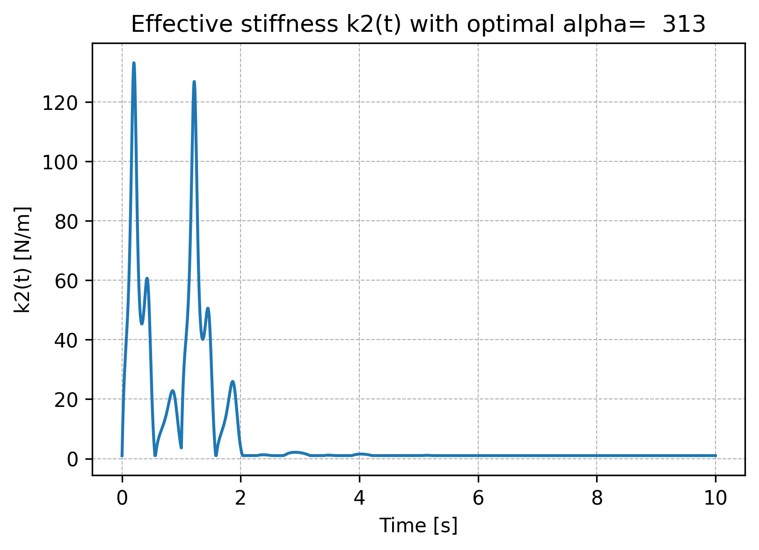
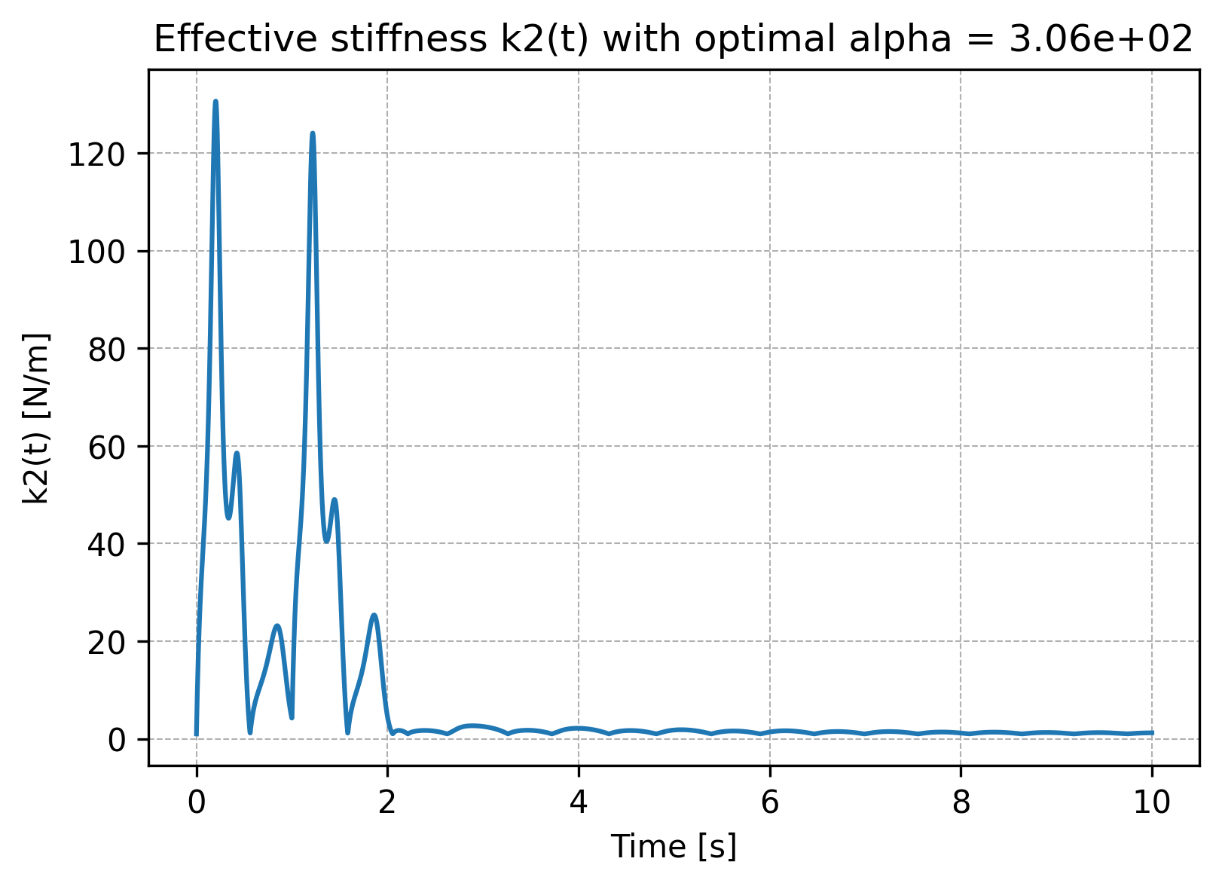

Another case
$F_{0}=1, t_{0}=$1
Minimize Scalar
Very FAST
Adjoint
Time consuming

