Slide 1

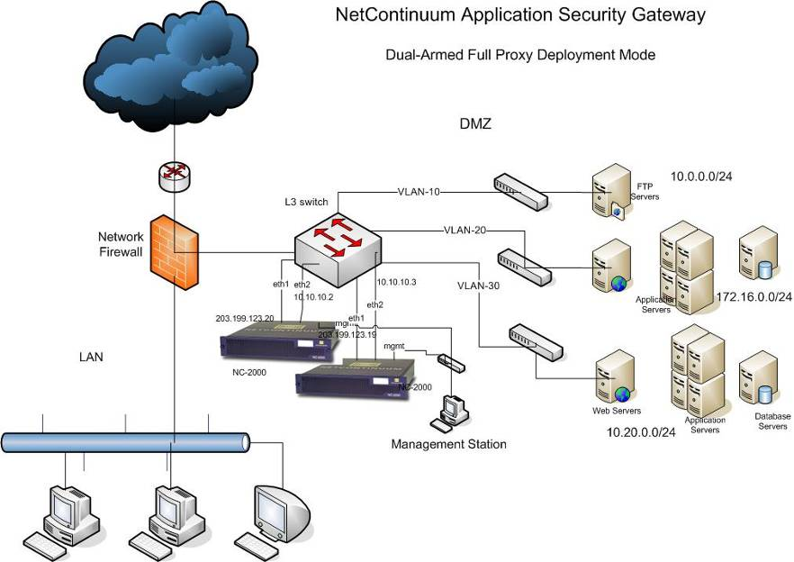
Multi-VLAN Deployment Scenario
NC in front of Load Balancer
Load Balancer

Slide 2
Multi-VLAN Deployment Scenario
-NC behind Load Balancer
Load Balancer
Load Balancer
If NC-1 fails, the Load Balancer detects the
same and directs traffic through 2nd NC.

Slide 3
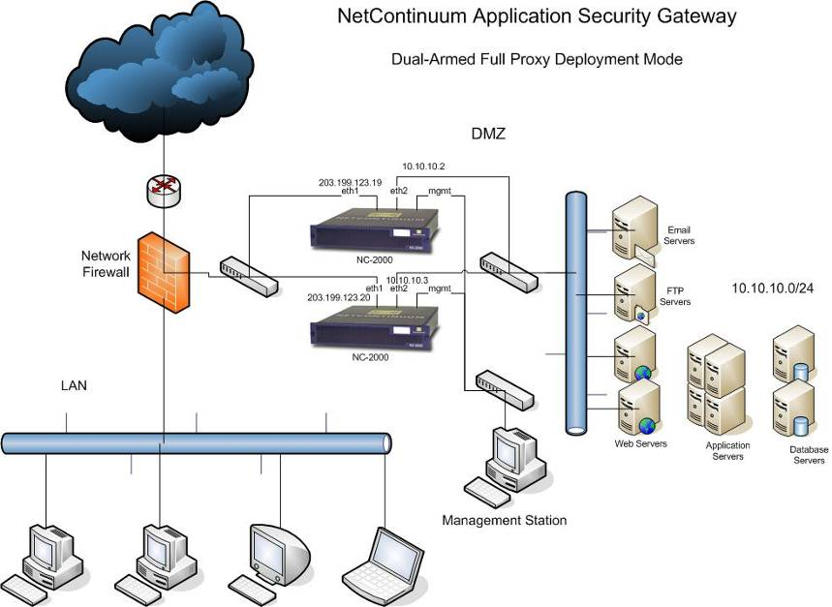
Deployment Scenarios

Slide 4
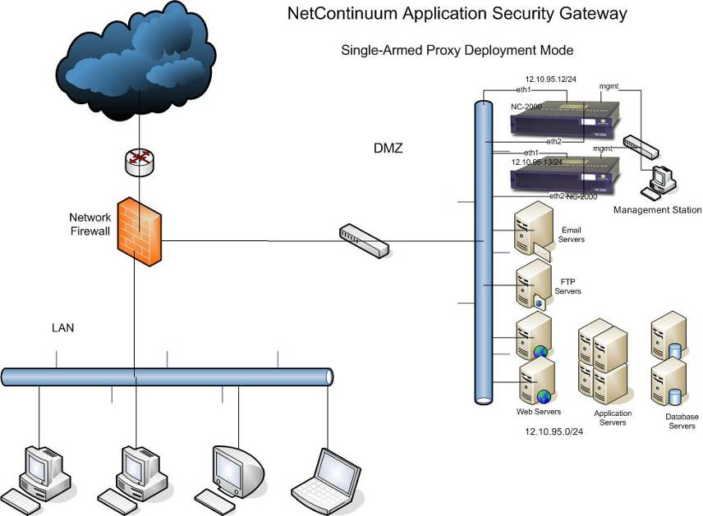
Deployment Scenarios

Slide 5
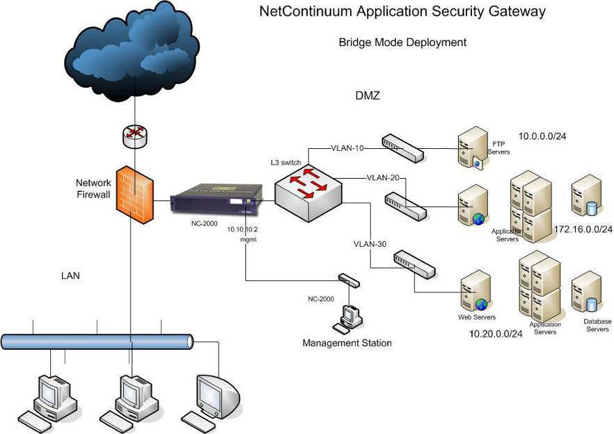
Bridge Mode Deployment
NOW with
FAIL OPEN!!

