Slide 1
IRONHACK
QUIZ ETHNIE

Slide 2
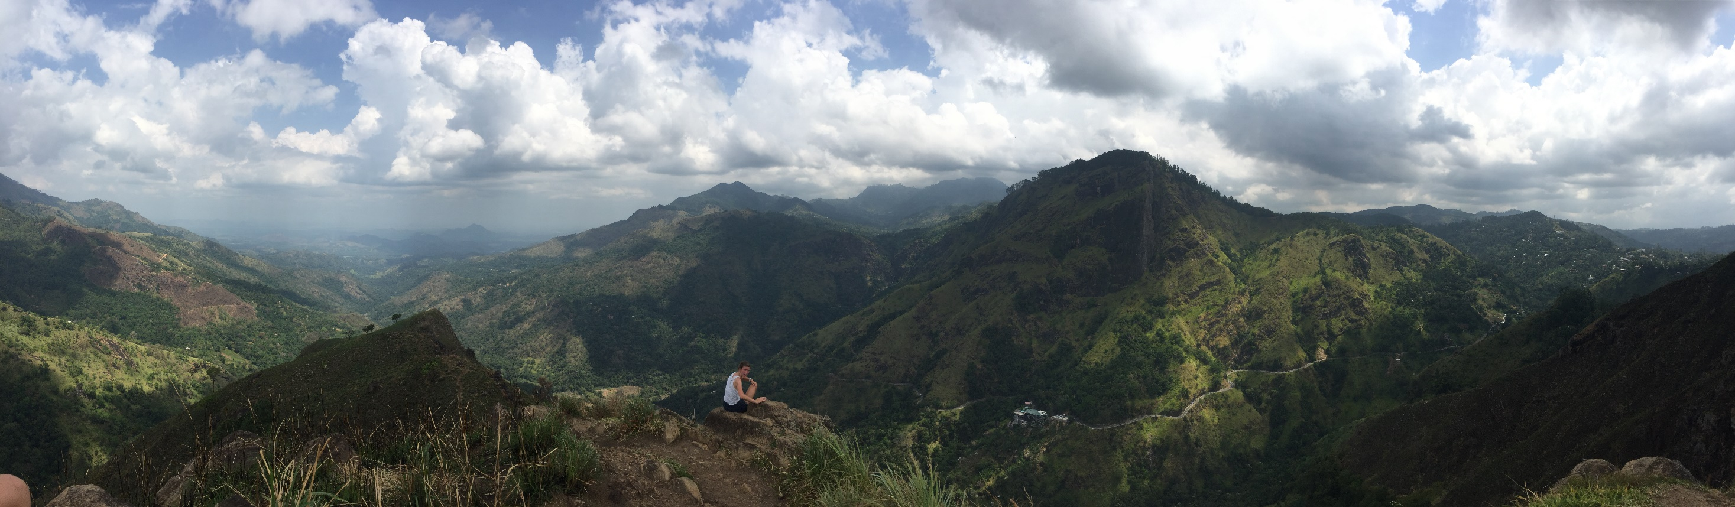
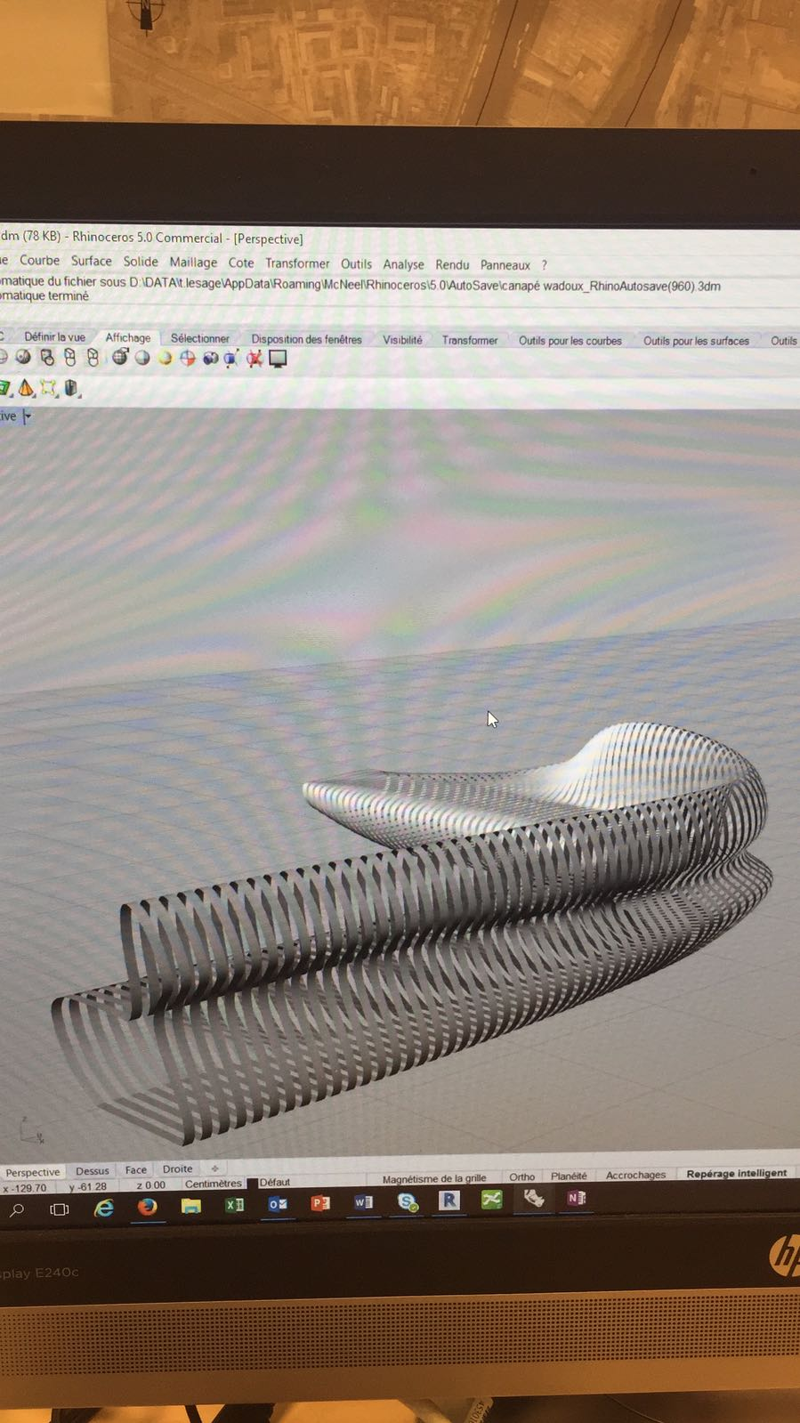

About Me!

Slide 3
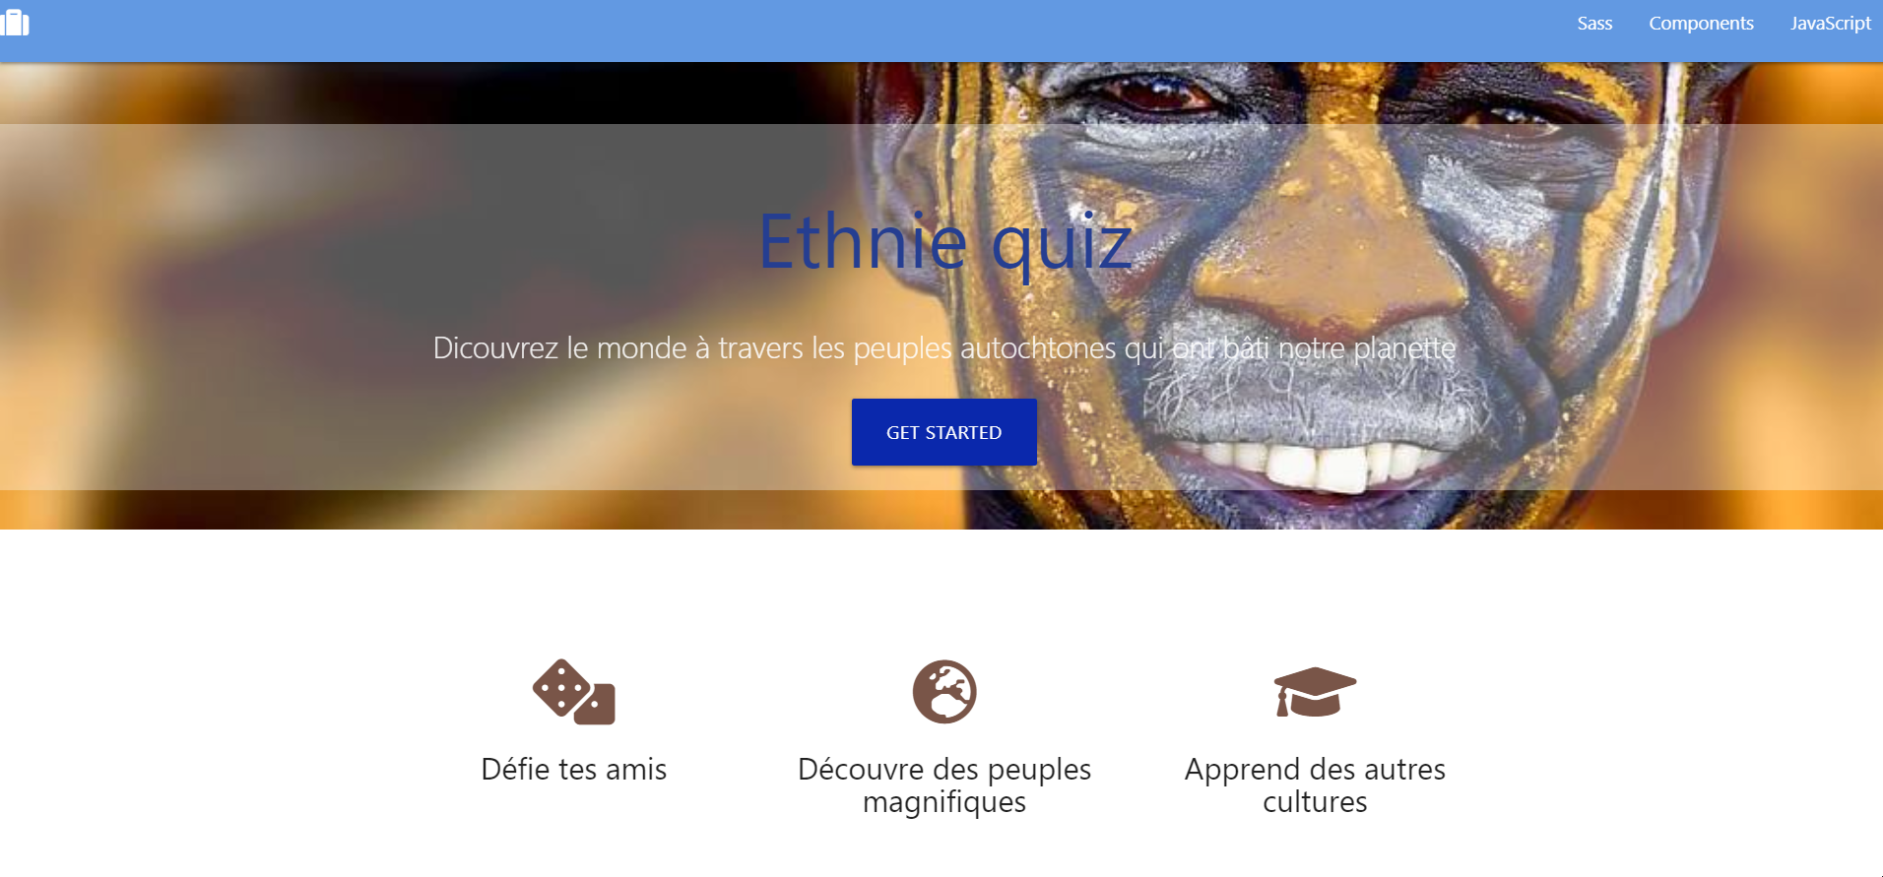

Slide 4
What is my project?
How does it work?
Why did I choose it?

