Slide 1

Unit Testing T-SQL Code
Steve Jones
Editor,
SQLServerCentral
Redgate Software

Slide 2
Agenda
Who Am I?
Testing Software
Database Testing Frameworks
Test Examples

Slide 3
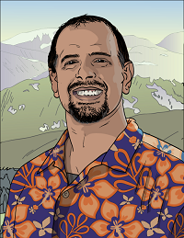



Who am I?
Steve Jones
SQLServerCentral founder
Redgate Software Evangelist
www.voiceofthedba.com
sjones@sqlservercentral.com
@way0utwest
/in/way0utwest

Slide 4
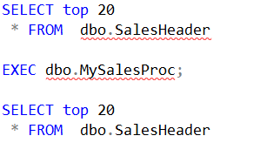
Who Does T-SQL Unit Testing?
Not this
This

Slide 5
Unit Testing
“The primary goal of unit testing is to take the smallest piece of testable software in the application, isolate it from the remainder of the code, and determine whether it behaves exactly as you expect.“
From https://msdn.microsoft.com/en-us/library/aa292197%28v=vs.71%29.aspx

Slide 6
Unit Testing
“Unit testing is a lot like going to the gym. You know it is good for you, all the arguments make sense, so you start working out. There's an initial rush, which is great, but after a few days you start to wonder if it is worth the trouble.”
From http://stackoverflow.com/questions/67299/is-unit-testing-worth-the-effort

Slide 7
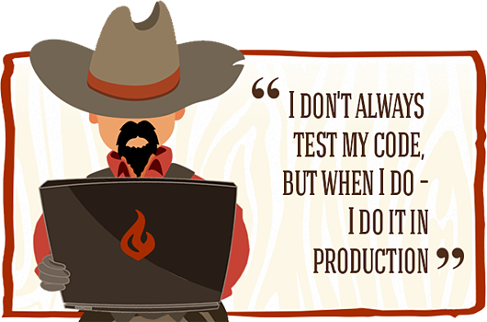
Database Unit Testing
Notes:
http://nathanleclaire.com/images/unit-test-angularjs-service/cowboy.png

Slide 8
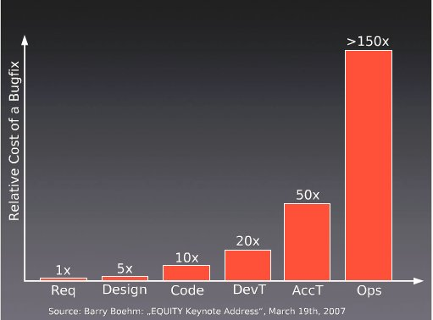
Why Test?
Notes:
Note that the cost of bugs rises. We know this. The earlier we find issues, the better. We can see from this survey that the cost of bugs rises dramatically as we get closer to the client.

Slide 9
Building Tests
We want repeatable tests
We want automated tests
We want a suite of tests

Slide 10
Writing Tests
TDD?
Write before coding
Good for listing requirements
Forces you to slow down and think about the problem
Can write after
Write as you get feedback from CI and QA
All bugs should create a new test
Prevent regressions

Slide 11
Structure of tests
Classes
Group by object/area being tested
Or scale (Google – S, M, L)
Layout
Assemble
Act
Assert
Tests fail first

Slide 12
Test Data
We don't need lots of data to write code
Ideally our tests contain data
For more extensive testing, we should have a curated set of data that all developers (and systems) use.

Slide 13
Test Data Options
Restore/Clone database
Load from flat files
Load with insert statements

Slide 14
Test Data
Storing and Loading Test Data

Slide 15
Testing Frameworks
There are a number of frameworks for databases
Some are based on other unit testing frameworks, like Junit
For SQL Server
tSQLt
MS Unit Testing Framework
DBTest
TSQLUnit
DBFit
SS-Unit
T.S.T
dbForge
others

Slide 16
tSQLt
tSQLt is a free, similar to nUnit/jUnit
tSQLt.org (requires CLR)
Stored procedures in their own schema
Can run setup before tests
Can mock objects
Can implement teardown
Support via Posts
Articles at Simple Talk
Notes:
Introduce the framework. Give URL, support, this is free.

Slide 17
Microsoft Unit Testing Framework
For SQL Server, implemented as part of SSDT
This framework allows us to write tests in T-SQL.
Tests are a part of a Visual Studio Database Project
The framework handles transaction wrapping
Notes:
https://msdn.microsoft.com/en-us/library/jj851212(v=vs.103).aspx

Slide 18
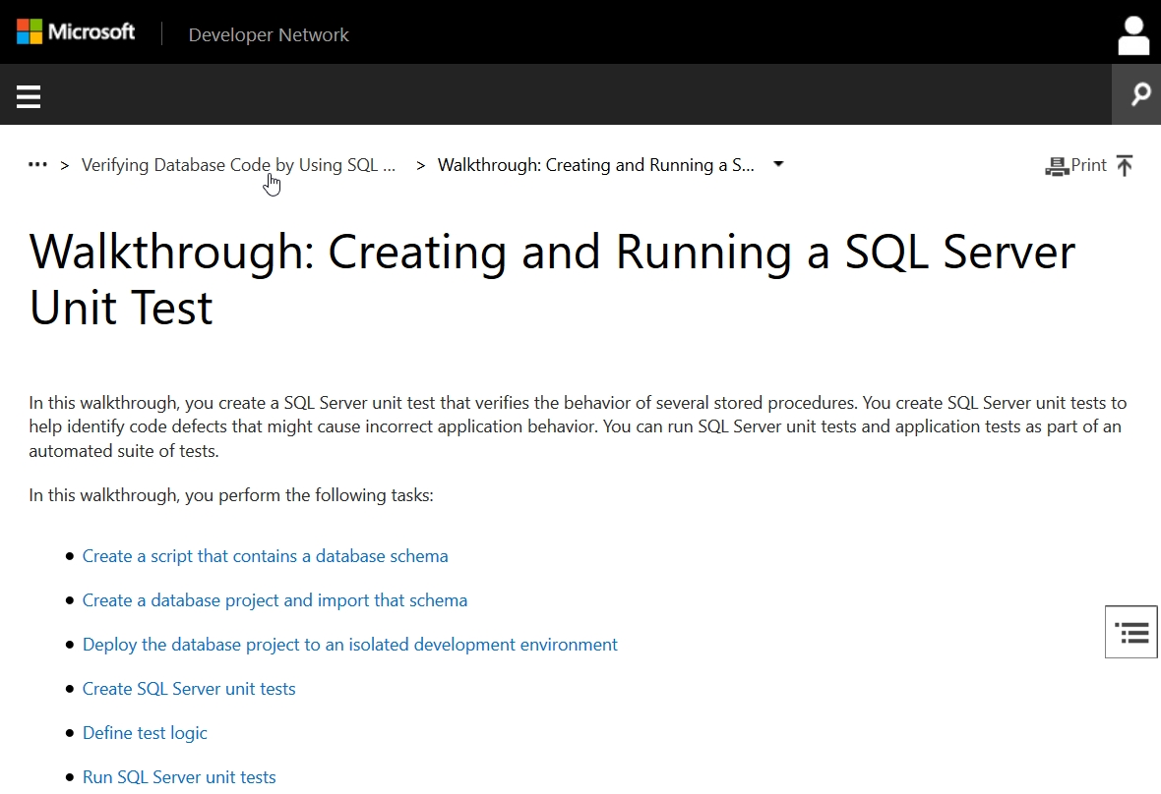

Slide 19
Standards Tests
Ensure that the standards you care about are followed.
SQLCop – sqlcop.lessthandot.com
Easy to write your own.

Slide 20
Catching bad CODE
Using Standards and Naming Tests
Notes:
Demo that shows how we build a table that doesn’t follow good practices. Use tblStagingImages as a table name
SQL Cop catches an error. Actually catches two, name and no PK.

Slide 21
Logic Tests
These are unit tests designed to find issues with a particular specific function.
This are especially useful when writing code as requirements may not be clear
Using a test ensures we document the results we expect, and have no ambiguity
This also helps prevent regressions when altering code

Slide 22
Checking Joins
Joins can pull data together in different ways
Refactoring can cause problems
Writing code for important, complex, or problematic queries is helpful to prevent regressions

Slide 23
Checking Joins
Testing Code Logic
Notes:
Write proc for insert and select of images
Create new test for insert, don’t fill stub
Create new test for select and edit
Run tests, get caught naming issues, as well as one procedure works, one fails. We get the failure in the test we didn’t edit.
Correct issues in both procedures

Slide 24
Checking Calculations
There are times we perform calculations in SQL
This is business logic that needs validation
Tests help ensure that the correct formula is used
Test to be sure the correct data is used

Slide 25
Testing Calculations
Testing Code
Notes:
Write proc for insert and select of images
Create new test for insert, don’t fill stub
Create new test for select and edit
Run tests, get caught naming issues, as well as one procedure works, one fails. We get the failure in the test we didn’t edit.
Correct issues in both procedures

Slide 26
Checking Boundaries
We often use CASE/SWITCH/IF logic
These can result in missing boundary conditions
Tests can help ensure all boundaries are implemented

Slide 27
Checking Boundaries
Testing Code
Notes:
Write proc for insert and select of images
Create new test for insert, don’t fill stub
Create new test for select and edit
Run tests, get caught naming issues, as well as one procedure works, one fails. We get the failure in the test we didn’t edit.
Correct issues in both procedures

Slide 28
Checking NULLs
NULL is a special case in databases
We often find these where we don't expect it
We need to account for NULL with some logic

Slide 29
Checking NULLS
Testing Code
Notes:
Write proc for insert and select of images
Create new test for insert, don’t fill stub
Create new test for select and edit
Run tests, get caught naming issues, as well as one procedure works, one fails. We get the failure in the test we didn’t edit.
Correct issues in both procedures

Slide 30
0-1-Some
A good test pattern is 0-1-some
Test times when no data exists (0 rows)
Test when 1 row exists
Test when more than 1 row exists

Slide 31
0-1-Some test pattern
Testing Code
Notes:
Write proc for insert and select of images
Create new test for insert, don’t fill stub
Create new test for select and edit
Run tests, get caught naming issues, as well as one procedure works, one fails. We get the failure in the test we didn’t edit.
Correct issues in both procedures

Slide 32
Having a Test Suite
By continuing to grow your test suite with each change, developers spread the load
By having a large suite, we have better code coverage.
We can easily regression test.

Slide 33
Start With One Test
Developers are not responsible for testing existing code
Developers are responsible for testing their new code
One test a day for new code will build a suite

Slide 34
Summary
Testing will improve the quality of your code
Testing will lower the cost of code
tSQLt is a framework for testing T-SQL code
SQL Cop can help you easily test for standards

Slide 35


The End
Questions?
www.sqlservercental.com
www.simple-talk.com
www.voiceofthedba.com
sjones@sqlservercentral.com
@way0utwest
/in/way0utwest

Slide 36
References
Continuous Integration – http://en.wikipedia.org/wiki/Continuous_integration
Getting Started Testing Databases with tSQLt - https://www.simple-talk.com/sql/t-sql-programming/getting-started-testing-databases-with-tsqlt/

Slide 37
Images
CD pipeline - http://www.getchef.com/images/chart-continuous-delivery.png
CD process - http://eavonius.github.io/powerdelivery/img/website_pipeline_activities.jpg
Flow - http://www.rampmeupscotty.com/media/images/2012-08-23_changes_moving_through_deployment_pipeline.png
Maturity model - http://www.infoq.com/resource/articles/Continuous-Delivery-Maturity-Model/en/resources/fig1large.jpg
Notes:
CD pipeline - http://www.getchef.com/images/chart-continuous-delivery.png
CD process - http://eavonius.github.io/powerdelivery/img/website_pipeline_activities.jpg
Flow - http://www.rampmeupscotty.com/media/images/2012-08-23_changes_moving_through_deployment_pipeline.png
Maturity model - http://www.infoq.com/resource/articles/Continuous-Delivery-Maturity-Model/en/resources/fig1large.jpg

