Slide 1
Advanced JavaScript
Douglas Crockford
© 2006 Douglas Crockford

Slide 2
Coming Up
Inheritance
Modules
Debugging
Efficiency
JSON

Slide 3
Inheritance
Inheritance is object-oriented code reuse.
Two Schools:
  Classical
  Prototypal

Slide 4
Classical Inheritance
Objects are instances of Classes.
A Class inherits from another Class.

Slide 5
Prototypal Inheritance
Class-free.
Objects inherit from objects.
An object contains a secret link to another object.
Mozilla calls it __proto__.
var newObject = object(oldObject);
newObject
oldObject
__proto__

Slide 6
Prototypal Inheritance
var oldObject = {
firstMethod: function () {...},
secondMethod: function () {...}
};
var newObject = object(oldObject);
newObject.thirdMethod = function () {...};
var myDoppelganger = object(newObject);
myDoppelganger.firstMethod();

Slide 7
Prototypal Inheritance
If an object has a foo property, then the chain will not be consulted when accessing member foo.
newObject.foo newObject['foo']
newObject
oldObject
foo | 2
foo | 1

Slide 8
Prototypal Inheritance
If access of a member of newObject fails, then search for the member in oldObject.
If that fails, then search for the member in Object.prototype.
newObject
oldObject

Slide 9
Prototypal Inheritance
Changes in oldObject may be immediately visible in newObject.
Changes to newObject have no effect on oldObject.
newObject
oldObject

Slide 10
Prototypal Inheritance
oldObject can be the prototype for an unlimited number of objects which will all inherit its properties.
newObject
oldObject

Slide 11
Prototypal Inheritance
newObject can be the prototype for an unlimited number of even newer objects.
There is no limit to the length of the chain (except common sense).
myDoppelganger = object(newObject);
newObject
oldObject

Slide 12
Augmentation
Using the object function, we can quickly produce new objects that have the same state and behavior as existing objects.
We can then augment each of the instances by assigning new methods and members.

Slide 13
Pseudoclassical
A prototypal inheritance language should have an operator like the object function, which makes a new object using an existing object as its prototype.
JavaScript instead uses operators that look classical, but behave prototypally.
They tried to have it both ways.

Slide 14
Pseudoclassical
Three mechanisms:
Constructor functions.
The new operator.
The prototype member of functions.

Slide 15
new operator
function Constructor() {
this.member = initializer;
return this; // optional
}
Constructor.prototype.firstMethod =
function (a, b) {...};
Constructor.prototype.secondMethod =
function (c) {...};
var newobject = new Constructor();

Slide 16
Constructor
When functions are designed to be used with new, they are called constructors.
Constructors are used to make objects of a type or class.
JavaScript's notation can get a little strange because it is trying to look like the old familiar classical pattern, while also trying to be something really different.

Slide 17
new operator
new Constructor() returns a new object with a link to Constructor.prototype.
var newObject = new Constructor();
newObject
Constructor.prototype

Slide 18
new operator
The Constructor() function is passed the new object in the this variable.
This allows the Constructor function to customize the new object.
newobject
Constructor.prototype

Slide 19
Warning
The new operator is required when calling a Constructor.
If new is omitted, the global object is clobbered by the constructor, and then the global object is returned instead of a new instance.

Slide 20
prototype
When a function object is created, it is given a prototype member which is an object containing a constructor member which is a reference to the function object.

Slide 21
prototype
You can add other members to a function's prototype. These members will be linked into objects that are produced by calling the function with the new operator.
This allows for adding constants and methods to every object produced, without the objects having to be enlarged to contain them.
Differential Inheritance.

Slide 22
method method
Function.prototype.method =
function (name, func) {
this.prototype[name] = func;
return this;
};
Constructor.
method('first_method',
function (a, b) {...}).
method('second_method',
function (c) {...});

Slide 23
Pseudoclassical Inheritance
Classical inheritance can be simulated by assigning an object created by one constructor to the prototype member of another.
This does not work exactly like the classical model.
  function BiggerConstructor() {};
  BiggerConstructor.prototype =
  new MyConstructor();

Slide 24
Example
function Gizmo(id) {
this.id = id;
}
Gizmo.prototype.toString = function () {
return "gizmo " + this.id;
};

Slide 25
Example
new Gizmo(string)
function Gizmo(id) {
this.id = id;
}
Gizmo.prototype.toString = function () {
return "gizmo " + this.id;
};
id | string
Gizmo
constructor
toString | function
prototype
Object
constructor
toString | function
prototype

Slide 26
Example
new Gizmo(string)
function Gizmo(id) {
this.id = id;
}
Gizmo.prototype.toString = function () {
return "gizmo " + this.id;
};
id | string
Gizmo
constructor
toString | function
prototype
Object
constructor
toString | function
prototype

Slide 27
Example
new Gizmo(string)
function Gizmo(id) {
this.id = id;
}
Gizmo.prototype.toString = function () {
return "gizmo " + this.id;
};
id | string
Gizmo
constructor
toString | function
prototype
Object
constructor
toString | function
prototype

Slide 28
Inheritance
If we replace the original prototype object with an instance of an object of another class, then we can inherit another class's stuff.

Slide 29
Example
function Hoozit(id) {
this.id = id;
}
Hoozit.prototype = new Gizmo();
Hoozit.prototype.test = function (id) {
return this.id === id;
};

Slide 30
Example
function Hoozit(id) {
this.id = id;
}
Hoozit.prototype = new Gizmo();
Hoozit.prototype.test = function (id) {
return this.id === id;
};
new Hoozit(string)
id | string
Gizmo
constructor
toString | function
prototype
Hoozit
constructor
prototype
test | function

Slide 31
Example
function Hoozit(id) {
this.id = id;
}
Hoozit.prototype = new Gizmo();
Hoozit.prototype.test = function (id) {
return this.id === id;
};
new Hoozit(string)
id | string
Gizmo
constructor
toString | function
prototype
Hoozit
constructor
prototype
test | function

Slide 32
object function
A prototypal inheritance language should have an operator like the object function, which makes a new object using an existing object as its prototype.

Slide 33
object function
  function object(o) {
  function F() {}
  F.prototype = o;
  return new F();
  }

Slide 34
object function
  function object(o) {
    function F() {}
    F.prototype = o;
    return new F();
  }
  newobject = object(oldobject)
F
prototype
constructor

Slide 35
object function
  function object(o) {
    function F() {}
    F.prototype = o;
    return new F();
  }
  newobject = object(oldobject)
F
prototype
constructor
oldobject

Slide 36
object function
  function object(o) {
    function F() {}
    F.prototype = o;
    return new F();
  }
  newobject = object(oldobject)
F
prototype
newobject
oldobject

Slide 37
object function
  function object(o) {
    function F() {}
    F.prototype = o;
    return new F();
  }
  newobject = object(oldobject)
newobject
oldobject

Slide 38
Public Method
A Public Method is a function that uses this to access its object.
A Public Method can be reused with many "classes".

Slide 39
Public Methods
function (string) {
return this.member + string;
}
We can put this function in any object at it works.
Public methods work extremely well with prototypal inheritance and with pseudoclassical inheritance.

Slide 40
Singletons
There is no need to produce a class-like constructor for an object that will have exactly one instance.
Instead, simply use an object literal.

Slide 41
Singletons
var singleton = {
firstMethod: function (a, b) {
...
},
secondMethod: function (c) {
...
}
};

Slide 42
Singletons
The methods of a singleton can enjoy access to shared private data and private methods.

Slide 43
Functions
Functions are used as
Functions
Methods
Constructors
Classes
Modules

Slide 44
Module
Variables defined in a module are only visible in the module.
Functions have scope.
Variables defined in a function only visible in the function.
Functions can be used a module containers.

Slide 45
Global variables are evil
Functions within an application can clobber each other.
Cooperating applications can clobber each other.
Use of the global namespace must be minimized.

Slide 46
Singletons
var singleton = function () {
var privateVariable;
function privateFunction(x) {
...privateVariable...
}
return {
firstMethod: function (a, b) {
...privateVariable...
},
secondMethod: function (c) {
...privateFunction()...
}
};
}();

Slide 47
Applications are Singletons
YAHOO.MyProperty = function () {
var privateVariable;
function privateFunction(x) {
...privateVariable...
}
return {
firstMethod: function (a, b) {
...privateVariable...
},
secondMethod: function (c) {
...privateFunction()...
}
};
}();

Slide 48
Privileged Method
A Privileged Method is a function that has access to secret information.
A Privileged Method has access to private variables and private methods.
A Privileged Method obtains its secret information through closure.

Slide 49
Power Constructor
Put the singleton module pattern in constructor function, and we have a power constructor pattern.
Make a new object somehow.
Augment it.
Return it.

Slide 50
function powerConstructor() {
var that = object(oldObject),
privateVariable;
function privateFunction(x) {}
that.firstMethod = function (a, b) {
...privateVariable...
};
that.secondMethod = function (c) {
...privateFunction()...
};
return that;
}

Slide 51
Power Constructor
Public methods (from the prototype)
  var that = object(my_base);
Private variables (var)
Private methods (inner functions)
Privileged methods (that...)
No need to use new
  myObject = power_constructor();

Slide 52
Parasitic Inheritance
A power constructor calls another constructor, takes the result, augments it, and returns it as though it did all the work.

Slide 53
function symbol(s, p) {
return {
id: s,
lbp: p,
value: s
};
}
function delim(s) {
return symbol(s, 0);
}
function stmt(s, f) {
var x = delim(s);
x.identifier = true;
x.reserved = true;
x.fud = f;
return x;
}
function blockstmt(s, f) {
var x = stmt(s, f);
x.block = true;
return x;
}

Slide 54
Pseudoclassical Inheritance
function Gizmo(id) {
this.id = id;
}
Gizmo.prototype.toString = function () {
return "gizmo " + this.id;
};
function Hoozit(id) {
this.id = id;
}
Hoozit.prototype = new Gizmo();
Hoozit.prototype.test = function (id) {
return this.id === id;
};

Slide 55
Parasitic Inheritance
function gizmo(id) {
return {
id: id,
toString: function () {
return "gizmo " + this.id;
}
};
}
function hoozit(id) {
var that = gizmo(id);
that.test = function (testid) {
return testid === this.id;
};
return that;
}

Slide 56
Secrets
function gizmo(id) {
return {
toString: function () {
return "gizmo " + id;
}
};
}
function hoozit(id) {
var that = gizmo(id);
that.test = function (testid) {
return testid === id;
};
return that;
}

Slide 57
Shared Secrets
function gizmo(id, secret) {
secret = secret || {};
secret.id = id;
return {
toString: function () {
return "gizmo " + secret.id;
};
};
}
function hoozit(id) {
var secret = {}, /*final*/
that = gizmo(id, secret);
that.test = function (testid) {
return testid === secret.id;
};
return that;
}

Slide 58
Super Methods
function hoozit(id) {
var secret = {},
that = gizmo(id, secret),
super_toString = that.toString;
that.test = function (testid) {
return testid === secret.id;
};
that.toString = function () {
return super_toString.apply(that, []);
};
return that;
}

Slide 59
Inheritance Patterns
Prototypal Inheritance works really well with public methods.
Parasitic Inheritance works really well with privileged and private and public methods.
Pseudoclassical Inheritance for elderly programmers who are old and set in their ways.

Slide 60
Working with the Grain
Pseudoclassical patterns are less effective than prototypal patterns or parasitic patterns.
Formal classes are not needed for reuse or extension.
Be shallow. Deep hierarchies are not effective.

Slide 61
later method
The later method causes a method on the object to be invoked in the future.
my_object.later(1000, "erase", true);

Slide 62
later method
Object.prototype.later =
function (msec, method) {
var that = this,
args = Array.prototype.slice.
apply(arguments, [2]);
if (typeof method === 'string') {
method = that[method];
}
setTimeout(function () {
method.apply(that, args);
}, msec);
return that;
};

Slide 63
Multiples
When assigning functions in a loop, be aware that all of the functions are bound to the same closure.
This can be avoided by using a factor function to produce unique bindings.

Slide 64
Multiples
for (i ...) {
var div_id = divs[i].id;
divs[i].onmouseover = function () {
show_element_id(div_id);
};
}
for (i ...) {
var div_id = divs[i].id;
divs[i].onmouseover = function (id) {
return function () {
show_element_id(id);
};
}(div_id);
}

Slide 65
Debugging
As programs get larger and more complex, debugging tools are required for efficient development.

Slide 66
Debugging
IE
  Microsoft Script Debugger
    Office 2003
    Visual Studio
Mozilla
  Venkman
  Firebug
Safari
  Drosera

Slide 67
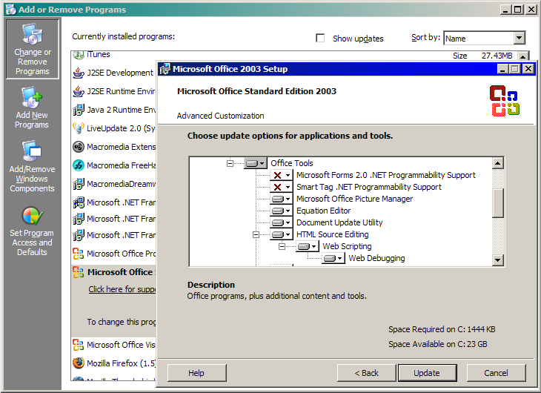
Microsoft Script Debugger

Slide 68
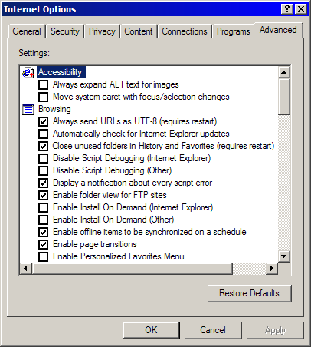
Microsoft Script Debugger

Slide 69
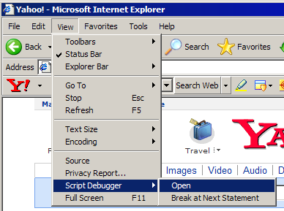
Microsoft Script Debugger

Slide 70
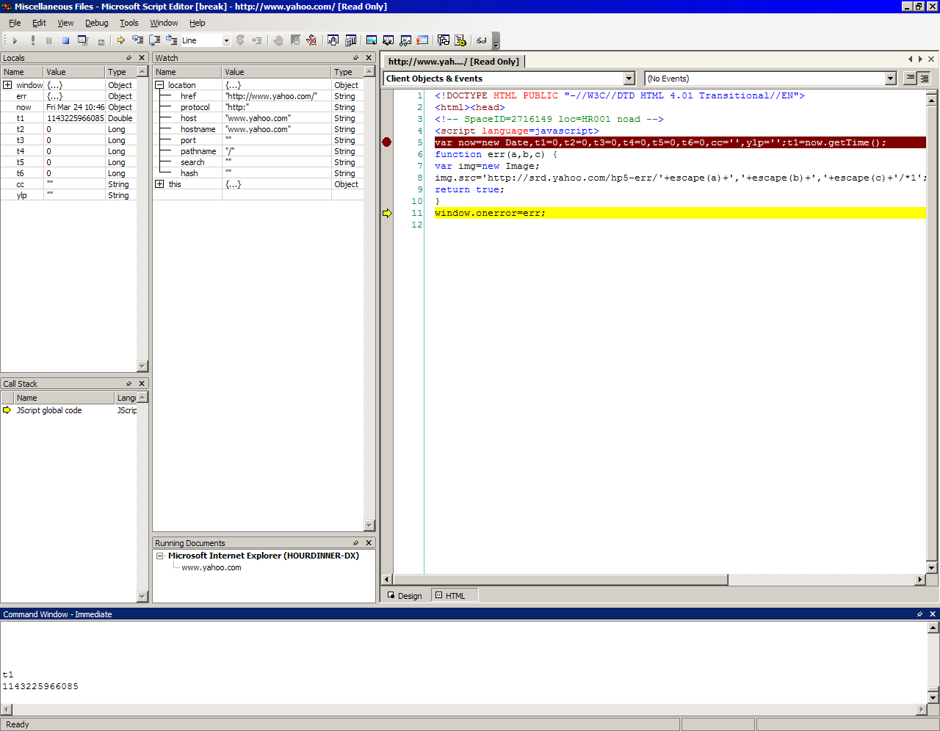
Microsoft Script Debugger

Slide 71
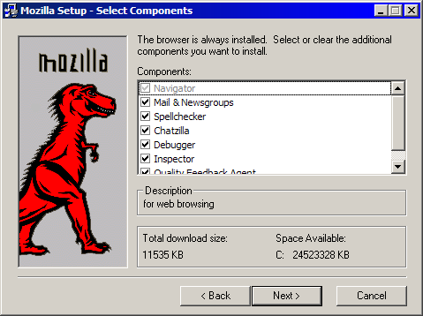
Venkman

Slide 72
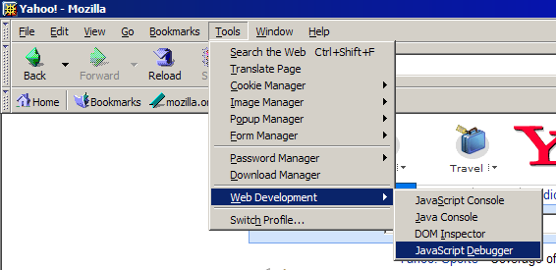
Venkman

Slide 73
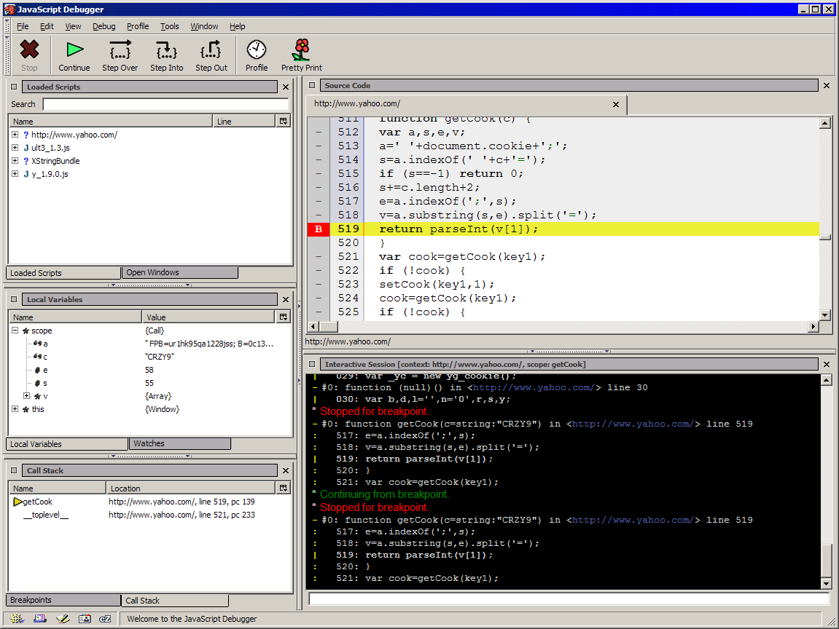
Venkman

Slide 74
debugger
The debugger statement can be used as a programmable breakpoint.
  if (something === 'wrong') {
  debugger;
  }

Slide 75
Performance
Provide a good experience.
Be respectful of our customer's time.
Hoare's Dictum: Premature optimization is the root of all evil.

Slide 76
Efficiency
The first priority must always be correctness.
Optimize when necessary.
Consider algorithmic improvements
  O (n) v O (n log n) v O (n²)
Watch for limits.

Slide 77
Coding Efficiency
Common subexpression removal
Loop invariant removal

Slide 78
Before
for (var i = 0; i < divs.length; i += 1) {
divs[i].style.color = "black";
divs[i].style.border = thickness +
'px solid blue';
divs[i].style.backgroundColor = "white";
}

Slide 79
After
var border = thickness + 'px solid blue',
nrDivs = divs.length;
for (var i = 0; i < nrDivs; i += 1) {
var ds = divs[i].style;
ds.color = "black";
ds.border = border;
ds.backgroundColor = "white";
}

Slide 80
Strings
Concatenation with +
  Each operation allocates memory
  foo = a + b;
Concatenate with array.join('')
  The contents of an array are concatenated into a single string
  foo = [a, b].join('');

Slide 81
Minification vs Obfuscation
Reduce the amount of source code to reduce download time.
Minification deletes whitespace and comments.
Obfuscation also changes the names of things.
Obfuscation can introduce bugs.
Never use tools that cause bugs if you can avoid it.
  http://www.crockford.com/javascript/jsmin.html

Slide 82
JSON
JavaScript Object Notation.
A Data Interchange Format.
Text-based.
Light-weight.
Easy to parse.
Language Independent.
A Subset of ECMA-262 ECMAScript Third Edition.

Slide 83
Object

Slide 84
Array

Slide 85
Value

Slide 86
String

Slide 87
Number

Slide 88
Advanced JavaScript
Douglas Crockford
© 2006 Douglas Crockford

