Slide 1

small footprint ZERO\few shot KWS in hebrew
Tomer askenazi , raz shemesh. Deep learning 00460211

Slide 2
introduction
Keyword spotting (KWS) is a well-established problem, yet most novel models and datasets are predominantly designed for English.
This project aims to adapt a model that is mostly trained on the Google Commands Dataset, to provide KWS in Hebrew.

Slide 3
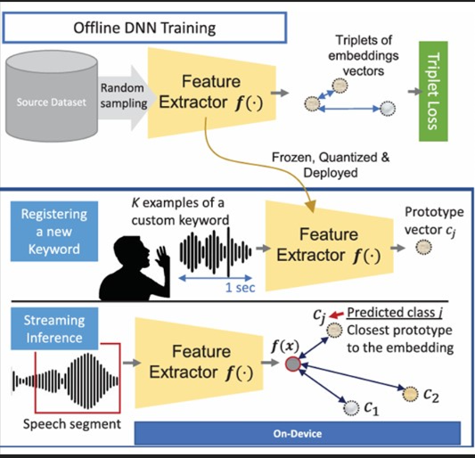
Environment
We were inspired by [1] , and followed the workflow presented, first training (offline) a feature Extractor, Then customizing it (online).
The few-shot examples (we used 5) are introduced in the online phase, where the feature extractor is used to create a classifier

Slide 4

DATASETs
Used Google Commands Dataset for the offline phase of training.
Intergerned ivrit.ai as an auxiliary weakly supervised dataset, and for evaluation and testing as a ‘unknowen’ label
For testing we recorded 20 utterance of each label (4 labels overall)

Slide 5
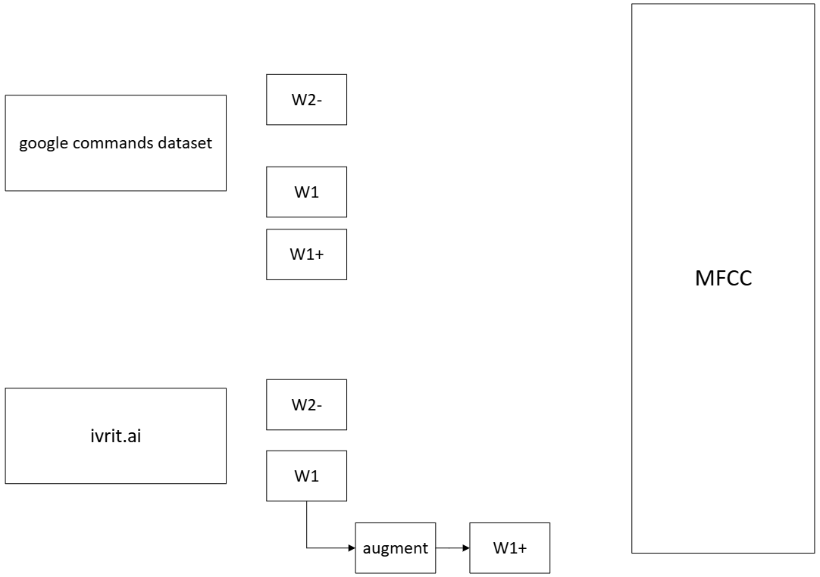
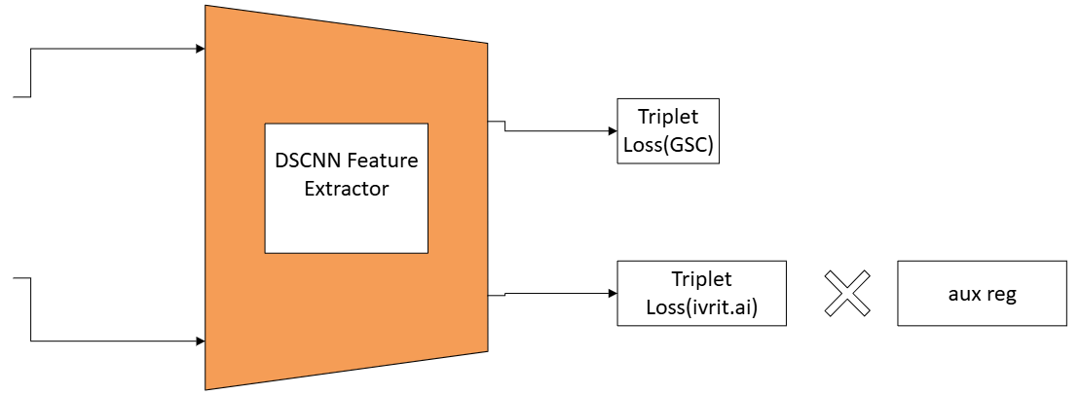
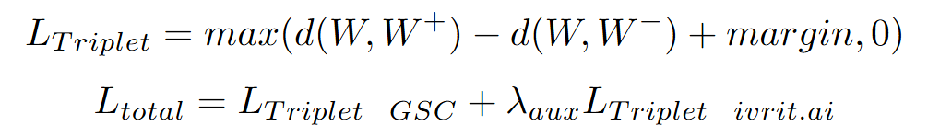
Feature extractor (offline)
1 sec utterances to create a triplets from the different datasets
Use Mel-sectogram to create a 10x50 TF map

Slide 6
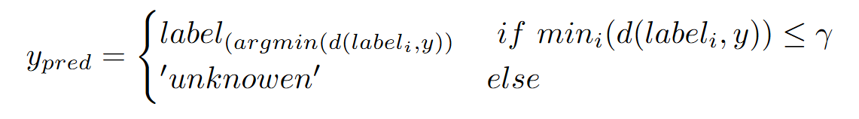
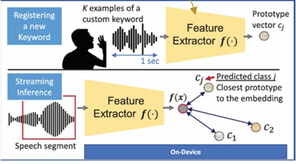
Zero shot classifier (ONLINE)
Controlling the margin of the triplet loss, We can set gamma=margin in the following classifier.
After few-shot samples are collected, create a label_i vector using the mean of the embedding vectors.

Slide 7
Zero shot optimize gamma classifier (ONLINE)
Using ivrit.ai to create 50 utterance samples labeled as “unknown” are used to optimize the gamma selection for the previous classifier
Evaluate the classifier performance on the ‘unknown’ buffer + the few samples.
We've choose to take the lowest gamma that maximizes the accuracy with less then 5% FAR (false acceptance rate).

Slide 8
Few shot learning – prototypical net (ONLINE)
Now we use the few online samples collected to adjust the Feature Extractor.
Using the collected samples to train, and the ‘unknowen’ buffer for validation and scheduling.

Slide 9
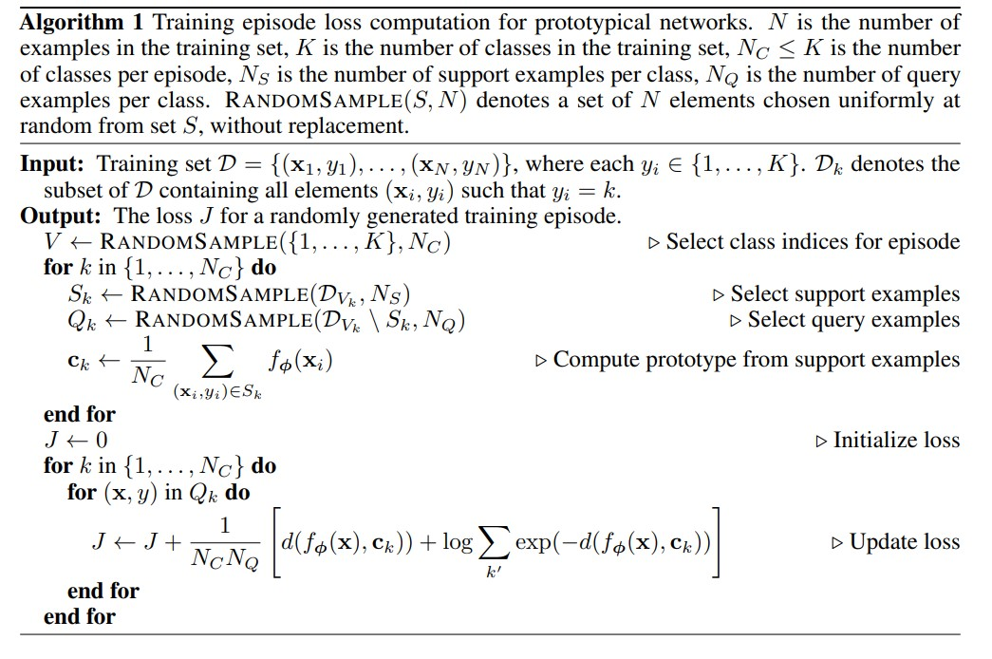
Few shot learning – prototypical net (ONLINE)
Preform 20 epidose
Use ACC achieved as a validation metric
For ‘reduce LR on platu’ scheduler
Initalize Zero shot optimize
gamma classifier

Slide 10
Results - Zero shot classifier
Lamda_aug | Avg Accuracy | Standard Deviation | Avg FAR | Standard Deviation
0 | 70.7% | 4.2% | 14.1% | 4.4%
0.01 | 70% | 3% | 5.7% | 2.7%
0.1 | 67.3% | 4.1% | 5.1% | 3.1%
1 | 62.5% | 2% | 0.4% | 0.8%

Slide 11
Results - Zero shot optimize gamma classifier
Lamda_aug | Avg Accuracy | Standard Deviation | Avg FAR | Standard Deviation
0 | 68.8% | 4% | 5% | 4%
0.01 | 67.5% | 4.1% | 3.7% | 4.3%
0.1 | 65.6% | 4.5% | 2.6% | 2.6%
1 | 65.1% | 4.3% | 2.5% | 2.9%

Slide 12
Further work
Explore different usage of auxiliary data in architecture.
Usage of other methods for few-shot learning
Use weakly supervised data to automatic dataset generation

