Slide 1

Trip Planner – Final Project
React + Node.js + MongoDB Full Stack Application
By Tomer Natan, Almog Asia and Zohar Marziano

Slide 2
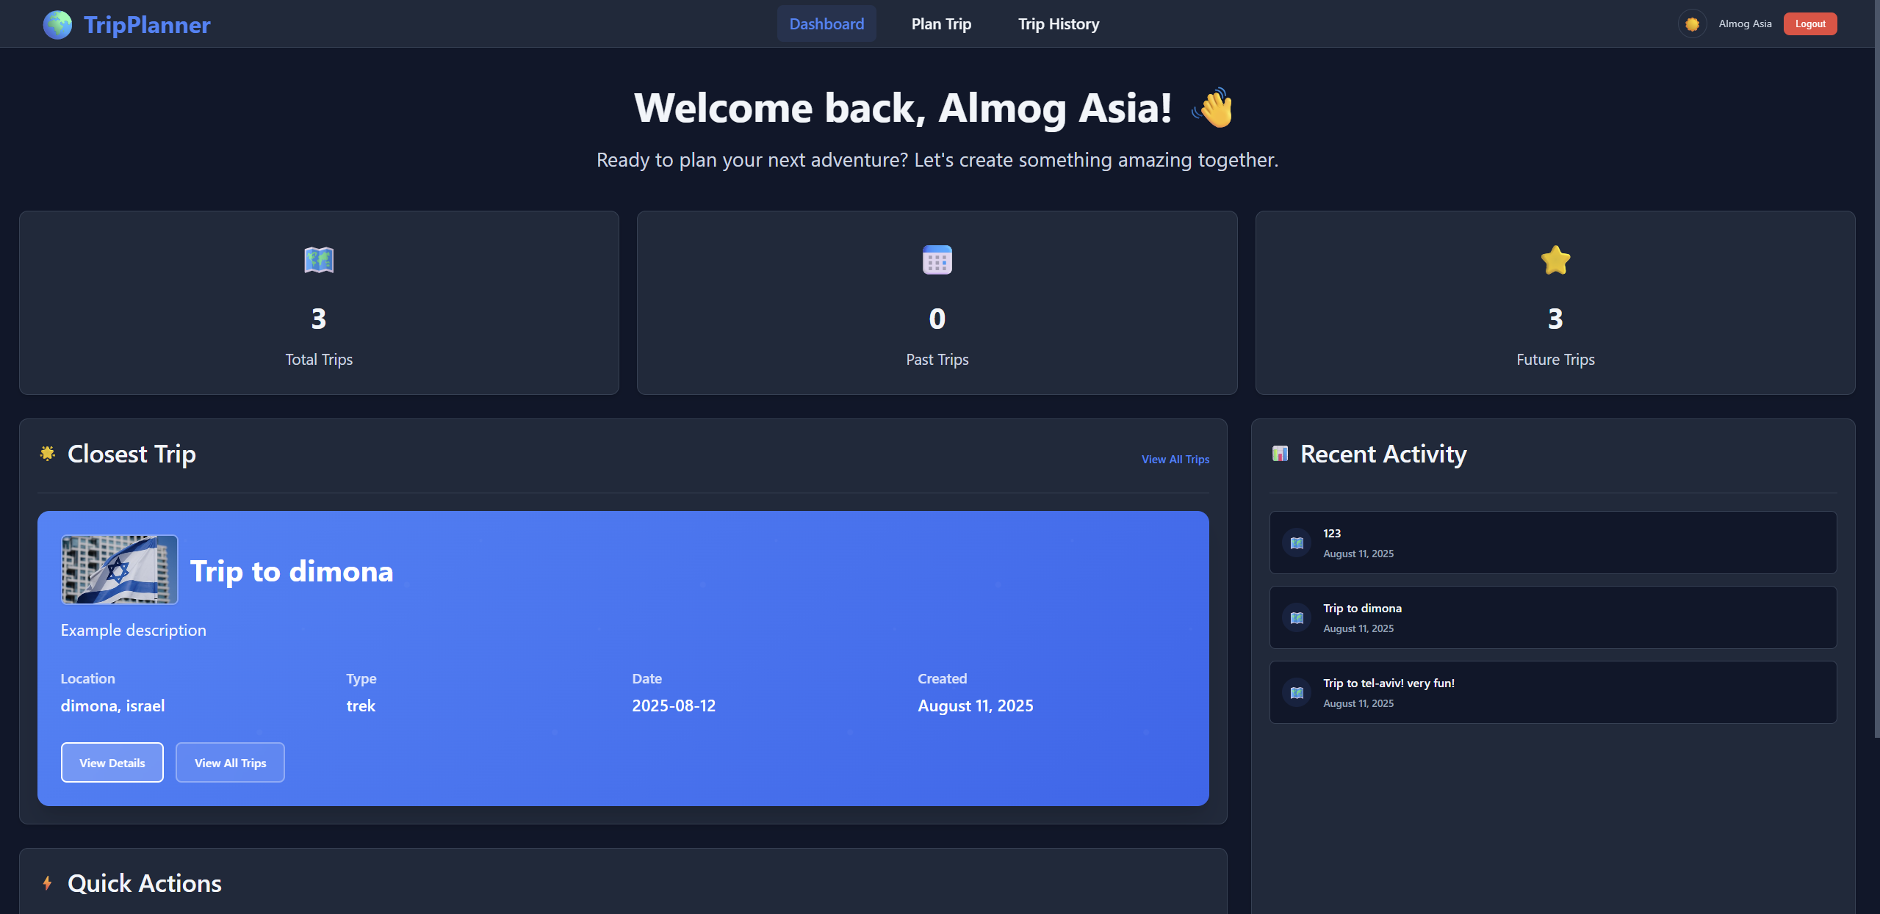
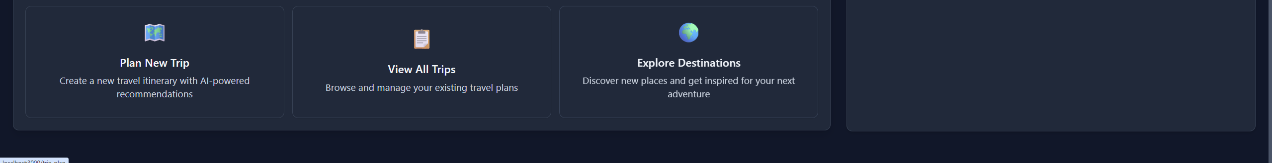
Project Overview
Plan, view, and save custom travel routes
Personalized trips with route, weather, and map
RESTful API backend with secure user system

Slide 3
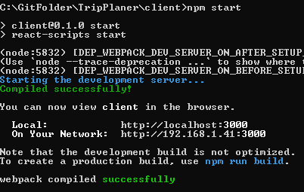

Technologies & Libraries
Frontend:
React, React Router, Axios, Leaflet, React Leaflet, Polyline
Backend:
Node.js, Express, JWT, bcrypt, Mongoose
APIs:
OpenRouteService, WeatherAPI, Unsplash, GROQ

Slide 4
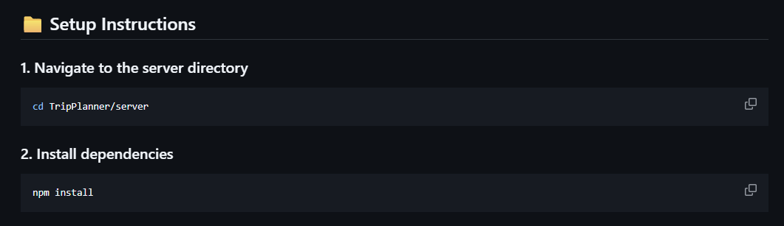
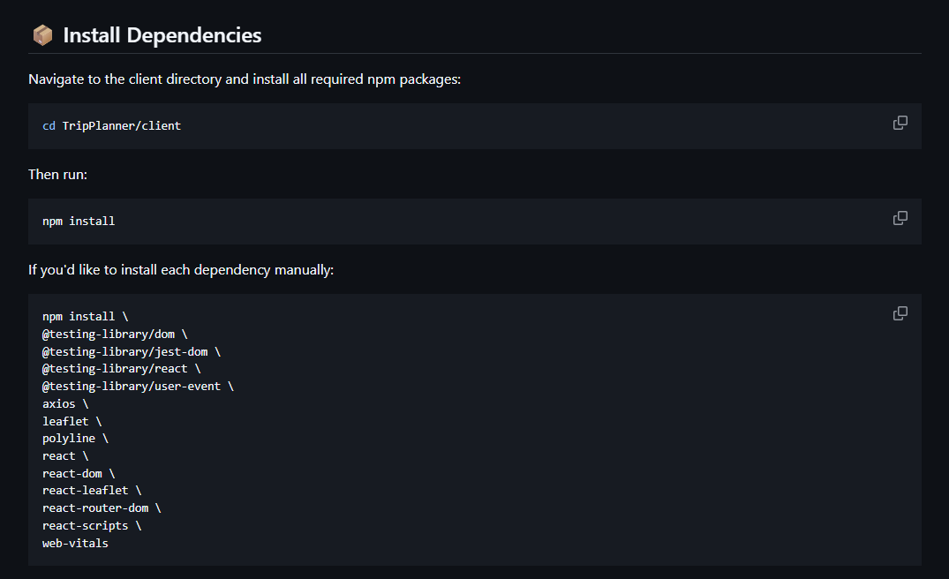
Installation & Setup
npm install for client & server
Run npm install in both the client and server directories to set up dependencies.
.env files for API keys (Unsplash, ORS, Weather)
Create .env files in the respective directories and add your API keys for external services.
MongoDB Atlas or local instance
Configure your MongoDB connection, either using a cloud-hosted Atlas instance or a local MongoDB server.

Slide 5
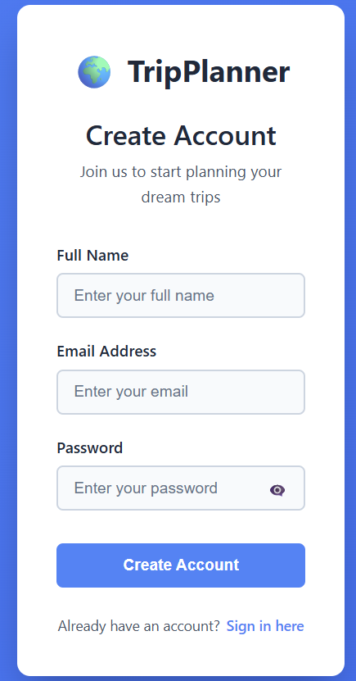
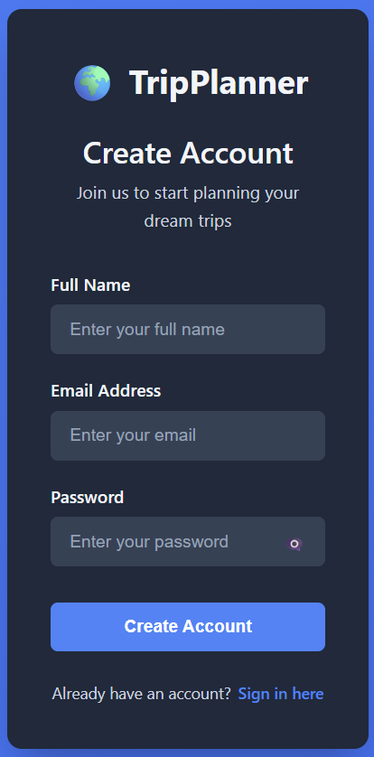


Registration Page
Input: name, email, password
Password is hashed with bcrypt
On success, JWT is generated and sent

Slide 6
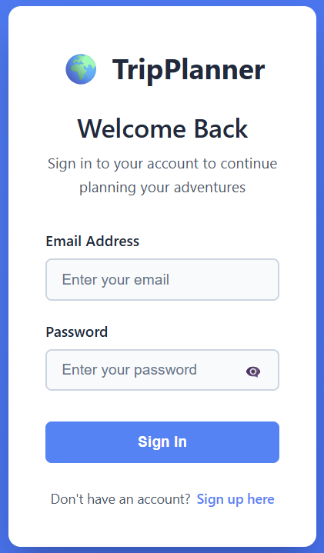
Login Page
Email & password login
Password compared with hashed version
JWT returned and saved in localStorage

Slide 7
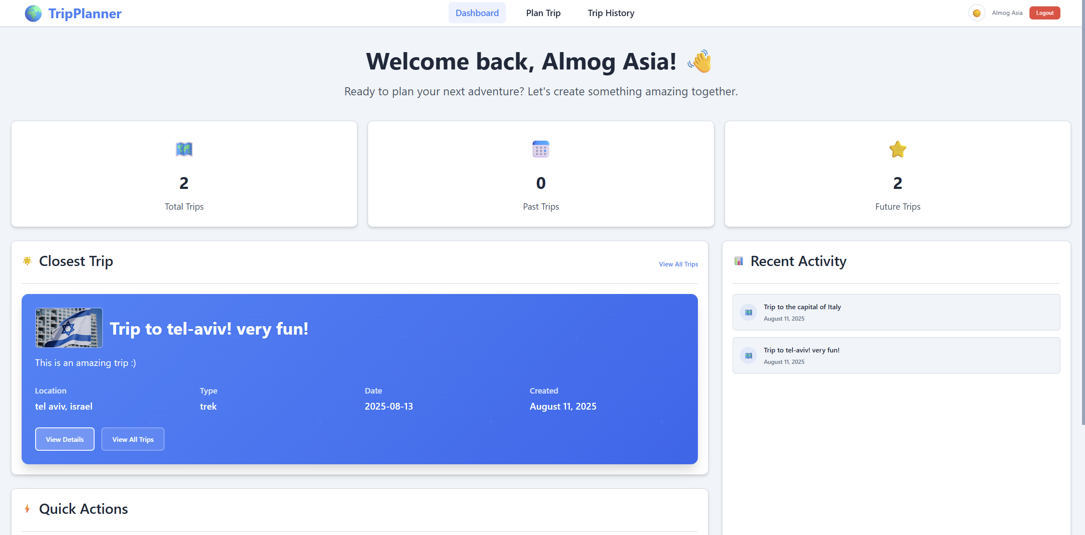
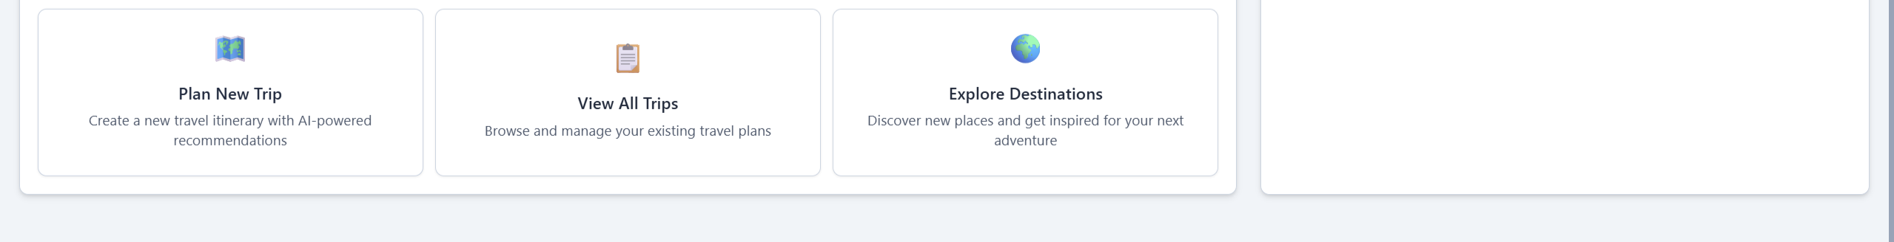
Dashboard Page
Welcome message with user’s name
Personalized greeting for the logged-in user.
Last trip preview
Quick access to details of the most recently planned trip.
Buttons: Create Trip / View History
Navigation options for planning new trips or reviewing past ones.

Slide 8
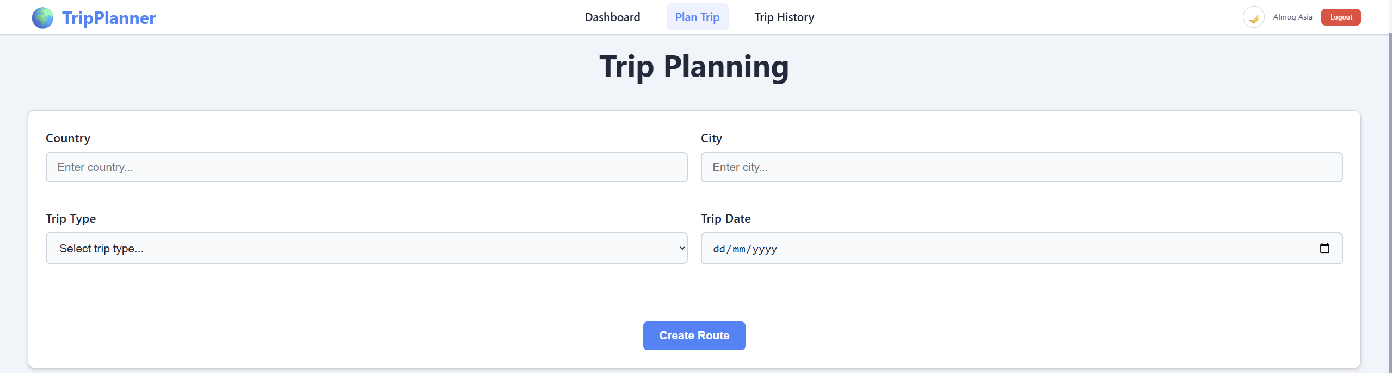
Trip Planning Page
Inputs: Country, City, Type (bike/trek), Date
User clicks "Generate Route"

Slide 9
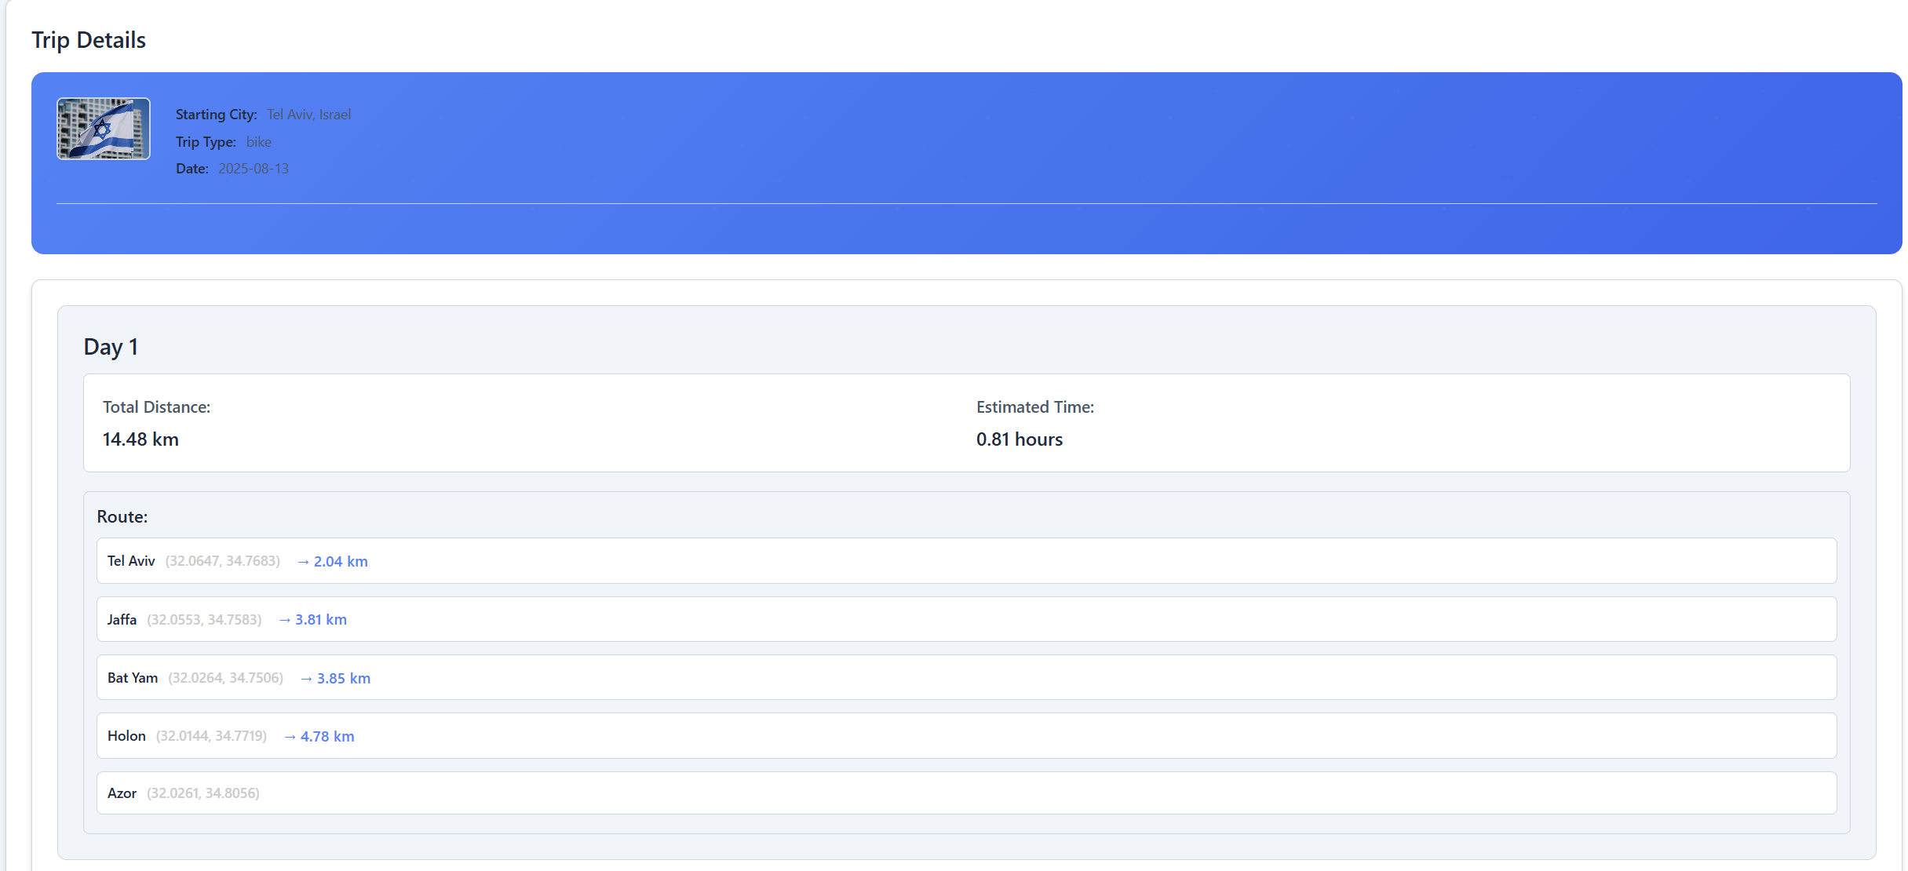
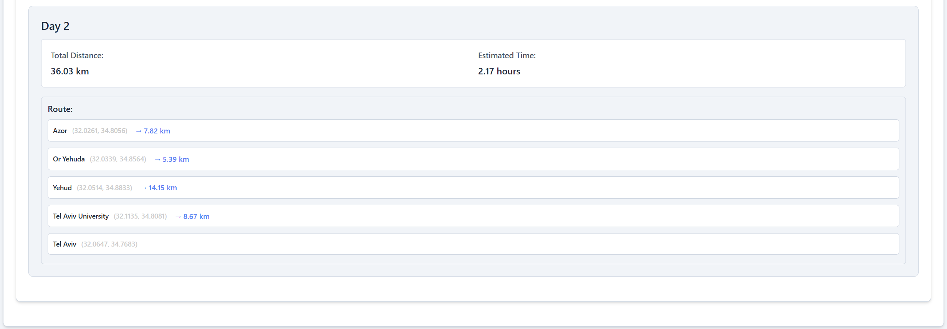
Trip Map + Route Summary
Route shown with coordinates on Leaflet map
Weather forecast or fallback to current weather
Image of country via Unsplash
Route info: coordinates, distance, ETA
Save button to add to history

Slide 10
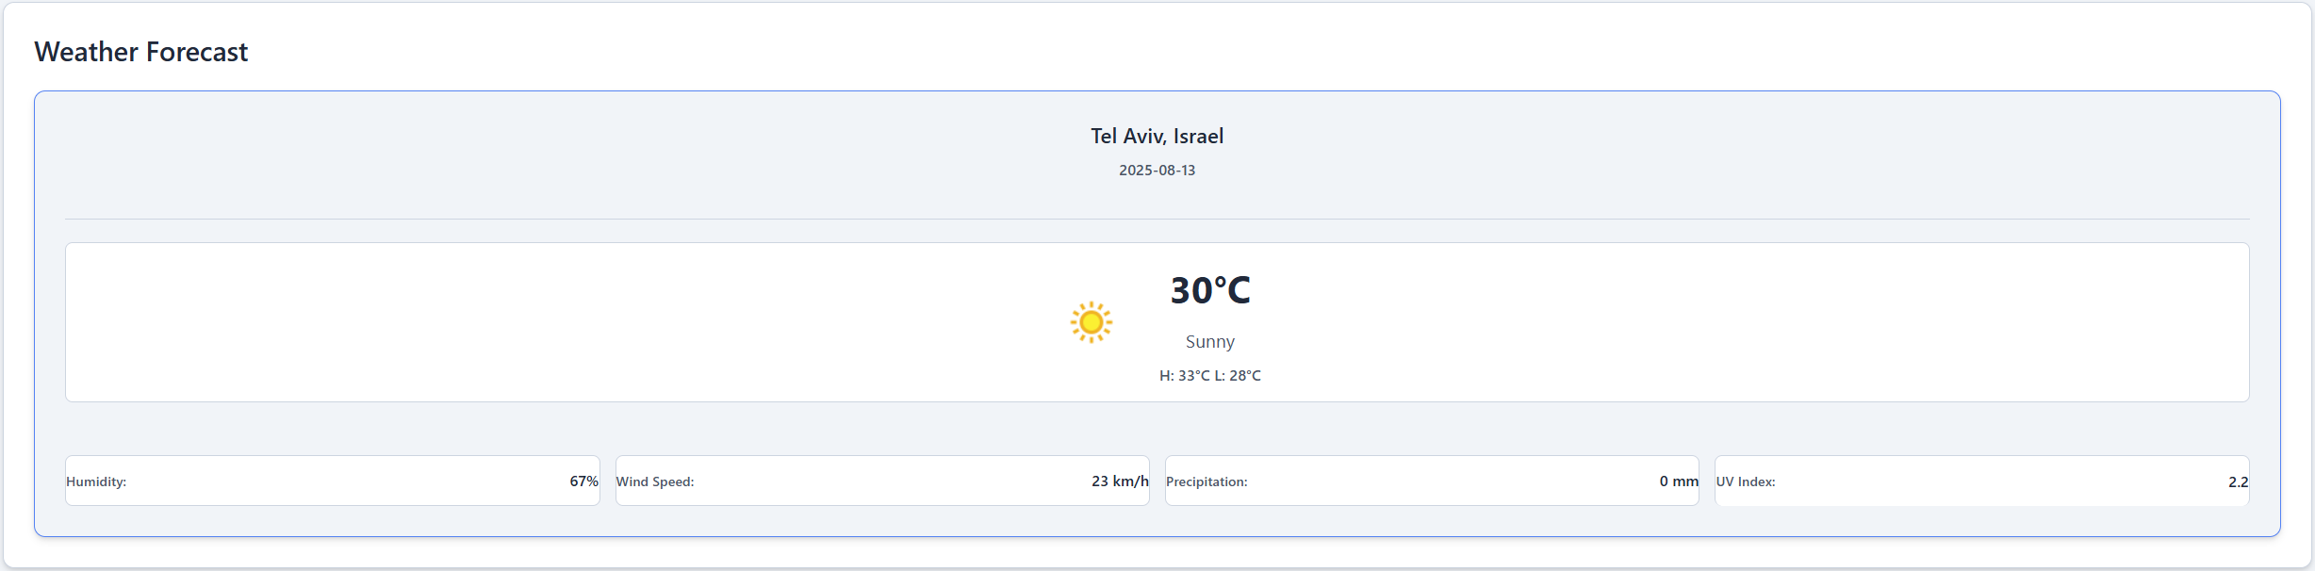
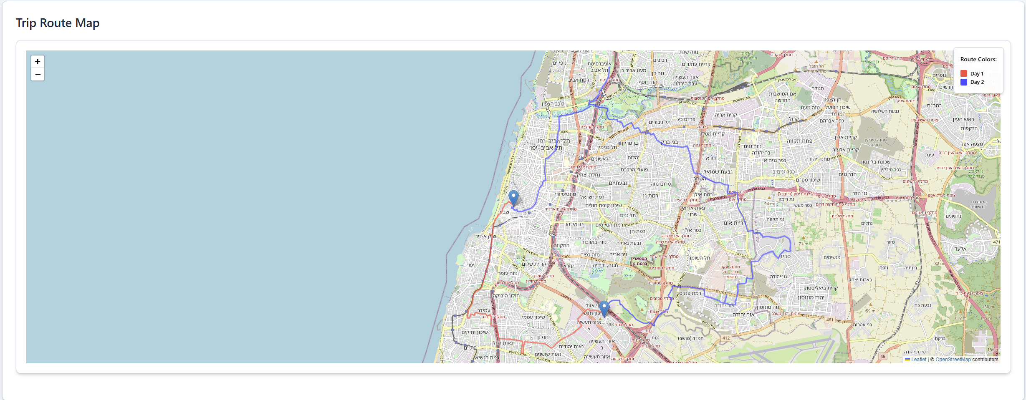
Trip Map + Route Summary

Slide 11

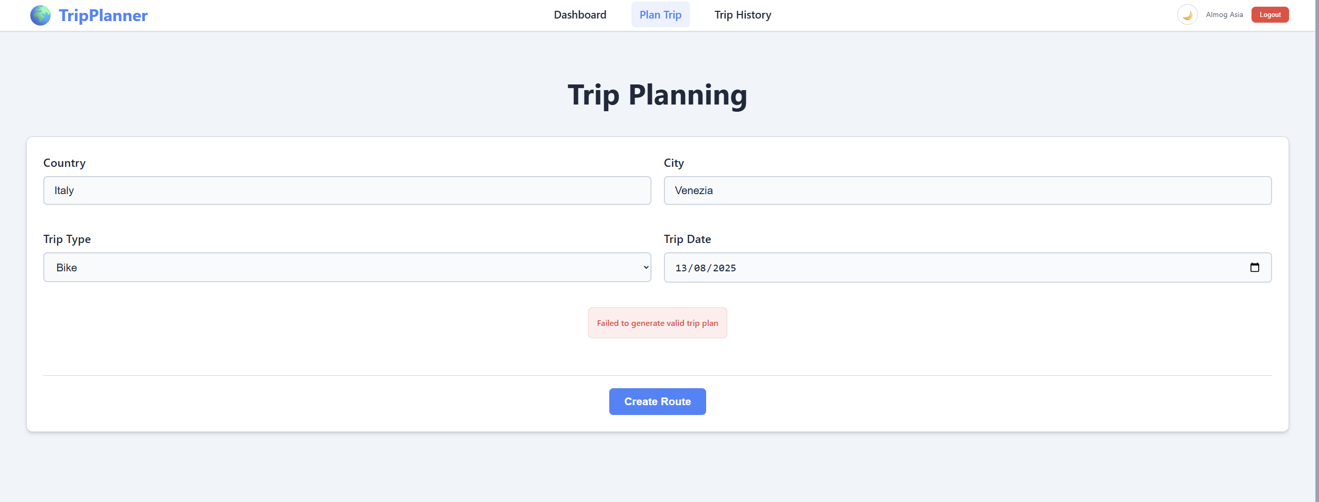



LLM Integration & Validation
Prompt sent to LLM to generate coordinates
The system sends a request to the Large Language Model for route coordinates.
If invalid → OpenRouteService routing fails
If the LLM's output is not valid, the routing service will fail to generate a route.
Retry prompt up to 5 times
The system attempts to re-prompt the LLM multiple times to get valid coordinates.
On total failure → user sees error message
If all retries fail, an error message is displayed to the user.

Slide 12
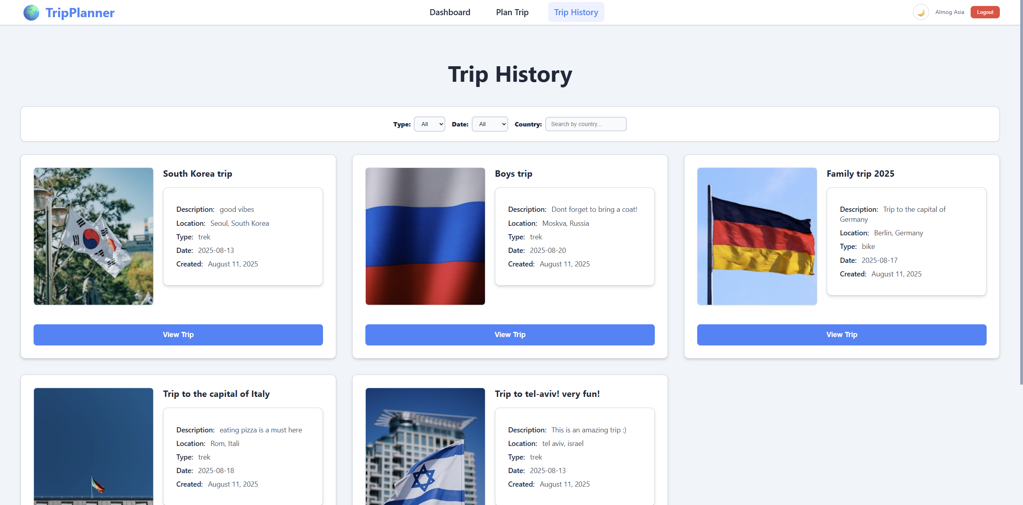
Trip History Page
Displays past/future trips
Filter: Type, Country, Date, Weather
View full trip details

Slide 13
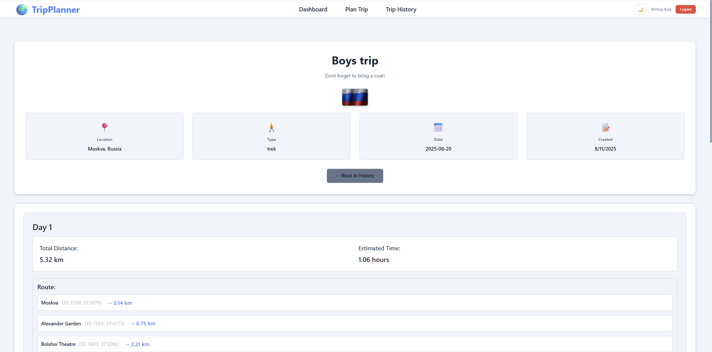
Trip History Page – View trip

Slide 14
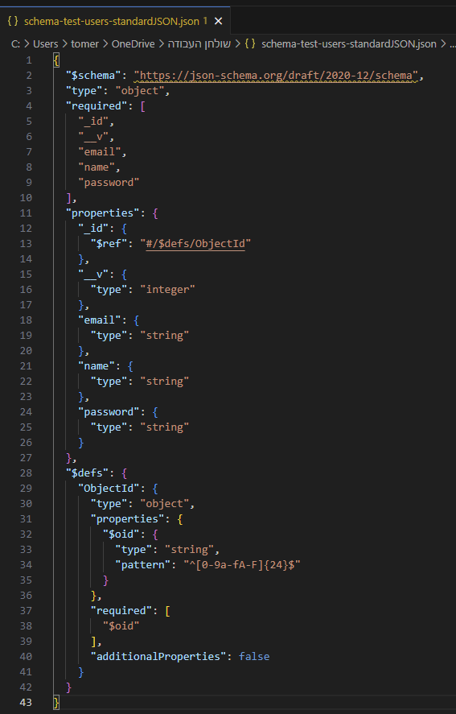

MongoDB Schema & Storage
Inputs: Country, City, Type (bike/trek), Date
User clicks "Generate Route"

Slide 15
✅ Responsive UI with dynamic routing and trip feedback
Final Notes
Full stack app with secure login and trip planning
Integrated APIs: LLM, ORS, WeatherAPI, Unsplash
MongoDB stores user and trip data
Responsive UI with dynamic routing and trip feedback
Secure password hashing using bcrypt
Protected routes via JWT

