Slide 1
PageBook
A ”good enough” order book for Soroban
Notes:
PageBook is an experiment: a Soroban contract that stores, matches, and settles limit orders on-chain. It runs on testnet today with a web client and a set of bots. It is not production software and nothing about its economics or interface is final.
The talk is thirty minutes. The shape is: a demo, why the obvious designs fail on Soroban, what we gave up, the three data structures that make it work, and what testnet measured. Slides and links are on the site afterwards.

Slide 2
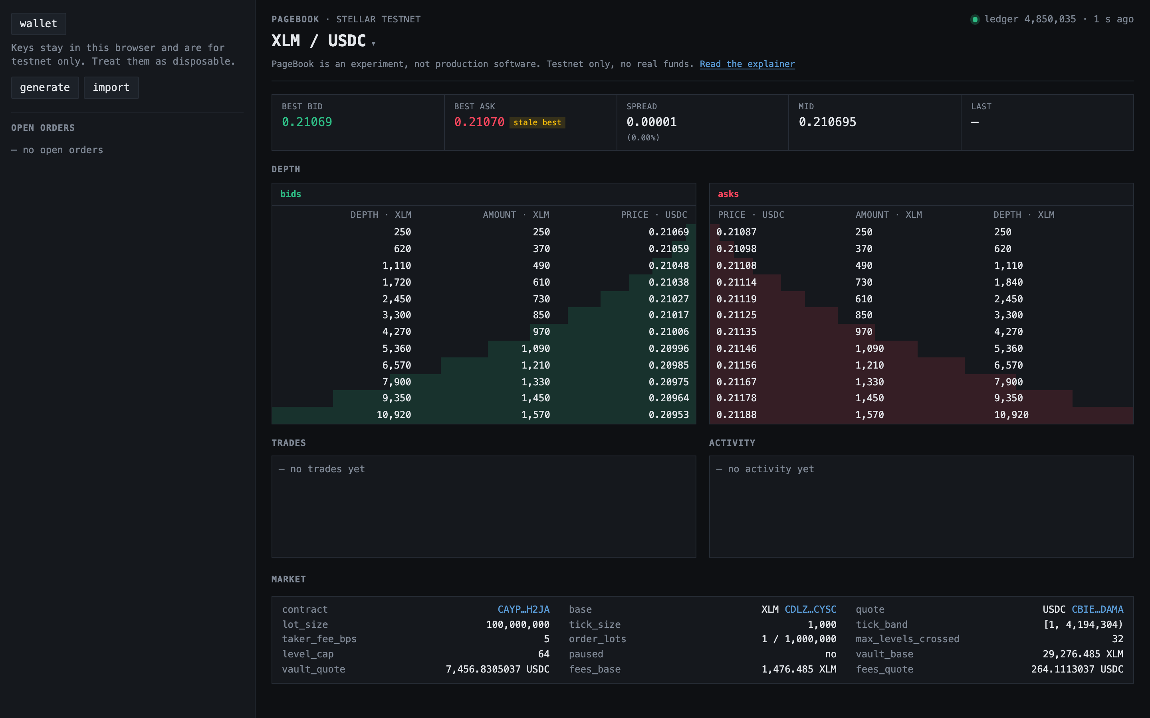
Demo
tomerweller.com/pagebook
Notes:
Open the client. Point at the book: best bid and ask, depth per side, recent trades, the vault and fee balances at the bottom. The wallet is a disposable testnet key funded by friendbot. The market maker bot keeps both sides quoted.
Rest a quote a tick inside the spread. Take it from the other side. Settle the maker order and watch the balance come back. Then open the take on stellar.expert and scroll to the footprint: around twenty read-write entries, and most of them are Level keys at ticks nobody quoted. That band is the padding. Keep this picture in mind. The rest of the talk explains every line of it.
Fallback if RPC misbehaves: the screen recording on the laptop.

Slide 3
1
Why build a Soroban Orderbook
SDEX exists but,
contracts can't call SDEX and SDEX can't call contracts.
  Example: contract tokens
No room for customization.
  Example: taker fees, maker discounts
No proper metering
  Example: an order that crosses 1 offer “costs” as much as an order that crosses 1000 offers
Notes:
Stellar already has an order book in the protocol. The problem is the boundary: a Soroban contract cannot place an SDEX offer or route a payment through it, and SDEX cannot invoke a contract. Any DeFi that wants an order book as a building block needs one on the Soroban side.
Being a contract buys things SDEX cannot offer: contracts can be makers and takers, a route across markets is atomic, a market operator can charge a taker fee, and time-in-force flags exist. The cost is real: a PageBook market is separate liquidity, and nothing inside a contract can bridge it to SDEX.
The other motive is that an order book is close to the worst case for Soroban's storage model. If it fits, most things fit. Much of what we learned is feedback for the platform.

Slide 4
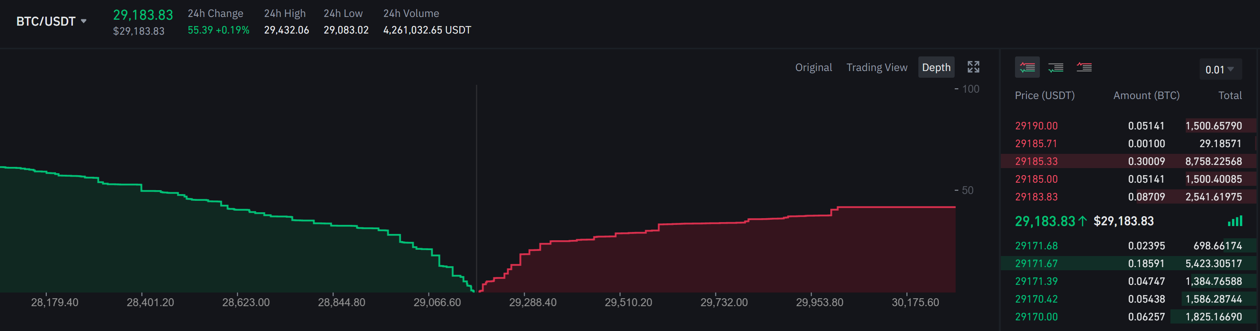
2
Order book 101
Limit order: buy or sell an amount at a price or better; rests until matched or cancelled
Two sides: bids to buy, asks to sell; the gap between the best of each is the spread
Price-time priority: best price first, then oldest order at that price
Makers rest orders; takers cross the spread and match against them
Notes:
Standard vocabulary, stated once so the rest of the talk can use it. Two sides. Each side is a set of price levels. Each level is a queue in arrival order. A maker rests at the tail of a level; a taker starts at the best level on the opposite side and consumes from the head outward.
The repo pins the words. Entry points are what you call: place, replace, settle, route. Behaviors are what a call did: take, rest, sweep. "Fill" is only ever an order state. This matters because the same word meaning two things caused real confusion in review.
On every chain the hard part is the same: finding the next live level while other people are adding and removing orders at the same time.

Slide 5
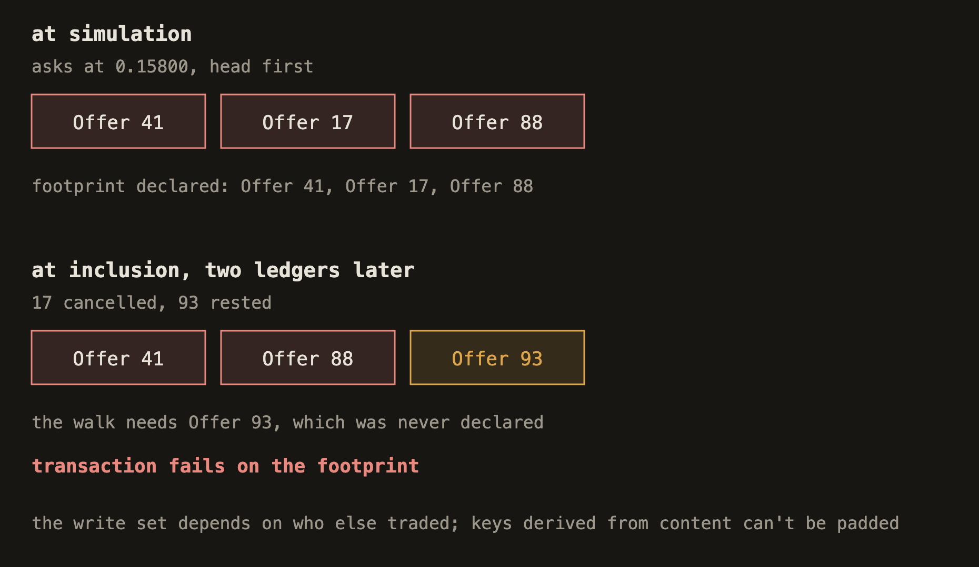
3
Naive design one: SDEX-ish
One ledger entry per offer, keyed by offer id, like OfferEntry
Problem: Soroban needs the footprint before execution, but the offers a take crosses depend on the live queue
Lesson: Predictable keys, Stable footprints
Notes:
The first thing anyone tries is to copy SDEX: one entry per offer, an offer id as the key, match by walking offers in price-time order. On the classic protocol that works because the protocol reads whatever it needs at apply time.
Soroban demands the read-write set before execution. The set of offers a take will cross is a function of the queue at apply time, and the queue changes with every rest and cancel by anyone else. Simulation tells you the keys as of now. By inclusion they can be wrong, and the host fails the transaction on an undeclared access. The busier the market, the more often this happens, and you cannot over-declare because you do not know the ids of offers that do not exist yet.
The same thing kills Deepstate's radix tree, which is the most inventive EVM design we looked at: its keys are derived from content, so any concurrent write renames the keys on the path. The lesson from every working on-chain CLOB is that book state must live at addresses that are pure functions of market, side, and price.

Slide 6
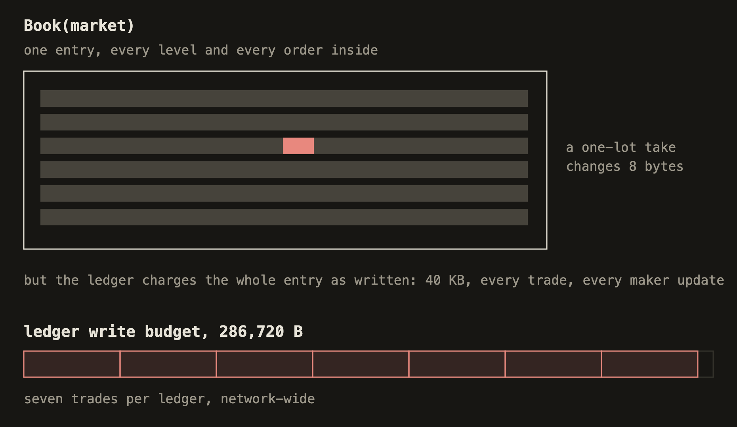
4
Naive design two: the monolith
Whole book in one entry; the footprint is trivially predictable
Problem: Soroban charges write bytes for the whole entry on every rewrite, and every trade rewrites the book
Lesson: Small entries
Notes:
The opposite extreme: put the whole book in one entry. The footprint is one key, always known, and there is no race to declare. This is roughly what Phoenix does on Solana, and it works there because rewriting part of a large account costs the same as rewriting a small one.
Soroban meters write bytes, and it charges every byte of every entry you rewrite. A one-lot take changes a handful of bytes but pays for the whole blob. Write bytes are also the scarce shared resource: the network admits 286,720 bytes of writes per ledger, about 132 KB per transaction, and a 40 KB book would let seven trades through per ledger for the whole network. The 64 KB entry cap bounds the book on top of that.
One thing the monolith does not lose against PageBook: parallelism. Every PageBook operation that settles funds writes the vault's balance entry for the token, so a whole market, and every market sharing a token, is one serial cluster in v1 too. The lesson here is only about write bytes: small entries at predictable keys.

Slide 7
5
PageBook’s “good enough” concessions
Price quantization. Admin-created markets with a fixed lot size, tick size, and tick band
Async maker settlement. The taker settles at apply; the maker calls settle later
Slightly stale best. The take starts from the best price seen at simulation
Footprint padding. The client declares a band of price levels around the simulated best
Notes:
PageBook does not reproduce SDEX. It accepts four concessions, and each one buys something.
Quantization: every price is a whole number of ticks, every size a whole number of lots. Matching becomes one multiplication with nothing to round. Every traditional venue quantizes both price and size; SDEX's rational prices are the unusual case. What we actually concede is that the grid is frozen at market creation, and a market whose price moves an order of magnitude needs a new market. That comes back at the end.
Async settlement: crediting makers during a take would put every maker's balance entry into the taker's footprint, which is the whole-book race again. So the taker settles at apply and makers claim later with one cheap transaction.
Stale best: the walk starts from the best seen at simulation, so a better quote that lands in the two ledgers before inclusion is invisible to that take. Padding: the client declares more keys than simulation returned. That is unusual on Soroban, and the network charges for it, but it is cheap in fees and it is what makes the race survivable.

Slide 8
6
Introducing PageBook
Orders live across three data structures with predictable keys and small entries
  Tick index finds price levels with supply
  Level queue holds the orders at one price
  Order record is a maker's claim on its place in the queue
Notes:
Two principles run through the whole design. First, every key is a pure function of things the client already knows: market, side, tick, or the maker's own address and a nonce it picked. Nothing assigned during execution ever appears in a key the client has to declare. Second, entries are small and sized to what they hold, so the write bytes a transaction pays track the work it did.
Book state is split by function into three structures. The tick index finds price levels that may have supply. The level queue stores the FIFO at one price in one entry. The order record is the maker's claim on a queue position. The taker walk touches the first two and never the third. Settle touches the third and one level.
One more rule: the order store, meaning levels and order records, is authoritative and never stale. The index is derived, holds no funds, and is allowed to be wrong in one direction: a live level always has its bit set, but a set bit may point at an empty level. An error there costs a wasted step, never a wrong settlement.

Slide 9
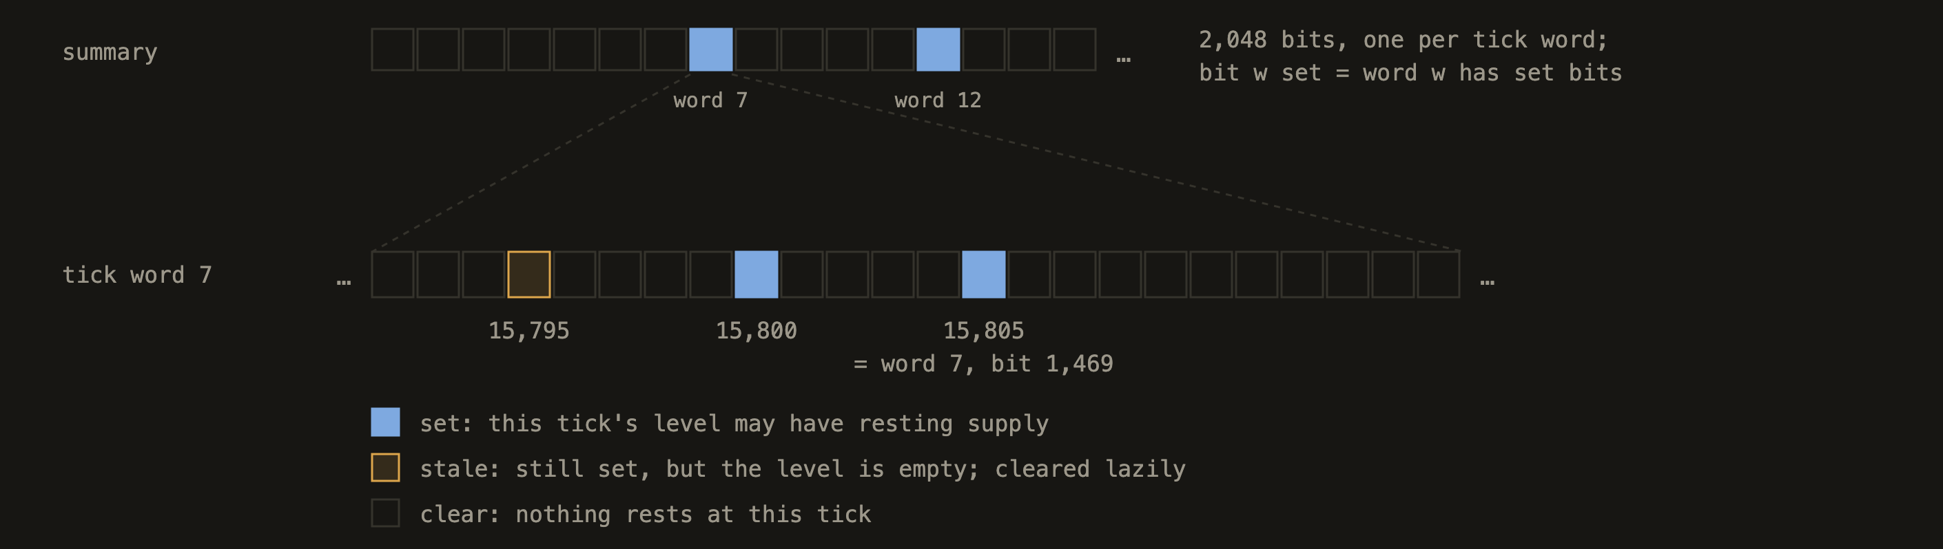
7
Tick index
A two‑level bitmap of which price levels may have supply, so matching finds the next level without a scan. A 2,048‑bit summary over 2,048‑bit words covers 2^22 ticks; each bitmap is one 256‑byte entry
Derived, allowed to be stale. A live level always has its bit set; a set bit over an empty level is cleared by the next taker to land there
Notes:
Each market side has a two-level bitmap: a 2,048-bit summary over 2,048-bit words, which covers four million ticks. Each bitmap is a 256-byte entry. A tick number splits into a word index and a bit index, so the key for any tick's word is known in advance. BestTick is a hint for where to start.
Finding the next candidate tick is a find-first-set on the current word, then on the summary, without scanning prices.
The index is derived. A live level must have its bit set; a set bit may point at a level that emptied through cancels. The taker that lands on that level finds it empty, clears the bit, and moves on, spending one of its crossing slots. Keeping the index exact would put bitmap writes into every settle, and settle is the one path we most want to keep tiny.

Slide 10
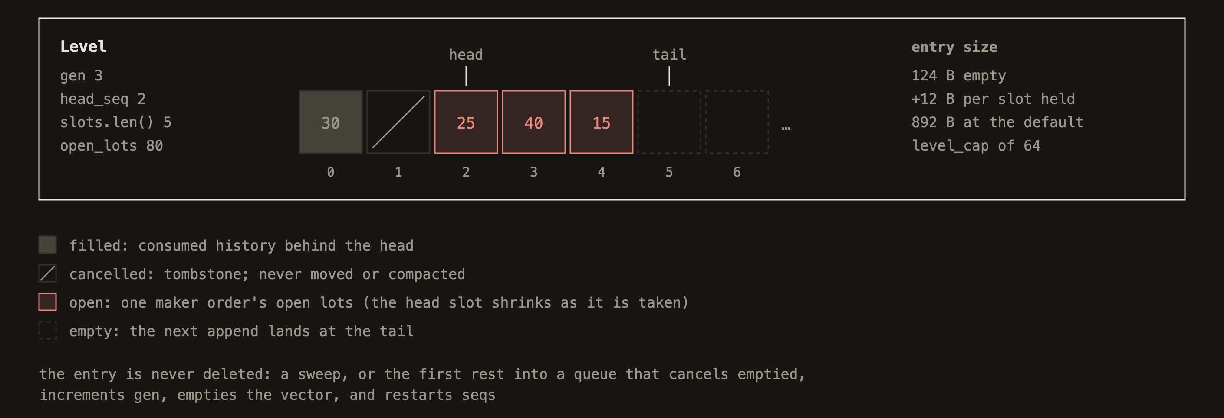
8
Level queue
One entry per price level, so crossing a price touches one key however many orders rest there. A FIFO of order quantities: appends go at the tail, the head advances, consumed history is dropped behind it. 124 B empty, 12 B per slot ahead of the head
A sweep is one write. A taker that clears the level prices it from the open total and writes it empty without reading a single slot. Matching cost scales with levels crossed, not with makers
Notes:
The whole FIFO at one price lives in one entry: a generation counter, a head sequence number, the open total, and a vector of quantity slots. Sequence numbers are slot positions. A rest pushes onto the end. A take decrements the head slot in place and advances the head. A cancel zeroes its slot. Nothing is ever moved or compacted.The entry is sized to occupancy: 124 bytes empty, 12 more per resting order, about 900 bytes at the default cap of 64 orders. A swept level is written empty, so the hot-path writes are small.A taker that consumes the whole level prices it from the open total, writes the entry empty, and bumps the generation. It never reads the slots. Sweeping a level with sixty makers costs one write, the same as sweeping one. And because the queue lives under the key the transaction already declared, a queue that deepens in flight changes nothing about the footprint. Level entries are never deleted; the generation counter must survive so old makers can still settle.
A cancel leaves its slot in place at zero, a tombstone, because later makers' sequence numbers point at positions and their records cannot be rewritten. The walk skips tombstones. The level cap of 64 counts the slots ahead of the head, live or tombstoned; a sweep or a rest into an empty level starts a new generation and clears them. The current contract also keeps filled history behind the head until then, which is issue 66: co-located makers refreshing one tick can fill it with tombstones. The fix drops the consumed prefix behind the head, which the slide describes.

Slide 11
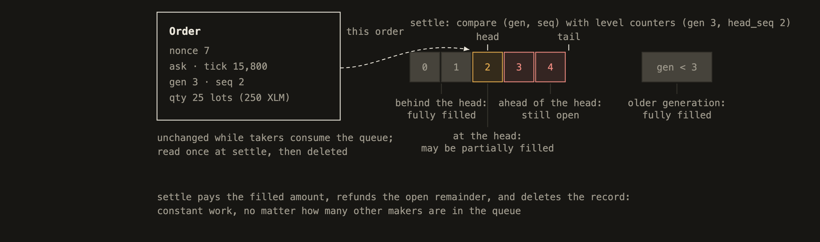
9
Order record
Ownership lives apart from the queue, so a taker never writes maker state.
Keyed by the maker and a nonce it picks, so the key is known before the transaction runs; the queue position is stored inside, where it cannot affect the footprint
Settle is a comparison. The record's generation and sequence against the level's counters say filled, still open, or both, in constant work whatever the queue holds
Replace rewrites in place. The record is fixed-size, so moving a quote pays no new rent
Notes:
The queue stores quantities only. Who owns them lives in a separate record per order, keyed by the maker's address and a nonce the maker chose before simulation. That is what makes the key declarable no matter what the book does in flight. The queue position, generation and sequence, is assigned at execution and stored inside the entry, where it cannot affect any footprint.
At settle, the contract compares the record's generation and sequence with the level's counters. An older generation, or a sequence behind the head, is fully filled. At the head, possibly partially filled, so read that one slot. Ahead of the head, still open. It pays the filled part, refunds the open part, and deletes the record. Constant work regardless of how many other makers are in the queue.
The record is fixed-size, so replace can rewrite it in place without paying rent again. Rent is the dominant per-order cost, about 0.046 XLM for the 120-day minimum, so this is what makes market making affordable.

Slide 12
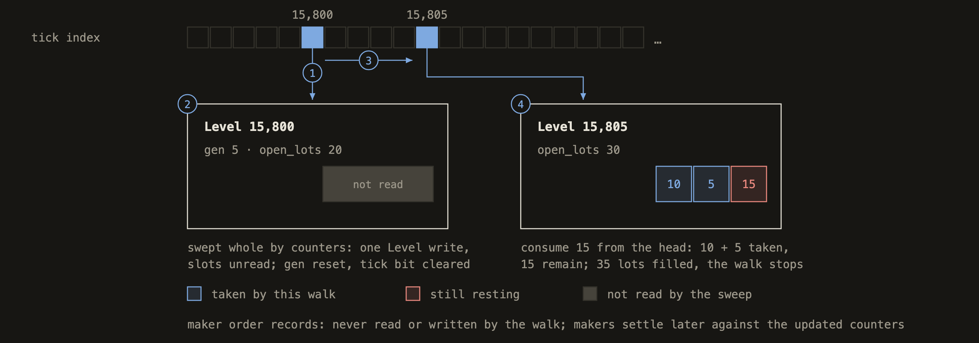
10
The taker walk
A take crosses the opposite side from the best price outward. Index, then level, then index again, at most 32 levels per transaction; hitting the cap keeps the progress made, and the remainder rests or is refunded by flag
One way to fail. Only a walk past the padded band fails on the footprint; every other outcome is a typed result. Arithmetic is exact, and the taker fee is the only rounding
Example: buy 35 lots with a limit of 15,805, against 20 lots resting at 15,800 and 30 at 15,805. Steps 1 to 4 in the figure.
Notes:
Worked example from the explainer: asks of 20 lots at 15,800 and 30 lots at 15,805, and a bid for 35 lots. The index says start at 15,800. That level has fewer lots than the taker wants, so it is swept whole by its counters for 31.60 USDC: one write, slots unread, generation bumped, bit cleared. The index's next set bit is 15,805. Fifteen lots come off the head of that queue for 23.7075 USDC, and the walk stops there. No maker record was touched.
Every loop is bounded by a constant. A walk crosses at most 32 levels and reads at most a level's cap of slots when it partially consumes one. Hitting a cap is not an error: progress is kept and the rest is refunded, or rests, depending on flags. The single hard failure is the walk needing a level past the padded band, which fails on the footprint. That residual is real, and we say so.
Quote amounts are lots times tick times tick size, in checked 128-bit integers, so there is nothing to round in matching. The taker fee rounds up and the dust goes to the fee accrual.

Slide 13
11
Putting it all together: simulate, pad, submit
Simulate. Call quote_place() for the starting tick and the levels the walk expects to cross. Pick a nonce
Pad. Add to the simulated footprint what the book could need if it moves: a band of level keys around the simulated best, empty or not, and the keys a rest would touch
Submit. If the book moved inside the band, the transaction still runs and reports a different fill, a cap hit, or a typed error
Notes:
The client's half of the protocol. Simulate to learn where the walk starts and what it expects to cross. Then pad: declare every level key in a contiguous band from the simulated best out to a chosen end, set or not, plus the bitmap words that span it, the keys a rest on the own side would touch, the order record at the chosen nonce, the vault's balance in both tokens, the caller's own balances, and both fee accruals. That list is exhaustive; a place touches nothing else. Then submit.
What can happen at apply: the book moved inside the band, which is fine, the walk reads what is there. A cap was hit, remainder refunded. A rest raced onto a full level, typed error. Only a walk that needs a level beyond the band fails on the footprint. The client chooses band width against trap probability.
Padding is not free on Soroban: a declared read-write key pays the write-entry fee whether touched or not, and an existing one is charged its bytes as if written. It is cheap in fees, and it does consume ledger capacity. Testnet has the whole stack running: contract, web client, bots on a Docker host, and the permissionless cranks for fee collection and keepalive.

Slide 14
12
Results, measured on testnet
Invocation, XLM/USDC market | RW entries | Instructions | Write KB declared | Fee charged
Rest a maker quote | 16 | 3.0M | 7.8 | 0.014 XLM
Replace one quote | 17 | 3.4M | 8.4 | 0.008 XLM
Replace 8 quotes in one batch | 52 | 11.8M | 24.1 | 0.023 XLM
Settle a maker order | 11 | 2.5M | 5.0 | 0.005 XLM
Take at the touch, 1 level | 21 | 3.3M | 10.8 | 0.009 XLM
Take across 4 to 6 levels | 57 | 8.7M | 30.5 | 0.024 XLM
Maximum take, 32 levels | 77 | 18.7M | 38.6 | 0.036 XLM
Maker paths are flat: rest, replace, and settle never walk, so their footprints are functions of the arguments alone
The heaviest legal take uses under a third of every per-transaction cap. Ledger write bytes bind first: four deep takes fill a ledger, and under saturation the chain sat at 97% of write bytes with instructions at 55%
Notes:
These are real landed transactions on the testnet XLM/USDC market, the median of thirty samples per shape, except the maximum take, which was constructed against a 32-level ladder. Read down the fee column: quoting costs about a hundredth of an XLM, and the heaviest transaction the contract allows costs under four hundredths.
The design's central promise shows up as three flat rows: rest, replace, and settle have no variance, because they never walk. Takes scale with levels crossed, twice over: each real level adds keys to what is written, and the band adds one key per tick to what is declared.
Against the limits: the 32-level take uses 18.7 million of a 400 million instruction budget and 38.6 of 132 KB of write bytes. Nothing per transaction is tight. Per ledger, write bytes bind: a deep take reserves a quarter of a ledger. We tested that directly with eight accounts firing near-cap batches at 2.6 times oversubscription. The chain admitted three per ledger at 97.4 percent of write bytes, with write entries at 57 percent and instructions at 55 percent. The excess queued and then hit surge pricing. Small transactions kept landing in the gaps.
If the network raises one thing for this workload, it is ledger write bytes. The other lever is ours: declared bytes run about 1.7 times metered on the heavy shapes, because the pad covers every band level at full size. An existence-aware pad gets five batches per ledger instead of three.

Slide 15
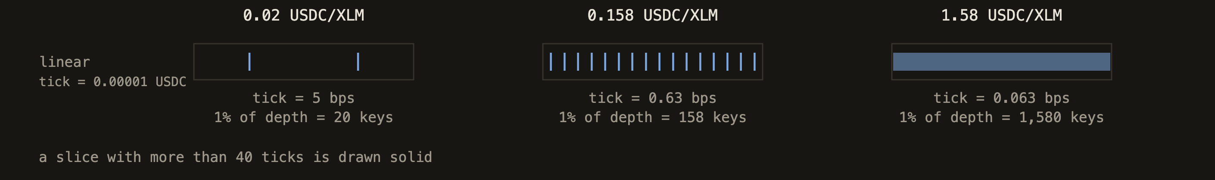
13
Quantization today: linear ticks
Prices move in a fixed step. A market fixes its lot size, tick size, and tick range at creation; every price is a whole number of ticks, so matching is one multiplication with nothing to round
A fixed step is a different fraction of the price at every price. On the example market, 5 bps at 0.02 and 0.06 bps at 1.58
Both ends hurt. At low prices the step is too coarse to quote inside the spread. At high prices, padding 1% of depth takes 1,580 level keys, eight times what a transaction may write. Once the price leaves the tick range, the only fix is a new market and a migration
Notes:
The concession that bites is the frozen grid. A linear tick is a fixed quote amount, so it is a different fraction of price at every price. On the example market the tick is 0.6 basis points at today's price. If XLM fell to two cents it would be 5 basis points and a maker could not ladder inside the spread. If XLM rose to 1.58 it would be 0.06 basis points, and padding one percent of depth would need 1,580 level keys, eight times the writes a transaction may hold. The only remedy today is a new market and a migration of resting liquidity.
A geometric grid, as in the Liquidity Book, makes relative tick width constant, but its prices are not whole atoms, so matching would have to round, and the rounding lands inside the maker's claim. That trades away the property the whole correctness argument rests on.
A significant-figure grid, which is what Hyperliquid and every traditional tick table do, keeps prices as whole atoms, needs no band, and holds relative width within a fixed window. The 1-2-5 table variant that MiFID venues use keeps round prices too. If a v2 market type is built, that is the better candidate. None of this changes existing markets; quantization is frozen per market.
Other v2 items: per-market vault sub-accounts so markets sharing a token stop forming one serial cluster, batched settle, and permissionless market creation with an anti-spam fee.

Slide 16
14
Future work: a better tick grid
Geometric ticks. The step is a fixed fraction of the price, so no tick range is needed, but prices are no longer whole numbers of quote units and matching would have to round
Significant-figure ticks, 1-2-5 tables. Prices stay whole, the step stays within a fixed fraction of the price, no tick range. What Hyperliquid and traditional exchanges use, and the better candidate
Try it: tomerweller.com/pagebook/explainer/tick-grids.html, drag the price and watch each grid respond
Also on the list: per-market vault sub-accounts so markets sharing a token stop serializing, settle batching, permissionless market creation.

Slide 17
Links
Web client
tomerweller.com/pagebook
Explainer
tomerweller.com/pagebook/explainer
Repository
github.com/tomerweller/pagebook
Architecture
docs/04-architecture.md
Measurements
docs/09-resource-utilization.md
These slides
tomerweller.com/pagebook/talk
PageBook is an experiment. Do not deploy it with real funds.
Notes:
Questions. The explainer is the short version of the design, the architecture document is the full specification, and the decisions folder in the repo records every place where reality corrected the plan.

