Slide 1

Songs Recommendation System
29/6/16
Tomer Wizman
Hilla Shinitzky

Slide 2

The Problem
There are all kinds of places that need to play music continuously (bars, restaurants etc.).
Preferably, every following song should relate some how to the songs the played before him.
To achieve that, one need to prepare manually music playlists, or in some cases hire a professional (DJ).
3

Slide 3

Goal
Develop an automatic system of song recommendation for a given playlist.
3

Slide 4
Song’s Attributes
Title
Artist
Play count
BPM
Genres
Key
3

Slide 5
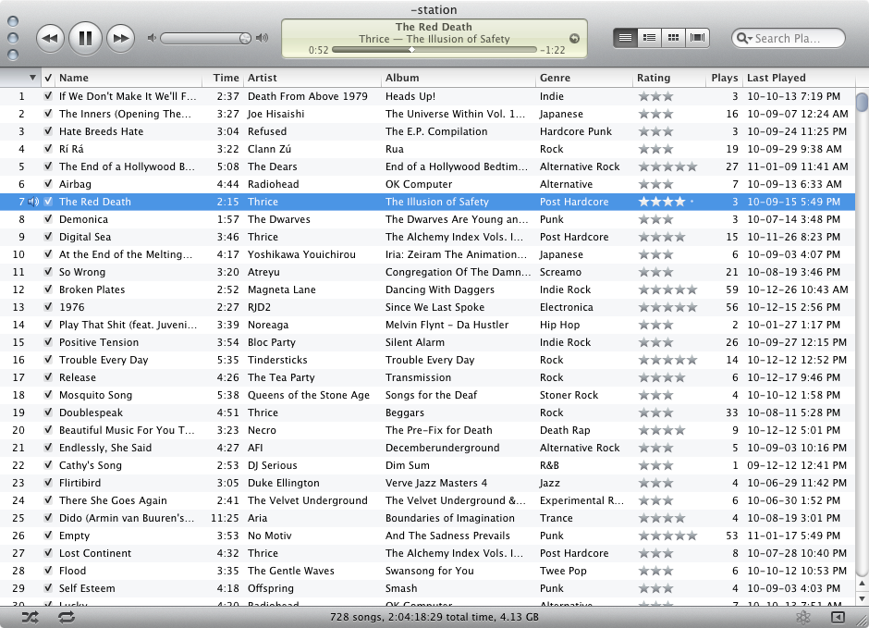

How it works
Input – Data collection of the songs
Output – Next song to play, based on the current playlist
4

Slide 6
How it works
Computes similarity between song to the current playlist
Parameters taken into account – BPM, Genre, Key, Artist
Total score calculation is based on weights
Returns the song with the highest score (=highest similarity to the current playlist)
4

Slide 7
How it works
For each song1 in the data set:
Compute song1’s score:
For each song2 in the play list:
Calculate similarity between song1 and song2:
Attributes taken into account – BPM, artist, key, genres.
The score will be the weighted average of the similarities.
Choose the song with the highest score
4

Slide 8
Testing & Results
How to test the recommendation system results?
Test data: DJ’s playlist
Take a portion from the test playlist
The recommendation system will recommend a song according to this partial playlist
Calculate the similarity between the song that was recommended and the next song in the playlist
4

Slide 9
Results
Billionaire - Travie McCoy feat. Bruno Mars | 1
Price Tag - Jessie J Feat. B.o.B | 2
Baby Boy - Beyonce Feat. Sean Paul | 3
Fancy - Iggy Azalea Feat. Charli XCX
4

Slide 10
Results
Billionaire - Travie McCoy feat. Bruno Mars | 1
Price Tag - Jessie J Feat. B.o.B | 2
Baby Boy - Beyonce Feat. Sean Paul | 3
Beyonce Knowles ft. Jay-Z - Crazy In Love | 4
Fancy - Iggy Azalea Feat. Charli XCX
4

Slide 11
Results
Hey Ya - Sean Paul | 1
Uptown Funk - Mark Ronson Feat Bruno Mars | 2
Play Hard - David Guetta Ft. Ne-Yo & Akon | 3
Shot Me Down - David Guetta Feat. Skylar Grey | 4
Bang My Head - David Guetta, Sia | 5
John Legend - All Of Me (Tiesto Electro Boost) | 6
Ayy Ladies - Travis Porter | 7
Shirt Control - T Pain VS Mr Carmack | 8
Im Into You - Jennifer Lopez F Lil' Wayne | 9
Birthday' - Will.I.Am Feat. Cody Wise | 10
Twerk It Like Miley - Brandon Beal ft. Christopher | 11
Hachi Israeli Remix - Gal Goren & DJ Smiley
4

Slide 12
Results
Hey Ya - Sean Paul | 1
Uptown Funk - Mark Ronson Feat Bruno Mars | 2
Play Hard - David Guetta Ft. Ne-Yo & Akon | 3
Shot Me Down - David Guetta Feat. Skylar Grey | 4
Bang My Head - David Guetta, Sia | 5
John Legend - All Of Me (Tiesto Electro Boost) | 6
Ayy Ladies - Travis Porter | 7
Shirt Control - T Pain VS Mr Carmack | 8
Im Into You - Jennifer Lopez F Lil' Wayne | 9
Birthday' - Will.I.Am Feat. Cody Wise | 10
Twerk It Like Miley - Brandon Beal ft. Christopher | 11
Gyal You A Party Animal - Charly Black | 12
Hachi Israeli Remix - Gal Goren & DJ Smiley
4

Slide 13
Main Difficulties
Very large music collection – contains some irrelevant songs
Testing the algorithm
Songs with missing attributes
Comparing the algorithm to another recommendation algorithms (that aren’t content based)
4

Slide 14
Future tasks
Recommendation based on user inputs (favorite artists, newest songs etc.)
Taking into account release date of songs
Limit the number of recommendations from the same artists
More ways to test the recommendation system
4

Slide 15
Any Questions?
13

