Slide 1
Optimizing Pixomatic For Modern Processors
Michael Abrash
RAD Game Tools, Inc.

Slide 2
Assume Nothing

Slide 3
Pixomatic
X86 software renderer
Windows and Linux
High-end DX7-class feature set
  Except cubemaps
Low-end DX7-class performance
  Peak P4/3GHz performance, 1 texture+Gouraud
    110 megapixels/second
    4.86 million triangles/second

Slide 4
A DX7-Class Rasterizer Turned Out To Be Possible

Slide 5
Appropriate Technology In Appropriate Places
Mostly C
Inline ASM in key places
Custom preprocessor
Welding - code compiled on the fly

Slide 6
Pixel Pipeline Register Allocation
EAX - scratch register
EBX - z-buffer pixel address
ECX - loop counter
EDX - texture 0 pointer
ESI - span-list pointer
EDI - pixel-buffer pixel address
EBP - texture 0 pointer
ESP - 1/z
MM0 - texture 0 coordinates (u0, v0)
MM1 - texture 1 coordinates (u1, v1)
MM2 - Gouraud color
MM3 - specular color
MM4-MM7 - scratch registers

Slide 7
Span Generation Register Allocation
EAX - scratch register EBX - -scanline length
ECX - 1/z EDX - scratch register
ESI - pixel-buffer pixel address EBP - span list pointer
EDI - z-buffer pixel address ESP - stack pointer
MM0 - previous span (u0, v0) XMM0 - 1/w
MM1 - previous span (u1, v1) XMM1 - u0,v0,u1,v1
MM2 - Gouraud GB components XMM2 - 1/w2
MM3 - Gouraud AR components XMM3 - left edge 1/w2
MM4 - specular GB components XMM4 - left edge 1/w
MM3-MM7 - scratch registers XMM5 - left edge
XMM6-XMM7 - scratch registers u0, v0, u1, v1

Slide 8
MMX Pixel Format
A
R
G
B
63
0
Each field has 8 integral bits;
the number of fractional bits
varies throughout the pipeline

Slide 9
Texture Mapping Code
pand mm0,[WrapUV0Mask]
pshufw mm5,mm0,0Dh
psrld mm5,[WrapUV0RightShift]
movd eax,mm5
movd mm7,[edx+eax]
padd mm0,[UV0Step]

Slide 10
From U,V To A Texture Address
00VV.vvvv
UU.uuuuuu
63
48
47
32
31
16
15
0
PSHUFW
00VV
UU.uu
63
48
47
32
31
16
15
0
PSRLD
0 0 0 0VVUU
63
48
47
32
31
16
15
0

Slide 11
Welded Code Sample 1
LoopTop:
add esp,dword ptr [_RotatedFixed16ZXStep] ; stepping
adc esp,0
paddsw mm2,mmword ptr [_argb7x_GouraudXStep]
paddd mm0,mmword ptr _Spans+20h[esi]
cmp sp,word ptr [ebx+ecx*2] ; z buffering
ja LoopBottom
mov word ptr [ebx+ecx*2],sp
pand mm0,mmword ptr [_TexMap] ; texture mapping
pshufw mm5,mm0,0Dh
psrld mm5,mmword ptr [_TexMap+28h]
movd eax,mm5
movd mm7,dword ptr [edx+eax*4]
movq mm6,mm2 ; Gouraud shading
punpcklbw mm7,dword ptr [_MMX_0]
psllw mm7,1
pmulhw mm7,mm6
packuswb mm7,mm7 ; pixel pack/write
movd dword ptr [edi+ecx*4],mm7
LoopBottom:
inc ecx ; loop control
jne LoopTop

Slide 12
Welded Code Sample 2
LoopTop:
add esp,dword ptr [_RotatedFixed16ZXStep]
adc esp,0
paddsw mm2,mmword ptr [_argb7x_GouraudXStep]
paddd mm0,mmword ptr _Spans+20h[esi]
cmp sp,word ptr [ebx+ecx*2]
ja LoopBottom
mov word ptr [ebx+ecx*2],sp
pand mm0,mmword ptr [_TexMap]
pshufw mm6,mm0,0Dh
psrld mm6,mmword ptr [_TexMap+28h]
movd eax,mm6
movd mm7,dword ptr [edx+eax*4]
pslld mm6,mmword ptr [_TexMap+28h]
add eax,dword ptr [_TexMap+0F4h]
and eax,dword ptr [_TexMap+0F8h]
paddw mm6,mmword ptr [_TexMap+40h]
psrld mm6,mmword ptr [_TexMap+28h]
movq mm4,mm0
psrld mm4,mmword ptr [_TexMap+48h]
pand mm4,mmword ptr [_MMX_0x003F003F003F003F]
movd mm5,dword ptr [edx+eax*4]
movd eax,mm6
punpcklbw mm7,dword ptr [_MMX_0]
movd mm6,dword ptr [edx+eax*4]
punpcklbw mm5,dword ptr [_MMX_0]
pshufw mm4,mm4,0
add eax,dword ptr [_TexMap+0F4h]
and eax,dword ptr [_TexMap+0F8h]
punpcklbw mm6,dword ptr [_MMX_0]
movq mmword ptr [_MMX_UFrac],mm4
movd mm4,dword ptr [edx+eax*4]
punpcklbw mm4,dword ptr [_MMX_0]
psubw mm6,mm7
psubw mm4,mm5
psubw mm5,mm7
psubw mm4,mm6
pmullw mm6,mmword ptr [_MMX_UFrac]
psraw mm6,6
pmullw mm4,mmword ptr [_MMX_UFrac]
paddw mm6,mm7
pshufw mm7,mm0,0AAh
psrlw mm7,6
psllw mm5,6
pmulhw mm4,mm7
pmulhw mm7,mm5
paddw mm6,mm4
paddw mm7,mm6
packuswb mm7,mm7
movq mm6,mm2
punpcklbw mm7,dword ptr [_MMX_0]
psllw mm7,1
pmulhw mm7,mm6
packuswb mm7,mm7
movd dword ptr [edi+ecx*4],mm7
LoopBottom:
inc ecx
jne LoopTop

Slide 13
Out Of Order Processing is Cool
No need to swizzle textures
No need to overlap divides
Extra moves are often free

Slide 14
Try Stuff And See What Sticks

Slide 15
Loop Unrolling Is Rarely A Win
Unrolling once sometimes helped

Slide 16
Branch Prediction, And Unexpected Implications Thereof

Slide 17
Linear Search
if (condition 1)
{
handler 1
}
else if (condition 2)
{
handler 2
}
else if (condition 3)
{
handler 3
}
else
{
handler 4
}

Slide 18
Linear Branching Patterns
pass condition 1
fail condition 1
fail condition 2
pass condition 3
fail condition 1
pass condition 2
fail condition 1
fail condition 2
fail condition 3

Slide 19
Binary Search
if (condition 2)
{
if (condition 1)
handler 1
else
handler 2
}
else
{
if (condition 3)
handler 3
else
handler 4
}

Slide 20
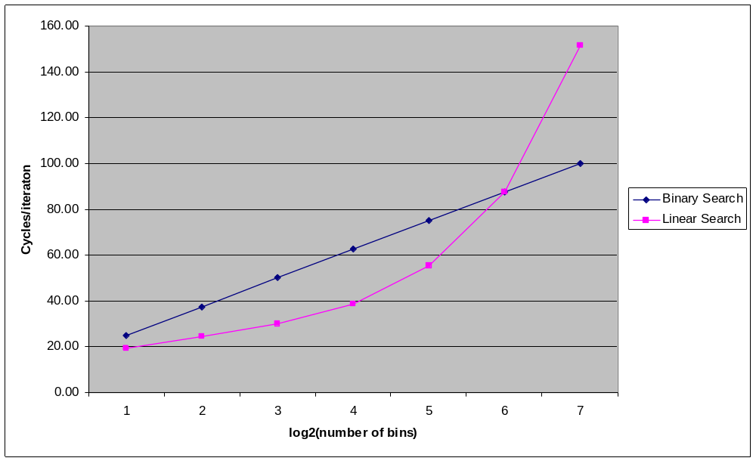
Linear Versus Binary Search

Slide 21
Help The Data Cache Work Efficiently
Hundreds of cycles per miss to memory
Not always hidden by caching and out-of-order processing
Don’t chase sparse pointers
Avoid sparse accesses to large data structures in general

Slide 22
SSE2 Didn’t Help Us Much
For integer ops, half the speed of MMX
Doubled parallelism didn’t help us
Requires yet another code path
For doubles, only 2-way SIMD

Slide 23
Small Changes -> Huge Effects
Double alignment on stack
64K aliasing

Slide 24
Hyperthreading Didn’t Help
Not a good fit for a standard 3D pipeline
Potentially helpful for deferred rendering

Slide 25
Questions?

