Slide 1
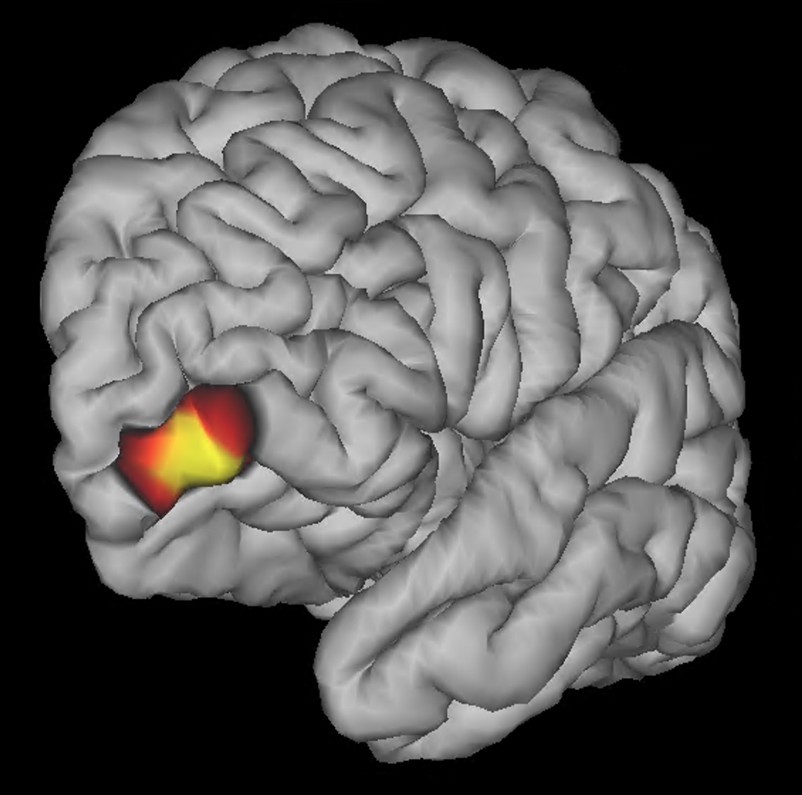
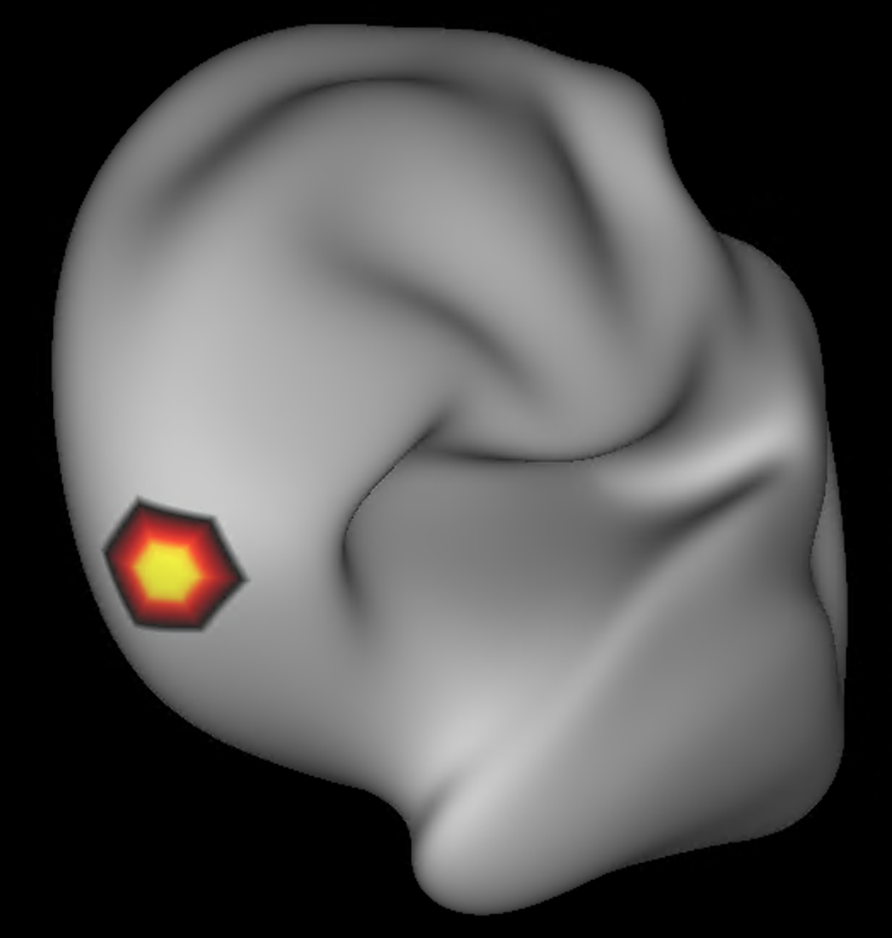

Slide 2
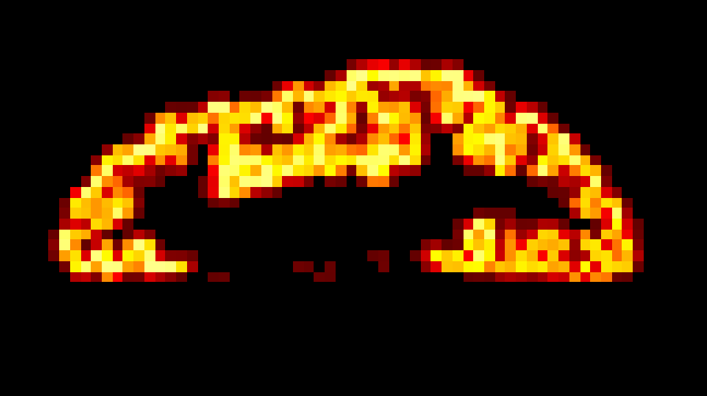

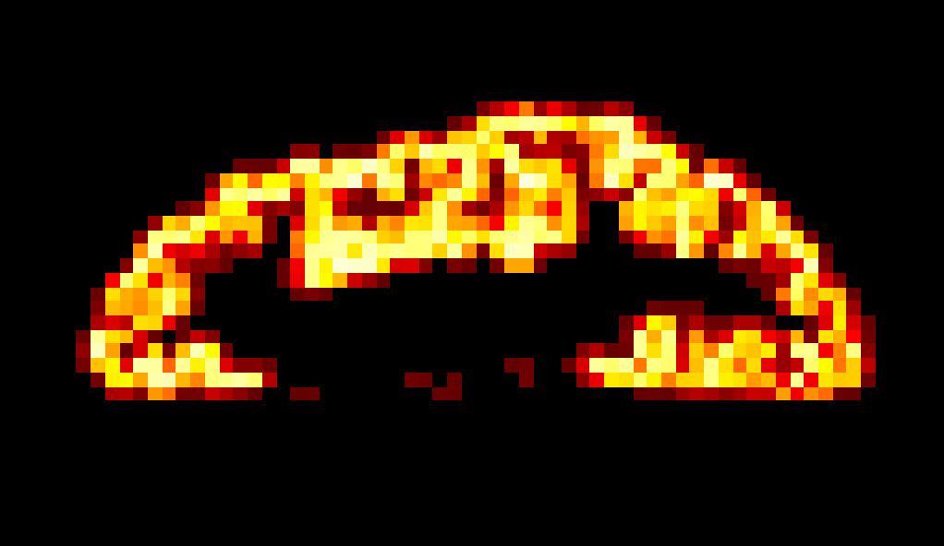
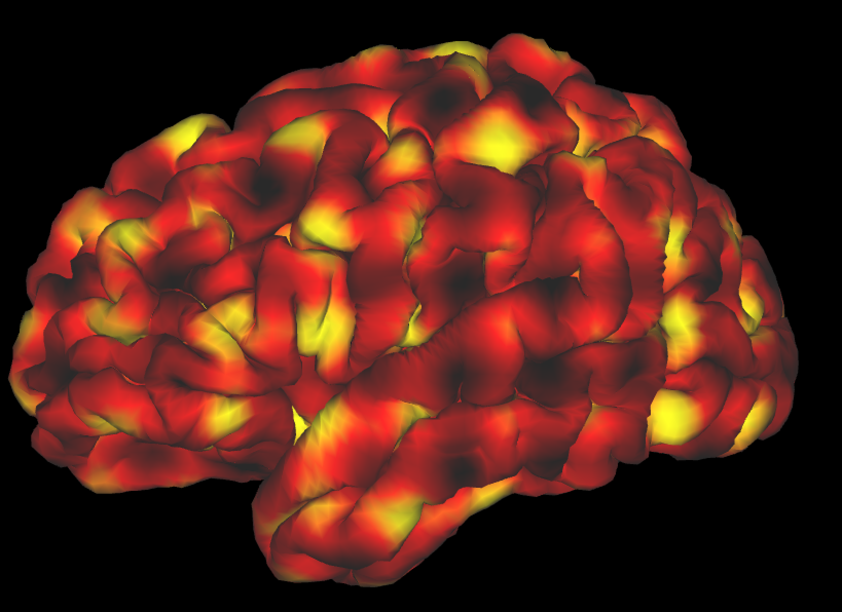
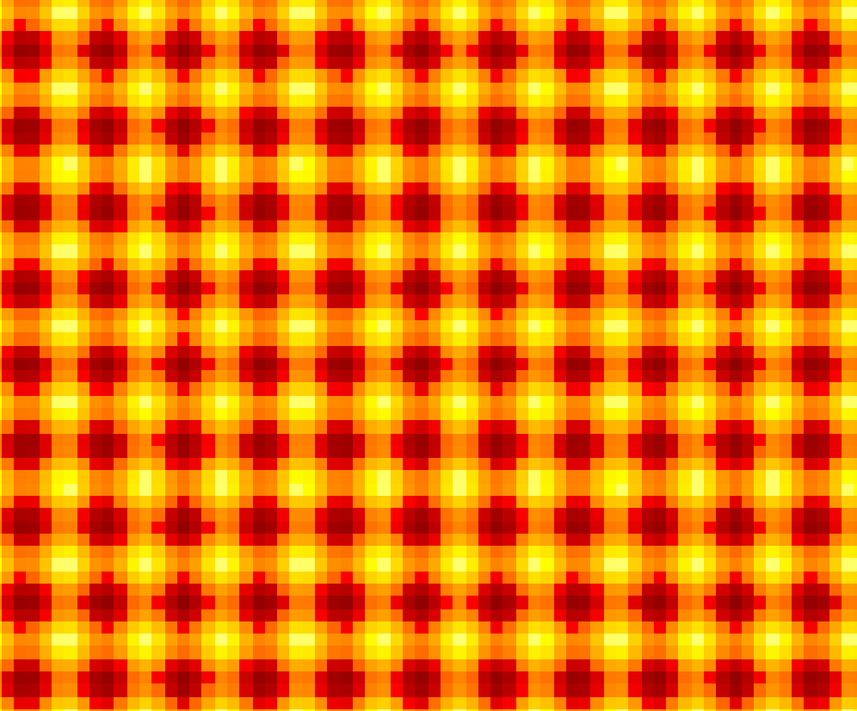
20
80
uniform
surface
ground truth
trilinear
interpolation
volumetric
field
multiplication with
voxel-wise GM PV
volumetric
ground truth
sinusoid

Slide 3
ground truth
Toblerone
RC
1
surface-volume projected data
surface space
2
volume space
3
Toblerone
RC
Toblerone-lsQR
RC-lsQR
surface-volume-surface projected data
calculate error wrt. ground truth

