Slide 1
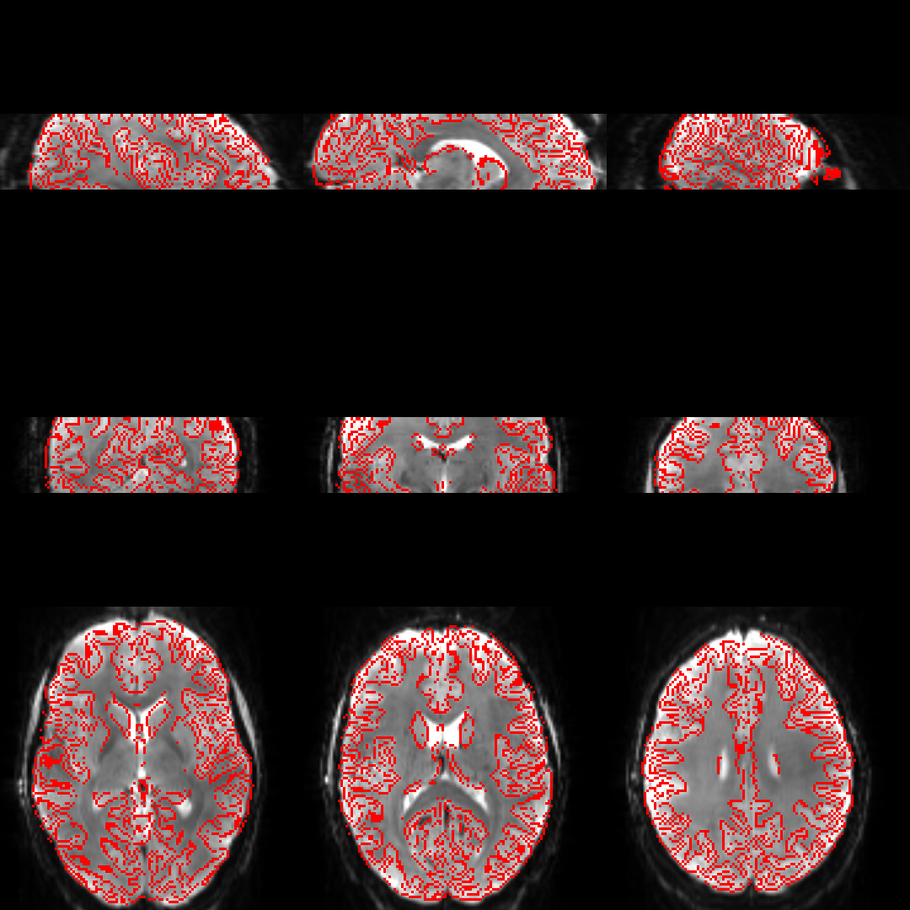
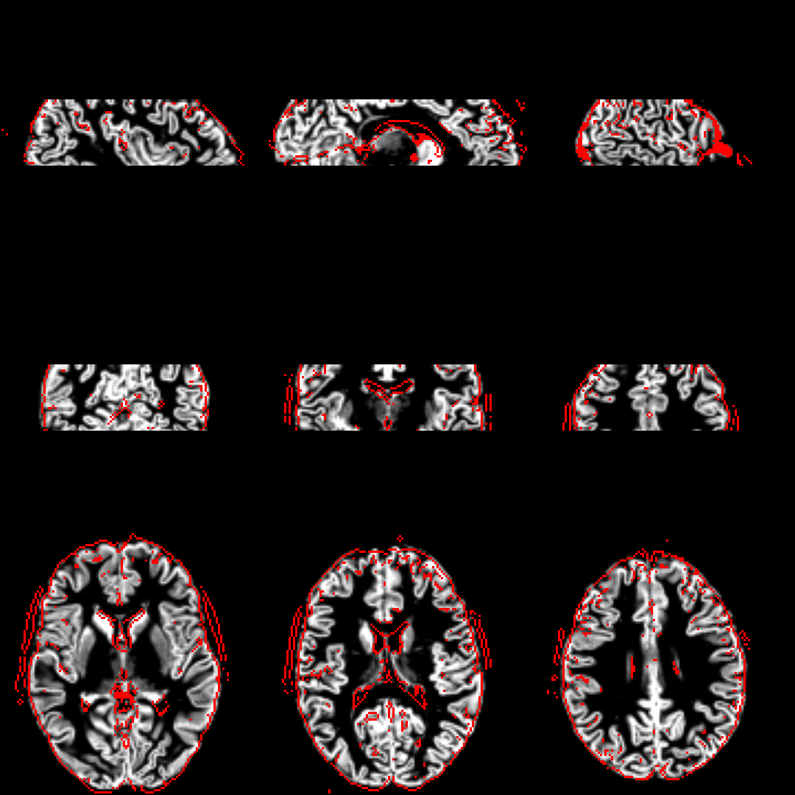
GM PV overlaid on M0
M0 overlaid on GM PV

