Slide 1
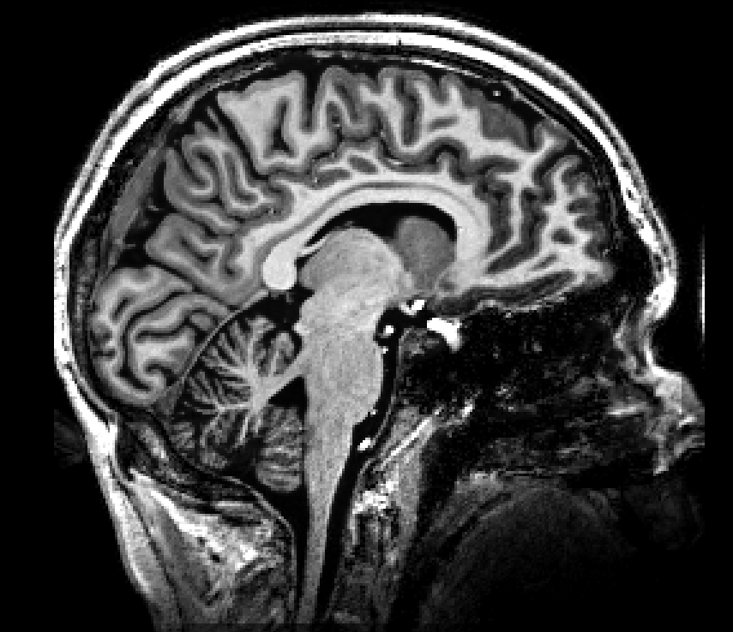
pcASL
pASL
imaging region
imaging region
label plane
label region

