Slide 1
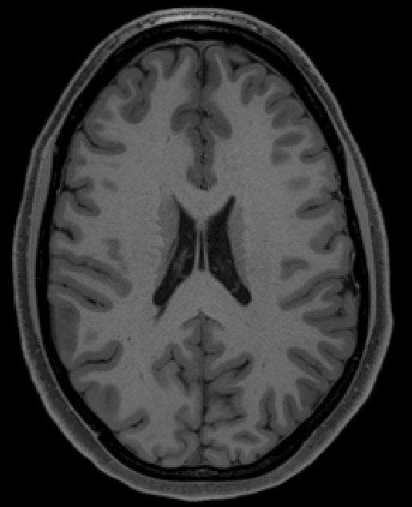
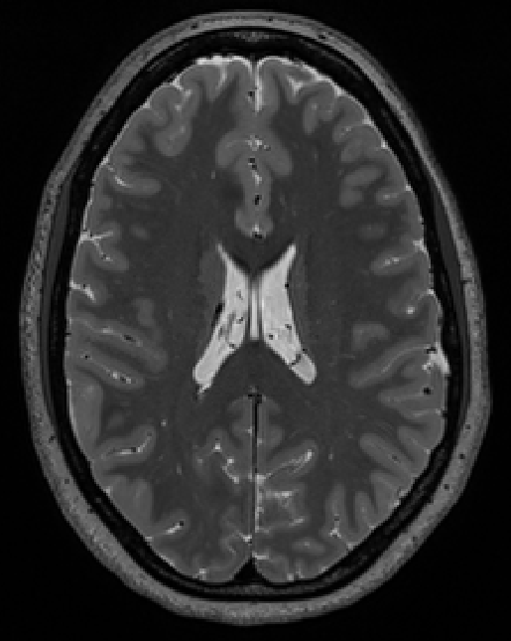
WM
CSF
GM
T1-weighted
T2-weighted

